Slide 1
Section 2 Introduction to Scientific Papers

Slide 2
文献在研究过程中的作用
确定研究方向，研究项目（点）
相关信息搜集
确定研究课题两种方式：
（1）导师只给方向或领域；
（2）导师给具体题目和范围；
相关信息收集
认识文献的重要地位
和全世界最顶尖同行专家交流的途径
聚焦最权威、最高端、最热门期刊
IEEE Transactions文献资料检索和下载
聚焦最近1-2年文献
谨慎对待陈年文献的阅读
整理、分析、综合
推测（创新）
验证（建模，试验）
结果分析
重复几次到几千次
产生新技术方案（成功）

Slide 3
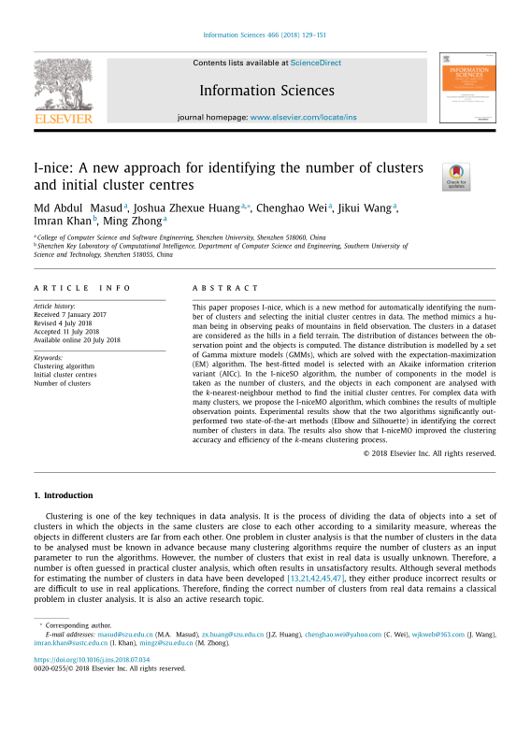
Scientific Paper
科研人员、研究生发表科研成果的主要手段。
Scientific papers are the major means for researchers and graduate students to publish and disseminate their research results to academic communities and the public.
Publish or perish.
A phrase coined to describe the pressure in academia to rapidly and continually publish academic work to sustain or further one's career. (Wikipedia)

Slide 4
Types of Scientific Papers
Research papers
Survey papers
Technical review papers
Scientific reports

Slide 5
The Basic Structure of a Scientific Paper
Title
Affiliations
Abstract
Key words
Introduction
Related work
Background and preliminaries
Method(s) and analysis
Experiment
Environment
Settings
Evaluation Methods
Results
Discussions
Conclusions
Acknowledgement
References
Appendix

Slide 6
What is good academic writing?
Writing that meets the expectations of the audience.
The most important audience is the reviewers of your writing who comment on your paper and make recommendations on whether your paper should be accepted for publication or not.
When you are writing a paper for publication, it is important to keep in mind the criteria that the reviewers will use in assessing your work.

Slide 7
Criteria of Assessment for Student Thesis
Evidence of adequate and appropriate background reading
A clear statement of aims and relevant selection of content
Sensible planning and organization
Evidence of systematic thought and argument
Clarity of expression
Careful presentation (e.g. accurate typing and proof-reading, helpful diagrams, etc.)
Observation of conventions of academic discourse, including Bibliographic information
Observation of length requirements

Slide 8
Criteria of Assessment for a TKDE Paper
A. Reader Interest
Which category describes this manuscript?
(1) Practice / Application / Case Study / Experience Report; (2) Research / Technology; (3) Survey / Tutorial / How-To
How relevant is this manuscript to the readers of this periodical?
Very Relevant \ Relevant \ Interesting - but not very relevant \ Irrelevant
B. Content
Please explain how this manuscript advances this field of research and / or contributes something new to the literature.
Is the manuscript technically sound?
Yes \ Appears to be - but didn't check completely \ Partially \ No

Slide 9
Criteria of Assessment for a TKDE Paper
C. Presentation
Are the title, abstract, and keywords appropriate?
Yes \ no
Does the manuscript contain sufficient and appropriate references?
References are sufficient and appropriate
Important references are missing; more references are needed
Number of references are excessive
Does the introduction state the objectives of the manuscript in terms that encourage the reader to read on?
Yes \ Could be improved \ No
How would you rate the organization of the manuscript? Is it focused? Is the length appropriate for the topic?
Satisfactory \ Could be improved \ Poor
Please rate and comment on the readability of this manuscript.
Easy to read \ Readable - but requires some effort to understand \ Difficult to read and understand \ Unreadable
TKDE-IEEE Transactions on Knowledge and Data Engineering

Slide 10
Summary and Recommendation
A. Evaluation
Award Quality
Excellent
Good
Fair
Poor
B. Recommendation
Accept with no changes
Author should prepare a minor revision
Author should prepare a major revision for a second review
Reject

Slide 11
Criteria of Assessment for International Conferences
Originality
Quality
Relevance
Presentation
Recommendation

Slide 12
What is a good scientific paper?
A good and interesting topic
Good research problems
Innovative solution
Impressive and significant results
Good and logical structure
Excellent presentation

Slide 13
Good Balance of a Paper
One key element in a successful assignment is balance, in two senses:
physically, it refers to the distribution of information in your text; and
intellectually, there is an expectation that you will present both sides of an issue.
Balance in presentation
You need to decide roughly how much space (how many words) to allocate to the various sections of the assignment.
Balance in argument
The second aspect of balance in academic writing is to present an ‘even-handed’ argument.
Making a strong logical case to persuade your reader to accept your point is really only half the picture.
Effective argumentation also involves
anticipating possible objections to your reasons or evidence
showing that you have considered those objections,
using counter-arguments - the process known as refutation.

