Slide 1

Professional Basic English Lecture 7 (10), October , 2021
陈剑勇
jychen@szu.edu.cn
Note: The content are mainly provided by Dr. Jari Korhonen

Slide 2
Expressing caution
Literature: Academic Essay Writing for Postgraduates, Unit 5. English Language Teaching Centre, University of Edinburgh, 2014
There are many possible causes for mistakes and misinterpretations in scientific studies
Mistakes in the results reported in the literature
Mistakes in test design or implementation
Correlation does not imply causation
It is necessary to indicate the uncertainties in scientific writing
The strength of a claim must be adjusted to match the strength of the evidence

Slide 3
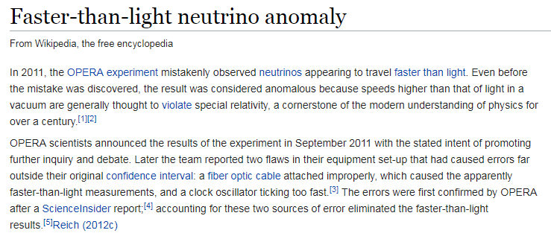
Why is it important to be cautious…

Slide 4
Sources of uncertainty
Uncertainty of the results by the others
Outdated information, mistakes in experiments or interpreting the results, (rarely) intentional misleading (bias for economic benefit, scientific fraud)
The more researchers have obtained the same results independently, the more certain the results are (scientific consensus)
Uncertainty of the results obtained by yourself
Mistakes in the test design, using wrong analysis methods, logical fallacies
Wishful thinking: trying to explain results so that they match with the hypothesis
Correlation does not imply causation

Slide 5
Correlation does not imply causation
Swimming accidents and ice cream consumption are highly correlated: eating ice cream causes swimming accidents?
More credible explanation: hot summer increases ice cream consumption and swimming, temperature is the real cause

Slide 6
Possible alternative explanations
Is moderate drinking better for health than not drinking at all?
…or…
Are some people not drinking because they have health problems?
… public health officials and brewery(啤酒厂) owners may have different opinions…

Slide 7
Words for expressing degree of certainty
Used to adjust the strength of the claim in e.g. cited research
Hedged claims (claims limited by conditions) are ’tentative’, ‘limited’, ‘moderate’, or ‘modest’
Claims that are stronger than justified by evidence are ‘overstated’, ‘exaggerated’, or ‘immoderate’
Claims not supported by evidence are ‘unfounded’ or ‘unwarranted’(无根据的，不合理的)

Slide 8
Words for expressing caution谨慎的用词
Modal verbs(情态动词): must / should / may / might / could (have ..ed)
Full verbs(全动词): appear to / seem to (have ..ed) / suggest, point to, imply
Adverbs(副词): apparently / perhaps / possibly / potentially
relatively / comparatively
arguably
Nouns(名词): possibility, potential, (on the) evidence (available)
Adjectives（形容词）: possible / potential / plausible(看似合理的) / probable / likely /
not impossible / reasonable to assume

Slide 9
Classroom task
Read the extract from a study investigating how British students who speak Spanish as a second language (L2) are influenced as they learn Portuguese as a third language (L3). Find the definite expressions and the cautious expressions.
Source: Writing Postgraduate Assignments, English Language Teaching Centre, 2010

Slide 10
Classroom task: text
One point about which there is wide agreement in the literature is that transfer (both positive and negative) is more likely to take place from a language which is similar to the new foreign language being learnt, than from a language which is unrelated. There is some evidence that this can lead to more transfer taking place from the L2 than from the mother tongue, where the L2 is perceived as closer to the new language being learnt. This phenomenon has been found in all areas of language, and with specific reference to Spanish and Portuguese. Clearly, Spanish and Portuguese are closer to each other (both historically and typologically) than they are to English, and it seems to be the case that learners’ perceptions of similarities between languages generally correspond to their actual relatedness. Hensey (1967) analysed the errors of learners of Portuguese (both Spanish L1 and Spanish L2) and found what appeared to be Spanish-based transfer errors in vocabulary, grammar and pronunciation.
Similarity is not the only cause for L2/L3 influence proposed in the literature. Bentahila (1975) and Rivers (1979) suggest recency as a possible factor: whichever foreign language was learnt most recently will influence the next language learnt. Meisel speculates that the way in which foreign languages are stored and processed in the brain may be different from the way in which the L1 is dealt with, and that this could lead to L2/L3 influence.

Slide 11
Classroom task: answer
One point about which there is wide agreement in the literature is that transfer (both positive and negative) is more likely to take place from a language which is similar to the new foreign language being learnt, than from a language which is unrelated. There is some evidence that this can lead to more transfer taking place from the L2 than from the mother tongue, where the L2 is perceived as closer to the new language being learnt. This phenomenon has been found in all areas of language, and with specific reference to Spanish and Portuguese. Clearly, Spanish and Portuguese are closer to each other (both historically and typologically) than they are to English, and it seems to be the case that learners’ perceptions of similarities between languages generally correspond to their actual relatedness. Hensey (1967) analysed the errors of learners of Portuguese (both Spanish L1 and Spanish L2) and found what appeared to be Spanish-based transfer errors in vocabulary, grammar and pronunciation.
Similarity is not the only cause for L2/L3 influence proposed in the literature. Bentahila (1975) and Rivers (1979) suggest recency as a possible factor: whichever foreign language was learnt most recently will influence the next language learnt. Meisel speculates that the way in which foreign languages are stored and processed in the brain may be different from the way in which the L1 is dealt with, and that this could lead to L2/L3 influence.

Slide 12
Caution in interpreting others’ research
It is important to check the results from different sources (if available)
Smith et al. [1] have found evidence that X causes Y. However, the findings by O’Connel et al. [2] suggest that in fact, Z may cause both X and Y…
If there is no scientific consensus or the topic is not yet mature, use cautious expressions
There is some evidence that X causes Y. Nevertheless, more research is needed to exclude other possible explanations.
Be clear about what are your own interpretations and what is claimed in the references
We assume that different results could be obtained by using different methodology from Smith’s [1].

Slide 13
Caution in interpreting your own findings
It is important that you choose the appropriate level of certainty when interpreting what you have found in your own research
Highest level of certainty if you have repeated experiment done earlier by someone else, and your findings are similar
Our results are similar to [1], and therefore provide further evidence of X …
If the results are as expected, you can be reasonably sure about them
X and Y are highly correlated, supporting the hypothesis that X causes Y …
If you have unexpected results, you need to be very cautious
Unexpectedly, only weak correlation between X and Y was observed. More research is needed to verify the results and formulate alternative hypothesis.

Slide 14
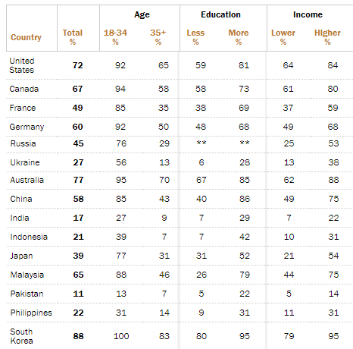
Caution in interpreting data
Take your time to look at the data, don’t rush to conclusions
Look the main headings and pick up some numbers to check if they make sense
Go back to the labels to be sure you know what you are looking for, read any footnotes
Scan the table horizontally and vertically, check especially for high and low points, trends and blips
Summarize yourself the main conclusions you think can be drawn
Smartphone ownership % (2015)*
* Source: http://www.pewglobal.org/2016/02/22/smartphone-ownership-and-internet-usage-continues-to-climb-in-emerging-economies/

Slide 15
Homework 4
Study the Table showing the smartphone ownership percentage in different countries. Write your conclusions (~100 words) about how the smartphone ownership is related to the age and the wealth of the country. Are there any exceptions to the general rules, and what could be the reason? Express appropriate level of caution.

Slide 16
Smartphone ownership %
 | Smartphone ownership (2015) |  |  | GDP (PPP) per capita | Average Age (years)
Country | Total | Age 18-34 | Age 35+
South Korea | 88% | 100% | 83% | 38 k$ | 41.8
USA | 72% | 92% | 65% | 59 k$ | 38.1
Germany | 60% | 92% | 50% | 51 k$ | 47.1
China | 58% | 85% | 43% | 17 k$ | 37.4
Russia | 45% | 76% | 29% | 26 k$ | 39.6
Brazil | 41% | 61% | 26% | 15 k$ | 32.6
Japan | 39% | 77% | 31% | 44 k$ | 47.3
Nigeria | 28% | 39% | 13% | 6 k$ | 18.4
India | 17% | 27% | 9% | 7 k$ | 28.1
Tanzania | 11% | 14% | 6% | 3 k$ | 17.7
Uganda | 4% | 6% | 2% | 2 k$ | 15.8
Sources: http://www.pewglobal.org/2016/02/22/smartphone-ownership-and-internet-usage-continues-to-climb-in-emerging-economies/
https://en.wikipedia.org/wiki/Education_Index,
https://en.wikipedia.org/wiki/List_of_countries_by_GDP_(PPP)_per_capita

Slide 17
Summary
In scientific writing, it is important to express caution
Indicates the degree of uncertainty in the results or their interpretations
Shows intellectual honesty
Especially important when the results are unexpected
Caution is also needed when interpreting the results by others
Check from many different sources, if possible
Distinguish clearly your own conclusions and the conclusions in the references

