Slide 1
ELEC5681M
Introduction to MATLAB
(Dr Dragan Indjin; d.indjin@leeds.ac.uk)

Slide 2
ELEC5681M MATLAB part (Unit 2)
Introduction Lecture (in week 7) and 4 Lab sessions (one each week in weeks 8-11)
End of Unit 2 Online Test: Thursday 14 December (Week 11) at 11:00
Unit 2 Mobius test contributes 30%
All on-line tests are prepared using Mobius. For best performance we recommend the use of Chrome, as a browser, in normal mode (i.e. no "incognito" or other non-standard browsing mode settings). You may also be required to allow cookies in order to be able to open the assignment.
When submitting, please be careful: you only have a single attempt to submit the test's final solutions, therefore do NOT press the "SUBMIT" button until you are absolutely sure that all questions have been answered

Slide 3
Installing MATLAB on a personal machine
Go to University of Leeds’ MATLAB Portal ( https://uk.mathworks.com/academia/tah-portal/university-of-leeds-40586183.html ) to download the software.
Click “Get Started Now” in the Download MATLAB box.
You will be asked to create a MathWorks Account. Once you do that, you will be associated to our MATLAB license and will be able to:
Download and activate software on your personal computer
Start using MATLAB Online from a web browser (on the link: https://uk.mathworks.com/products/matlab-online.html)
We strongly suggest you complete the 2 hours MATLAB Onramp tutorial that can be found on our MATLAB Portal (https://uk.mathworks.com/learn/tutorials/matlab-onramp.html?s_tid=tah_po_mlonramp).
If you have trouble installing MATLAB, go to the MATLAB Portal and click “Customer Support” to get help.

Slide 4
Today’s notes
MATLAB’s GUI
Basic MATLAB logical syntaxes
Arrays and Matrixes
Flow charts
Examples

Slide 5
What is MATLAB?
MATLAB (Matrix laboratory) is an interactive software system for numerical computations and graphics.
MATLAB is a programming language, and is one of the easiest programming languages for writing mathematical programs.
MATLAB is also a software for applied mathematics, particularly useful for linear algebra.
MATLAB has powerful graphic tools to visualize in both 2D and 3D.
MATLAB has great tool-boxes useful for signal processing, image processing, optimization, etc.
MATLAB is widely used in education, research, and industry.

Slide 6
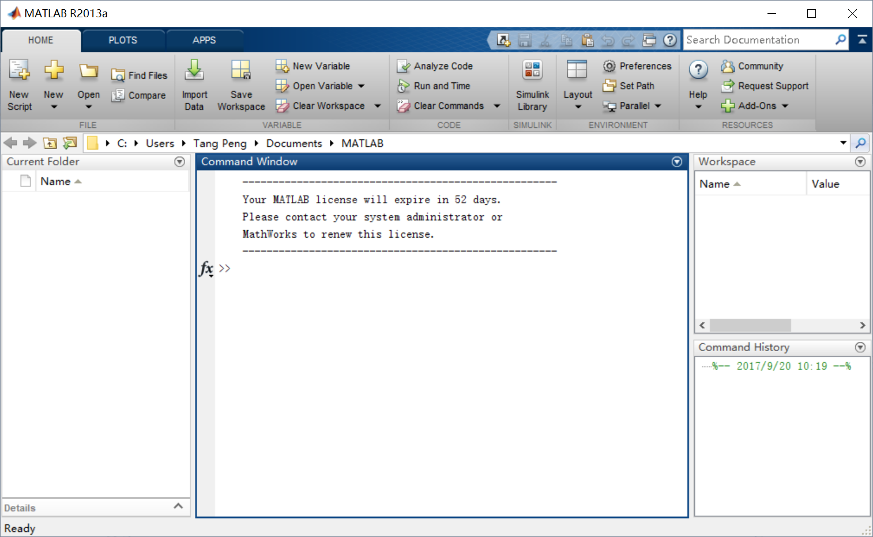
MATLAB’s GUI

Slide 7
MATLAB’s GUI
Toolbar

Slide 8
MATLAB’s GUI
Command Window
Enter commands at the command line, indicated by the prompt ( >> ).

Slide 9
MATLAB’s GUI
Current Folder
Access your files.

Slide 10
MATLAB’s GUI
Workspace
Explore data that you create or import from files..

Slide 11
MATLAB’s GUI
Command History
View or rerun commands that you entered at the command line.

Slide 12
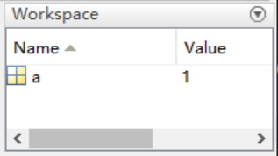
Variables
As you work in MATLAB, you issue commands that create variables and call functions. For example, create a variable named a by typing this statement at the command line
MATLAB adds variable a to the workspace and displays the result in the Command Window.
>> a = 1 a = 1 >>

Slide 13
Variables
Create a few more variables.
When you do not specify an output variable, MATLAB uses the variable ans, short for answer, to store the results of your calculation
>> b = 2 b = 2 >> c = a + b c = 3 >> d = cos(a) d = 0.5403
>> sin(a) ans = 0.8415
If you end a statement with a semicolon, MATLAB performs the computation, but suppresses the display of output in the Command Window.
>> e = a*b; >>

Slide 14
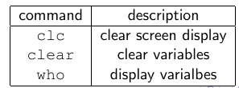
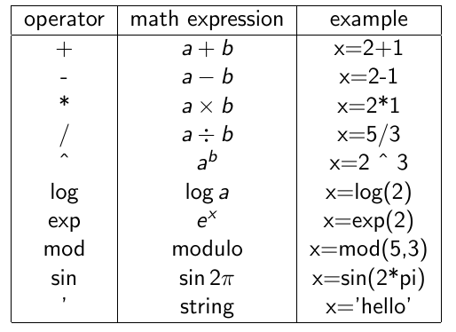
Built-in Commands and Functions
Useful commands
Built-in operators and function

Slide 15
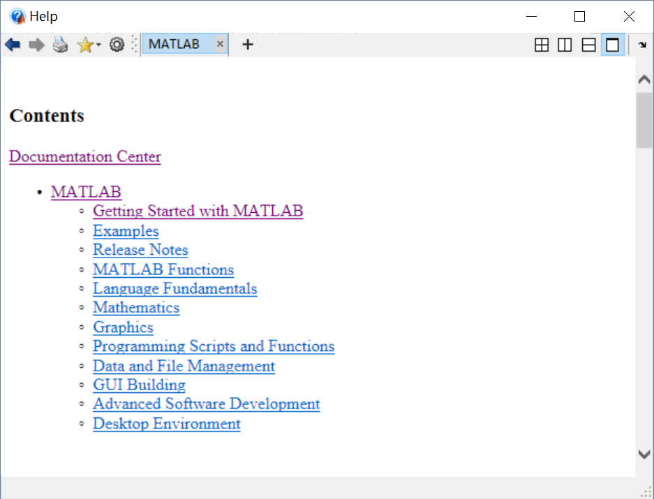
MATLAB’s help page

Slide 16
Basic MATLAB logical syntaxes

Slide 17
for loop
•The for loop provides the means to carry out series of statements with just a few lines of codes.
An example of syntax:
x=1;
s=0;
for m=1:20
x=x*m;
s=s+m;
end
The computer sets the index m to 1, carries out the statements between the for and end statements, then returns to the top of the loop, changes m to 2, and repeats the process. This continues until m is set to 21, in which case the computers leaves the loop.
What about x and s in this example?

Slide 18
for loop 2
The computer sets the index m to 1, carries out the statements between the for and end statements, then returns to the top of the loop, changes m to 2, and repeats the process. This continues until m is set to 21, in which case the computers leaves the loop.
What about x and s in this example?
1st cycle: 2nd cycle: 20th cycle:
x=1; s=0 m=2 m=2
m=1 x=1*2=2 x=1*2*…*20
x=1*1=1 s=0+1+2=3 s=0+1+2+…+20
s=s+1=0+1=1
Therefore, final s will be the sum of the first 20 integer number and final x will be the product of the first 20 integer numbers – factorial.

Slide 19
The while loop
In the while loop, the computer will carry out the statements between while and end statements as long as the condition in the while statement is satisfied.
m=1;
x=1;
s=0;
while m<21
x=x*m;
s=s+m;
m=m+1;
end
disp(s);
disp(x);
Again, final s will be the sum of the first 20 integer number and final x will be the product of the first 20 integer numbers (factorial).

Slide 20
if statement
If the logical expression is true, the upper set of statements is executed. If the logical expression is false, the bottom set of statements (after else) is executed. Example:
x=1;
s=0;
m=1;
for j=1:100
if (m==21)
disp(s);
disp(x);
break
else
x=x*m;
s=s+m;
m=m+1;
end
end
And again, final s would be the sum of the first 20 integer number and final x would be the product of the first 20 integer numbers (factorial).

Slide 21
if –elseif ladder
Syntax:
if (logical expression 1)
statements;
elseif (logical expression 2)
statements;
.
.
.
else
statements;
end
The if-else ladder works from top down.

Slide 22
if –elseif ladder 2
The if-elseif ladder works from top down:
If the top logical expression is true, the statements related to that logical expression are executed and the program leave the ladder
If the top logical expression is not true, the program moves to the next logical expression.
If that logical expression is true, the program will execute the group of the statements associated with that logical expression and leave the ladder.
If that logical expression is not true, the program moves to the next logical expression and continues the process
If none of logical expressions are true the program will execute the statements associated with the else statement. If else statement is not present and no upper logical expressions are true, no statements within ladder will be executed.

Slide 23
Logical expressions
The logical expressions are of the form (examples):
a==b; a<=b;
a<b; a>=b;
a>b; a~=b;
Compound logical expressions (examples):
a>b && a~=c; (and)
a>b || a<c; (or)

Slide 24
The break command
break command may be used with an if statement to end a loop. Example:
x=1;
s=0;
for m=1:100
x=x*m;
s=s+m;
if (m>19)
disp(s);
disp(x);
break
else
display('program is still doing loop');
disp(m);
end
end
And again, same as before for the final s and final x .

Slide 25
Arrays and Matrices

Slide 26
Arrays in MATLAB
The power of MATLAB really becomes apparent when we begin to use arrays.
>> a = [1 2 3 4 5 6 7 8 9 10]
a =
1 2 3 4 5 6 7 8 9 10
Suppose we want to make an array of numbers
>> a = [24 18 37 11 15 30]
a = 24 18 37 11 15 30
A specific element of array a can be selected by writing
>> a(5)
ans = 15
Or for two-dimensional array (matrix)
>>b=[1 3; 6 5];
b=[1 3
6 5]
>>b(2,2) ;
ans =5

Slide 27
Arrays in MATLAB
Colon Operator may be used to create a new matrix from an existing matrix:
>> a = [1 2 3; 4 5 6 ; 7 8 9]
a =
1 2 3
4 5 6
7 8 9
>> x=a(:,1)
x =
1
4
7
>> y=a(2,:)
y =
4 5 6
The semicolon in the expression (:,1) implies all the rows, and 1 implies column 1

Slide 28
Arrays 2
The for loop can be also used to manipulate with specific array’s elements
An example :
a= [3 5 7 9 11];
s=0;
for i=1:length(a)
s=s+a(i);
end
disp(s)
The computer define array a and sets initial value of s=0, sets the index i to vary from 1 to the length of a (5 for this particular case), carries out the statements s=s+a(i) until i=5. As result, s will be equal to sum of all elements of array a.

Slide 29
Flow charts

Slide 30
Algorithms and flow charts
You can write a variety of codes, once you know the basic instructions as if, for and while.
If you learn how to code well, the language you are using is irrelevant.
In many cases you will be given a specific description about your input, and what the output needs to be, and it will be up to you to design the solution.
The unambiguous specification of the solution is called algorithm, however even if you know the algorithm, there can be many different ways to implement it.
Your code needs to be written so that other people can understand it too, this is why flow-charts are really useful and they can give the idea how you implemented the algorithm.

Slide 31
Flow charts
Flow chart directly describes the commands you are planning to use in your code.
Every command has it is own symbol and anyone can understand your code by simply looking at the flow chart!
Always draft a flow chart before coding!

Slide 32
Flow charts
Start/End
Input/Output
Process
Sub-process (calling a function)

Slide 33
Flow charts
While loop
For loop
Loop condition
(While loop)
.
.
.
Loop start/end (for loop)
.
.
.
If command
If-else command
Decision (If command)
No
No branch is executed after keyword else
Yes
Yes

Slide 34
Examples for practice

Slide 35
Example – Prime numbers
Write a MATLAB program that takes positive integer number N as an input, and outputs the N-th prime number in prime number sequence. A number is called prime if it is only dividable by 1 and itself. To check divisibility you can use MATLAB’s y=mod(A,x) function which gives output y=0 if A can be divided by x (Check Matlab help page for more info).
The simplest algorithm requires you to find a root of A, round it to the nearest integer number x, and then check if A is dividable by any of the numbers in range 2,3,4,..,x. Do not use MATLAB’s primes(N) or isprime(N) functions.

Slide 36
Example – Prime numbers
N is input
Two loops are needed. One that test numbers (and counts up to N, i.e. while loop) and the second one (i.e. for loop) that finds a root of the test entry and checks if it is a prime number.
Your flow chart must match your code!

Slide 37



Example – Prime numbers
Start
N
Primes = zeros(1,N)
Yes
N <0
Error -> end
Primes(1)=2
Primes(2)=3
checkthis=5
i=3
i<=N
$$X=round\left(\sqrt{checkthis}\right)$$
checkrange = 1:2:X
j=1
Yes
mod(checkthis, checkrange(j))=0)
Itisprime=0
Break the inner loop and conserve memory
Itisprime=1
j=length(checkrange)
Yes
Primes(i)=checkthis;
i++;
Itisprime==1
$$checkthis+=2;$$
$$Primes(N)$$
End

Slide 38
Example – Prime numbers
Second approach – two for loops, try drafting the algorithm as a practice
Third (advance) approach–MATLAB function for the inner loop (the one that tests divisibility), then in the flow chart, the entire block of code for the inner loop can be interpreted as:
Calling my function …

Slide 39
Example - Bubble sort algorithm
Can we use for loop to manipulate with specific arrays elements in order to sort them in an ascending order using bubble sort algorithm? Try to write your flow chart as a practice.
An example
24 18 37 11 15 30
24 18 37 11 15 30 1st comparison: swap
18 24 37 11 15 30 2nd comparison: leave
18 24 37 11 15 30 3rd comparison: swap
18 24 11 37 15 30 4th comparison: swap
18 24 11 15 37 30 5th comparison: swap
18 24 11 15 30 37 End of first pass
We now return to the start of the list for second pass.
After the second pass the list becomes
18 11 15 24 30 37
After the third pass the list is
11 15 18 24 30 37

Slide 40
Bubble sort algorithm 2
display('Input the vector of numbers' )
a=[24 18 37 11 15 30 ];
disp(a)
% Number of entries, n
n=length(a);
% making (n-1) passes
for j=1:1:n-1
% comparing each number with the next and swapping
for i=1:1:n-1
if a(i)>a(i+1);
% temp is a variable where the numbers are kept
% temporarily for the switch
temp=a(i);
a(i)=a(i+1);
a(i+1)=temp;
end
end
end
disp ('The ascending matrix is' )
disp(a)

Slide 41
The End

