Slide 1
ELEC5681M
Lab 3 Notes (MATLAB functions and root finding)
(Dr D Indjin; d.indjin@leeds.ac.uk)

Slide 2
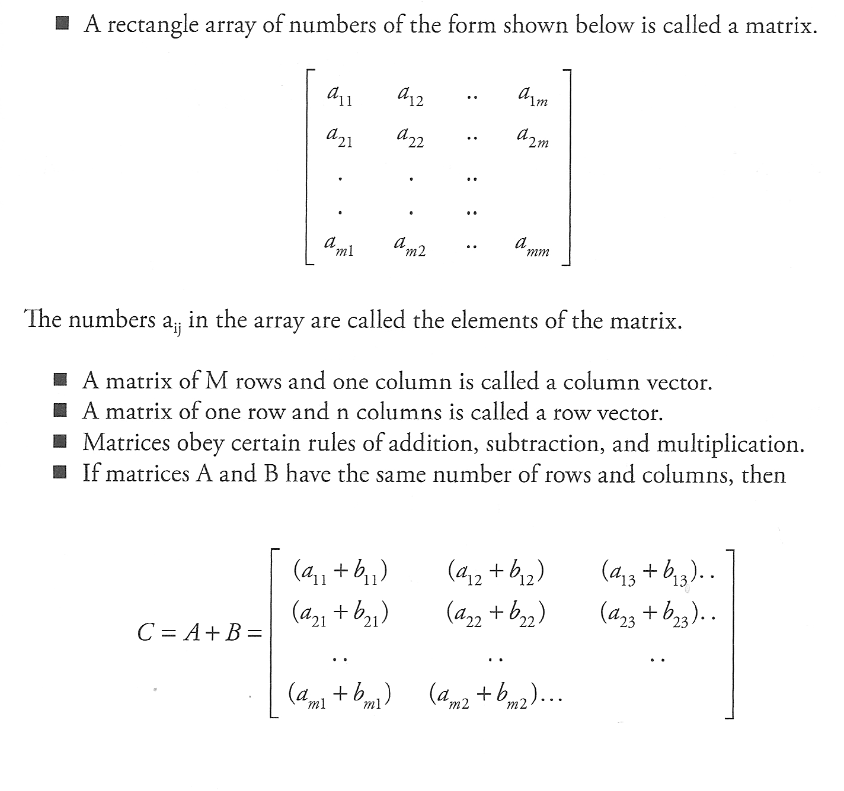
Matrices

Slide 3
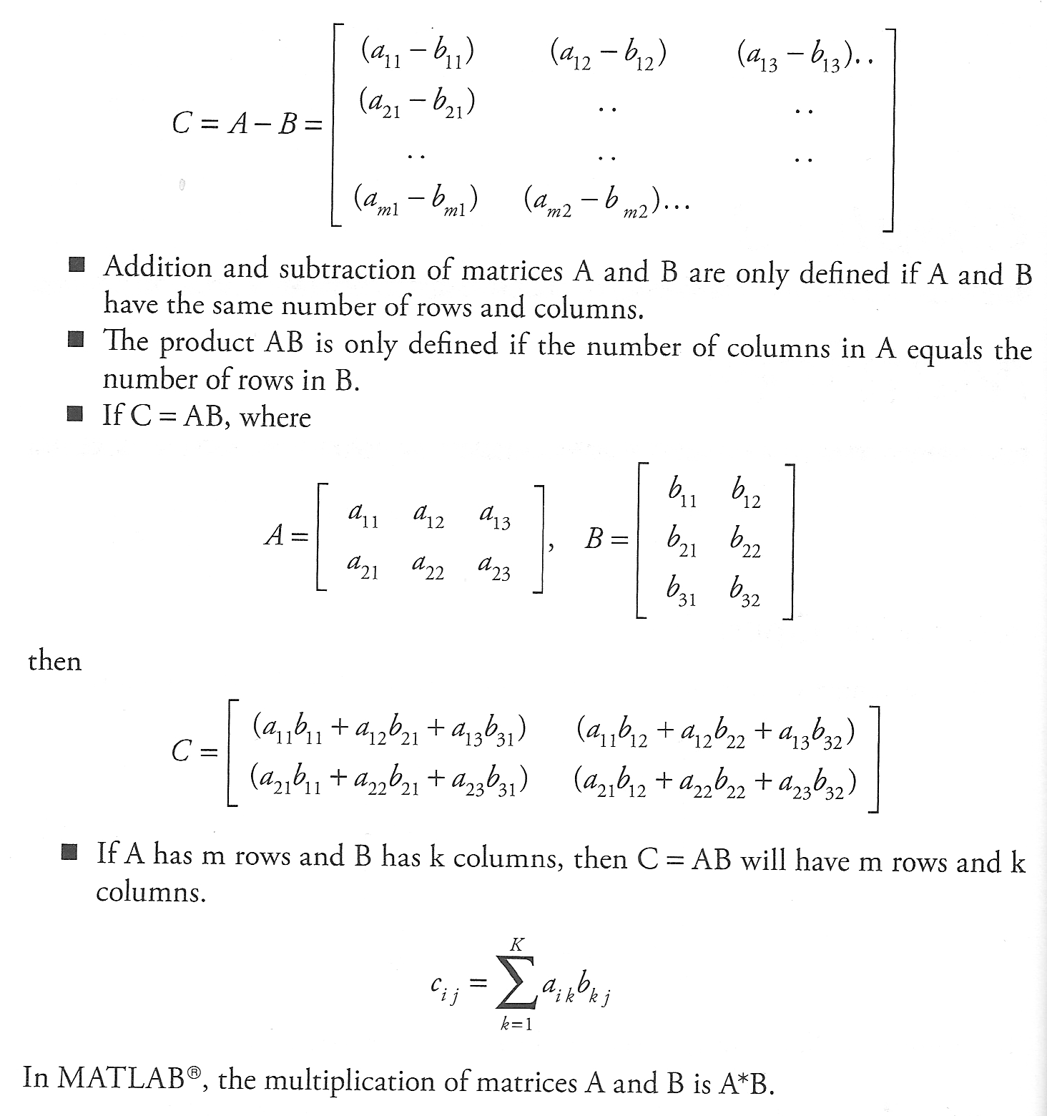
Matrix operations – an overview

Slide 4
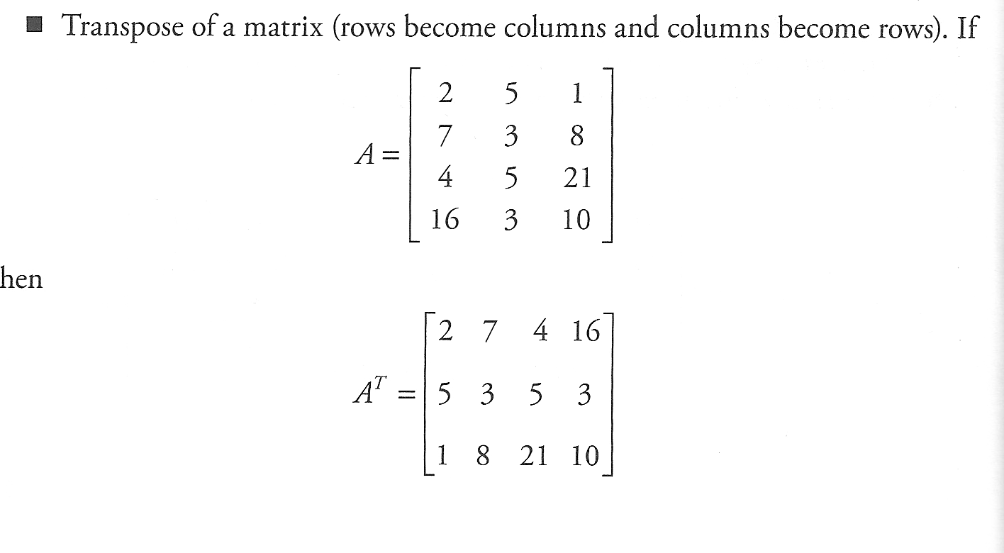
Matrix operations
In MATLAB A^{T}=A.’

Slide 5
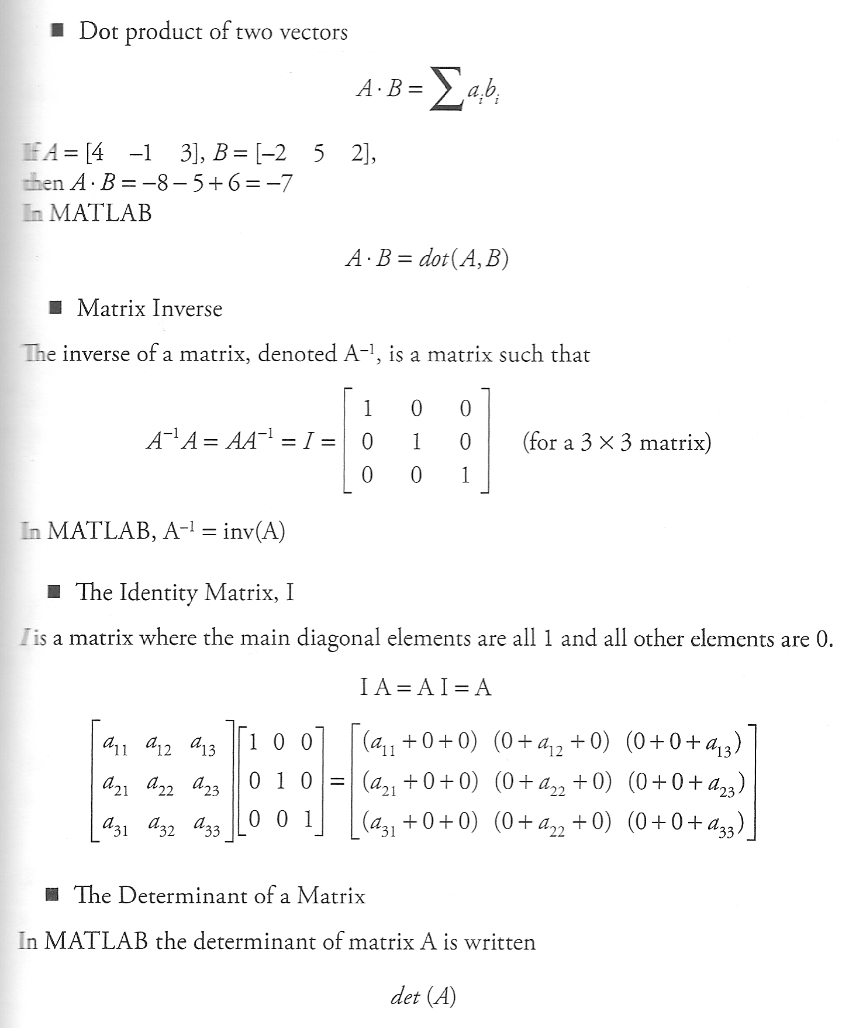
Matrix operations 2

Slide 6

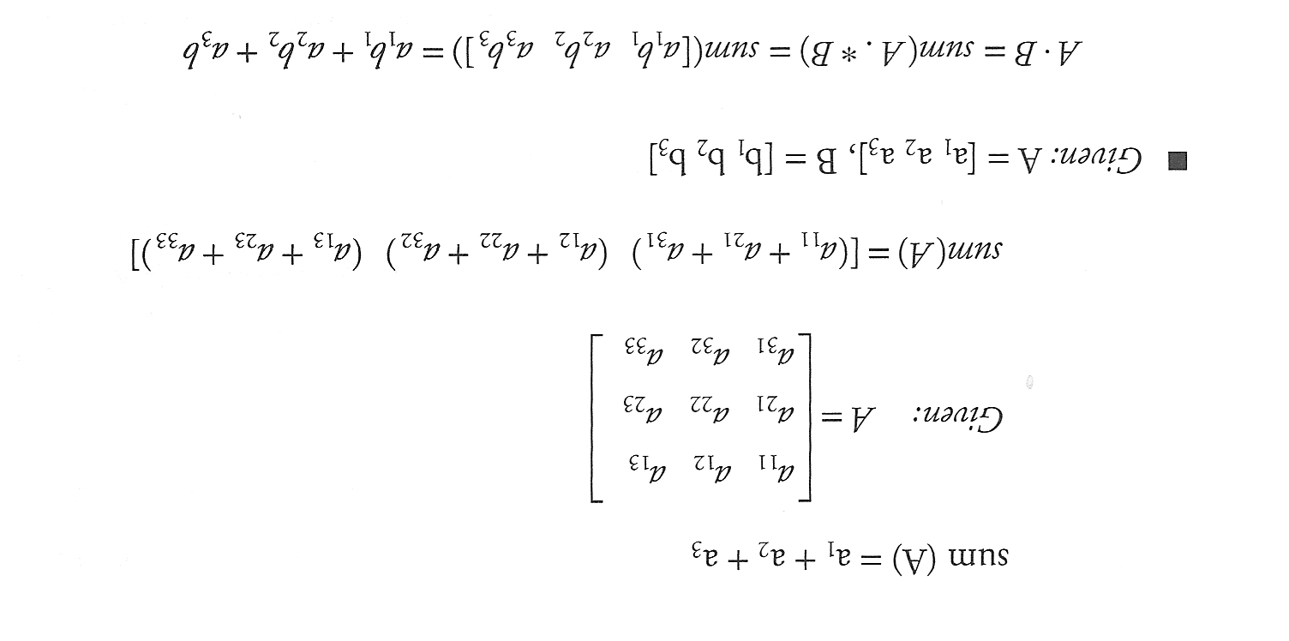
Matrix operations 3

Slide 7
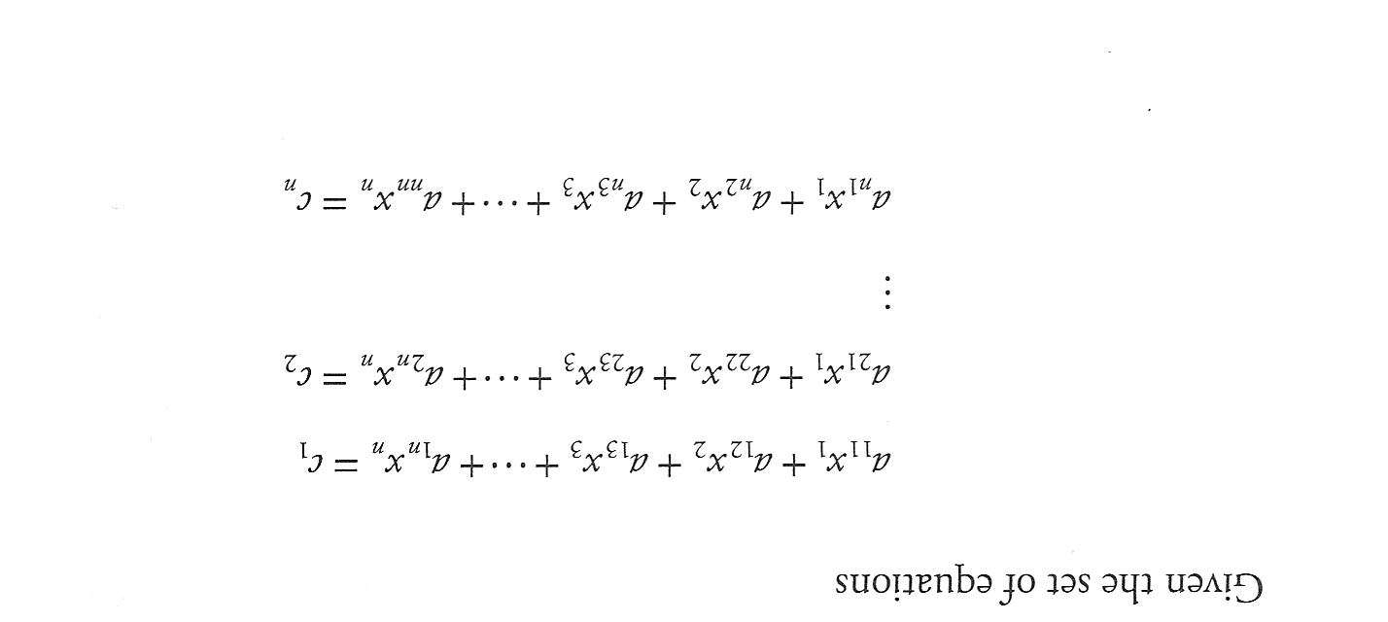
Example: System of Linear Equations

Slide 8
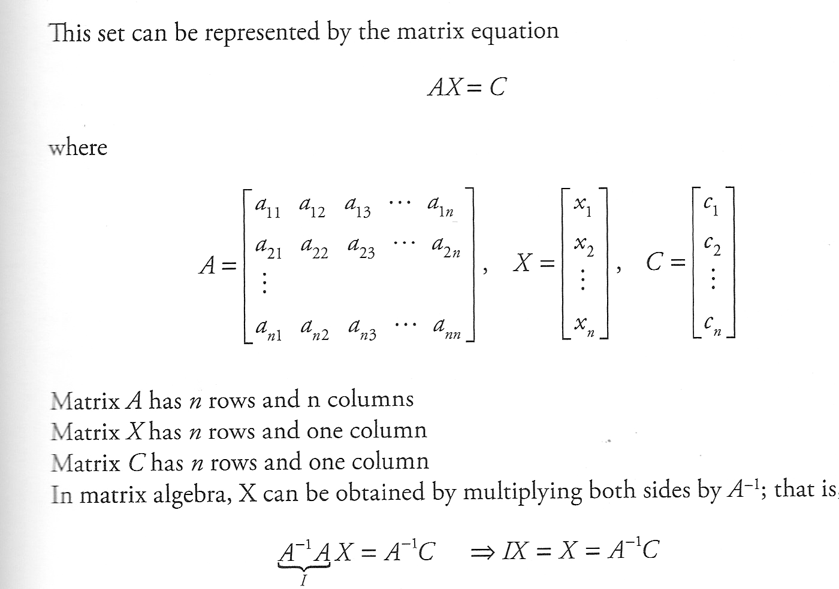
System of Linear Equations 2
In MATLAB X= inv (A)*C

Slide 9
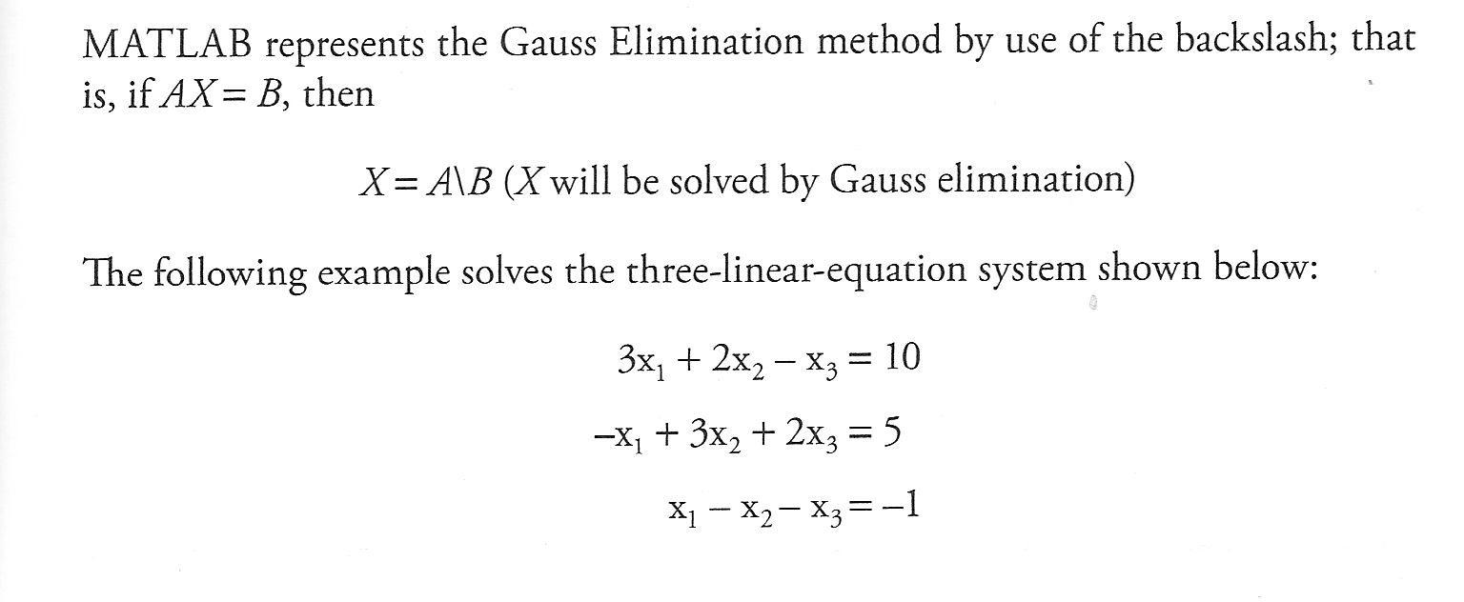
The Gauss Elimination Function
A=[3 2 -1; -1 3 2; 1 -1 -1]; %define matrix A
C=[10 5 -1]’ %define C
x=inv(A)*C %calculate x array
y=A\C %alternatively solve the system
A*x %check results

Slide 10
Function Files
Functions are useful for complicated program to be broken down into smaller parts; Also if series of statements is to be used many times
Syntax
function(output variables)=function_name(input variables)
Statements describing function
end
Function file name is to be saved as function_name.m and the first exactable statement must be “function”.
If there is more than one output value, one needs to put output variables in bracket. If there is only one output variable no brackets are necessary.
Variables defined and manipulated inside the function subroutine are local to the function.

Slide 11
Function Files 2
Let us try to create our own function
f(x)=x^4*exp(-x)*sin(x) and evaluate it for certain values of x. In the editor we can create a file like:
function myf=my_function1(x)
% Establish a function to evaluate
% f(x)=x^4*exp(-x)*sin(x)
y=x.^4.*exp(-x).*sin(x);%note using .
%(dot operator allows input x is array)
myf=y;
end
Now save this file as: my_function1.m
In command window we should type in for example:
>>x=-10:0.1:0;
>>y=my_function1(x);
>>plot(x,y)
>>grid

Slide 12
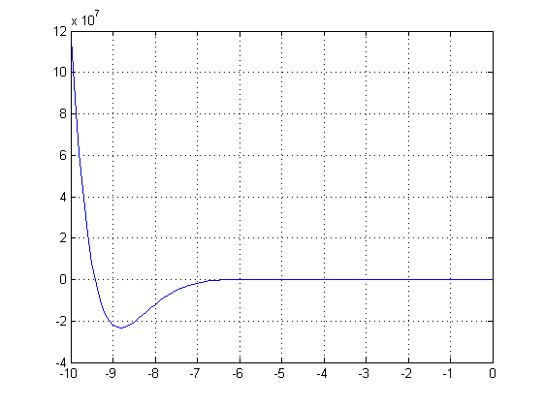
Function Files 3

Slide 13
Function Files 4
Let us try to create our own function which would calculate product of the first n positive integer numbers (i.e. n! ) – basic version
In the editor create the file:
function myfct=my_factorial (n)
% Establish a function to evaluate n!
f=1;
for i=1:n
f=f*i;
end
myfct=f;
end
We should save this file as: my_factorial.m
In command window we should now type in for example: >>my_factorial(10) or >>y=my_factorial(10)

Slide 14
Roots finding
What roots problems are and where they occur in engineering and science.
How to determine a root graphically.
Understanding the incremental search method and its shortcomings.
How to solve a roots problem with the bisection method.
MATLAB fzero and roots commands

Slide 15
Roots
“Roots” problems occur when some function f can be written in terms of one or more dependent variables x, where the solutions to f(x)=0 yields the solution to the problem.
These problems often occur when a design problem presents an implicit equation for a required parameter.

Slide 16
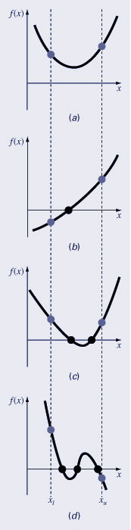
Graphical Methods
A simple method for obtaining the estimate of the root of the equation f(x)=0 is to make a plot of the function and observe where it crosses the x-axis.
Graphing the smooth function can also indicate where roots may be and where some root-finding methods may fail:
Same sign, no roots
Different sign, one root
Same sign, two roots
Different sign, three roots

Slide 17
Bracketing Methods – Search method
Bracketing methods are based on making two initial guesses that “bracket” the root - that is, are on either side of the root.
Brackets are formed by finding two guesses x_{l} and x_{u} where the sign of the function changes; that is, where
f(x_{l} ) f(x_{u} ) < 0
The incremental search method tests the value of the function at evenly spaced intervals and finds brackets by identifying function sign changes between neighboring points.
The sign change usually indicated that real root has been passed. However it may indicate a discontinuity of the function ( tan(x) is, for example, discontinuous at x=π/2 )

Slide 18
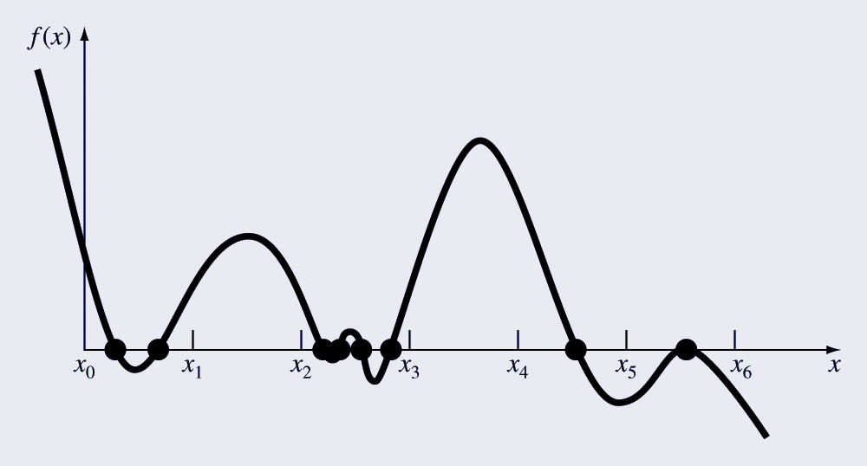
Incremental Search hazards
If the spacing between the points of an incremental search are too far apart, brackets may be missed due to capturing an even number of roots within two points.
Incremental searches cannot find brackets containing even-multiplicity roots regardless of spacing.

Slide 19
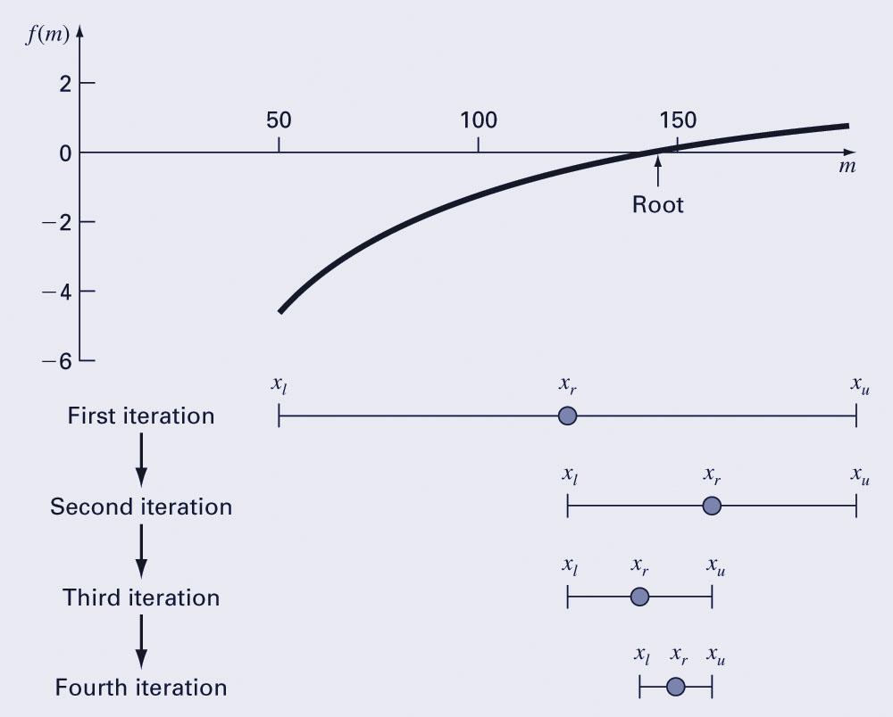
Bisection
The bisection method is a variation of the incremental search method in which the interval is always divided in half.
If a function changes sign over an interval, the function value at the midpoint is evaluated.
The location of the root is then determined as lying within the subinterval where the sign change occurs.
The absolute error is reduced by a factor of 2 for each iteration.

Slide 20
Bisection error
The absolute error of the bisection method is solely dependent on the absolute error at the start of the process (the space between initial two guesses Δx⁰) and the number of iterations:
n – number of bisections
The required number of iterations to obtain a particular absolute error can be calculated based on the initial guesses:

Slide 21
Programing Bisection
function [x e] = mybisect(f,a,b,n)
% function [x e] = mybisect(f,a,b,n)
% Does n iterations of the bisection method for a function f
% Inputs: f -- an inline function
% a,b -- left and right edges of the interval
% n -- the number of bisections to do.
% Outputs: x -- the estimated solution of f(x) = 0
% e -- an upper bound on the error
format long
c = f(a);
d = f(b);
if (c*d > 0.0)
error('Function has same sign at both endpoints.')
end
disp(' x y ')
for i = 1:n
x = (a + b)/2;
y = f(x);
disp ([ x y])
if (y == 0.0) % solved the equation exactly
e = 0;
break % jumps out of the for loop
end
if (c*y) < 0
b=x;
else
a=x;
end
end
x = (a + b)/2;
e = (b-a)/2;
end

Slide 22
Programing Bisection 2
Example: find zeros of function
in the interval (-3< x <3)
M-file: function script defining our own function:
function y=my_function1(x)
y=x.^3+4*x.^2-7*x-20;
end
>>x=-3:0.1:3;
>>plot(x,my_function1(x))
>>grid
Function y(x) has zeros
between x_{l}=-2 and x_{u}=-1,
and between x_{l}=2 and x_{u}=3

Slide 23
Programing Bisection 2
Let us start program for n=5 iterations:
>>[zero1_bisect,error1_bisect]=mybisect(inline('my_function1(x)'),-2,-1,5)
or
>>[zero1_bisect,error1_bisect]=mybisect(@(x)my_function1(x),-2,-1,5)
x y
-1.50000000000000 -3.87500000000000
-1.75000000000000 -0.85937500000000
-1.87500000000000 0.59570312500000
-1.81250000000000 -0.12622070312500
-1.84375000000000 0.23623657226563
zero1_bisect =
-1.82812500000000
error1_bisect =
0.01562500000000
------------------------------------------------------------------------------------
>> [zero2_bisect,error2_bisect]=mybisect(inline('my_function1(x)'),2,3,5)
>> [zero2_bisect,error2_bisect]=mybisect(@(x)my_function1(x),2,3,5)
x y
2.50000000000000 3.12500000000000
2.25000000000000 -4.10937500000000
2.37500000000000 -0.66601562500000
2.43750000000000 1.18530273437500
2.40625000000000 0.24868774414063
zero2_bisect =
2.39062500000000
error2_bisect =
0.01562500000000

Slide 24
Open Methods
Open methods differ from bracketing methods, in that open methods require only a single starting value or two starting values that do not necessarily bracket a root.
Open methods may diverge as the computation progresses, but when they do converge, they usually do so much faster than bracketing methods.

Slide 25
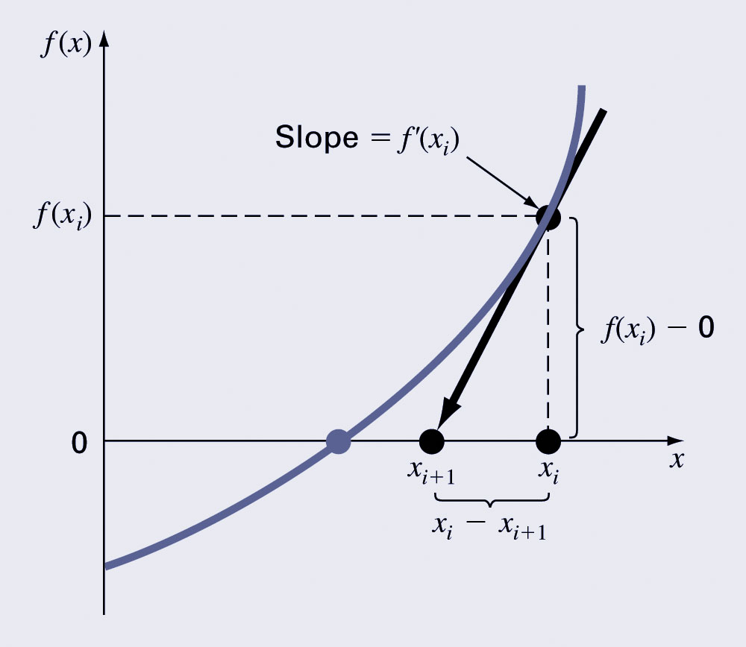
Newton-Raphson Method
Based on forming the tangent line to the f(x) curve at some guess x, then following the tangent line to where it crosses the x-axis.

Slide 26
Newton-Raphson Method
Now let’s do a program that does n steps (iterations) of Newton’s method. We will need to input the function, its derivative, the initial guess, and the number of steps. The output will be the final value of x, i.e. xn. If we have a certain tolerance for |rn| = |f(xn)|, then we can incorporate that into our Newton method:
function x = mynewton(f,f1,x0,n,tol)
% Solves f(x) = 0 by doing n steps of Newton’s method starting at x0.
% Inputs: f -- the function, input as an inline
% f1 -- it’s derivative, input as an inline
% x0 -- starting guess, a number
% tol -- desired tolerance, prints a warning if |f(x)|>tol
^{% Output:} ^{x -- the approximate solution}
x = x0; % set x equal to the initial guess
^{for i=1:n % Do n times}
x = x - f(x)/f1(x) % Newton’s formula
^{end}
^{r = abs(f(x))}
^{if (r > tol)}
warning(’The desired accuracy was not attained’)
^{end}
^{end}

Slide 27
Newton-Raphson Method -Example
Let us define function
And its first derivative
Define inline function and its first derivative and then run mynewton to
find zero and compare it with
Use program with n=5 and tol=0.01 and x₀=2. Next change tol to 10^-10
and repeat
>> zero=mynewton(inline('x^3-5','x'),inline('3*x^2','x'),2,5,0.01)
zero =
1.709975946676697
>> zero=mynewton(inline('x^3-5','x'),inline('3*x^2','x'),2,5,1e-10)
zero =
1.709975946676697
Change initial value x₀=5
>> zero=mynewton(inline('x^3-5','x'),inline('3*x^2','x'),5,5,1e-10)
Warning: The desired accuracy was not attained
> In mynewton at 14
zero =
1.710148601756556
>> zero=mynewton(inline('x^3-5','x'),inline('3*x^2','x'),5,7,1e-10)
zero =
1.709975946676697

Slide 28
Newton-Raphson Method -Example
If x₀ is not close to real zero that the linear approximation is
valid, than first iteration gives some x₁ than may or may not be any better than initial guess. If we keep iterating than x_{j} will eventually get closer to real zero and method will converge rapidly or iteration will not approach real zero.
>> zero=mynewton(inline('x^3-5','x'),inline('3*x^2','x'),2,5,0.01)
zero =
1.709975946676697
>> zero=mynewton(inline('x^3-5','x'),inline('3*x^2','x'),2,5,1e-10)
zero =
1.709975946676697
Change initial value x₀=5
>> zero=mynewton(inline('x^3-5','x'),inline('3*x^2','x'),5,5,1e-10)
Warning: The desired accuracy was not attained
> In mynewton at 14
zero =
1.710148601756556
Increase number of iteration to be n=7
>> zero=mynewton(inline('x^3-5','x'),inline('3*x^2','x'),5,7,1e-10)
zero =
1.709975946676697

Slide 29
Newton-Raphson Method 2
Even for a well-behaved problem, if we make n too small then the tolerance will not be attained and we will have to go back and increase it, or, if we make n too big, then the program will take more steps than necessary.
One way to control the number of steps taken is to iterate until the residual |r_{n}| = |f(x)| = |y| is small enough. In MATLAB this is easily accomplished with a while ... end loop:
function [x no_iterations]= mynewtontol(f,f1,x0,tol)
x = x0; % set x equal to the initial guess x0.
^{i=0; % set counter to zero}
^{y = f(x);}
while (abs(y) > tol && i < 1000)
% Do until the tolerance is reached or max iter.
x = x - y/f1(x); % Newton’s formula
^{y = f(x);}
^{i = i+1;}
^{end}
^{no_iterations=i-1;}
^{end}

Slide 30
Newton-Raphson Method 3
[zero no_iterations]=mynewtontol(inline('x^3-5','x'),inline('3*x^2','x'),2,1e-10)
^{zero =}
^{1.709975946676833}
^{no_iterations =}
³
>> [zero no_iterations]=mynewtontol(inline('x^3-5','x'),inline('3*x^2','x'),5,1e-15)
^{zero =}
^{1.709975946676697}
^{no_iterations =}
⁶
>> [zero no_iterations]=mynewtontol(inline('x^2','x'),inline('2*x','x'),3,1e-15)
^{zero =}
^{2.235174179077148e-008}
^{no_iterations =}
²⁶
Solution does converge but not that rapidly as before

Slide 31
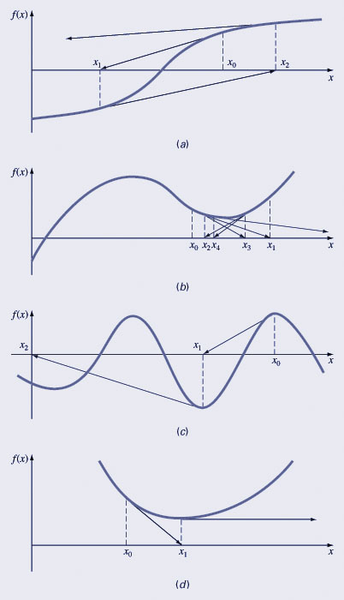
Pros and Cons
Pro: The error of the i+1th iteration is roughly proportional to the square of the error of the i^{th} iteration - this is called quadratic convergence
Con: Some functions show slow or poor convergence

Slide 32
MATLAB’s fzero Function
MATLAB’s fzero provides the best qualities of different root finding methods.
Using an initial guess: x = fzero(function, x0) [x, fx] = fzero(function, x0)
function is a function handle to the function being evaluated
x0 is the initial guess
x is the location of the root
fx is the function evaluated at that root
Using an initial bracket: x = fzero(function, [x0 x1]) [x, fx] = fzero(function, [x0 x1])
As above, except x0 and x1 are guesses that must bracket a sign change

Slide 33
fzero Options
Options may be passed to fzero as a third input argument - the options are a data structure created by the optimset command
options = optimset(‘par₁’, val₁, ‘par₂’, val₂,…)
par_{n} is the name of the parameter to be set
val_{n} is the value to which to set that parameter
The parameters commonly used with fzero are:
display: when set to ‘iter’ displays a detailed record of all the iterations
tolx: A positive scalar that sets a termination tolerance on x.

Slide 34
fzero Example
options = optimset(‘display’, ‘iter’);
Sets options to display each iteration of root finding process
[x, fx] = fzero(@(x) x^10-1, 0.5, options)
Uses fzero to find roots of f(x)=x¹⁰-1 starting with an initial guess of x=0.5.
MATLAB reports x=1, fx=0 after 35 function counts

Slide 35
The End

