Slide 1

CAPSTONE PROJECT Hybrid Recommendation System
Presented By: JANNABHATLA NATRAJ SAKSHITH
Student Name: JANNABHATLA NATRAJ SAKSHITH
College Name: K.L UNIVERSITY
Department: ECE
Email ID:2000040213ece@gmail.com
AICTE Student ID:STU62b42fb0719921655975856

Slide 2
OUTLINE
Problem Statement
Proposed System/Solution
System Development Approach
Algorithm & Deployment
Result (Output Image)
Conclusion
Future Scope
References

Slide 3

Problem Statement
The exponential growth of online content across platforms like streaming services, e-commerce, and digital libraries has made it increasingly difficult for users to discover relevant and personalized recommendations. Traditional recommendation systems struggle with challenges such as data sparsity, cold-start problems for new users and items, and limited adaptability to changing user preferences. This project aims to overcome these issues by leveraging a hybrid recommendation approach, ensuring users receive accurate and meaningful recommendations tailored to their interests.

Slide 4

Proposed Solution
To address the challenges faced by conventional recommendation systems, we propose a Hybrid Recommendation System that integrates the strengths of collaborative filtering, content-based filtering, and clustering techniques to improve recommendation accuracy.
Key Components: 1. Collaborative Filtering → Analyzes user interaction history to find patterns and suggest items based on behavior similarities. 2. Content-Based Filtering → Utilizes item attributes (such as genre, category, etc.) to recommend content closely aligned with user preferences. 3. Clustering for User Segmentation → Groups users with similar engagement patterns to enhance personalization and recommendation efficiency. 4. Optimized Algorithm Performance → Implements PCA for feature reduction, cosine similarity for relevance matching, and hyperparameter tuning to enhance efficiency. Scalability & Frontend Integration → Ensures seamless deployment across diverse datasets and future integration with an interactive user interface (Flask/Streamlit).
This approach mitigates cold-start issues and data sparsity, resulting in a more dynamic and personalized recommendation experience.

Slide 5

System Approach
System requirements:
Hardware:
Processor: Intel Core i5 or higher.
RAM: Minimum 8 GB (16 GB recommended for faster processing).
Storage: At least 10 GB of free space for datasets and model files.
Software:
Operating System: Windows 10/11 or Linux.
Development Environment: Jupyter Notebook, Visual Studio Code, or any preferred IDE.
Library required to build the model:
Data Manipulation and Preprocessing : pandas ,NumPy , re
Machine Learning & Feature Engineering: sklearn
Visualization: seaborn,matplotlib
:

Slide 6

Algorithm & Deployment
1 Algorithm Selection:
The system combines collaborative filtering, clustering, and content-based filtering to provide a personalized recommendation experience while mitigating data sparsity issues.
2 Data Input Processing:
The system processes user-item interaction data, item features (such as genre and category), and contextual metadata like timestamps and user profiles.
3 Training Process:
Collaborative filtering models leverage interaction matrices to analyze user preferences.
Content-based filtering utilizes feature extraction techniques like TF-IDF and cosine similarity to match relevant items.
Clustering segmentation refines user grouping for improved targeting.
Hyperparameter tuning and cross-validation optimize the model performance to ensure reliability.
4 Prediction & Recommendation Generation:
The hybrid system blends predictions from collaborative and content-based approaches, ensuring robust recommendations.
Fallback recommendations based on popularity trends prevent empty results in cases of limited data.

Slide 7
Result
✅ The hybrid recommendation system demonstrated higher accuracy and personalization compared to standalone collaborative or content-based models. ✅ Precision & recall metrics validated improved relevance, ensuring users receive meaningful suggestions. ✅ The clustering technique further refined user segmentation, enhancing recommendation efficiency

Slide 8
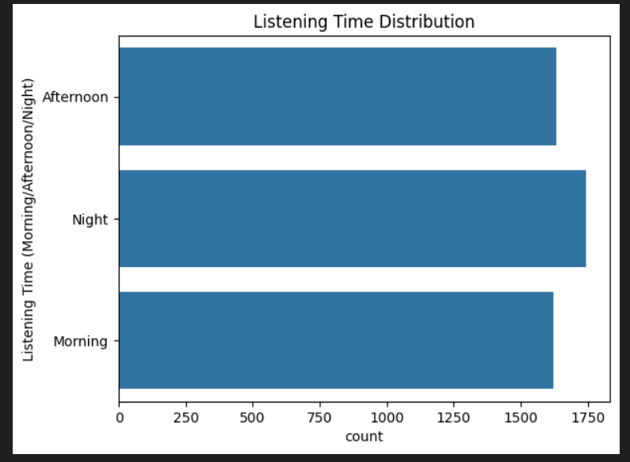
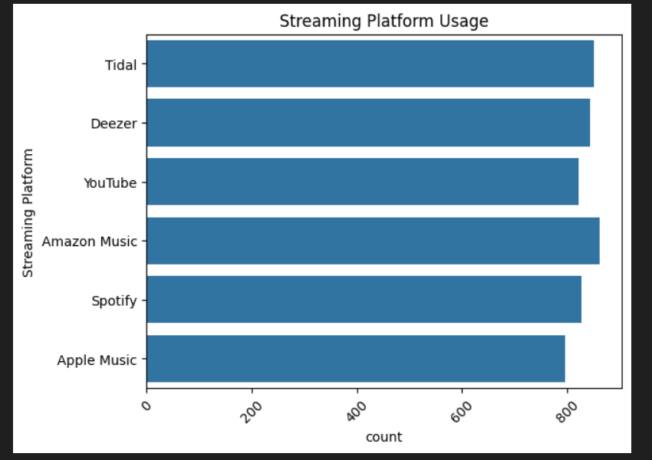

Slide 9
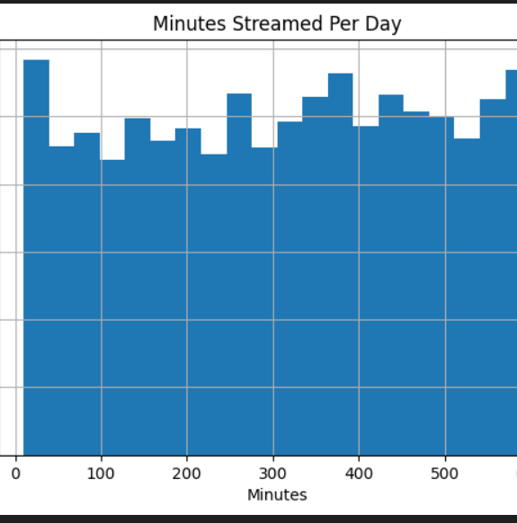
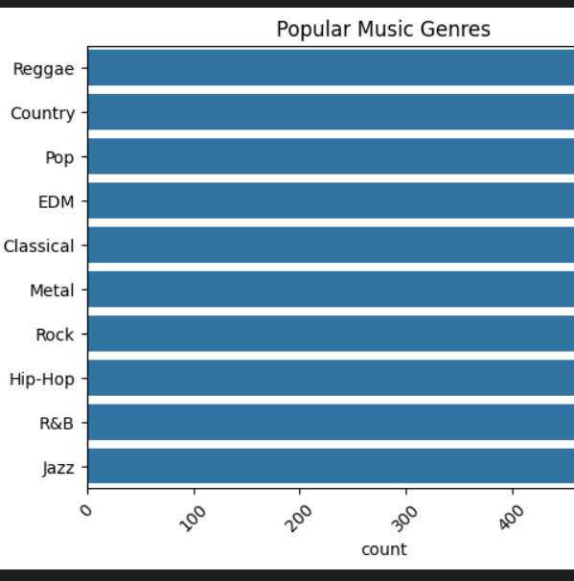

Slide 10
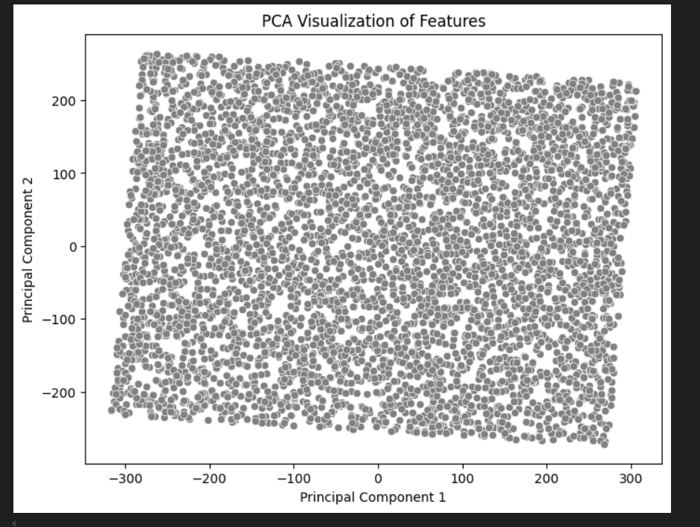
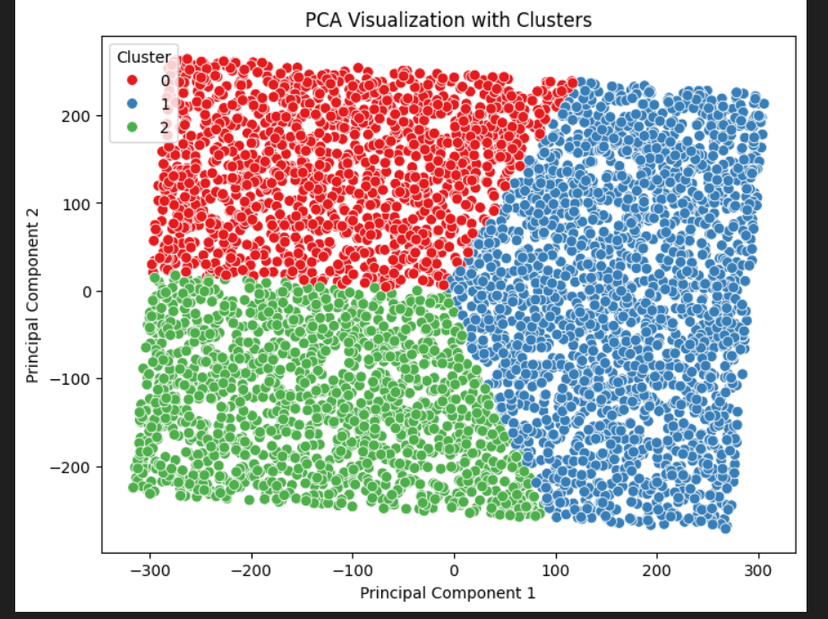

Slide 11
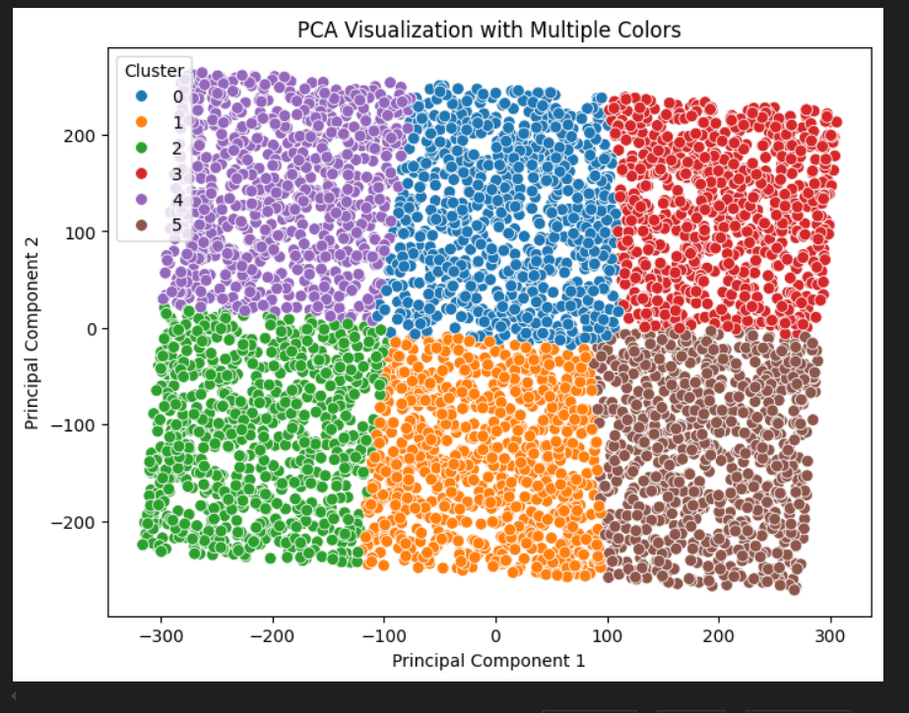

Slide 12

Conclusion
The Hybrid Recommendation System leverages a combination of collaborative filtering, content-based filtering, and clustering techniques to enhance the accuracy of recommendations. By analyzing user-item interactions, item attributes, and contextual data, the system ensures personalized suggestions tailored to individual preferences. Collaborative filtering identifies patterns based on user behavior, while content-based filtering matches items based on their features. Additionally, clustering enables segmentation, helping improve recommendation efficiency. The system is optimized with PCA for dimensionality reduction, TF-IDF for feature extraction, and cosine similarity for preference matching, ensuring scalability and adaptability across various domains. Future enhancements include real-time feedback loops, deep-learning integration, and frontend development using Streamlit or Flask for a more interactive user experience.

Slide 13
Future scope
1 Frontend Development:
Create an interactive and user-friendly interface using tools like Streamlet or Flask, allowing users to
experience seamless access to personalized recommendations.
2 Integration of Advanced Techniques:
Explore deep learning-based hybrid models, such as neural collaborative filtering, to further enhance the accuracy and
efficiency of recommendations.
3 Scalability:
Optimize the system to handle larger datasets and scale across various domains like e-commerce, streaming
service flatforms.
4 Dynamic Recommendations:
Incorporate real-time data analysis for adaptive recommendations based on changing user preferences and trends.
5 User Feedback Loop:
Implement mechanisms to collect and analyze user feedback, enabling continuous improvement of recommendation quality.

Slide 14
References
Articles on hybrid recommendation systems in journals like IEEE Xplore, Springer, or ScienceDirect.
Key references discussing collaborative filtering, content-based filtering, and hybrid approaches.model evaluation.

Slide 15

Thank you

