Slide 1
Group Member:
Jannat Ara Ferdouse Raya
ID:1811526042
Section: 2
Tittle: Predicting Patient’s Condition based on review

Slide 2
What was the problem?
Problem is described below:
A data set from Kaggle is given. The link of the dataset is: https://www.kaggle.com/jessicali9530/kuc-hackathon-winter-2018.
The UCI ML Drug Review dataset provides patient reviews on specific drugs along with related conditions and a 10-star patient rating system reflecting overall patient satisfaction. The data was obtained by crawling online pharmaceutical review sites.
From this dataset, I have to predict patient’s condition based on review. I have to select a Machine learning model with highest accuracy, which can predict the condition of a patient such as whether a patient in on Birth control or she/he has Diabetes.

Slide 3
How did you solve it?
There are few steps that are followed to solve the problem. So, the steps are:
Import all the important libraries.
Data preprocessing : The dataset contains 7 features and among them only two features will be used for the problem. The features are review and condition. Both feature’s values are in text form. So, to preprocess a few steps are taken:
Dropping Nan values
Clean text, redundant numbers and punctuations using Regax
Lowercasing the text
Keep the class which have more than 20 values
Balancing classes using under sampling.
Feature Extraction: Vectorize the text data from text using CountVectorizer. It will convert the text into a sparse matrix.

Slide 4
How did you solve it?
4. Train the model: Then trained the model with train data as the data set was separated into test data and train data . At first Random Forest Model is train with the train data.
Then SVM or Support Vector Machine model is trained.

Slide 5
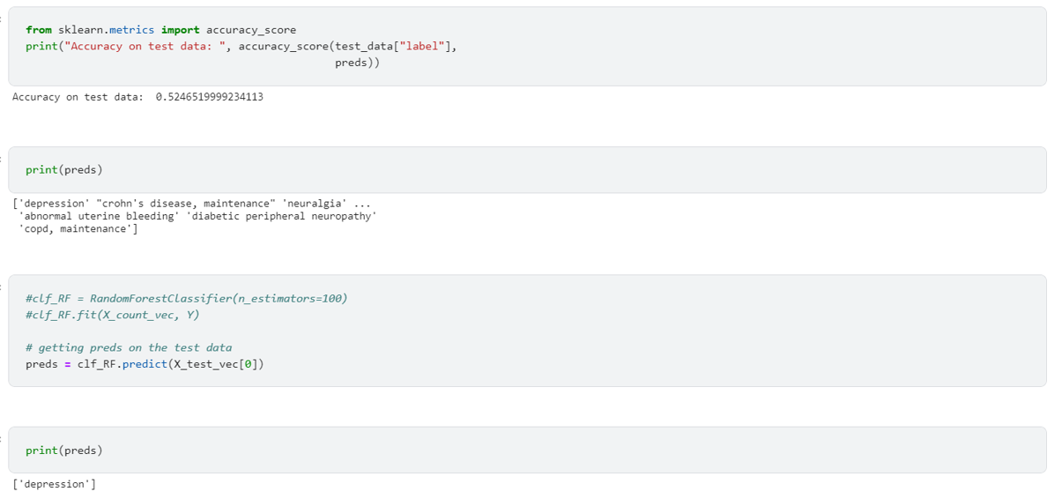
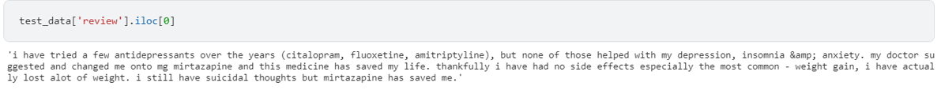
Result:
Here is the Snapshot of the Result: The models tested using test data .The accuracy of Random Forest Model is around 52% and the accuracy of SVM is around 38%.

