Slide 1
BFS(Breadth First Search) Queue(FIFO)

Slide 2
BFS
BFS is a traversal algorithm used in graphs that explores neighbors level-by-level, starting from a chosen source node. It uses a queue(FIFO) structure to manage exploration order.
When to use BFS:
1. To find the shortest path in an unweighted graph
2. To check connectivity between nodes
3. To perform a level-order traversal.

Slide 3
Input: node=5 edge=4
0 1
0 2
1 3
1 4
Start from node 3
int main()
{
int n, e;
cin >> n >> e;
vector<vector<int>> adj(n);
for (int i = 0; i < e; i++)
{
int a, b;
cin >> a >> b;
adj[a].push_back(b);
adj[b].push_back(a);
}
int start;
cin >> start;
BFS(start, adj);
}
vector<vector<int>> adj(n);
adj | { { } | { } | { } | { } | { } }
Index | 0 | 1 | 2 | 3 | 4
adj[a].push_back(b);
adj[b].push_back(a);
adj | {1, 2} | {0, 3, 4} | {0} | {1} | {1}
Index | 0 | 1 | 2 | 3 | 4

Slide 4
void BFS(int s, vector<vector<int>> adj)
{
int n = adj.size();
queue<int> q;
vector<int> vis(n, false);
q.push(s);
vis[s] = true;
cout << "Traversing Starts from " << s << " : ";
queue<int> q;
vector<int> vis(n, false);
F | F | F | F | F
0 | 1 | 2 | 3 | 4
q.push(s);
3
Vis[s]=true; ->vis[3]=true;
F | F | F | T | F
0 | 1 | 2 | 3 | 4

Slide 5
while (!q.empty())
{
int p = q.front();
q.pop();
cout << p << " ";
for (auto u : adj[p])
{
if (!vis[u])
{
vis[u] = true;
q.push(u);
}
}
}
cout << endl;
}

Slide 6
Step-01
p=q.front(); -> p=3
q.pop()
q
for (auto u : adj[3])
{
if (!vis[1])
{
vis[1] = true;
q.push(1);
}
}
adj | {1, 2} | {0, 3, 4} | {0} | {1} | {1}
Index | 0 | 1 | 2 | 3 | 4
VIS | F | T | F | T | F
 | 0 | 1 | 2 | 3 | 4
q | 1

Slide 7
Step-02
p=q.front(); -> p=1
q.pop()
q
for (auto u : adj[1])
{
if (!vis[0]) (0,4)
{
vis[0] = true; (0,4)
q.push(0); (0,4)
}
}
adj | {1, 2} | {0, 3, 4} | {0} | {1} | {1}
Index | 0 | 1 | 2 | 3 | 4
VIS | T | T | F | T | T
Index | 0 | 1 | 2 | 3 | 4
q | 0 | 4

Slide 8
Step-03
p=q.front(); -> p=0
q.pop()
q | 4
for (auto u : adj[0])
{
if (!vis[2])
{
vis[2] = true;
q.push(2);
}
}
adj | {1, 2} | {0, 3, 4} | {0} | {1} | {1}
Index | 0 | 1 | 2 | 3 | 4
VIS | T | T | F | T | T
Index | 0 | 1 | 2 | 3 | 4
q | 4 | 2

Slide 9
Step-04
p=q.front(); -> p=4
q.pop()
q | 2
adj | {1, 2} | {0, 3, 4} | {0} | {1} | {1}
Index | 0 | 1 | 2 | 3 | 4
VIS | T | T | F | T | T
 | 0 | 1 | 2 | 3 | 4
q | 2

Slide 10
Step-05
p=q.front(); -> p=2
q.pop()
q
adj | {1, 2} | {0, 3, 4} | {0} | {1} | {1}
Index | 0 | 1 | 2 | 3 | 4
VIS | T | T | F | T | T
 | 0 | 1 | 2 | 3 | 4
q

Slide 11
Queue and Visit State per Step:
Step | Queue | Visited | Output
1 | [3] | [F, F, F, T, F] | [3]
2 | [1] | [F, T, F, T, F] | [3, 1]
3 | [0, 4] | [T, T, F, T, T] | [3, 1, 0]
4 | [4, 2] | [T, T, T, T, T] | [3, 1, 0, 4]
5 | [2] | [T, T, T, T, T] | [3, 1, 0, 4, 2]

Slide 12
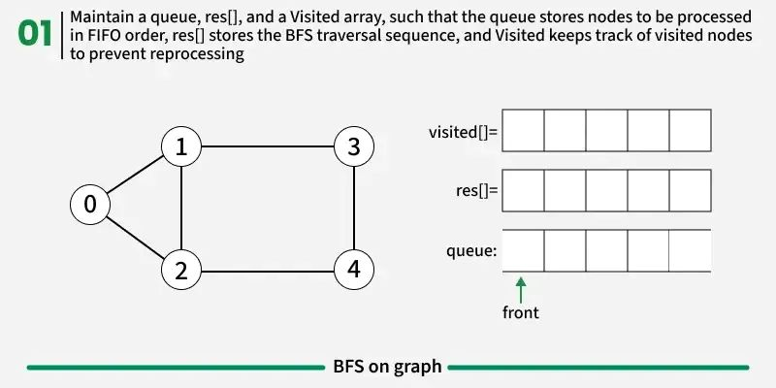

Slide 13
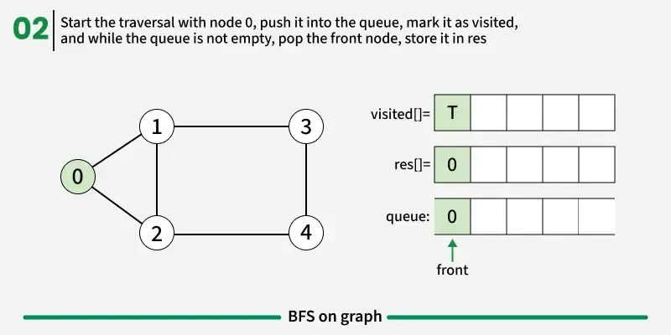

Slide 14
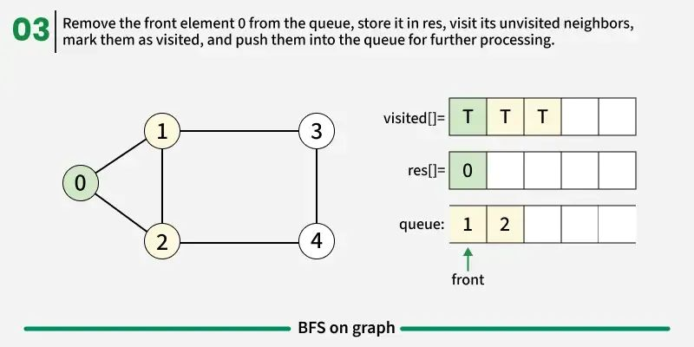

Slide 15
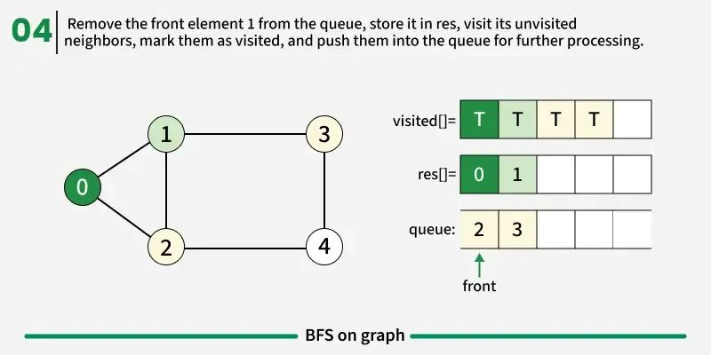

Slide 16
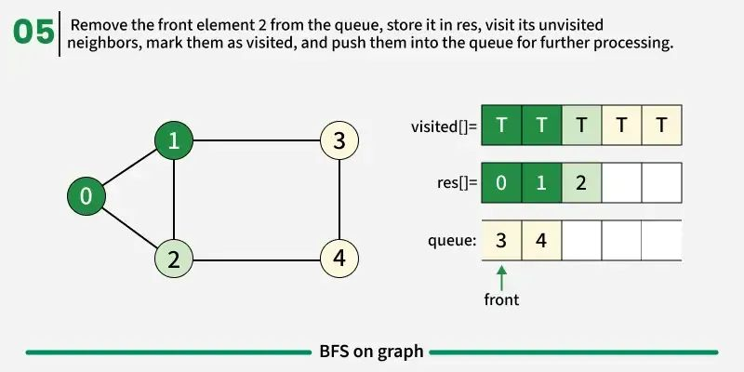

Slide 17
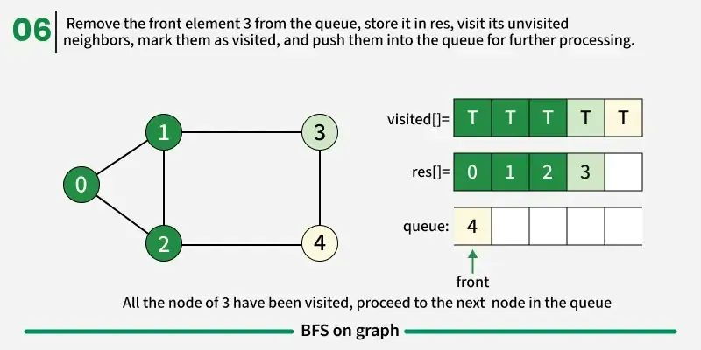

Slide 18
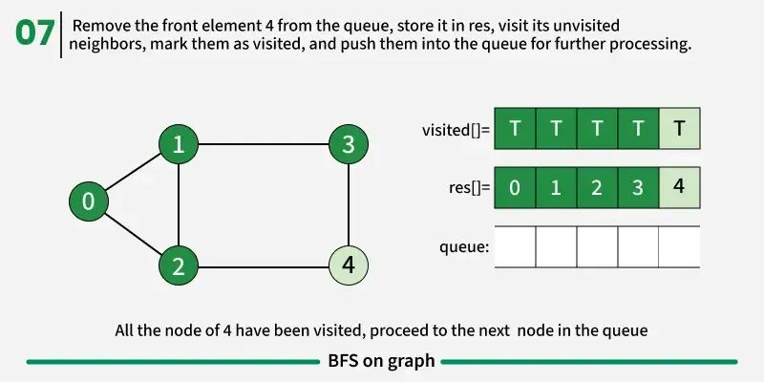

Slide 19
