Slide 1

Chapter - 7
“Introduction to the measurement of Interest rate risk”
Presented by Tamanna

Slide 2
Presented by group no-02
Department of Finance and Banking
(MBA, 2nd semester)
UNIVERSITY OF BARISHAL

Slide 3
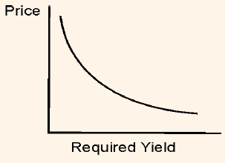
Review of price
There exists inverse relationship between price of an option free bond and the required yield.
The graph of the price-yield relationship of any option free bond for an instantaneous change in the required yield is referred to as convex.

Slide 4
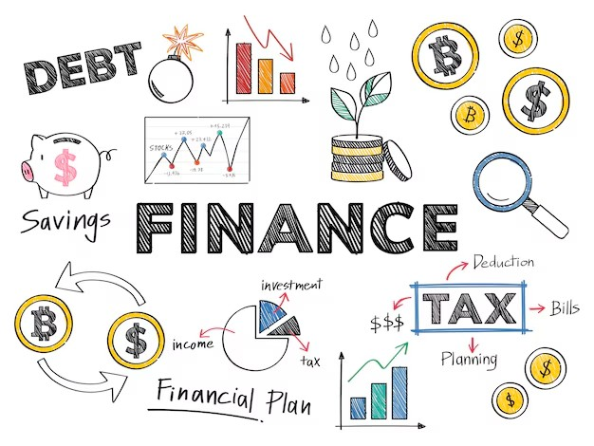
Review of price
For large changes in the required yield, the percentage price change is not the same for an increase in the required yield as it is for a decrease in the required yield.
For the small changes in the required yield, the percentage price Change is the same or close to near amount or percentage.

Slide 5
Review of price
Although the prices of all option-free bonds in the opposite direction with respect to change in yield, the percentage price change not the same for all bonds.
For a very small change in the required yield, the percentage price change for a given bond is roughly the same, whether the yield required increases or decreases.
For large changes in the required yield, the percentage price change is not the same for an increase in the required yield as it is for a decrease in the required yield.
For a given large change in yield, the percentage price increase is greater than the percentage price decrease.

Slide 6

Review of price
The price yield relationship model :
Major sources: industrial waste, agricultural runoff, and plastic pollution.
Damages marine ecosystems and reduces biodiversity.
Causes health issues like gastrointestinal diseases and reproductive problems in humans.

Slide 7
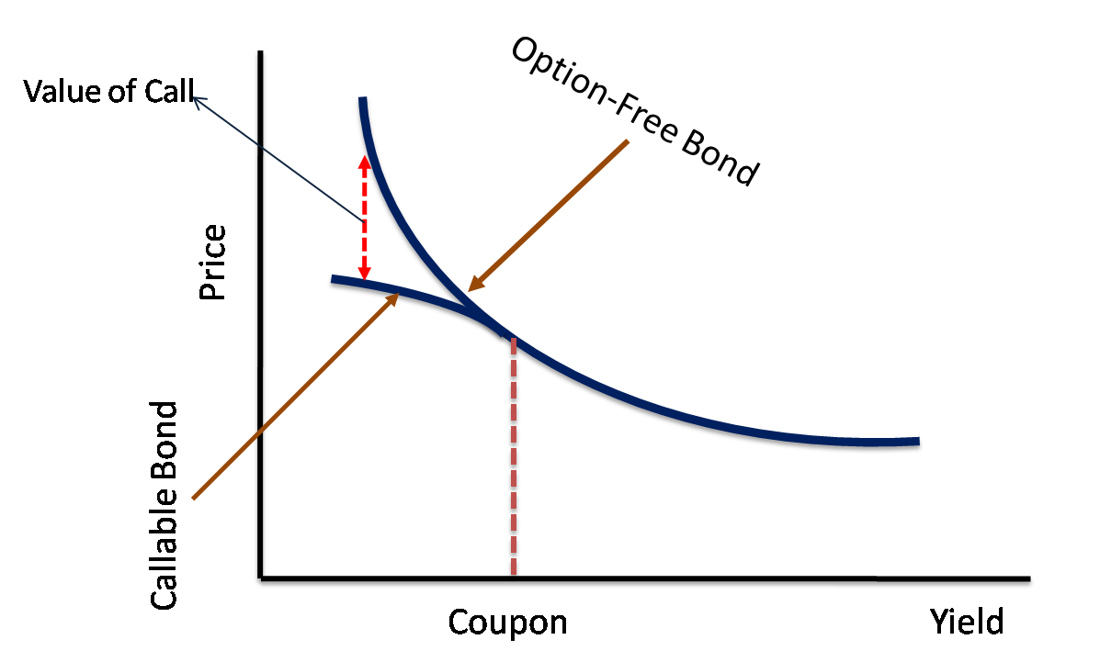
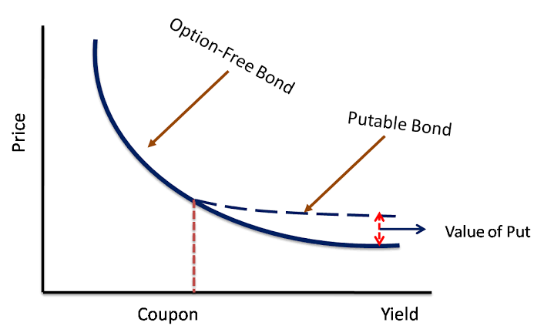
Price-yield relationship
Figure : 1
Figure : 2

Slide 8
Deposit and loan To the Customer services
Flowchart
Deposits → Loans →Assets
Deposit
Demand deposit
Savings deposit
Loan
Home loan
Assets
Buildings land
Time deposit
Mortgage loanty
Land
Mortgaget

Slide 9
How good is the approximation?
 | 6% YIELD | New Price |  | Percent price change as per
Yield Change (basis points) | Initial Price | Based on duration | Actual Price | Duration | Actual | Difference
10= 6.10% | 134.6722 | 133.2366 | 133.2472 | -1.066 | -1.06 | 0.006
-10= 5.90% | 134.6722 | 136.1078 | 136.1193 | 1.066 | 1.07 | 0.004
200= 8% | 134.6722 | 105.9601 | 109.8964 | -21.32 | -18.4 | 2.92
-200 =4% | 134.6722 | 163.3843 | 168.3887 | 21.32 | 25.04 | 3.72

Slide 10
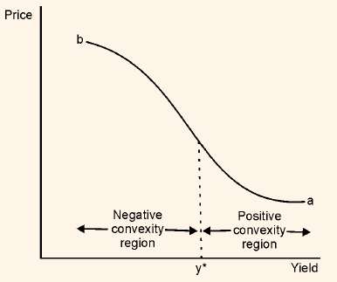
Positive and Negative Convexity Adjustment
When the convexity adjustment is positive, the gain is greater than the loss for a given large change in rates.
When the convexity adjustment is negative, the loss will be greater than the gain.
A callable bond exhibits negative convexity at low yield levels and positive convexity at high yield levels

Slide 11



Deposit mobilization
Deposit
Savings
Term
Real Estate bank
Reduce investment

Slide 12
Characteristics Affecting Price Volatility
For large changes in the required yield, the percentage price change is not the same for an increase in the required yield as it is for a decrease in the required yield.
For the small changes in the required yield, the percentage price Change is the same or close to near amount or percentage.
Capital adequacy and Basal III

Slide 13

Combating pollution requires a collective effort from governments, non-governmental organizations, businesses, and individuals to implement effective policies, promote sustainable practices, and raise awareness. By fostering collaboration and commitment to environmental stewardship, we can mitigate pollution's effects and work towards a cleaner, healthier, and more sustainable world for all.

Slide 14
Characteristics Affecting Price Volatility
Coupon
For a given term to maturity and initial yield, the price volatility of a bond is greater, the lower the coupon rate.
Term to Maturity
For a given coupon rate and initial yield, the longer the term to maturity, the greater the price volatility.

Slide 15
Thank you

