Slide 2


Slide 3
INTRODUCTION
Foodpanda is an online food delivering platform that lead customer to order restaurant via
The company consists of multiple brand operating in more than 40 countries across south America , Asia , The middle east, Eastern Europe and Africa
The company is established in the year 2012 Headquartered in the berlin and within a short span of time it establishes in business in approx. 40 different nation and earn a huge market share
Foodpanda has partnered with more than 58,000 restaurants worldwide and over 3,000 -5,000 restaurant in Pakistan

Slide 4
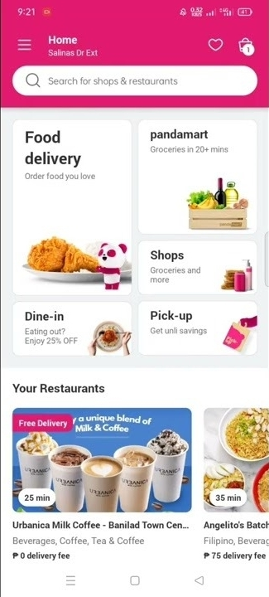
TARGET AUDIENCE
Smartphone users
Age: 18-35
Prefer convenience over ambiance
Always on the go
Teach savy
Couch potatoes

Slide 5

BENEFIT OF USING FOOD PANDA
Convenient
Food is freshly cook
Different kind of cuisine and drinks
Attractive deals like enjoy discount on order
Free delivery
Promo codes

Slide 6

HISTORY
Foodpanda
Foodpanda was launched in march 2012 in Singapore and expanded into 16 countries by the end of the year .By February 2013 Foodpanda was operating in 23 countries. The company stated that it aimed to move into 40 nation in Asia , Europe , latin America the middle east and Africa by the end Q1 2014 and did so.

Slide 7
WEBSITE FEATURES
Foodpanda
Foodpanda has partnered with more than 58,000 restaurant worldwide. It connects customers with restaurants that offer food delivery in their area and let them choose, order and pay online. Foodpanda also has a review section on restaurant pages, where customers orders are also saved, allowing for reorders to be done quickly, while multiple addresses can also be stored.

Slide 8
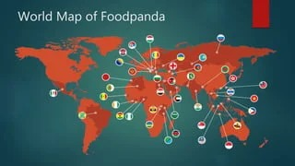

Slide 9
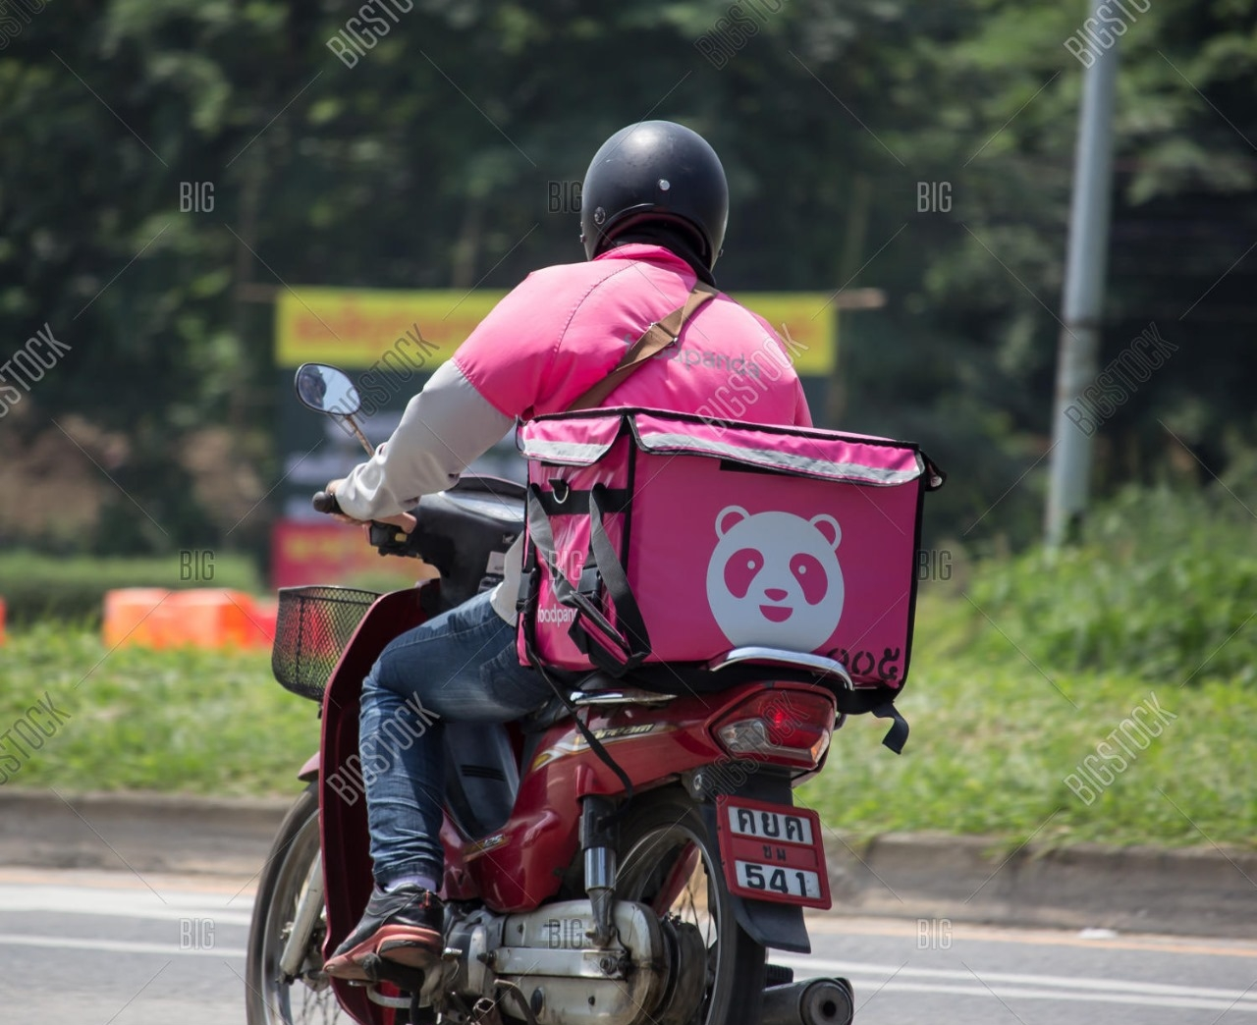
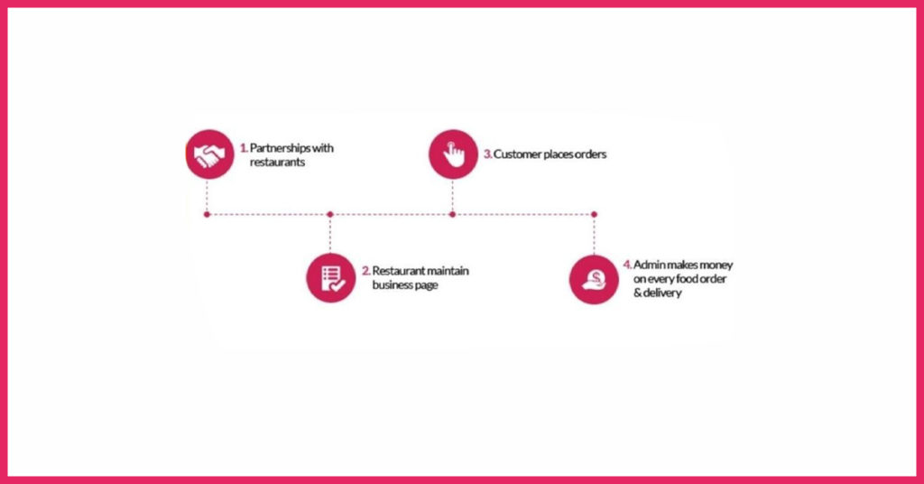
How food ordering & delivery websites make money?

Slide 10
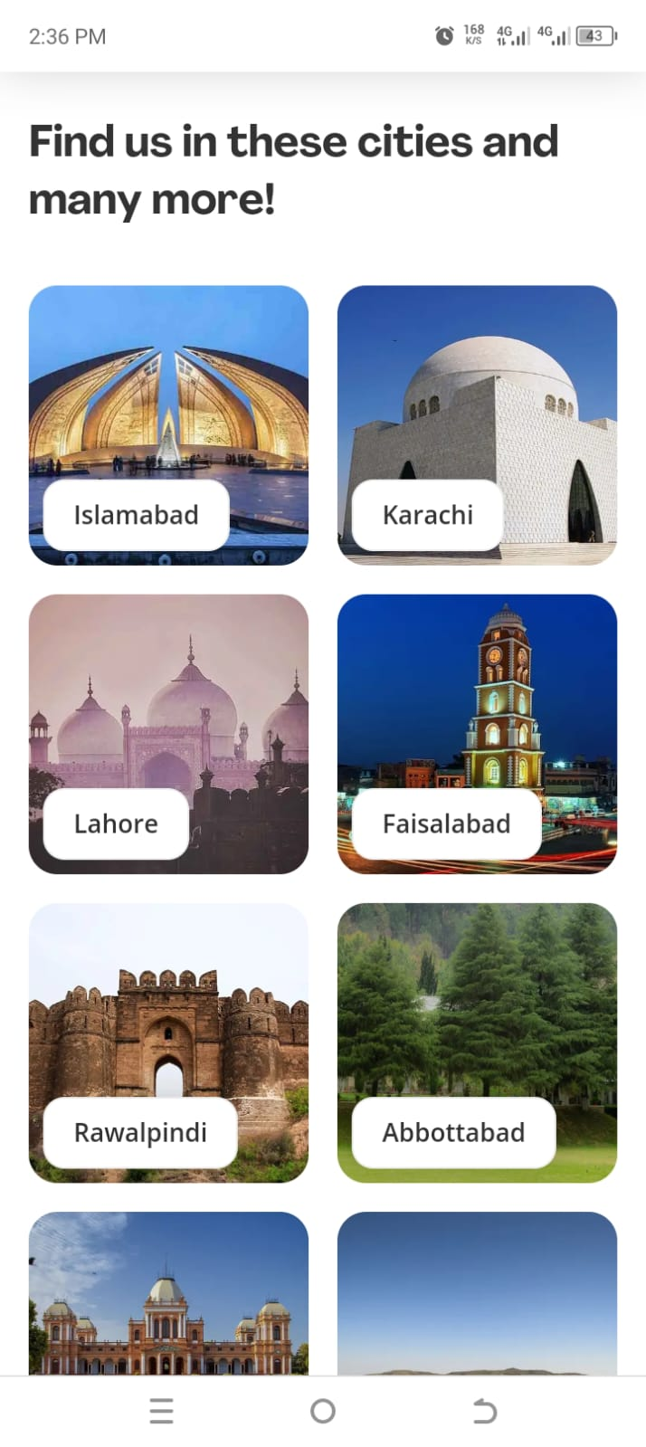
Foodpanda available in any city of Pakistan and its delivered food in any other city of Pakistan

Slide 11


