Slide 1
WELCOME TO MY
PRESENTATION
Name: Jannatul Mawa
Roll: 941451

Slide 2
Software Design Strategies
Software design is a process to conceptualize the software requirements into software implementation. Software design takes the user requirements as challenges and tries to find optimum solution. While the software is being conceptualized, a plan is chalked out to find the best possible design for implementing the intended solution.

Slide 3
Structure Design
Structured design is a conceptualization of problem into several well-organized elements of solution. It is basically concerned with the solution design. Benefit of structured design is, it gives better understanding of how the problem is being solved. Structured design also makes it simpler for designer to concentrate on the problem more accurately.

Slide 4
Function Oriented Design
In function-oriented design, the system is comprised of many smaller sub-systems known as functions. These functions are capable of performing significant task in the system. The system is considered as top view of all functions.
Function oriented design inherits some properties of structured design where divide and conquer methodology is used.

Slide 5
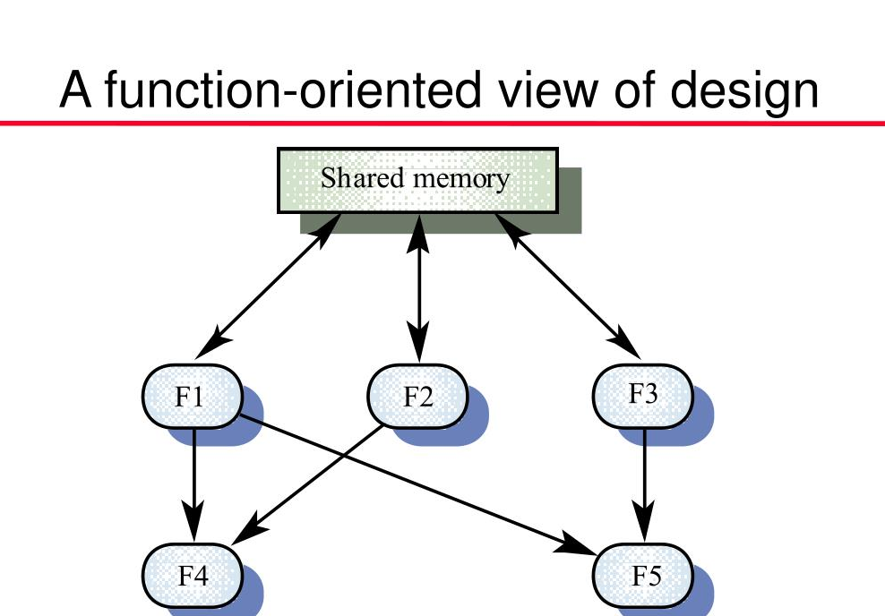

Slide 6
Object Oriented Design
Object oriented design works around the entities and their characteristics instead of functions involved in the software system. This design strategies focuses on entities and its characteristics. The whole concept of software solution revolves around the engaged entities.
Let us see the important concepts of Object Oriented Design:
Object.
Classes.
Inheritance
Polymorphism
Encapsulation

Slide 7
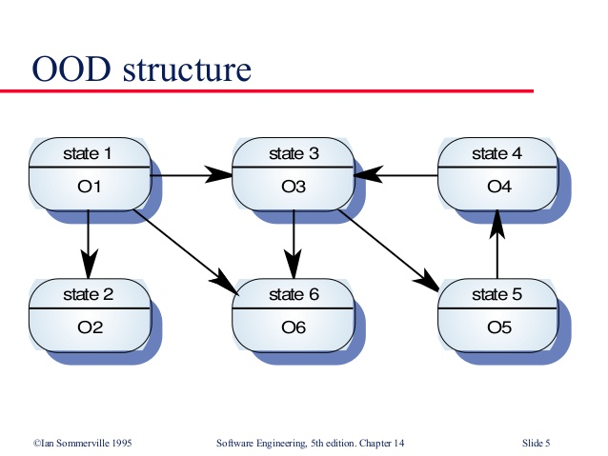

Slide 8
Software Design Patterns
Software design process can be perceived as series of well-defined steps. Though it varies according to design approach (function oriented or object oriented, yet It may have the following steps involved:
A solution design is created from requirement or previous used system and/or system sequence diagram.
Objects are identified and grouped into classes on behalf of similarity in attribute characteristics.
Class hierarchy and relation among them is defined.
Application framework is defined.

Slide 9
Software Design Approaches
Here are two generic approaches for software designing:
Top Down Design
We know that a system is composed of more than one sub-systems and it contains a number of components. Further, these sub-systems and components may have their on set of sub-system and components and creates hierarchical structure in the system.
Top-down design takes the whole software system as one entity and then decomposes it to achieve more than one sub-system or component based on some characteristics.

Slide 10
Bottom-up Design
The bottom up design model starts with most specific and basic components. It proceeds with composing higher level of components by using basic or lower level components. It keeps creating higher level components until the desired system is not evolved as one single component. With each higher level, the amount of abstraction is increased.
Bottom-up strategy is more suitable when a system needs to be created from some existing system, where the basic primitives can be used in the newer system.

Slide 11
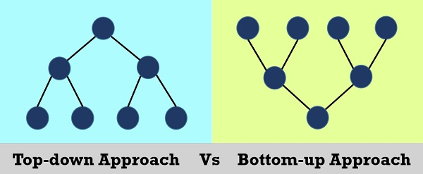

Slide 12
Thanks For Watching

