Slide 1
Sentiment & Emotion Analysis of Social-Media Comments on Elder Abuse
Bangla · Banglish · English — a deep-analysis NLP study
End-to-end pipeline complete — Phase 0 → 6 (data · models · deep analysis)
Lamia Islam Mim · CSE 499A (Capstone), North South University
Component added per supervisor brief: “the deeper the analysis, the better”

Slide 2
Objective & Why It Matters
• Goal: a publishable NLP system that classifies public comments on elder-abuse news/videos by sentiment AND fine-grained emotion.
• Why it matters:
– Elder abuse is rising in Bangladesh; public reaction reveals social attitudes — condemnation, sympathy, and (critically) victim-blaming.
– Most Bangla sentiment work is on product/movie reviews; emotion analysis on a real social-issue corpus is novel.
• Two research outputs:
– (1) A new annotated Bangla/Banglish elder-abuse emotion dataset (with a novel victim-blaming class).
– (2) Benchmarked models + a deep analysis of how reactions vary by abuse type, platform, and language.

Slide 3
The Pipeline — Phase 0 → 6
Every stage below is complete
Phase | What was done | Status
0 Cleaning | 2,454 → 2,301 comments, language-tagged | DONE
1 Annotation | 2-level labels (polarity + emotion) via a written guideline | DONE
1.5 EDA | 13 charts + 7 documented findings | DONE
2 Split | 1609 / 345 / 345, stratified, test sha256-locked | DONE
3 Modelling | TF-IDF+SVM baseline + fine-tuned BanglaBERT | DONE
4 Evaluation | held-out test set + McNemar significance | DONE
5 Deep analysis | language · embeddings · religion · explainability · errors | DONE
6 Paper assets | all tables + 21 figures assembled | DONE

Slide 4
The Dataset
Scraped YouTube + Facebook comments on elder-abuse videos
2,454
raw scraped
2,301
after cleaning
2,299
modelling set
• Cleaning removed 153 junk items: 118 textless/emoji-only, 13 spam, 13 duplicates, 9 too-short.
• Platforms: YouTube 1632 · Facebook 669.
• Video topic (context only, NOT the comment label): Neglect · Abandonment · Physical · Verbal · Murder.
• Handled up-front: scrape-time date (no temporal claims); abuse_type is video-level context; 84% of likes = 0; emoji & punctuation kept (they carry emotion).

Slide 5
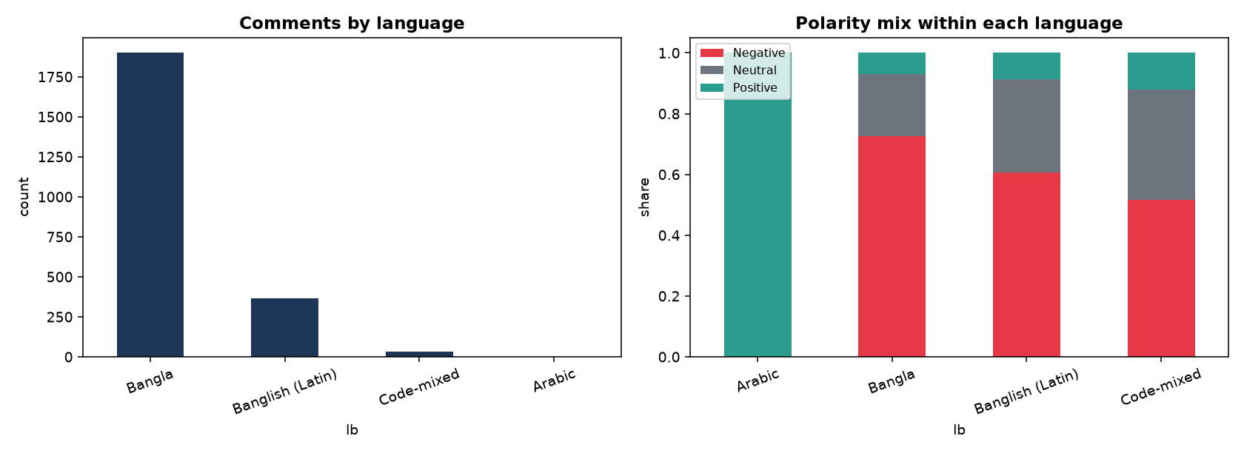
Language Composition
Detected by script (Unicode ranges) at cleaning time
• Bangla 1,899 — pure Bangla script.
• Banglish (Latin) 367 — Bangla written in English letters.
• Code-mixed 33 — Bangla + English in one comment.
• Arabic 2 — short religious phrases.
• ≈16% is Latin-script — this matters a lot for model choice (shown later).

Slide 6
Two-Level Label Scheme
• Level A — Polarity (3): Negative · Neutral · Positive (overall emotional valence).
• Level B — Fine-grained emotion (5):
– Anger/Condemnation — outrage, demand for justice/punishment.
– Victim-blaming — blaming the elder/family (the novel, high-value class).
– Grief/Sympathy — sorrow, empathy for the victim.
– Prayer/Religious — dua, blessings, religious framing.
– Neutral-Other — factual, procedural, off-topic.
• Every comment gets one polarity + one emotion. Test set is sha256-locked.

Slide 7
How Labels Were Assigned
A written codebook — not ad-hoc
• A formal annotation guideline defines each label with rules, examples, and tie-breaks.
• Key rules:
– Label the COMMENT text only — never the video's abuse_type (avoids topic bias).
– Religion is the language, not the label: dua for victim → Positive/Prayer; curse on abuser in God's name → Negative/Anger.
– Emoji are evidence: 😢 → grief, 😡 → anger. Sarcasm → intended meaning.
– Multiple emotions → pick the dominant one.
• Examples: “আল্লাহ জান্নাত দিক” → Positive · “কুলাঙ্গারের ফাঁসি হোক” → Negative/Anger · “ভিডিওটা কোথাকার?” → Neutral.

Slide 8
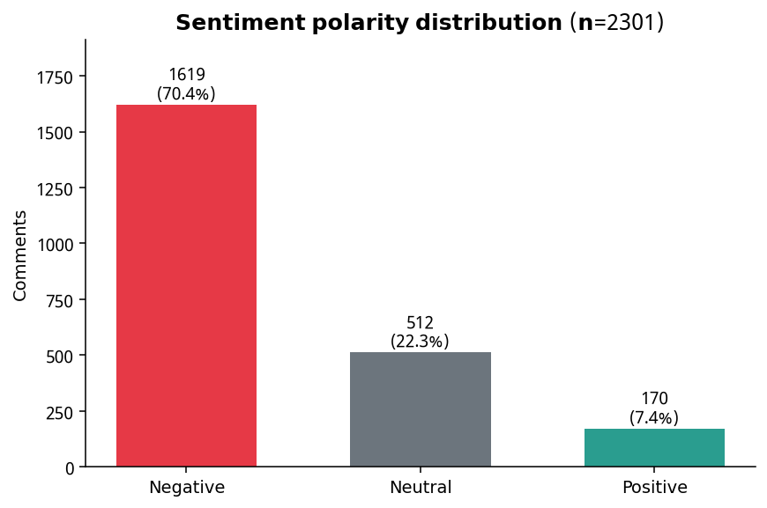
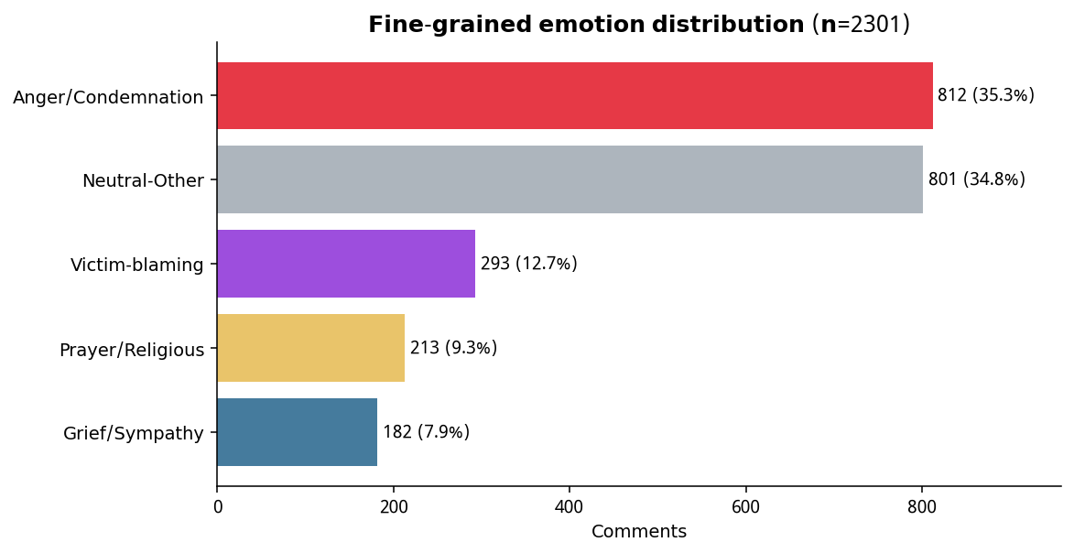
Result — Label Distributions
70% of reactions are Negative. Anger (~35%) and victim-blaming (~13.5%) dominate the emotion mix.

Slide 9
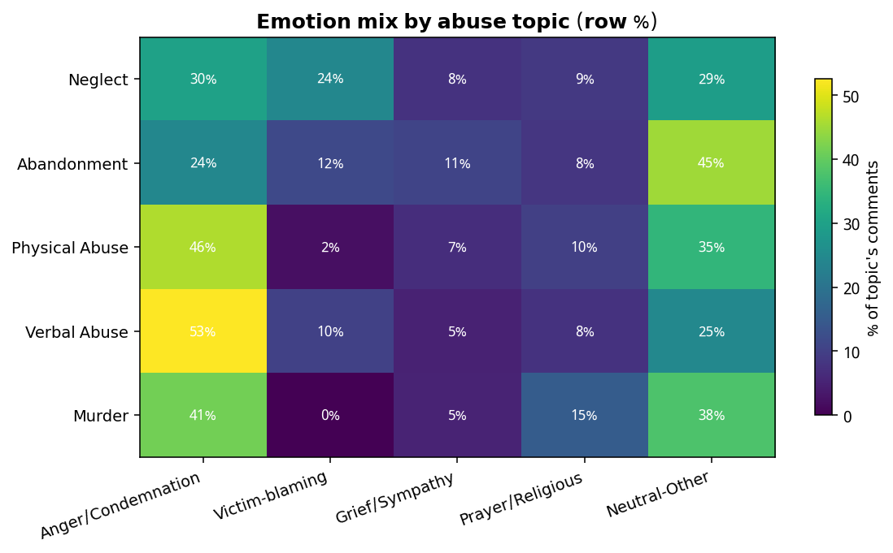
Key Finding 1 — Emotion Depends on Abuse Type
Anger peaks for Verbal/Physical abuse; prayer peaks for Murder; victim-blaming concentrates in Neglect/Abandonment.

Slide 10
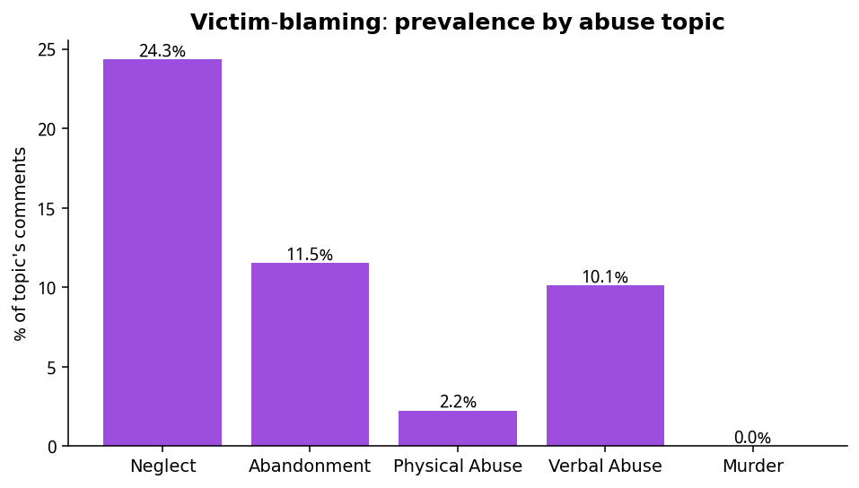
Key Finding 2 — Victim-Blaming is Topic-Specific
• 25.7% of Neglect comments blame the victim/family…
• …but 2.2% for Physical and 0% for Murder.
• When elders are abandoned (often educated/wealthy parents), a vocal minority blames them (“bad upbringing”, “haram money”).
• When harm is undeniable violence, the public unites in condemnation.
• Victim-blaming comments are also the LONGEST — they argue and justify.

Slide 11
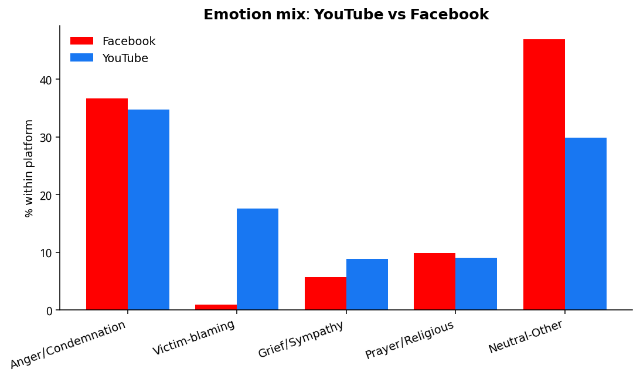
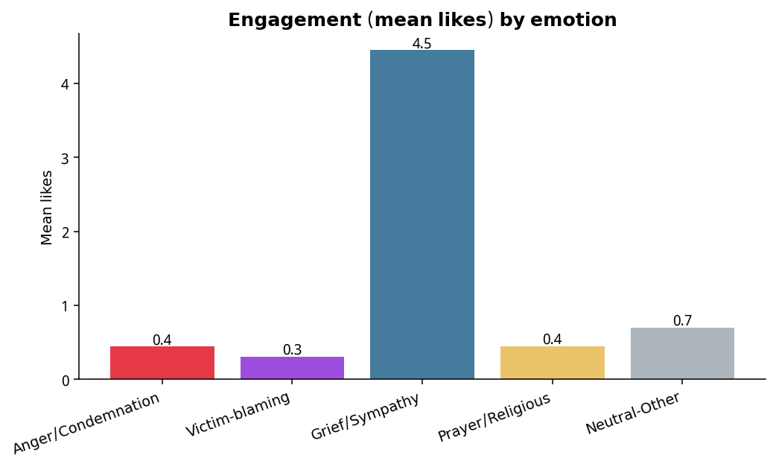
Key Findings 3 & 4 — Platform and Engagement
Victim-blaming is 18.6% on YouTube vs 0.9% on Facebook. Grief/Sympathy earns ~10× more likes than anger.

Slide 12
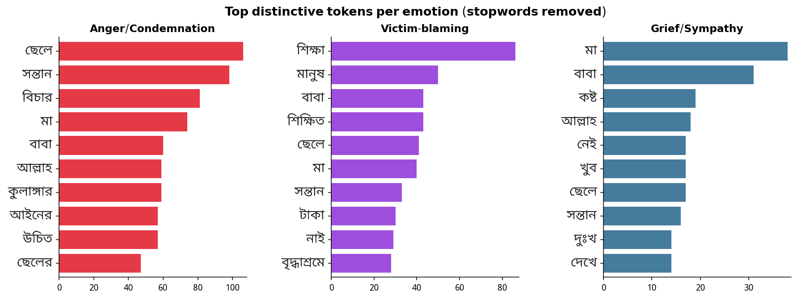
Key Finding 5 — Clean Lexical Separation
Distinctive words per emotion are sharply different (justice/wretch vs education/old-age-home vs pain/sorrow) — supports the 5-class scheme.

Slide 13
Phase 2 — Dataset Split
Zero-leakage, imbalance-aware
1,609
train
345
validation
345
test (locked)
• Text-dedup BEFORE splitting → no leakage across sets.
• Stratified 70/15/15 by polarity (seed 42) → same class ratios in every split.
• Test set sha256-locked and touched exactly once (final evaluation only).
• Primary metric = macro-F1 — averages classes equally, so the rare Positive/Neutral classes count as much as the dominant Negative.

Slide 14
Phase 3 — Modelling Approach
Why each choice
• Baseline — TF-IDF + Linear SVM:
– Word n-grams (1–2) + character n-grams (3–5). Char n-grams absorb Bangla spelling variation AND romanized Banglish.
– Class-weighted to handle the Negative-heavy imbalance.
• Transformer — BanglaBERT (sagorsarker/bangla-bert-base):
– Fine-tuned with class-weighted loss; best validation checkpoint kept.
– Tuned: 5 epochs, warmup, weight-decay.
• Fit on TRAIN only; selected on VALIDATION; TEST stays locked → honest generalisation.

Slide 15
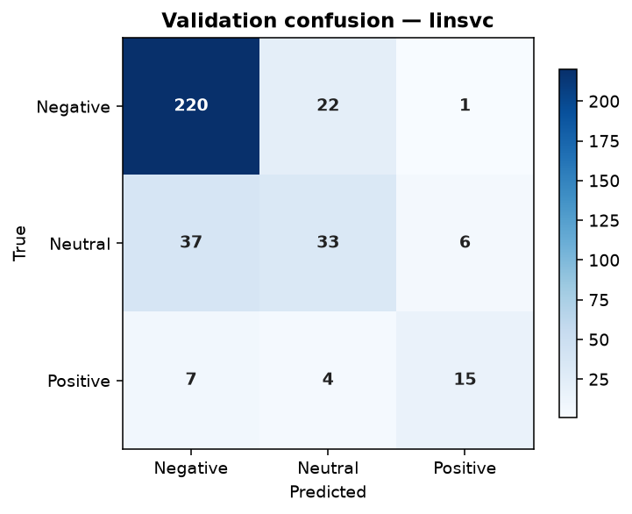
Phase 3 — Validation Results
Model | macro-F1 | accuracy
Logistic Regression | 0.653 | 0.759
Linear SVM ★ best | 0.661 | 0.777
Complement NB | 0.487 | 0.704
BanglaBERT (tuned) | 0.579 | 0.713
• Negative detected very well (F1 0.86).
• Neutral is the hard class (fuzzy middle).
• SVM leads on validation.

Slide 16
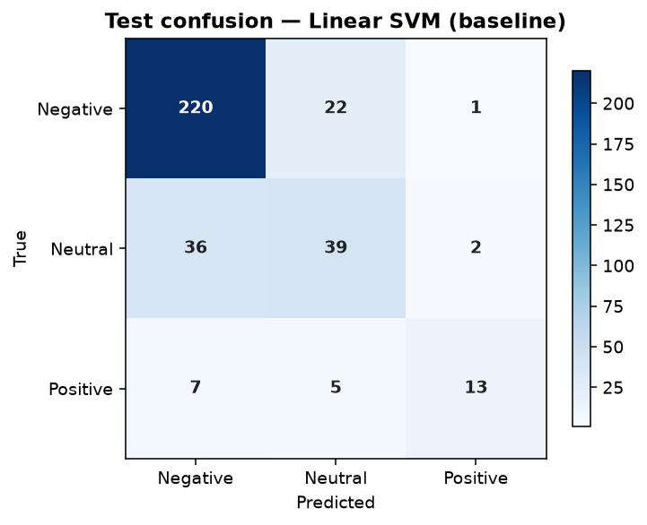
Phase 4 — Final Test-Set Evaluation
Locked test set, touched once
Model | test macro-F1 | test acc | weighted-F1
Linear SVM ★ | 0.683 | 0.788 | 0.780
BanglaBERT (tuned) | 0.611 | 0.728 | 0.718
• Both generalise well — test ≥ validation (no overfitting).
• McNemar p = 0.026 → the gap is statistically significant; the Linear SVM outperforms BanglaBERT.
• Linear SVM is the practical choice: simpler, faster, no GPU.

Slide 17
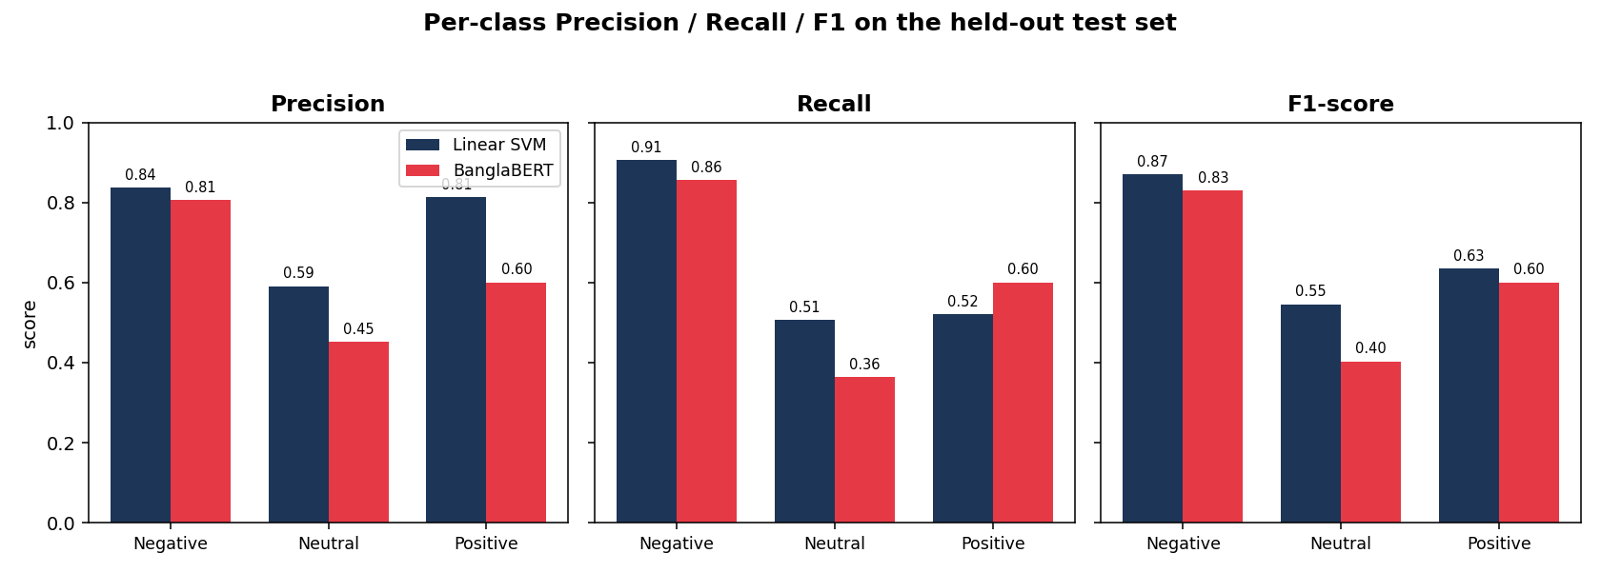
Per-Class Precision / Recall / F1
Held-out test — where each model wins
Both models are strong on Negative; Neutral is the hard middle. The SVM is more balanced on the rare Positive/Neutral classes, which lifts its macro-F1.

Slide 18
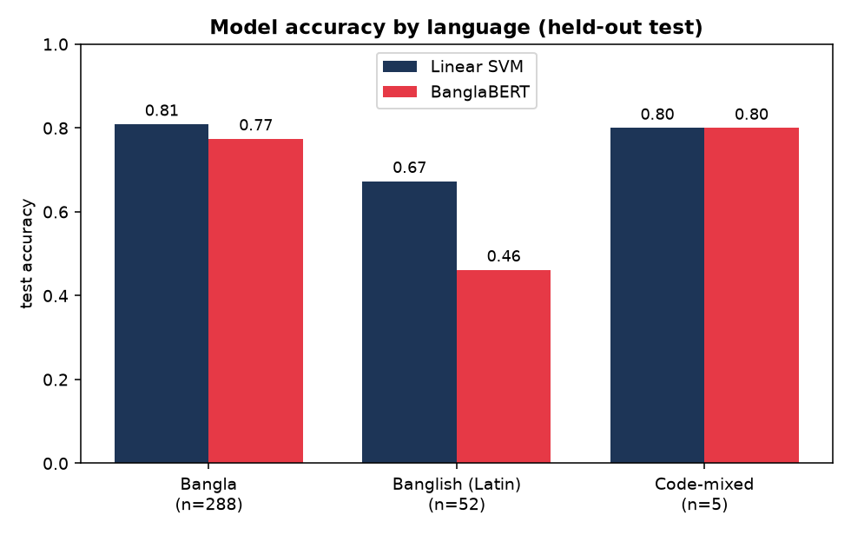
Phase 5 — Why the Baseline Wins: Language Robustness
• On held-out test, by language:
– Bangla — SVM 0.81 · BanglaBERT 0.77
– Banglish (Latin) — SVM 0.67 · BanglaBERT 0.46 ← collapses
• BanglaBERT was pre-trained on Bangla SCRIPT — it can't read romanized Banglish.
• The char-ngram SVM stays robust. Since ~16% of the corpus is Latin-script, this largely explains why the baseline wins overall.

Slide 19
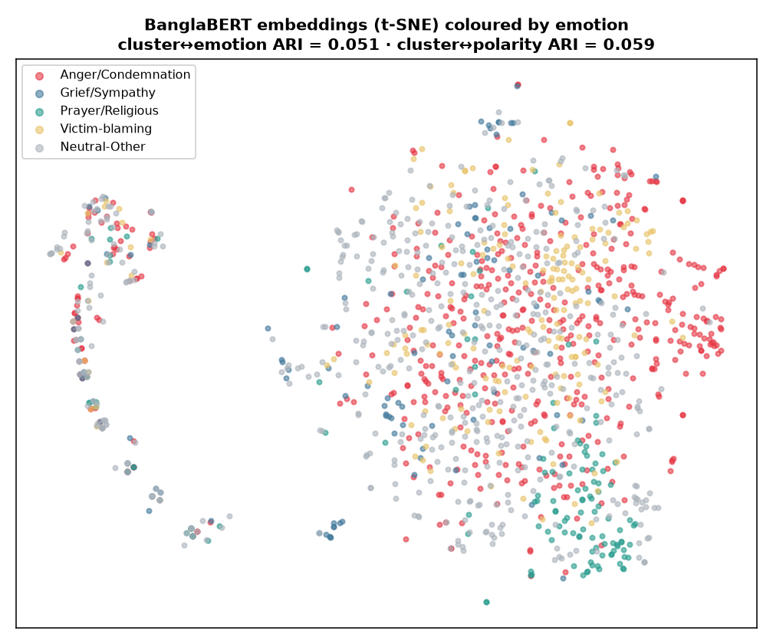
Phase 5 — Embedding Structure
• BanglaBERT sentence embeddings → KMeans vs human labels (Adjusted Rand Index):
– cluster ↔ emotion: ARI = 0.051
– cluster ↔ polarity: ARI = 0.059
• Low ARI ⇒ emotion classes OVERLAP in embedding space (semantic, not lexically separable) ⇒ supervised labels are genuinely needed.
• The detached blob (left) is Latin-script text — grouped by script, not emotion.

Slide 20
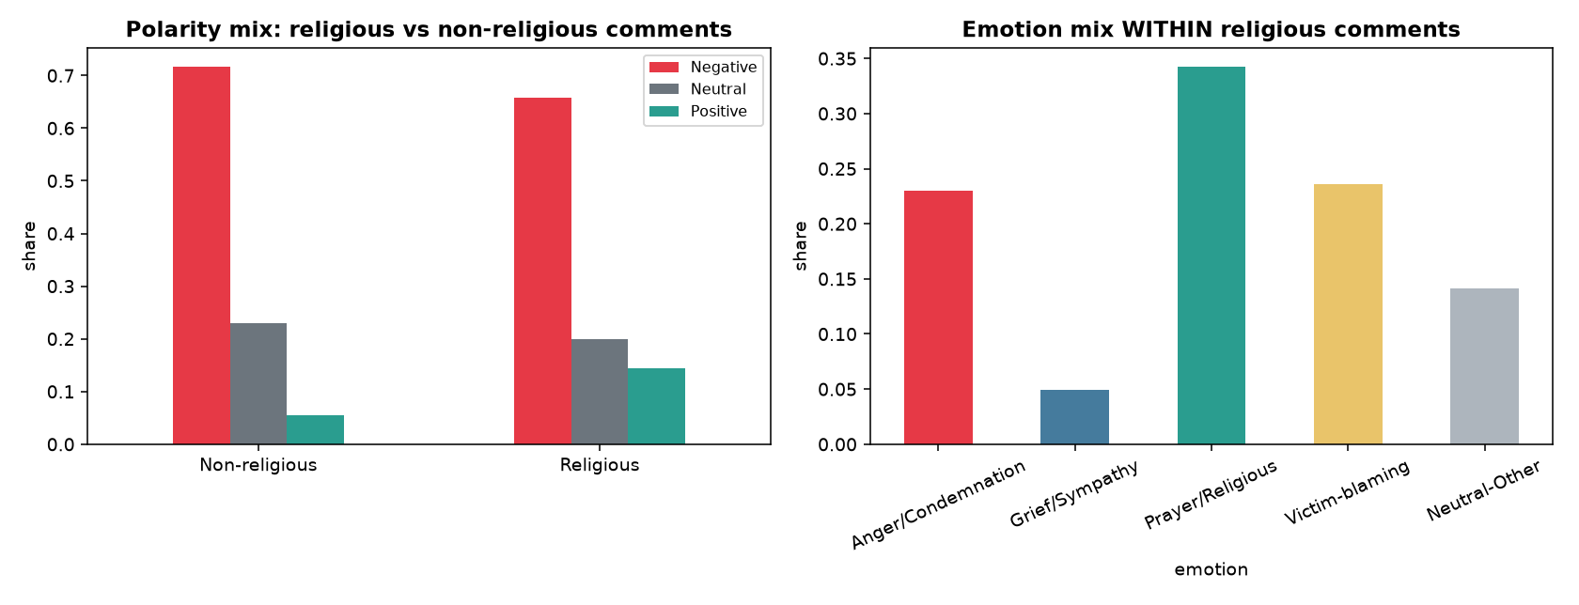
Phase 5 — Religious Framing
• 22% of all comments use religious language.
• Within religious comments:
– Prayer/Religious 34% (blessing)
– Victim-blaming 24% · Anger 23% (blame)
• Religion is the vehicle of BOTH blessing and condemnation — it skews comments slightly more Positive (dua) than non-religious ones.

Slide 21
Phase 5 — Explainability & Error Analysis
• Transparent — top Linear-SVM word features per class (no black box):
– Negative: ai · বিচার · এমন · শিক্ষিত · অবস্থা · o · মহিলা
– Neutral: করা উচিত · মা বাবা · ভাবে · দাও · করতে হবে · baber · হতে পারে
– Positive: ভিডিও · আল্লাহ সবাইকে · আমার বাবা · good · ধন্যবাদ · সহায় · ভালো (incl. English ‘thank’, Arabic الله)
• Errors (test):
– Hardest boundary = Neutral ↔ Negative (the fuzzy middle) for both models.
– BanglaBERT error 0.51 on Latin/code-mixed and 0.43 on emoji comments vs ~0.23 otherwise — the SVM is stable across both.

Slide 22
Error Analysis — Hardest Cases (both models wrong)
true | SVM | BERT | comment
Neutral | Negative | Negative | Ai Milton shomdder keo koto bitorko korselo.jara Val…
Neutral | Negative | Negative | উনাকে বৃদ্ধা আশ্রমে তো দিতে পারে, সাংবাদিক ভাইরা চা…
Positive | Neutral | Negative | নাদিরা বেগম কি বেঁচে আছেন? She seems very lonely an…
Neutral | Negative | Negative | ৩১ বছর আগে তো উনি বুড়া ছিলেন না
Neutral | Negative | Negative | আপনি কলেজে শিক্ষক আপনার সন্তানদের মানুষ করতে যে পরিম…
Neutral | Negative | Negative | এমন দুর্দশা থেকে মুক্ত করতেই কুরআনের আগমন। আপনারা আধ…
• Nearly all hard cases sit on the Neutral ↔ Negative boundary.
• Common types: rhetorical questions, mixed sentiment, sarcasm, and code-switched text.
• These are genuinely ambiguous — even human annotators would disagree, which sets a realistic ceiling on accuracy.

Slide 23
Statistical Validation
Findings are not chance — Chi-square / Fisher's exact
Association | p-value | Cramér's V | significant?
emotion × abuse-type | 2.8e-47 | 0.17 | YES
polarity × abuse-type | 4.9e-14 | 0.132 | YES
emotion × platform | 1.7e-31 | 0.256 | YES
polarity × platform | 1.2e-01 | 0.043 | no
polarity × language | 1.8e-05 | 0.077 | YES
• Fisher's exact — victim-blaming × Neglect/Abandonment: odds ratio 4.87, p = 3.9e-25 → victim-blaming is ~5× more likely in neglect topics.
• Emotion↔topic, emotion↔platform and victim-blaming↔topic are all statistically significant.
• Note (fair nuance): overall polarity↔platform is NOT significant — the platform effect is on fine-grained emotion, not coarse polarity.

Slide 24
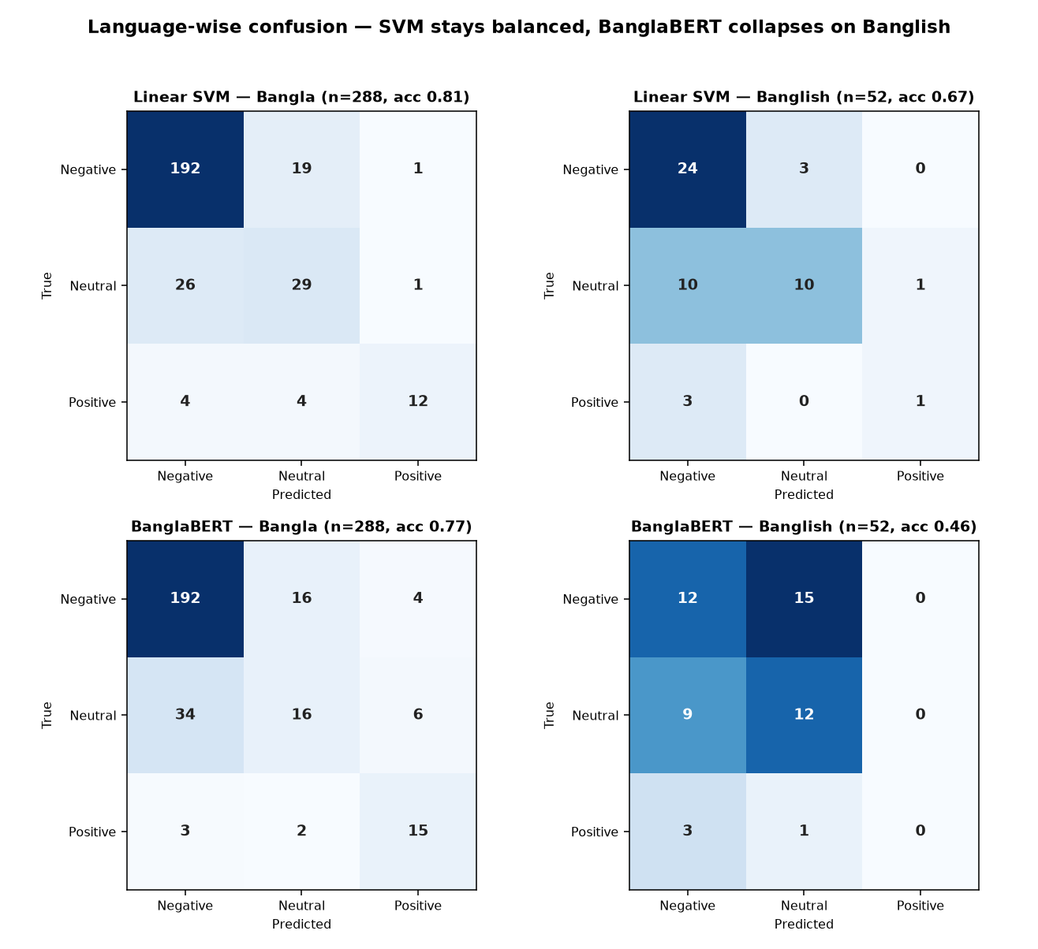
Language-Wise Confusion — Seeing BanglaBERT Fail
SVM keeps a balanced diagonal on both scripts; BanglaBERT collapses on Banglish (never predicts Positive, scatters to Neutral) — the language finding, made visual.

Slide 25
Key Findings & Contributions
✔ New annotated Bangla/Banglish elder-abuse dataset with a novel victim-blaming class.
✔ 70% of reactions Negative; victim-blaming is topic-specific (high in Neglect, 0% in Murder).
✔ Platform effect: victim-blaming 18.6% on YouTube vs 0.9% on Facebook.
✔ Classical SVM beats fine-tuned BanglaBERT on test (0.68 vs 0.61, McNemar p=0.026).
✔ Explained WHY: BanglaBERT can't read Latin-script Banglish (err 0.51) or emoji (err 0.43); the char-ngram SVM is robust to both.
✔ Religion frames both blessing and condemnation (22% of comments).
✔ All key associations are statistically significant (Chi-square / Fisher's; victim-blaming odds ratio ≈ 4.9 in neglect topics).

Slide 26
Limitations
Stated honestly
• Labels are model-generated (silver) following a codebook; human inter-annotator (Kappa) validation is planned but not yet complete.
• Small & imbalanced (2,301 comments; ~70% Negative) — caps rare-class performance and transformer fine-tuning.
• Narrow domain — YouTube/Facebook elder-abuse comments; may not transfer to other topics.
• Fine-grained emotion is subjective at the boundary (victim-blaming vs anger vs neutral).
• Point-in-time scrape (no temporal analysis); abuse_type is video-level context, not a per-comment label.
• BanglaBERT under-reads Latin-script Banglish and emoji — transformer results are a lower bound for code-switched text.

Slide 27
Ethics Statement
• Only publicly-posted comments are used — no private data.
• Analysis is aggregate: we report patterns, never profile or expose individual commenters; names are not analysed or published.
• Elder abuse and its victims are treated with care — no attempt to re-identify anyone.
• The victim-blaming class is studied to understand and surface a harmful attitude — not to endorse it.
• Offensive comments are used solely for research and shown only as de-identified examples.
• Data collected in line with each platform's public-content terms; no user was contacted.

