Slide 1
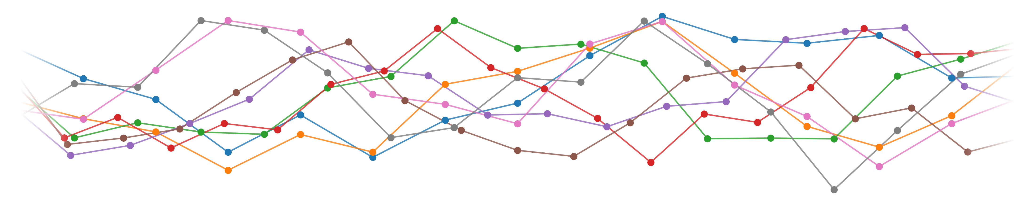
Applied Machine Learning
Titanic – Machine Learning from Disaster
Janne Berger, Rebekka Füllemann, Delia Schüpbach

Slide 2
Content
Project Goal
Exploratory Data Analysis
Data Cleaning / Preprocessing
Model Building
Results
Applied Machine Learning
01.11.2022

Slide 3
Project Goal
Join the competition on Kaggle
Build a predictive model
What sorts of people were more likely to survive?
Using passenger data (i.e. name, age, gender etc)
01.11.2022

Slide 4
Exploratory Data Analysis
The data consists of 10 features, 891 samples
Numerical | Categorical | Other
Age | Survived | Name
SibSp (Siblings and Spouses) | Pclass | Ticket
Parch (Parents and Children) | Sex
Fare | Cabin
 | Embarked
01.11.2022

Slide 5
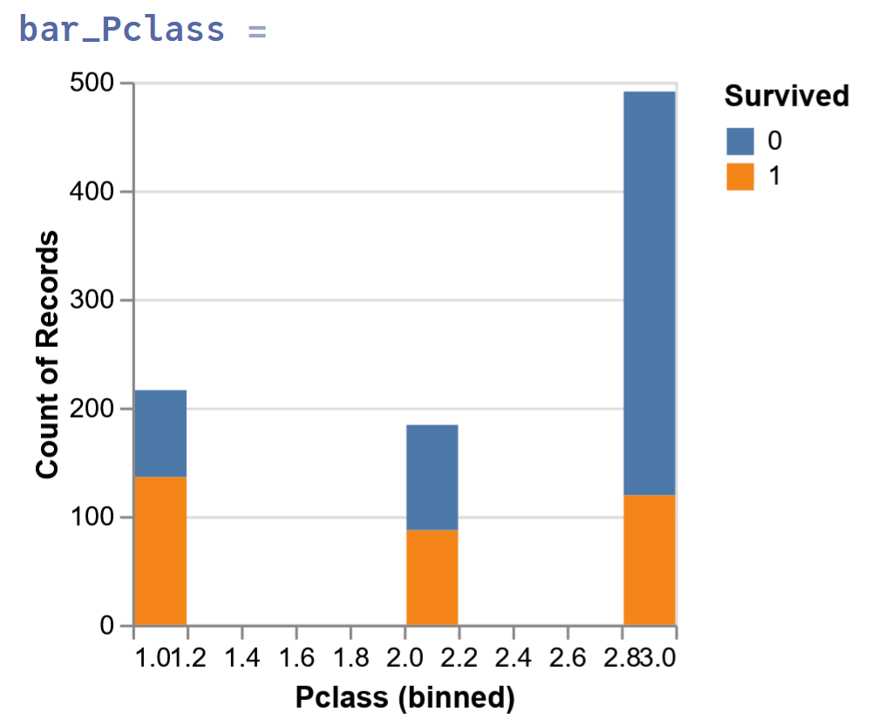
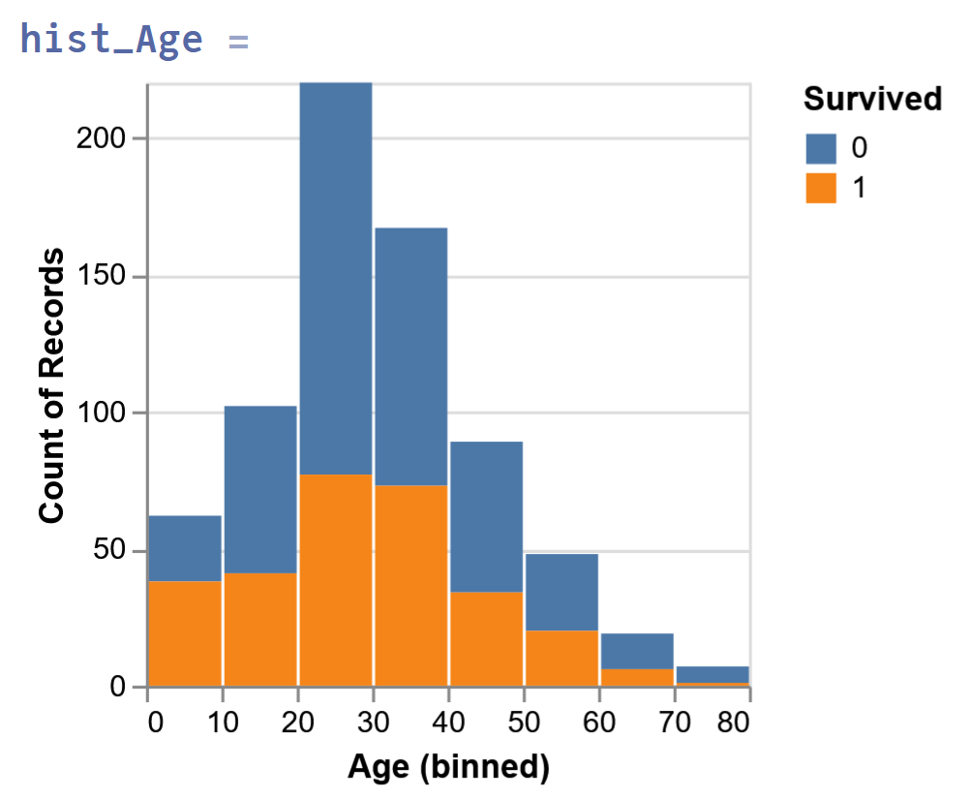
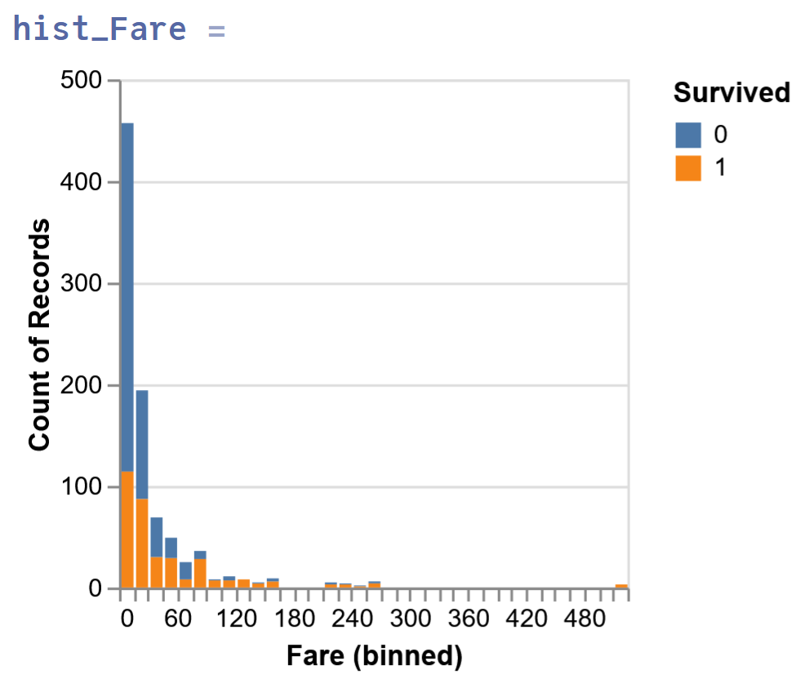
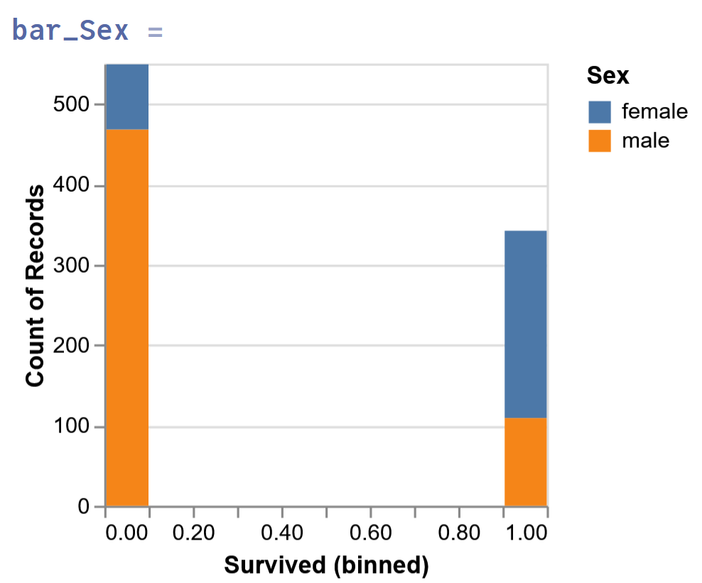
Exploratory Data Analysis
01.11.2022

Slide 6
Data Cleaning
Dealing with missing values:
Age: 177 missing -> replace with mean +/- sd
Cabin: 687 missing -> don’t use Cabine as feature
Embarked: 2 missing -> drop them
Fare: if missing -> replace with mean from class
Feature Selection:
Pclass, Sex, Age, SibSp and Parch (Relatives), Fare, Embarked
01.11.2022

Slide 7
Data Cleaning
Genauere function für data cleaning? (encoding)
… (in vorherigen Folie bei Feature selection sagen)
01.11.2022

Slide 8
Model Building
Linear Regression
Ridge Regression
LASSO Regression
Logistic Regression
K Nearest Neighbor
Decision Tree
Random Forest
Naive Bayes
Accuracy around 14%
01.11.2022

Slide 9
Model Building
Model | Accuracy (approx.)
Logistic Regression | 70%
K Nearest Neighbor | 54%
Decision Tree | 60%
Random Forest | 67%
Naive Bayes | 66%
01.11.2022

Slide 10
Voting Classifier
Voting Classifier soft around 68%
Voting Classifier hard around 69%
01.11.2022

Slide 11
Results
TEXT
TEXT
01.11.2022

Slide 12
TITLE
TEXT
TEXT
01.11.2022

Slide 13



TITLE
TEXT
TEXT
01.11.2022

Slide 14
TITLE
TEXT
TEXT
01.11.2022

Slide 15
TITLE
TEXT
TEXT
01.11.2022

Slide 16
TITLE
TEXT
TEXT
01.11.2022

Slide 17
TITLE
TEXT
TEXT
01.11.2022

Slide 18
Discussion

