Slide 1
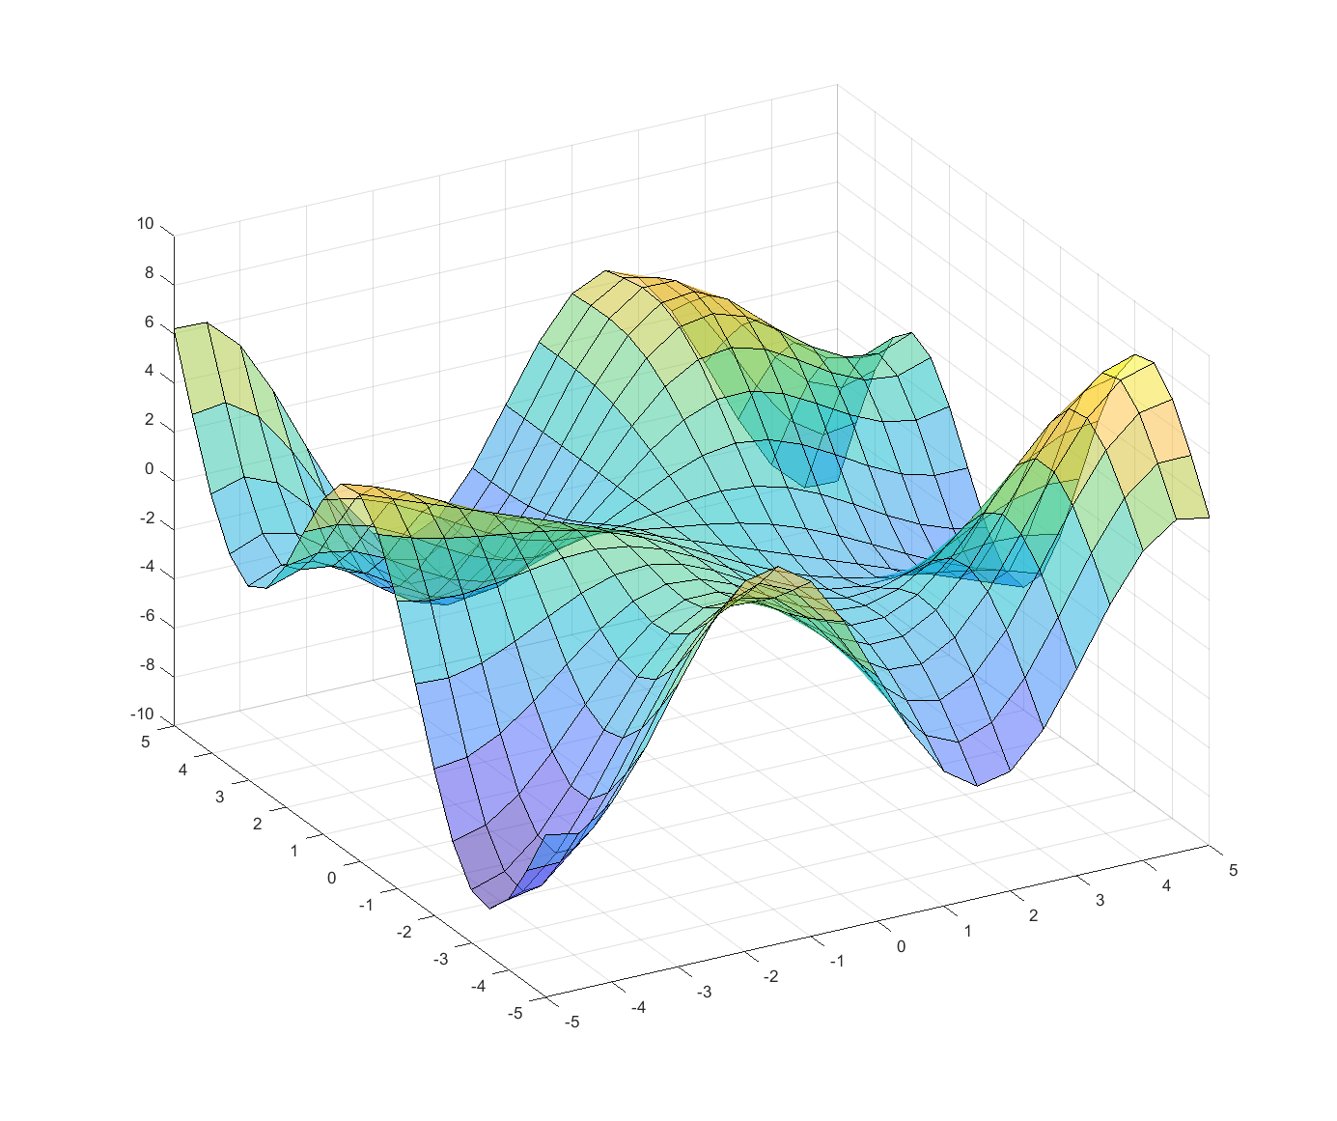

Pyhon
Linear Regression
Jannik Wiessler, Daimler Truck AG
Q3 2022
DHBW Lörrach

Slide 2
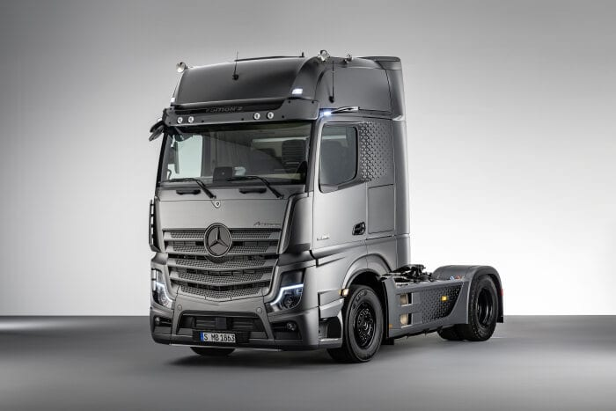
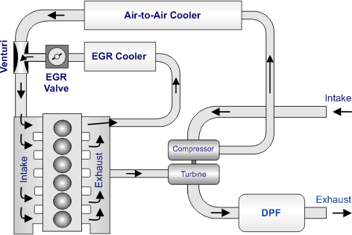
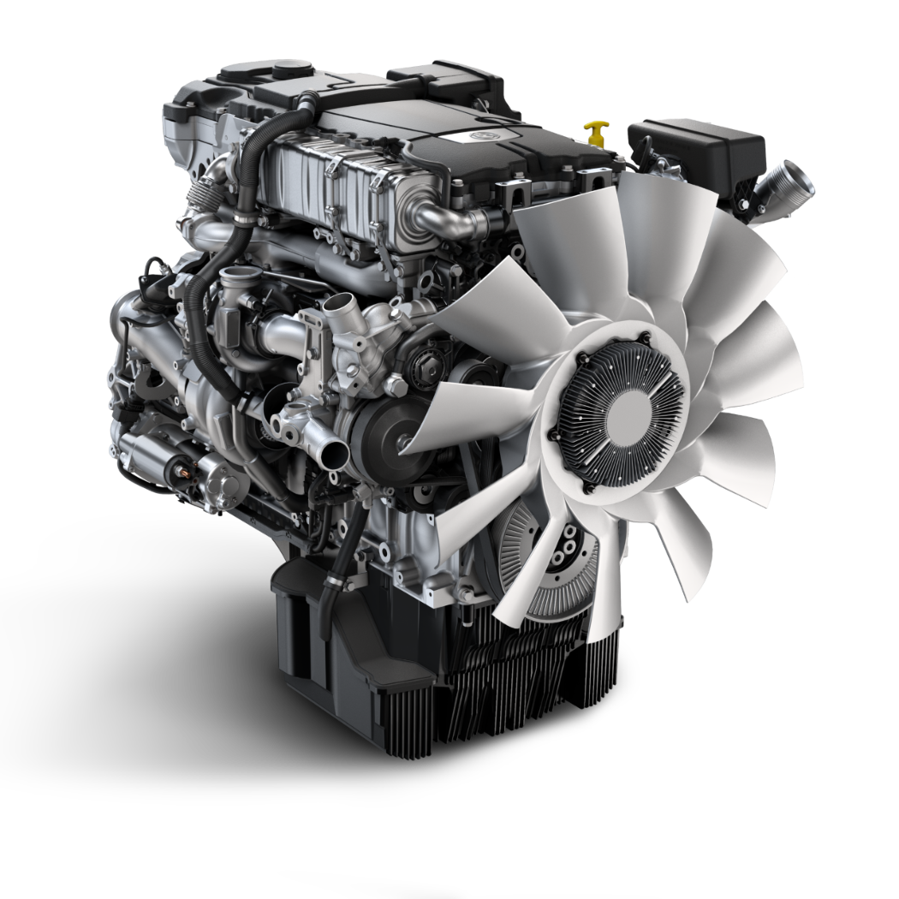
Use Case
Overview
Gradient descent
Linear Regression
https://dieselnet.com/tech/engine_egr.php
T3
T4
Jannik Wiessler | Python (Lineare Regression)
1

Slide 3
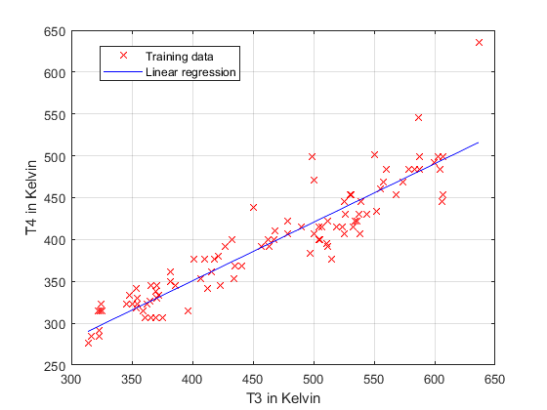

Use Case
Overview
Gradient descent
Linear Regression
$$h_{θ}=θ_{0}+θ_{1}x$$
Univariante lineare Regression
x: T3
y: T4
365.99
354.37
370.49
370.69
…
345.41
322.32
345.41
330.02
…
m = 98 samples
Jannik Wiessler | Python (Lineare Regression)
1

Slide 4


Use Case
Overview
Gradient descent
Linear Regression
$$h_{θ}=θ_{0}+θ_{1}x$$
Univariante lineare Regression
x: T3
y: T4
365.99
354.37
370.49
370.69
…
345.41
322.32
345.41
330.02
…
m = 98 samples
$$\min_{θ_{0},θ_{1}}{\frac{1}{2m} \sum_{i=1}^{m}{{\left(h_{θ}\left(x_{i}\right)−y_{i}\right)}^{2}}=\min_{θ_{0},θ_{1}} J }$$
$$J(θ_{0},θ_{1})$$
cost function
squared error function
Jannik Wiessler | Python (Lineare Regression)
1

Slide 5
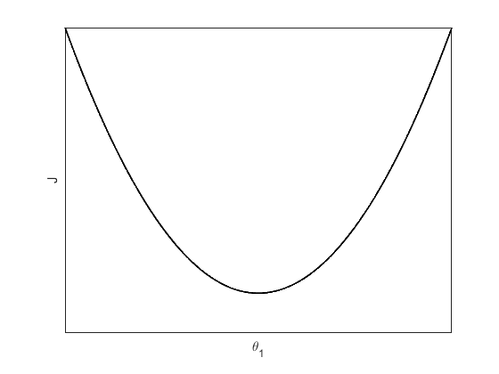




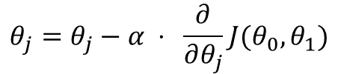
Use Case
Overview
Gradient descent
Linear Regression
$$θ_{j}=θ_{j}−α ⋅ \frac{∂}{∂θ_{j}}J(θ_{0},θ_{1})$$
learning rate
derivative
+
$$θ_{1}=θ_{1}−α ⋅ \frac{∂}{∂θ_{1}}J\left(θ_{0},θ_{1}\right) → decrease θ_{1}$$
$$θ_{1}$$
$$θ_{1}$$
-
$$θ_{1}=θ_{1}−α ⋅ \frac{∂}{∂θ_{1}}J\left(θ_{0},θ_{1}\right) → increase θ_{1}$$
Jannik Wiessler | Python (Lineare Regression)
1

Slide 6


Use Case
Overview
Gradient descent
Linear Regression
$$θ_{j}=θ_{j}−α ⋅ \frac{∂}{∂θ_{j}}J(θ_{0},θ_{1})$$
start
learning rate
derivative
$$α$$
too small: algorithm to slow
start
$$α$$
too large: algorithm diverge
Jannik Wiessler | Python (Lineare Regression)
1

