Slide 1

Municipality Motor Vehicle System
A Modern 3-Tier Web Application for Urban Vehicle Registry and Traffic Enforcement
ACADEMIC PROJECT
Project Overview
System Focus Areas
This presentation introduces the Municipality Motor Vehicle System, a fully architected 3-tier web application designed to modernize urban vehicle registration and streamline traffic enforcement operations for municipal governments.
Built with a focus on scalability, maintainability, and real-world applicability, the system demonstrates core principles of modern software architecture applied to a civic technology context.
Urban Vehicle Registry Management
Traffic Enforcement Workflows
3-Tier Web Architecture Design
Scalable Municipal Infrastructure
Course
Affiliation
Date
Software Architectures & Methodologies (SWAM)
University of Florence — Master's Degree in Computer Science
February 2026
Essa Janneh
Syed Umair Anwar
Co-Author & Presenter
University of Florence
Co-Author & Presenter
University of Florence

Slide 2
Context & Problem Statement
Municipal vehicle management systems face critical structural challenges that hinder effective urban governance and traffic enforcement.
The Legacy Challenge
Enforcement Blindspots
Fragmented, paper-reliant, or outdated local municipal vehicle records and static parking oversight leave cities unable to respond dynamically to modern demands.
Traffic officers lack immediate, real-time channels to verify zone-specific parking permissions on-site, reducing enforcement accuracy and efficiency.
Data Silos
The Goal
Lack of automated data consistency between a citizen's residential area, their active vehicle inventory, and historic traffic citations creates operational gaps.
A secure, scalable, and responsive web platform utilizing enterprise architecture patterns to streamline municipal management end-to-end.

Slide 3
Target Stakeholders & User Personas
The system is designed around three distinct user roles, each with tailored capabilities and access levels.
The Citizen
Law Enforcement Officer
Can register personal vehicles, request and purchase parking passes aligned with specific municipal zones, and self-review violation history.
Operates in the field to check license plate validity instantly and issue electronic citations linked to precise geographical zones.
System Administrator
Oversees master data configurations (Districts, Zones) and extracts multi-district operational analytics for governance reporting.

Slide 4
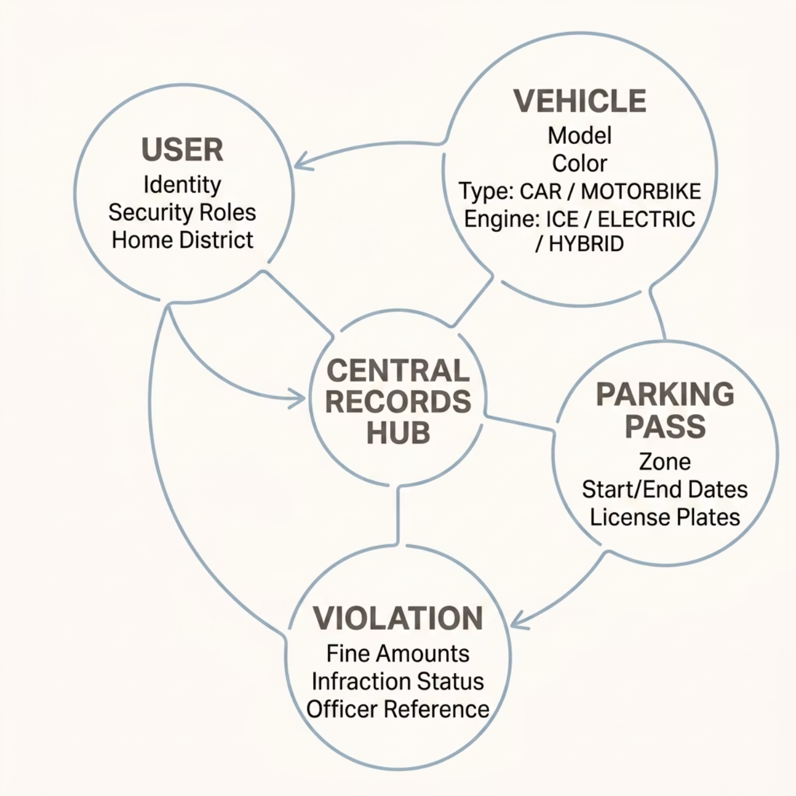
Domain Model & Conceptual Design
The system is built around four core entities forming a coherent object-relational structure that captures all aspects of municipal vehicle management.
1
2
User
Vehicle
Standard identity fields, assigned security roles, and an explicit association to a home District.
Model, color, VehicleType enum (CAR, MOTORBIKE), and EngineType enum (ICE, ELECTRIC, HYBRID) for environmental auditing.
3
4
ParkingPass
Violation
Defines spatial restrictions (Zone) and temporal validity (start/end dates) linked to allowed license plates.
Tracks fine amounts, infraction status, and references the specific officer who generated the data.

Slide 5
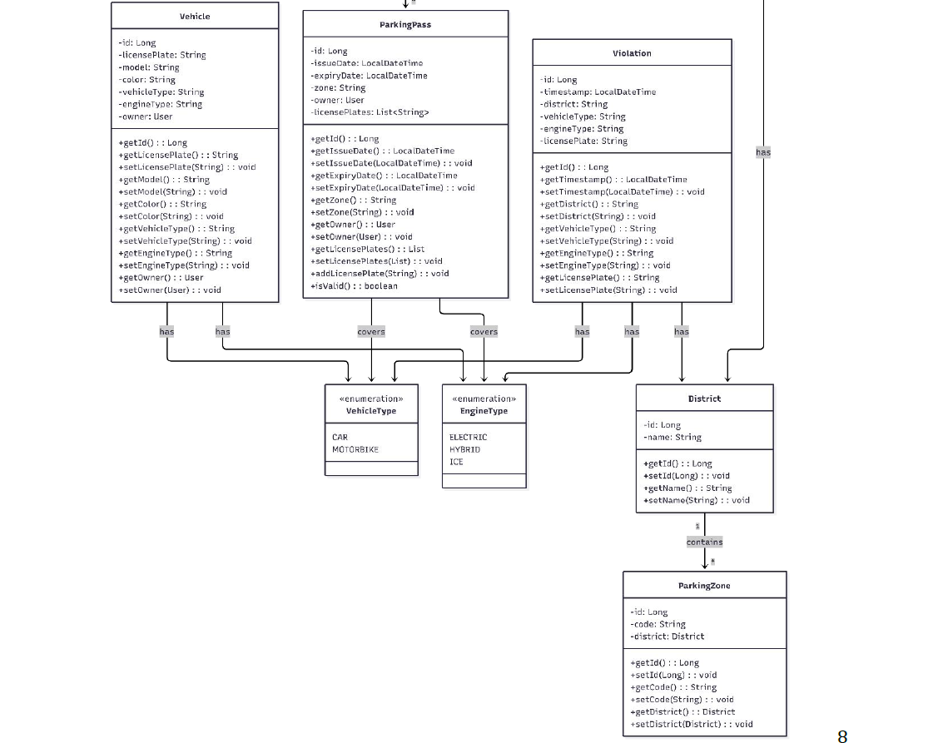
UML Class Diagrams — Domain Model Overview
This diagram holds the primary entities of the system. Vehicles holds license plate, model, color and engine type data. Parking pass tracke issue/expiry data, owner, zone and a list of license plates. Violation records timestamp, district, vehicle type, engine type and license plate

Slide 6
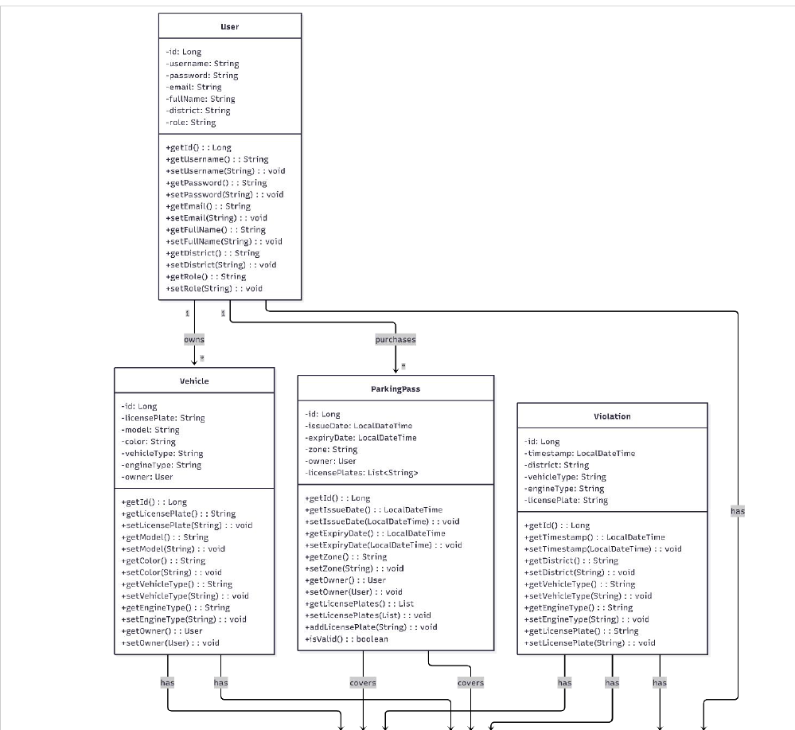
UML Class Diagrams — Domain Model Overview
This diagram introduces user entity which owns vehicles and purchases parking pass. User attributes username, password, email, fullname,district role and zone

Slide 7
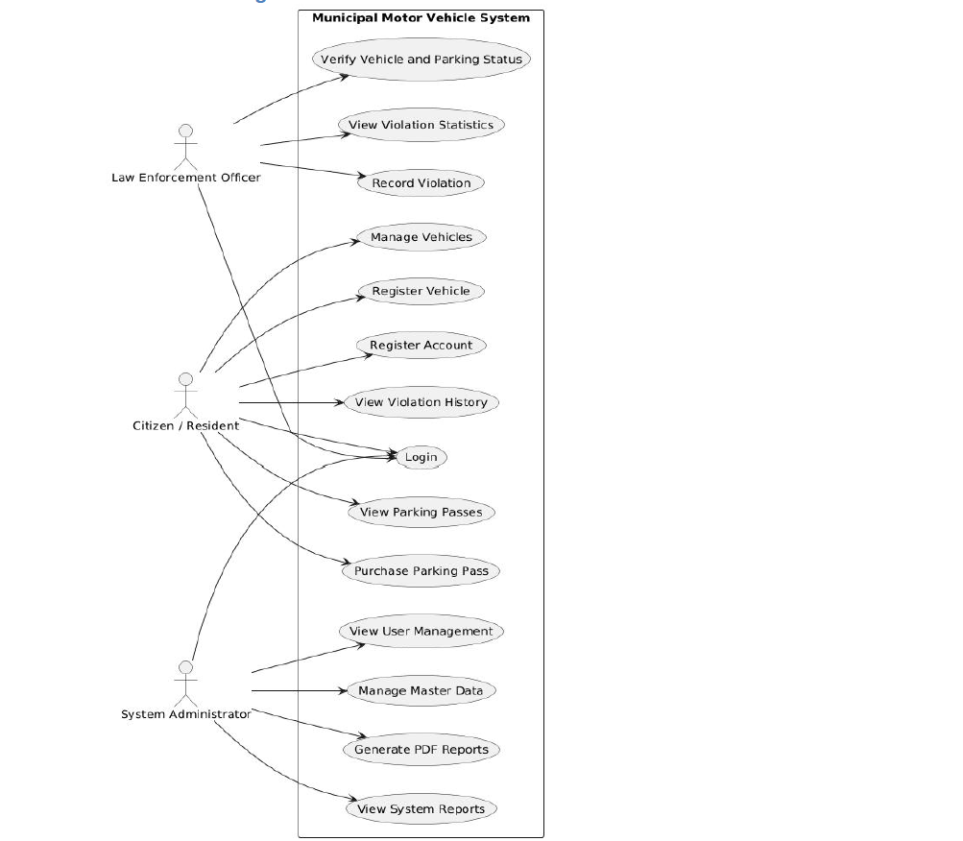
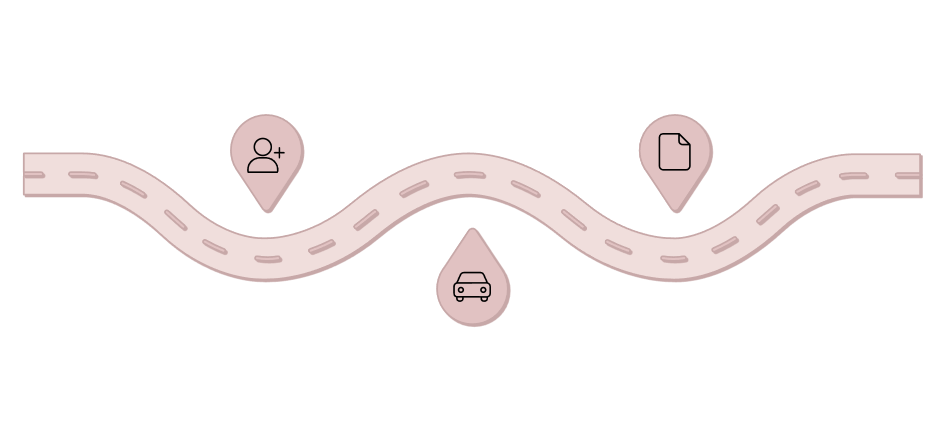
Use Case Analysis
The system defines three primary use cases that cover the full lifecycle of municipal vehicle management — from citizen onboarding to enforcement reporting.
User Registration
Record Violation
Create account and verify identity
Log infraction and generate report
Register Vehicle
Add vehicle and buy parking pass
Each use case maps to a distinct set of REST API endpoints and is scoped to specific authorized actors, ensuring role-based access control throughout the system.

Slide 8
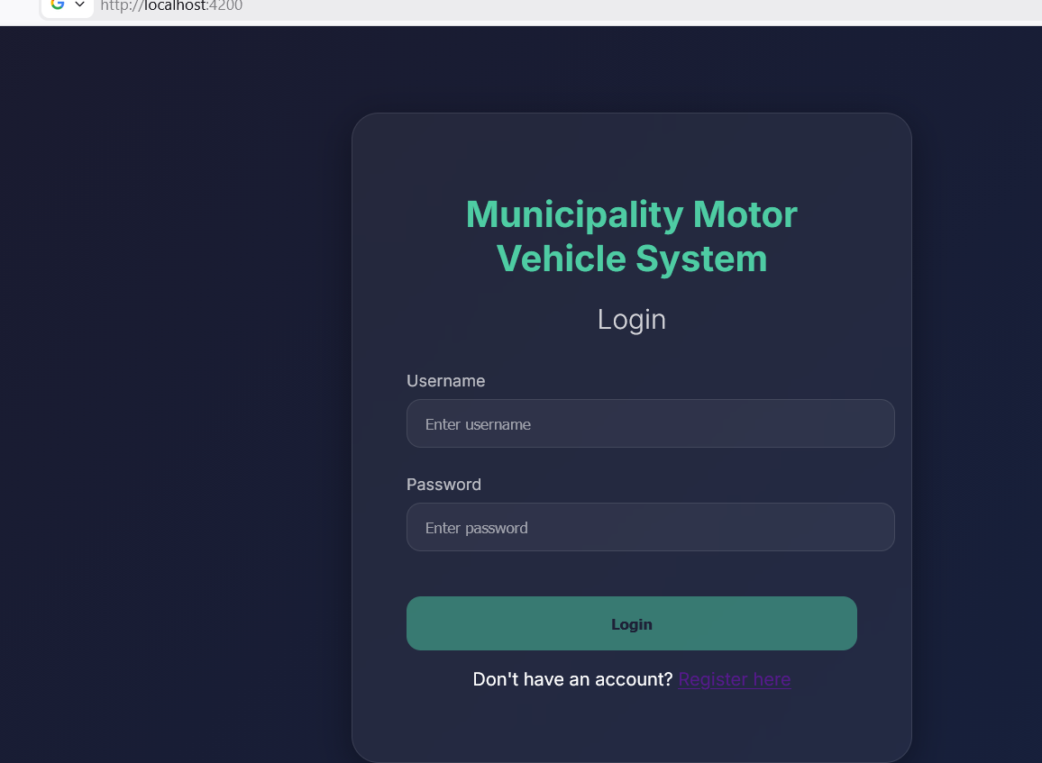
UC1 – User Registration
POST /API/AUTH/REGISTER
Authorized Actors
Unregistered Citizens, Unregistered Law Enforcement Personnel, System
Target Resource
User
Business Goal
To securely enroll new users into the database, assign their primary residential or operational District, and provision role-specific application permissions (CITIZEN or LAW_ENFORCEMENT).

Slide 9
UC2 – Register Vehicle & Purchase Parking Pass
AUTHENTICATED CITIZENS
Key Capabilities
Target Resources
Link vehicles to citizen profiles
Assign passes to specific Zones
Vehicle and ParkingPass
Business Goal
Cover up to 4 plates per pass
Manage temporal validity windows
To link personal transit assets to a citizen's profile and immediately provision a digital parking pass for a designated Zone, allowing up to 4 license plates to be covered concurrently under a single expiration window.
Associated REST Endpoints
POST /api/vehicles — Register a new vehicle
GET /api/vehicles?userId={id} — Retrieve user's vehicle inventory
POST /api/passes — Purchase a parking pass
GET /api/passes?userId={id} — Retrieve active user passes

Slide 10
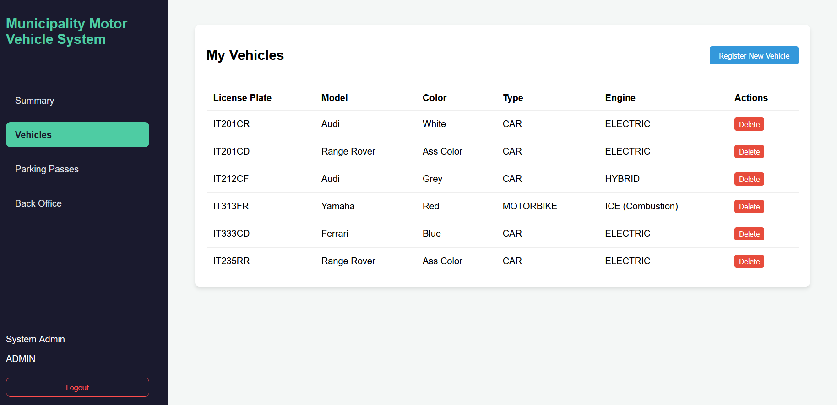
Vehicles Registered

Slide 11
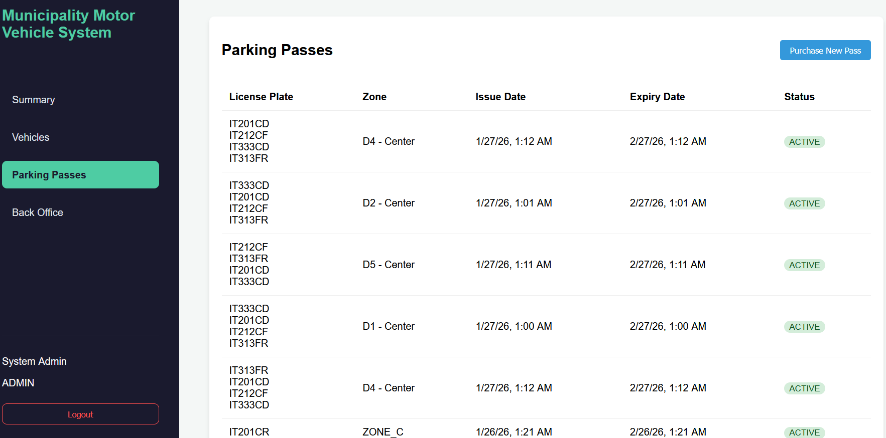
Parking Pass Purchase

Slide 12

UC3 – Record Violation & Generate Report
Empowers law enforcement officers and administrators to log infractions in real time and compile certified analytical reports.
Associated REST Endpoints
Authorized Actors
Target Resources
POST /api/violations — Record a real-time field infraction
GET /api/reports/violations?period={p}&groupBy={g} — Query aggregated statistical data
GET /api/reports/violations/pdf — Stream binary data to download physical PDF
GET /api/passes/count — Fetch total active system passes counter
Authenticated Law Enforcement Officers, Authenticated Administrators, System
Violation and Report
Business Goal
Log traffic compliance infractions instantly with automated timestamping, and empower administrators to aggregate municipal infraction data and compile certified, printable analytical reports via iText.
Automated timestamping ensures every violation record is legally traceable and audit-ready for municipal compliance.

Slide 13
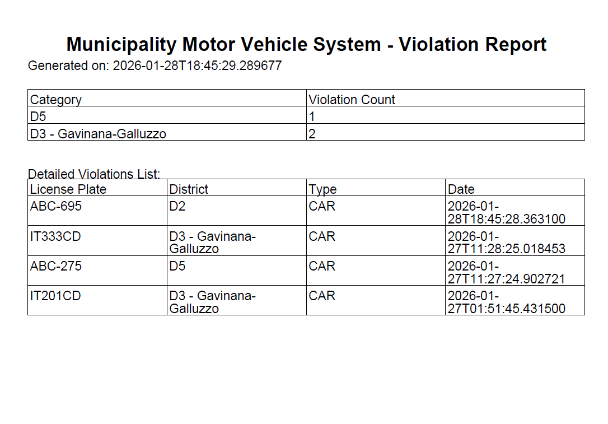
Report Generated

Slide 14
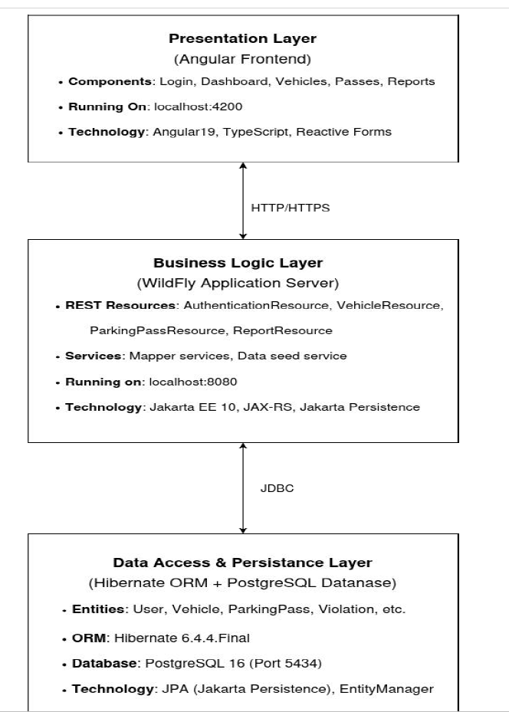
Architectural Overview: The 3-Tier Pattern
A fully decoupled enterprise architecture separating concerns across three distinct layers — Presentation, Business Logic, and Data Persistence — for scalability, maintainability, and clean separation of responsibilities.
Presentation Layer
Application / Business Layer
Frontend Single Page App built with Angular 19. Manages user views, state transitions, client-side routing, and active UI form validation.
Backend REST Services built with Jakarta EE 10 / JAX-RS. Deploys on WildFly 39. Contains Core Services, EJBs, DAOs, and DTOs.
Enterprise Data Layer
Relational storage powered by PostgreSQL 16. Managed object lifecycle through Hibernate ORM for seamless persistence.

Slide 15
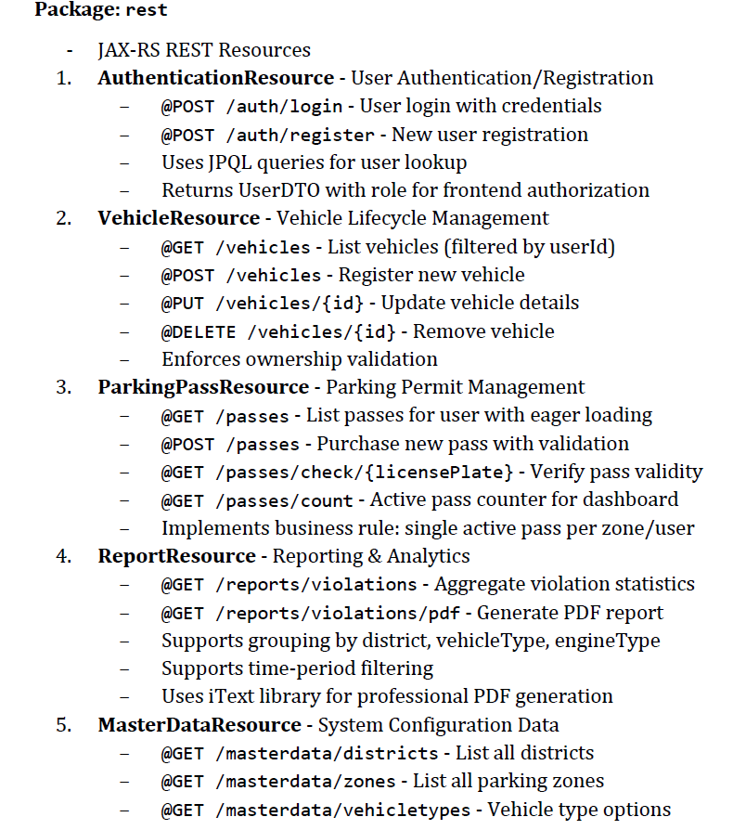
REST Endpoints
Resources are identified by URIs representing core system entities. Each endpoint maps to a distinct domain collection, enabling clean, resource-oriented communication across the application.
/api/users
User collection — manage system accounts and profiles.
/api/vehicles
Vehicle collection — register and track city vehicles.
/api/passes
Parking pass collection — issue and validate parking permits.
/api/violations
Violation collection — record and query enforcement events.
/api/reports
Report collection — generate administrative and analytical outputs.

Slide 16
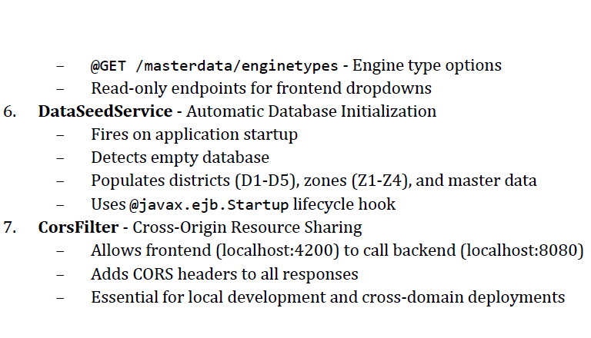
REST Endpoints

Slide 17

HTTP Methods & Resource Operations
Standard HTTP verbs define the contract for interacting with each resource. Every operation follows RESTful conventions for predictable, stateless communication.
Method
Purpose
Example
GET
Retrieve resources
GET /api/vehicles?userId=5
POST
Create resources
POST /api/vehicles (with JSON body)
PUT
Update resources
PUT /api/vehicles/12 (with updated JSON)
DELETE
Remove resources
DELETE /api/vehicles/12
All endpoints return standard HTTP status codes (200, 201, 400, 404, 500) to communicate operation outcomes clearly to the frontend client.

Slide 18
Technical Implementation Stack
A comprehensive overview of the languages, frameworks, persistence providers, build tools, and backend design patterns powering the system.
LANGUAGE & FRAMEWORK
PERSISTENCE & BUILD
Backend: Java 17 + Jakarta EE 10
Persistence Provider
Java 17 alongside Jakarta EE 10 APIs — JAX-RS for REST, CDI for dependency injection, and JPA for persistence abstraction.
Hibernate 6.4.4.Final managing Object-Relational mapping to the PostgreSQL database with full lifecycle control.
Frontend Ecosystem
Dependency & Server Management
TypeScript, Angular 19, HTML5, CSS3, and RxJS for reactive, asynchronous event streaming across the UI layer.
Apache Maven for backend builds, npm for frontend pipelines, and WildFly Application Server for runtime hosting.
Backend Design Patterns & Layers
A clean separation of concerns is enforced through a layered backend architecture, ensuring each component has a single, well-defined responsibility.
REST Resources
DTOs
Exposes API endpoints, intercepts HTTP JSON payloads, and handles initial protocol status codes.
Structural boundary objects preventing database entities from leaking directly to frontend clients.
Service Layer
DAOs
Houses core business rules, conditional checks, and controls transaction bounds.
Encapsulates native EntityManager operations, abstracting relational queries from business logic.

Slide 19




Technical Implementation Stack
Language & Framework
Frontend Ecosystem
Java 17 alongside Jakarta EE 10 APIs — JAX-RS for REST, CDI for dependency injection, and JPA for persistence abstraction.
TypeScript, Angular 19, HTML5, CSS3, and RxJS for reactive, asynchronous event streaming across the UI layer.
Persistence Provider
Dependency & Server Management
Hibernate 6.4.4.Final managing Object-Relational mapping to the PostgreSQL database with full lifecycle control.
Apache Maven for backend builds, npm for frontend pipelines, and WildFly Application Server for runtime hosting.
Backend Design Patterns & Layers
A clean separation of concerns is enforced through a layered backend architecture, ensuring each component has a single, well-defined responsibility.
REST Resources
DTOs
Exposes API endpoints, intercepts HTTP JSON payloads, and handles initial protocol status codes.
Structural boundary objects preventing database entities from leaking directly to frontend clients.
Service Layer
DAOs
Houses core business rules, conditional checks, and controls transaction bounds.
Encapsulates native EntityManager operations, abstracting relational queries from business logic.
3
.

Slide 20
Conclusion & Technical Takeaways
The project successfully delivered a fully operational, compliant 3-Tier Enterprise application meeting all architectural and functional requirements.
Full 3-Tier Compliance
End-to-End Type Safety
Successfully implemented a fully operational, compliant 3-Tier Enterprise application with clean layer separation.
Maintained absolute type-safety from backend Java definitions to frontend TypeScript data models via consistent DTO schemas.
Cross-Origin Security
Ensured complete security across boundaries by managing CORS rules between the separate WildFly and Angular server contexts.

Slide 21
Key Takeaways: Architectural Milestones
Three foundational pillars define the architectural success of this enterprise system, each representing a deliberate engineering decision that ensures long-term reliability and scalability.
Data Integrity
Implemented atomic transactions and referential integrity using JTA and foreign key constraints across all relational entities.
RESTful Principles
Achieved stateless, resource-oriented communication with standard HTTP status codes and clean URI design across all endpoints.
3-Tier Architecture
Successfully decoupled Presentation, Business, and Persistence layers — enabling independent scaling and maintainability.

Slide 22
Added Value: Real-World & Policy Impact
Beyond technical achievement, the system delivers measurable real-world impact for municipal enforcement operations and environmental policy goals.
Real-Time Enforcement
Eco-Auditing
Drastically reduced violation verification time for field officers, enabling faster, more accurate enforcement decisions on the ground.
Built-in support for environmental policy through Engine Type classification, enabling the city to track and regulate combustion engine activity in protected zones.
Professional Reporting
Dynamic PDF generation via iText produces official, tamper-proof municipal documentation suitable for police records and legal archives.

Slide 23

SYSTEM IMPROVEMENTS
Future Roadmap
The next phase of development focuses on three critical pillars: hardening security, enabling seamless payments, and delivering real-time communication across the platform.
Live Notifications
Payment Gateway
Leveraging WebSockets to push instant alerts to enforcement officers the moment a violation is detected. This eliminates polling delays and ensures officers receive real-time, actionable intelligence directly to their devices.
Security Hardening
Integration with Stripe and PayPal to enable real-time parking pass transactions. Users will be able to purchase, renew, and manage passes seamlessly within the platform, with full support for secure checkout flows and transaction history.
Implementing token-based JWT authentication to ensure secure, stateless session management across all endpoints. Password storage will be fortified using BCrypt hashing, protecting user credentials against brute-force and rainbow table attacks.
These enhancements collectively elevate the platform from a functional prototype to a production-ready, enterprise-grade parking management system.

