Slide 1

From Material Passports to Digital Product Passports Creating and Validating Linked Data-based Digital Product Passports for the AEC industry
Janneke Bosma, 1733133 MAY 2024
Master Construction Management & Engineering

Slide 2






Problem statement
Refuse
10R
Reduce
Renew
MP
…Recycle
Not all materials infinite
Processing and utilization results in significant CO2 emissions.
The construction sector contributes to 38% of total global energy-related CO2 emissions.
Minimize by acting higher on the 10R ladder. However, there are several challenges involved to renew (reuse) materials.
Material Passports can be a solution. However, there is no standard and no consensus among stakeholders regarding the content of the passport.
There is a need to verify the data to ensure its accuracy, thereby enhancing the prospects for reusing and recycling materials.
Notes:
Not all materials possess infinite utility. Moreover, the processing and utilization of these materials result in significant CO2 emissions.
The construction sector contributes to 38% of total global energy-related CO2 emissions.
To minimalize this there is need for ‘refuse’, ‘reduce’, and ‘renew’ even above recycling. However, there are several challenges involved to renew (reuse) materials.
Material Passports can be a solution to the challenges, such as connecting supply and demand. However, there is no standard and no consensus among stakeholders regarding the content of the passport.
Furthermore, there is a need to verify the data to ensure its accuracy, thereby enhancing the prospects for reusing and recycling materials.

Slide 3
Agenda
Literature Material Passports & Digital Product Passports
Research Questions
Conclusion
The process (DPP format and validation process)
Evaluation
Discussion
Contribution & recommendations

Slide 4







Material Passport
Digital interface
Single identifiable product and associated life cycle information
Sustainable and circular characteristics, value, and opportunities
Material,
product &
component
Eco-labels
BIM data
Nutrition certificates
Definition MP
Madaster
MP
Function MP
Digital Building Logbook
No standard
format
Cradle-to-cradle passport
CB’23
BAMB
Optimization tool & variant studies
Exact material composition
Second-hand raw material register
Notes:
Digital interface;
Single identifiable product and associated life cycle information ;
Gaining insight into sustainable and circular characteristics, value, and opportunities;
Not only of the product, but also underlying components and materials.
Mpa - serves as a rough estimation and optimization tool. Variants studies can look at the most appropriate construction based on recycling potential and environmental impact. This phase has the most impact in terms of recycling, waste and environmental impact. When using BIM, it is important here that the geometry is properly modulated and the elements are assigned the correct classification.
MPb - also functions as an optimization tool. Here e.g. thicknesses and layers of the applied product/material can still be adjusted.
MPc - During the tender phase, the exact material composition can be checked.
MPd- Serves as documentation in which the final situation is recorded and this can serve as a second-hand raw materials register.
A lot of existing passports and alternatives however scope and definition differ. No standard. Movement from Europe to a dpp

Slide 5
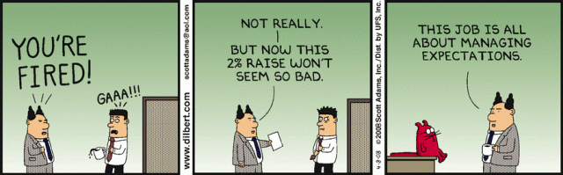
Challenges
Unclear exactly what belongs in a passport (no format);
The purpose of the passport differs, creating confusion among stakeholders about the benefits of a passport;
The above also creates limitations in creating (semantic and technical) standards to implement;
Etc..
Figure 1: Managing expectations
(Adams, 2008)

Slide 6








From material passport to digital product passport
Literature terminology DPP & MP used interchangeably
Seen as a solution to the lack of consistent and trustworthy information
Track and trace tool
Expected to become ‘mandatory’ in 2026
Subject to various regulations and standards, some of which are only now emerging
State-of-the-art
DPP
Type of data
No standard
format
Manufacturing data
Usage data
End-of-life data
Life cycle data
Notes:
In the literature, the terminology of an MP and DPP is used interchangeably;
DPP is seen as a solution to the lack of consistent and trustworthy information;
It can serve as a track and trace tool;
Expected to become ‘Mandatory’ in 2026.
The DPP is subject to various regulations and standards, some of which are only now emerging
Manufacturing data, usage data, end-of-life data & life cycle data

Slide 7
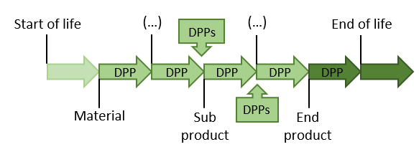
Digital product passport
The stakeholder (economic operator) who places the object on the market is responsible for creating the DPP and making it available to the public.
A lot of information will need to be exchanged during the life cycle of the object.
Linked data can form a solution to prevent data loss.
Linked Data is a way to organize and connect information on the internet so that computers and people can easily communicate and understand each other.
Figure 2: Cumulative DPP addition through the object life cycle

Slide 8








Differences DPP and MP
Pre-conceptual phase
Demonstration phase
Any physical good placed on the market or put into service
Building materials
Composition, origin, repair, and dismantling information. Handling information at the end of its service life
Information on reuse of materials; cross-ref. to data sheets, EPDs
DPP
Repair, production, and disposal to complete life-cycle
MP
End-of-life
Unknown
The MP platform, BIM discussed
Suppliers, manufacturers
Manufacturers
Consumers, market surveillance. Any industry
Architects, builders, etc. Built environment
Notes:
In the literature, the terminology of an MP and DPP is used interchangeably;
DPP is seen as a solution to the lack of consistent and trustworthy information;
It can serve as a track and trace tool;
Expected to become ‘Mandatory’ in 2026.
The DPP is subject to various regulations and standards, some of which are only now emerging
Manufacturing data, usage data, end-of-life data & life cycle data

Slide 9
Challenges
Existing MPs and DPPs are compared based on requirements from the literature and the later discussed must-haves. No passport is suitable at the moment.
Integrated into the existing regime and information requirements;
Varying information needs stakeholders;
Information shared through different portals and methods. Need to be consolidated in the DPP;
Absence of clear specifications leads to divergent industry-driven visions;
Obtaining product information and maintaining the DPP’s accuracy;
Currently no format available;
Etc.

Slide 10
Research question
How can a Digital Product Passport for the AEC industry be created and validated using BIM and semantic technologies?
This main question will be split up into multiple sub-questions. These include:
What is the current state-of-the-art of MPs, DPPs, automated data validation tools, BIM-based technologies, and semantic technologies?
Which parts of a DPP will need to be validated and which part of the validation process is required by the contractor?
How can a proof-of-concept for the DPP validation method be developed and tested in a real-world use case?
How can the validation process and output be visualized and feedback - provided to the end user?

Slide 11





Conclusion
How can a digital product passport for the AEC industry be created and validated by the use of BIM-based and semantic technologies?
DPP
SHACL
IFCtoLBD
PySHACL
Define must-haves
Define requirements
Collect data
(IFC)
DPP ontology
Convert IFC to linked data
Enrich /improve data & create material & product database
Set validation rules
Perform validation
Validation report
MP/DPP
Req.
Collect
Ontology
Data prep.
Rule prep.
Validate
Report
Evaluate
Conclude
Notes:
DPP must-haves are defined;
Requirements are defined (not discussed today);
IFC models converted to Linked data;
A DPP Ontology is proposed;
The data is enriched, and a material and product database is made;
Validation rules are established and written in SHACL;
The PySHACL script is adapted and used to perform the validation;
A validation report is generated and the IFC GUID can be used to improve the source documentation
All these steps constitute the validation process

Slide 12
The process
Material Passport and Digital Product Passport
Requirement definition
Data collection
Ontology creation
Data preparation
Validation rules and rule preparation
Rule execution
Validation report
Mock- up & Prototype evaluation
Discussion, Conclusion, Recommen-dations & Contribution
MP/DPP
Req.
Collect
Ontology
Data prep.
Rule prep.
Validate
Report
Evaluate
Conclude

Slide 13
The process
Material Passport and Digital Product Passport
Requirement definition
Data collection
Ontology creation
Data preparation
Validation rules and rule preparation
Rule execution
Validation report
Mock- up & Prototype evaluation
Discussion, Conclusion, Recommen-dations & Contribution
MP/DPP
Req.
Collect
Ontology
Data prep.
Rule prep.
Validate
Report
Evaluate
Conclude

Slide 14
Define topics DPP (must-have)
Geometric data | Circularity | Material circularity characteristics | General product information | Other
Dimensions | Recycling potential | Material composition | Product name/details | Building location
Weight | Reusability potential | Material criticality | Product object number | Updates
Density | Disassembly potential | Secondary material | Manufacturer article nr. | Time
Geometry | Future function | Origin | Temporal info | Condition assessment
Quantity | Circularity |  | Location in building
 |  |  | Warranties
 |  |  | Disassembly instructions
Table 1: Defined must-have topics
MP/DPP
Req.
Collect
Ontology
Data prep.
Rule prep.
Validate
Report
Evaluate
Conclude
Notes:
Missing topics from the workshop
Environmental Product Declaration;
General info (coordinates, object number, etc);
Data on maturity (maturity measurements);
Strategically scarce materials;
Inspections during the construction phase;
Information about the environment (e.g. subsoil)
Information on weather conditions during execution.

Slide 15
Data structures (UML)
Must-have topics are structured in a UML-diagram;
This to understand the various components that must be validated and their interrelationships.
Forms a basis for the following steps in the process
MP/DPP
Req.
Collect
Ontology
Data prep.
Rule prep.
Validate
Report
Evaluate
Conclude

Slide 16
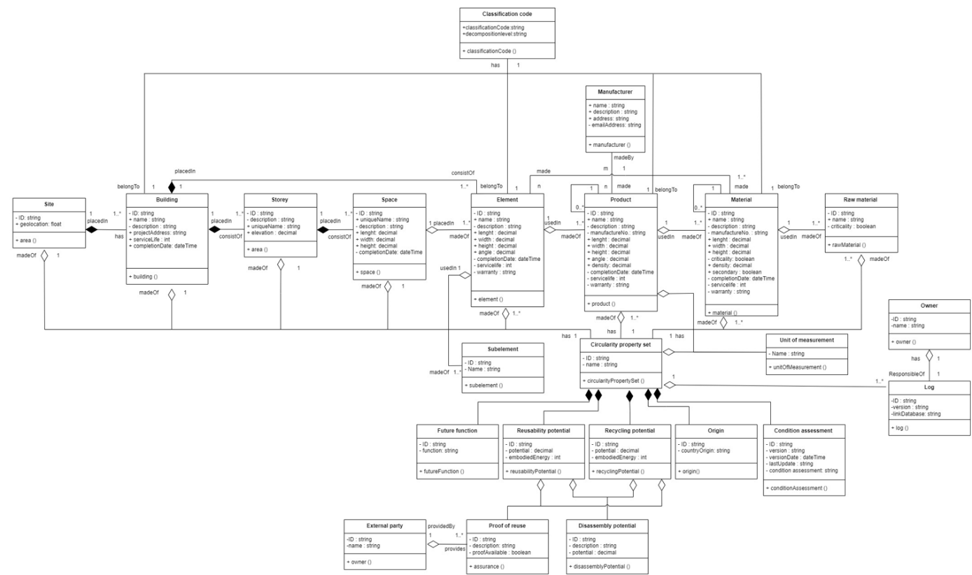
Classification code
Manufacturer
Building levels
Circularity
Figure 3: Data structure DPP
MP/DPP
Req.
Collect
Ontology
Data prep.
Rule prep.
Validate
Report
Evaluate
Conclude

Slide 17
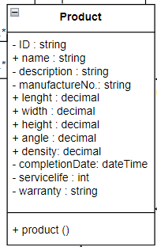
Example Class and Property
Class
Property
Figure 4: Example class and property
MP/DPP
Req.
Collect
Ontology
Data prep.
Rule prep.
Validate
Report
Evaluate
Conclude

Slide 18
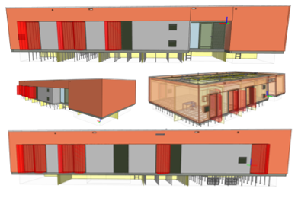
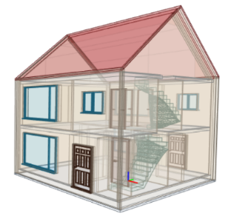
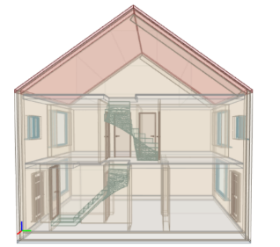
Data collection
IFC Models
Transformation building
2 Concrete walls
Insulation
Wall cladding
Terraced house
Door
Window
Concrete wall
Both models do not contain all must-have data
Figure 5: IFC model tranformation building and terraced house
MP/DPP
Req.
Collect
Ontology
Data prep.
Rule prep.
Validate
Report
Evaluate
Conclude
Notes:
In the built environment IFC is used a lot. E.g. a model can be made in the program revit. To share this information it is converted to IFC so different stakeholders can work together even if they used different BIM software. As long as it all is converted to IFC.

Slide 19
Ontology creation
Currently, there is no ontology for DPPs and MPs available
Based on the defined must-have topics in the UML a new ontology is proposed: the DPP ontology (focus on element, product, and material level)
For some must-have topics existing ontologies can be reused
MP/DPP
Req.
Collect
Ontology
Data prep.
Rule prep.
Validate
Report
Evaluate
Conclude
Notes:
Wat is een ontology visueel

Slide 20
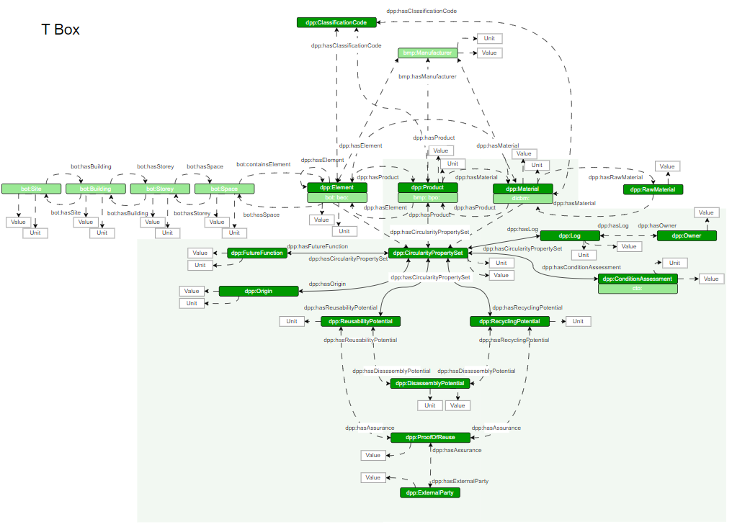
Ontology creation
Classification code
Manufacturer
Building levels
T box – only shows classes
Dark green shows the usage of the DPP ontology
The light green boxes show the alternative existing ontologies
Circularity
Figure 6: T Box digital product passport ontology
MP/DPP
Req.
Collect
Ontology
Data prep.
Rule prep.
Validate
Report
Evaluate
Conclude

Slide 21
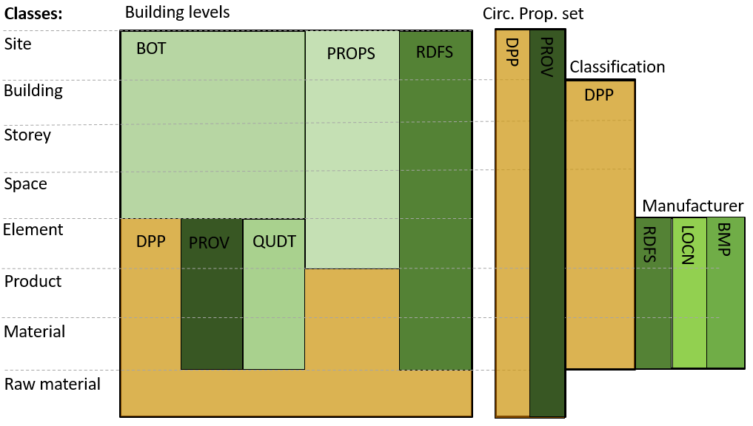
Ontology landscape
*
*QUDT is currently used, but OM is recommended
Figure 7: Ontology landscape
MP/DPP
Req.
Collect
Ontology
Data prep.
Rule prep.
Validate
Report
Evaluate
Conclude

Slide 22


Data preparation
IFC
Linked data
Check data
Add must-haves
Create material & product data
MP/DPP
Req.
Collect
Ontology
Data prep.
Rule prep.
Validate
Report
Evaluate
Conclude
Notes:
The models of the Transformation building, and Terraced house are translated to Linked data as well by using a python script
After the models are converted:
Some mistakes in the files are removed to make the data work
For both buildings a new file is made which includes the missing must-have topics
For both buildings a belonging materials and product database is created in linked data

Slide 23
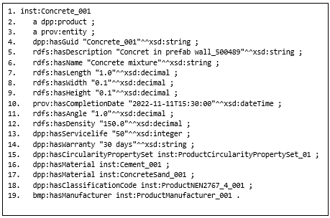
Data preparation
Example: Product data of concrete in Linked data format.
This is a section of the DPP
IFC
Linked data
Fragment 1: Snippet of digital product passport product concrete
MP/DPP
Req.
Collect
Ontology
Data prep.
Rule prep.
Validate
Report
Evaluate
Conclude

Slide 24
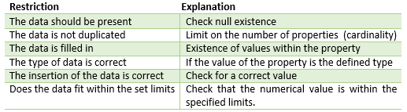
Validation rules
Next step is to validate the data (must-have topics).
Currently, no requirements within the relevant sustainability themes of MPs or DPPs.
Lee et al. (2016) created a rule-based validation method for the validation of IFC models.
(Lee et al, 2016)
Proposed in this thesis
Table 2: Validation rules
MP/DPP
Req.
Collect
Ontology
Data prep.
Rule prep.
Validate
Report
Evaluate
Conclude

Slide 25
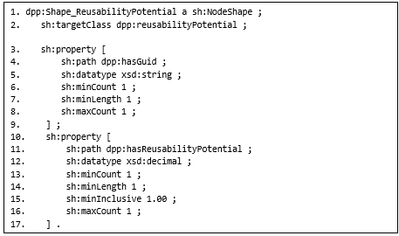
Rule preparation
This validation will be done by using Shape Constraint Language (SHACL)
Fragment 2: Snippet of SHACL reusability potential
MP/DPP
Req.
Collect
Ontology
Data prep.
Rule prep.
Validate
Report
Evaluate
Conclude

Slide 26
Rule execution
To execute the rules a Python script is used
Building, product & material data
SHACL Rules
PySHACL
Report
MP/DPP
Req.
Collect
Ontology
Data prep.
Rule prep.
Validate
Report
Evaluate
Conclude

Slide 27


Rule execution
Python
Python
Python
PySHACL
Missing classes
IFC GUID
& PDF Format
Validation report
MP/DPP
Req.
Collect
Ontology
Data prep.
Rule prep.
Validate
Report
Evaluate
Conclude
Notes:
-Mention an example of a class (e.g. the product example used earlier in the presentation)

Slide 28
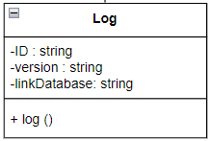
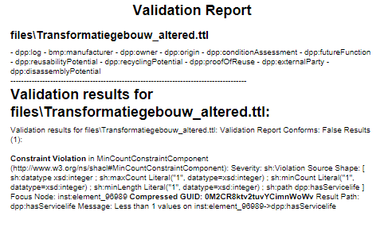

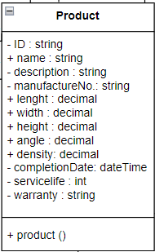

The validation report
Class level
Property level
Violation: missing property service life
MP/DPP
Req.
Collect
Ontology
Data prep.
Rule prep.
Validate
Report
Evaluate
Conclude

Slide 29
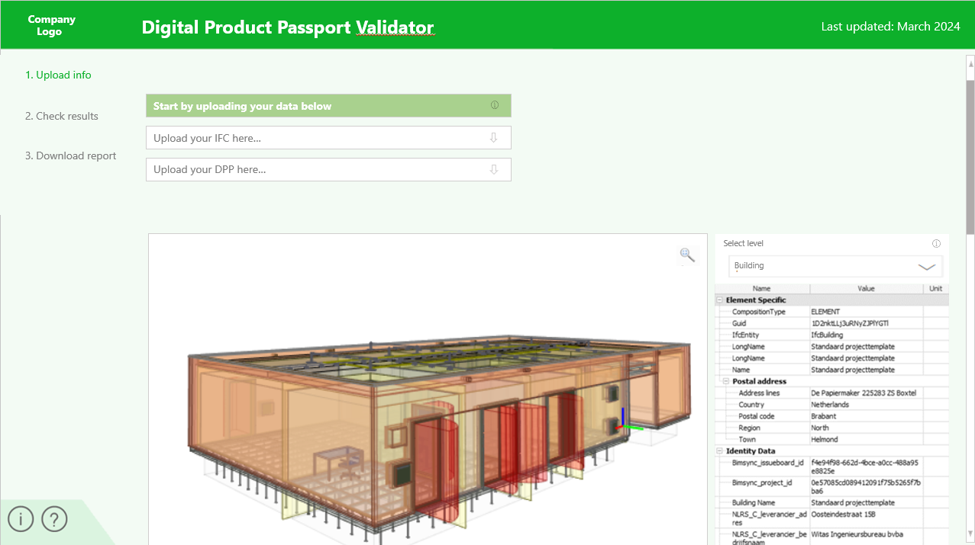
Dashboard Mock-up
Next step: integrate this process in a dashboard
Figure 8: Mock-up dashboard part 1
MP/DPP
Req.
Collect
Ontology
Data prep.
Rule prep.
Validate
Report
Evaluate
Conclude

Slide 30
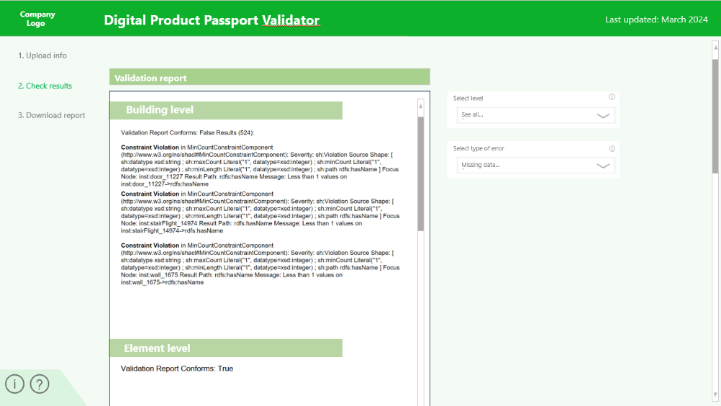
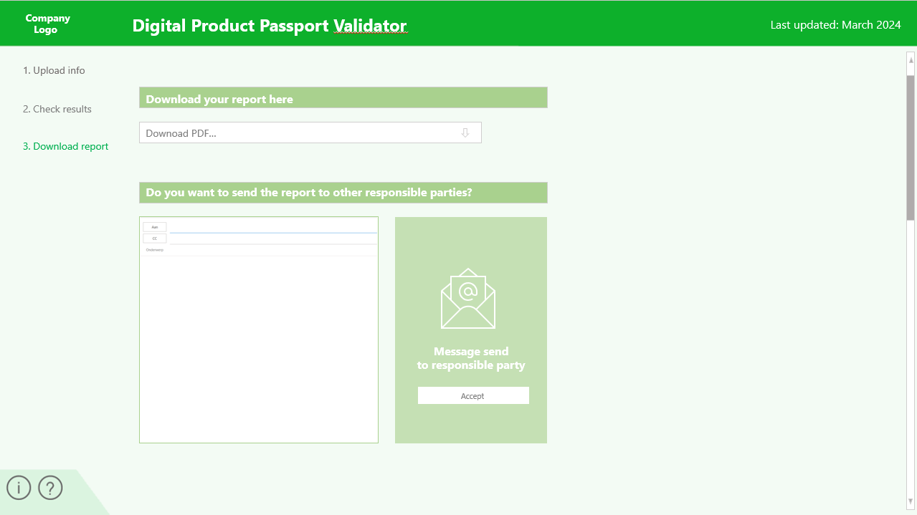
Dashboard Mock-up
Figure 9: Mock-up dashboard part 2
Figure 10: Mock-up dashboard part 3
MP/DPP
Req.
Collect
Ontology
Data prep.
Rule prep.
Validate
Report
Evaluate
Conclude

Slide 31
The prototype evaluation
Process validated among employees (potential users), by using competence questions and the requirements.
All requirements with priority 1 are met and all competence questions can be queried (all data wished to be included by potential users can be retrieved)
Feedback:
There need to be a manual for the process;
There need to be an ‘owner’ for the process;
There need to be a dashboard to enable an easier validation process;
Etc..
MP/DPP
Req.
Collect
Ontology
Data prep.
Rule prep.
Validate
Report
Evaluate
Conclude

Slide 32
Discussion
Current converter from IFC to Linked data does not include the DPP ontology;
Significant changes may occur for the DPP (and on what to validate) since it is a new subject, and regulations are unclear;
Assign an owner for the validation process;
Connection real databases and other ontologies;
Expand DPP ontology;
Align terminologies, e.g. material and product, based on regulations;
Validating bigger files can be time-consuming if printed in pdf.
MP/DPP
Req.
Collect
Ontology
Data prep.
Rule prep.
Validate
Report
Evaluate
Conclude

Slide 33
Contribution and recommendations
Scientific (SC) and Societal (SO) contribution
Format dpp (SC,SO)
Proof of concept validation process (SC)
Current state-of-the-art MP and DPP (SC,SO)
Use case linked data (SC)
Extension PySHACL (SC)
DPP ontology (SC,SO)
Accessible linked data (SO)
Dashboard, Incorporate feedback, Integration existing ontologies Protégé, Validate DPP throughout the entire chain, add should have topics & correctly configure BIM models and standardize data
MP/DPP
Req.
Collect
Ontology
Data prep.
Rule prep.
Validate
Report
Evaluate
Conclude

Slide 34
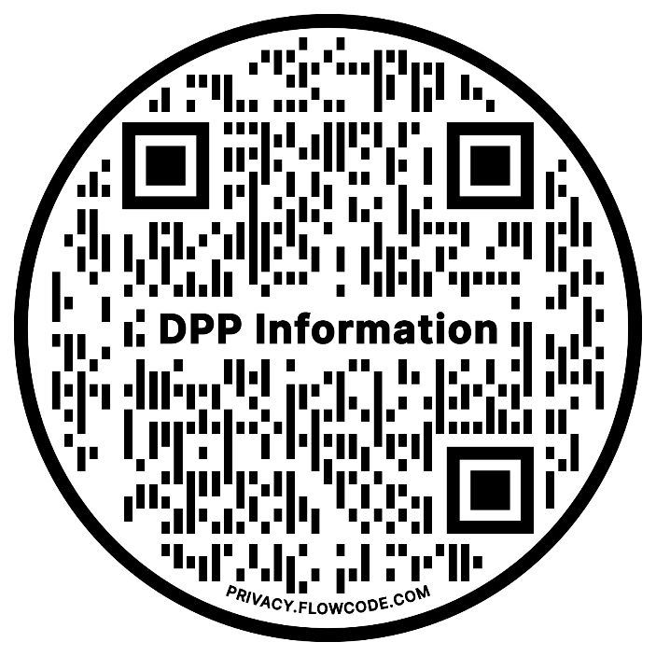
Where to find the information?
Python scrips, SHACL file, DPP Ontology & Example files Linked data
Explanatory PowerPoints & Thesis
Example process to try it out yourself
MP/DPP
Req.
Collect
Ontology
Data prep.
Rule prep.
Validate
Report
Evaluate
Conclude

Slide 35
Any questions?

Slide 36
Bibliography
Dia 2:
Anderson, J. E., Wulfhorst, G., & Lang, W. (2015). Energy analysis of the built environment—A review and outlook. Renewable and Sustainable Energy Reviews, 44, 149–158. https://doi.org/10.1016/J.RSER.2014.12.027
Cramer, J. (2017). The Raw Materials Transition in the Amsterdam Metropolitan Area: Added Value for the Economy, Well-Being, and the Environment. Https://Doi.Org/10.1080/00139157.2017.1301167, 59(3), 14–21. https://doi.org/10.1080/00139157.2017.1301167
Mehra, S., Singh, M., Sharma, G., Kumar, S., Navishi, & Chadha, P. (2022). Impact of Construction Material on Environment. Ecological and Health Effects of Building Materials, 427–442. https://doi.org/10.1007/978-3-030-76073-1_22
Rijkswaterstaat. (2020). Materialenpaspoort.
United Nations Environment Programme. (2020). 2020 GLOBAL STATUS REPORT FOR BUILDINGS AND CONSTRUCTION Towards a zero-emissions, efficient and resilient buildings and construction sector . www.globalabc.org.
MP/DPP
Req.
Collect
Ontology
Data prep.
Rule prep.
Validate
Report
Evaluate
Conclude

Slide 37
Sources
Dia 3:
van Capelleveen, G., Vegter, D., Olthaar, M., & van Hillegersberg, J. (2023). The anatomy of a passport for the circular economy: a conceptual definition, vision and structured literature review. Resources, Conservation and Recycling Advances, 17. https://doi.org/10.1016/J.RCRADV.2023.200131
Dia 4:
van Capelleveen, G., Vegter, D., Olthaar, M., & van Hillegersberg, J. (2023). The anatomy of a passport for the circular economy: a conceptual definition, vision and structured literature review. Resources, Conservation and Recycling Advances, 17. https://doi.org/10.1016/J.RCRADV.2023.200131
Honic, M., Kovacic, I., & Rechberger, H. (2019a). Concept for a BIM-based Material Passport for buildings. IOP Conference Series: Earth and Environmental Science, 225(1). https://doi.org/10.1088/1755-1315/225/1/012073
MP/DPP
Req.
Collect
Ontology
Data prep.
Rule prep.
Validate
Report
Evaluate
Conclude

Slide 38
Sources
Dia 5:
Adams, S. (2008). managing expectations comic Dilbert. https://nl.pinterest.com/pin/11188699044977708/
Honic, M., Kovacic, I., & Rechberger, H. (2019a). Concept for a BIM-based Material Passport for buildings. IOP Conference Series: Earth and Environmental Science, 225(1). https://doi.org/10.1088/1755-1315/225/1/012073
Hoosain, M. S., Paul, B. S., Raza, S. M., & Ramakrishna, S. (2020). Material Passports and Circular Economy. An Introduction to Circular Economy, 131–158. https://doi.org/10.1007/978-981-15-8510-4_8/TABLES/5
Munaro, M. R., Fischer, A. C., Azevedo, N. C., & Tavares, S. F. (2019). Proposal of a building material passport and its application feasibility to the wood frame constructive system in Brazil. IOP Conference Series: Earth and Environmental Science, 225(1). https://doi.org/10.1088/1755-1315/225/1/012018
MP/DPP
Req.
Collect
Ontology
Data prep.
Rule prep.
Validate
Report
Evaluate
Conclude

Slide 39
Sources
Dia 6:
Adisorn, T., Tholen, L., & Götz, T. (2021). Towards a digital product passport fit for contributing to a circular economy. Energies, 14(8). https://doi.org/10.3390/EN14082289
Guth-Orlowski, S. (2021, October 18). The digital product passport and its technical implementation | by Dr. Susanne Guth-Orlowski | Medium. https://medium.com/@susi.guth/the-digital-product-passport-and-its-technical-implementation-efdd09a4ed75
Harrison, K., & Conrad, T. (2011, August). Predicting Emerging Product Design Trend by Mining Publicly Available Customer Review Data | Request PDF. https://www.researchgate.net/publication/257919571_Predicting_Emerging_Product_Design_Trend_by_Mining_Publicly_Available_Customer_Review_Data
Plociennik, C., Pourjafarian, M., Saleh, S., Hagedorn, T., do Carmo Precci Lopes, A., Vogelgesang, M., Baehr, J., Kellerer, B., Jansen, M., Berg, H., Ruskowski, M., Schebek, L., & Ciroth, A. (2022). Requirements for a Digital Product Passport to Boost the Circular Economy. Lecture Notes in Informatics (LNI), Proceedings - Series of the Gesellschaft Fur Informatik (GI), P-326, 1485–1494. https://doi.org/10.18420/INF2022_127
MP/DPP
Req.
Collect
Ontology
Data prep.
Rule prep.
Validate
Report
Evaluate
Conclude

Slide 40
Sources
Dia 6:
van Capelleveen, G., Vegter, D., Olthaar, M., & van Hillegersberg, J. (2023). The anatomy of a passport for the circular economy: a conceptual definition, vision and structured literature review. Resources, Conservation and Recycling Advances, 17. https://doi.org/10.1016/J.RCRADV.2023.200131
Lell, O., Muster, V., Thorun, C., & Gossen, M. (n.d.). Förderung des nachhaltigen Konsums durch digitale Produktinformationen: Bestandsaufnahme und Handlungsempfehlungen | Umweltbundesamt. Retrieved November 30, 2023, from https://www.umweltbundesamt.de/publikationen/foerderung-des-nachhaltigen-konsums-durch-digitale
de Römph, T. J., & Cramer, J. M. (2020). How to improve the EU legal framework in view of the circular economy. Journal of Energy & Natural Resources Law, 245–260. https://doi.org/10.1080/02646811.2020.1770961
Walden, J., Steinbrecher, A., & Marinkovic, M. (2021). Digital Product Passports as Enabler of the Circular Economy. Chemie-Ingenieur-Technik, 93(11), 1717–1727. https://doi.org/10.1002/CITE.202100121
MP/DPP
Req.
Collect
Ontology
Data prep.
Rule prep.
Validate
Report
Evaluate
Conclude

Slide 41
Sources
Dia 7:
Adisorn, T., Tholen, L., & Götz, T. (2021). Towards a digital product passport fit for contributing to a circular economy. Energies, 14(8). https://doi.org/10.3390/EN14082289
Dia 8:
Cobuilder International. (2023, November 22). Navigating new EU Regulations and digital tranformation in Construction.
Cobuilder International. (n.d.). EU approach to the Digital Product Passport of the construction industry - Digital solutions for the construction industry. Retrieved March 14, 2024, from https://cobuilder.com/en/eu-approach-to-the-digital-product-passport-of-the-construction-industry/
Watson, K., Patzer, F., & Schöppenthau, F. (2023). Achieving a Sustainable Economy with Digital Product Passports. IIC Journal of Innovation.
MP/DPP
Req.
Collect
Ontology
Data prep.
Rule prep.
Validate
Report
Evaluate
Conclude

Slide 42
Sources
Dia 9:
Adisorn, T., Tholen, L., & Götz, T. (2021). Towards a digital product passport fit for contributing to a circular economy. Energies, 14(8). https://doi.org/10.3390/EN14082289
Berger, K., Schöggl, J. P., & Baumgartner, R. J. (2022). Digital battery passports to enable circular and sustainable value chains: Conceptualization and use cases. Journal of Cleaner Production, 353. https://doi.org/10.1016/J.JCLEPRO.2022.131492
Eppinger, E., Jain, A., Vimalnath, P., Gurtoo, A., Tietze, F., & Hernandez Chea, R. (2021). Sustainability transitions in manufacturing: the role of intellectual property. Current Opinion in Environmental Sustainability, 49, 118–126. https://doi.org/10.1016/J.COSUST.2021.03.018
Schützenhofer, S., Kovacic, I., & Rechberger, H. (2022). Assessment of Sustainable Use of Material Resources in the Architecture, Engineering and Construction Industry ˗ a Conceptual Framework Proposal for Austria. Journal of Sustainable Development of Energy, Water and Environment Systems, 10(4). https://doi.org/10.13044/J.SDEWES.D10.0417
European Commission. (2020b). Regulation of the European parliament and of the council - concerning batteries and waste batteries, repealing Directive 2006/66/EC and amending Regulation (Eu) no 2019/1020.
MP/DPP
Req.
Collect
Ontology
Data prep.
Rule prep.
Validate
Report
Evaluate
Conclude

Slide 43
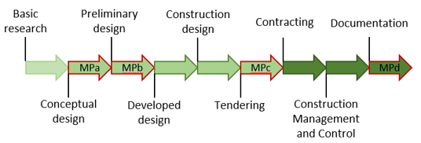
Material Passport
Figure 11: Stages of a material passport
MP/DPP
Req.
Collect
Ontology
Data prep.
Rule prep.
Validate
Report
Evaluate
Conclude
Notes:
Mpa - serves as a rough estimation and optimization tool. Variants studies can look at the most appropriate construction based on recycling potential and environmental impact. This phase has the most impact in terms of recycling, waste and environmental impact. When using BIM, it is important here that the geometry is properly modulated and the elements are assigned the correct classification.
MPb - also functions as an optimization tool. Here e.g. thicknesses and layers of the applied product/material can still be adjusted.
MPc - During the tender phase, the exact material composition can be checked.
MPd- Serves as documentation in which the final situation is recorded and this can serve as a second-hand raw materials register.

Slide 44
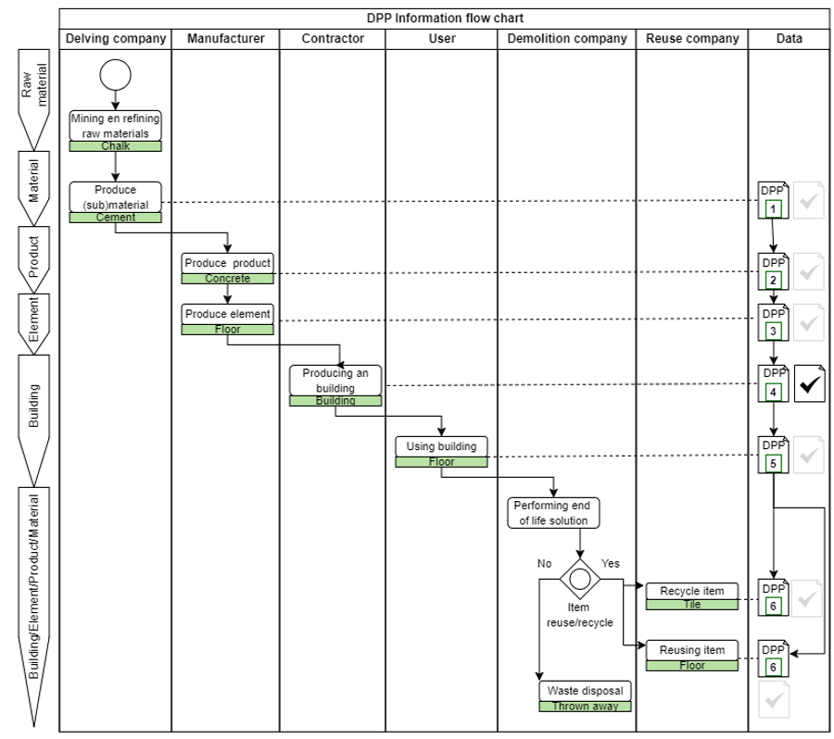
Process Digital Product Passport
Figure 12: DPP process scheme
MP/DPP
Req.
Collect
Ontology
Data prep.
Rule prep.
Validate
Report
Evaluate
Conclude
Notes:
Mpa - serves as a rough estimation and optimization tool. Variants studies can look at the most appropriate construction based on recycling potential and environmental impact. This phase has the most impact in terms of recycling, waste and environmental impact. When using BIM, it is important here that the geometry is properly modulated and the elements are assigned the correct classification.
MPb - also functions as an optimization tool. Here e.g. thicknesses and layers of the applied product/material can still be adjusted.
MPc - During the tender phase, the exact material composition can be checked.
MPd- Serves as documentation in which the final situation is recorded and this can serve as a second-hand raw materials register.

Slide 45
Requirement definition
Requirements resulting from literature and the must-haves are grouped.
User requirements, Validation process requirements & Data requirements
Must-have requirements are graded with priority 1
Based on the requirements and must-haves it is also determined no existing DPP/MP format is suitable to reuse for this research
MP/DPP
Req.
Collect
Ontology
Data prep.
Rule prep.
Validate
Report
Evaluate
Conclude

Slide 46
Requirement definition
The belonging requirement (R)
Must-have subject | MH
Legal obligations | L
Functional suitability | F
Security, confidentiality, and IP Protection | S
Accessibility | A
Interoperability | I
Modularity and Modifiability | MM
Availability and Time behavior | AT
Portability | P
Non-Redundancy | R
Applicability | AP
Tabel 3: The requirement topics

Slide 47
Requirement definition
User requirements
The user is able to … |  | P | R
1 | Validate their IFC and DPP whether the must-haves of the object are represented correctly. | 1 | MH, F
2 | Retrieve the information of the validation together with the corresponding IFC GUID of which object is wrong or missing | 1 | MH, F
3 | Make additions and modifications in the source data. | 2 | MM
4 | Remove or adapt actors, products, or attributes as requirements evolve | 3 | MM
5 | Easily understand the validation process and its results | 1 | A, AP
6 | Access the tools needed for the validation process without costs involved | 2 | AP
7 | Perform the validation process without extra steps or research needed | 2 | AP
Tabel 4: User requirements

Slide 48
Requirement definition
Validation proces requirements
The validation proces should be able to … |  | P | R
1 | Query and validate the must-haves from the IFC model and DPP and communicate the results. | 1 | MH, F, AP
2 | Comply with the following legal obligations: GDPR, the EPR, the ‘right to repair’, and the ESPR. | 3 | L, F
3 | Not impede existing chain processes, product quality, or safety. | 3 | F
4 | Provide a secure data exchange between the value chain members. | 3 | S
5 | Remain the data control with the data providers to safeguard intellectual property. | 3 | S
6 | Ensure access for assigned parties through an access control mechanism. | 3 | A
7 | Ensure participation opportunities for the parties without stable internet connections or advanced IT systems. | 3 | A
8 | Ensure permanent access to the whole life cycle data. | 3 | A
9 | Visualize the data in an understandable manner. | 2 | A
10 | Exchange validation information across different company boundaries. | 2 | I
11 | Show the information when needed. |  | AT
12 | Tranfer information between software systems to enable decentralized systems. | 3 | P
13 | Guarantee origin, integrity, verifiable, compliance, and immutability. | 3 | S
14 | Be scalable for various project sizes and environments, and its current level of use and adoption | 2 | AP
Tabel 4: Validation proces requirements

Slide 49
Requirement definition
Data requirements
The data should be able to … |  | P | R
1 | Show and validate the unit of measurements of the must-haves | 1 | MH
2 | Enable interoperability within and between systems by the use of shared semantics and standardized data schemes | 2 | I, P, R
3 | Be available real time (availability and time behaviour) | 3 | AT
4 | Uniquely identified, traceable, and time stamped | 1 | P
Tabel 5: Data requirements

Slide 50
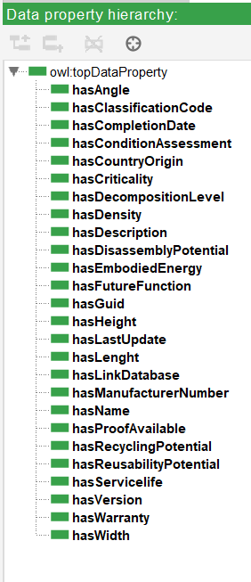
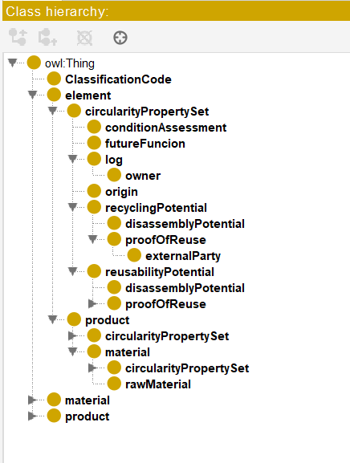
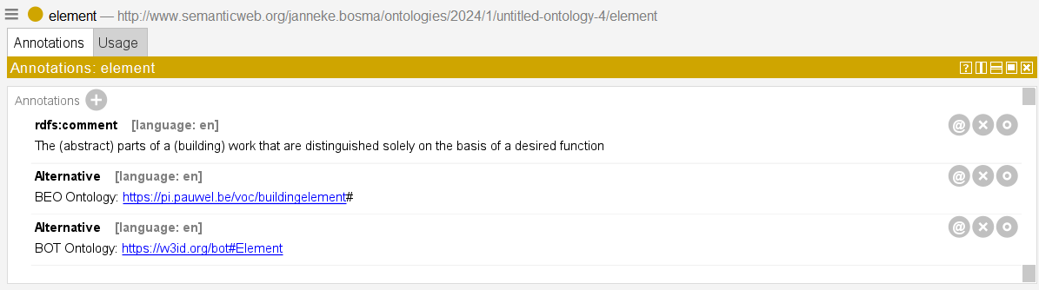
DPP ontology
Figure 14: Notation alternative ontologies
Figure 13: Classes DPP
Figure 14: Data properties DPP

