Slide 1
Pose Graph Optimization for Vision-Only Freehand 3D Ultrasound Reconstruction
Proposal for Master Thesis
Jannis Meyer

Slide 2


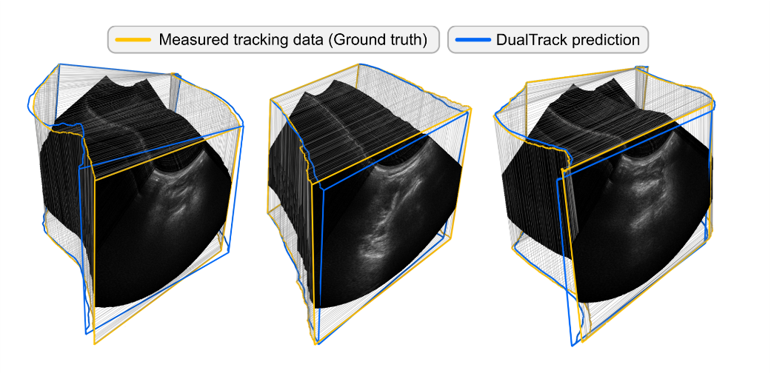
Introduction
3D Ultrasound (UR)
Expensive
Not always available
Limited resolution
3D UR Reconstruction
2D UR Images + Probe Pose = 3D Volume
Source: https://github.com/ImFusionGmbH/DualTrack

Slide 3



How do we get the probes pose?
Tracking Probe
Speckle Decorrelation
Deep Learning (DL)
Oftentimes: Additional data from IMU, external sensor etc.
➔ Current research focusses on vision-only DL methods
➔ Main Problems: Drift, Generalizability, Reproducibility

Slide 4
Research proposal
Build a pose graph from estimated probe poses
Use Pose Graph Optimization (PGO) to increase pose reconstruction accuracy
Existing research: Use of external sensor or IMU data, tests on non-public data sets; implicit global consistency
➔ Vision-only; explicit attention to global consistency; usage of realistic, publicly available data
Research hypothesis
“PGO will improve pose estimation performance and consistency of vision-based DL methods for 3d UR reconstruction.”

Slide 5
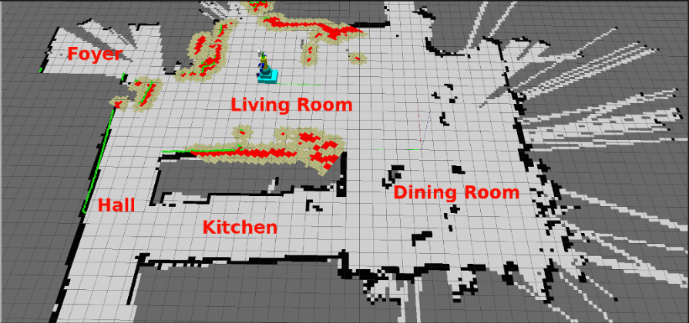
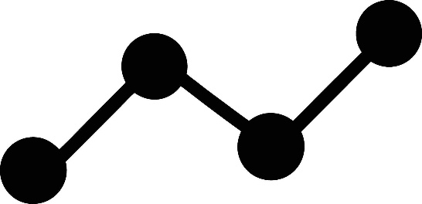
Pose Graph Optimization (PGO)
Simultaneous Localization and Mapping
(SLAM)
T₃
T_{2→3}
T_{1→2}
T₂
T₁
T_{0→1}
T₀
Source: https://sifsof.com/clinical-apps/simultaneous-localization-and-mapping-slam/
T_{i}: Pose at node i
T_{i→i+1}: Transform between nodes i, j

Slide 6
Pose Graph Optimization (PGO)
T_{i} / T_{i→i+1} : Six Degrees of Freedom (6DoF) Pose Matrix
T₃
r₀ | r₁ | r₂ | t₀
r₃ | r₄ | r₅ | t₁
r₆ | r₇ | r₈ | t₂
0 | 0 | 0 | 1
r_{i}: Rotation matrix
T_{2→3}
t_{i}: Translation vector
T_{1→2}
T₂
T₁
T_{0→1}
T_{i}: Absolute pose (relative to starting point)
➔ How do I rotate and translate to get from the starting point to the current node?
T_{i→i+1}: Relative transform between nodes
➔ How do I rotate and translate to get from one node to the next?
T₀

Slide 7
Methodology
1
Acquire pose predictions from DL model
Build initial pose graph
Add additional constraints
Add weights
Apply PGO
2
3
4
5

Slide 8
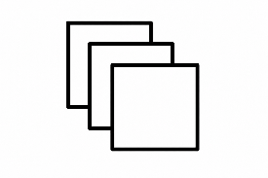
Acquire pose predictions from DL model
1
Pose predictions
absolute poses T_{i}
relative transforms T_{i→i+1}
UR Frames/Images
Feature vectors (FVs)
UR frames

Slide 9
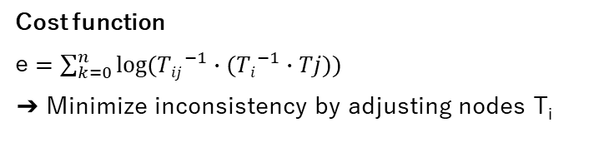
Build initial pose graph
2
Cost function
e $=\sum_{k=0}^{n}{log⁡({Tij}^{−1}∙({Ti}^{−1}∙Tj))}$
➔ Minimize inconsistency by adjusting nodes T_{i}
T₃
T_{2→3}
T_{i}
T_{i→i+1}
Optimizer
Gauss-Newton, Levenberg-Marquardt etc.
T_{1→2}
T₂
T₁
T_{0→1}
Noise Model/Weighting
Normal, Cauchy, Huber etc.
➔ Assume inconsistencies and errors in edges
T₀
!
This is not yet optimizable because of inherent consistency!

Slide 10
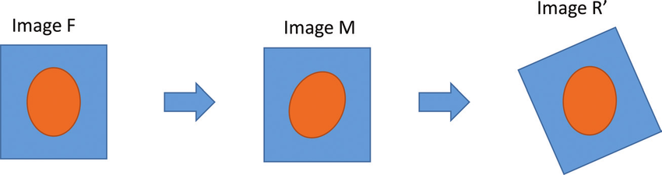
Detour
Image Registration (IR)
Find transform which makes one image align with another
Source: https://www.researchgate.net/figure/Basic-example-of-an-image-registration-procedure-F-is-the-target-image-M-is-the-image_fig4_320212021
➔ Create new edges for non-adjacent pairs of frame (i - j >= k, k > 1)

Slide 11
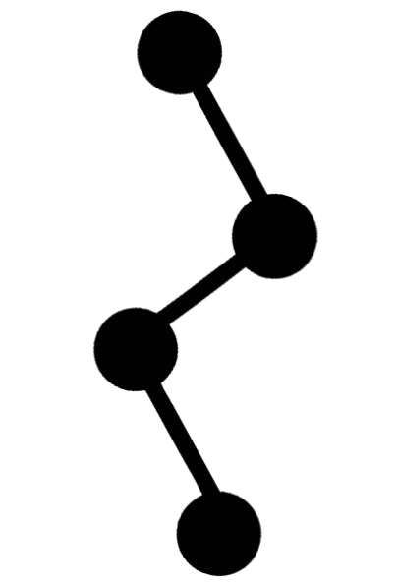
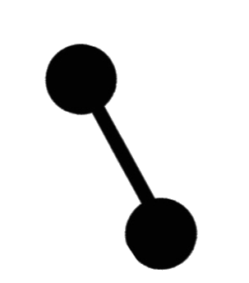
Detour
Loop Closure (LC)
Recognize already visited scan areas by comparing FVs found by DL model
T₃
T₃
T₃
T_{2→3}
T_{2→3}
T_{2→3}
T₂
T_{4→2}
T₄
T_{1→2}
T₂
T_{1→2}
T₂
T₁
T₁
T_{4→2}
T_{1→2}
T_{0→4}
T_{0→1}
T_{0→1}
T₄
T_{0→4}
T_{0→4}
T₁
!
T₀
!
T₀
T_{0→1}
T₀
FV T₄ ≈ FV T₂
T₄
➔ Create new edges for pairs of frames exhibiting a LC

Slide 12
Add additional constraints
3
T₃
T₃
T_{2→3}
T_{2→3}
T_{1→3}
T_{1→2}
T₂
T₂
Image Registration (IR)
Loop Closure (LC)
T_{1→2}
T₁
T₁
T_{0→2}
T_{0→1}
T_{0→1}
T₀
T₀
Initial pose graph
Extended pose graph

Slide 13
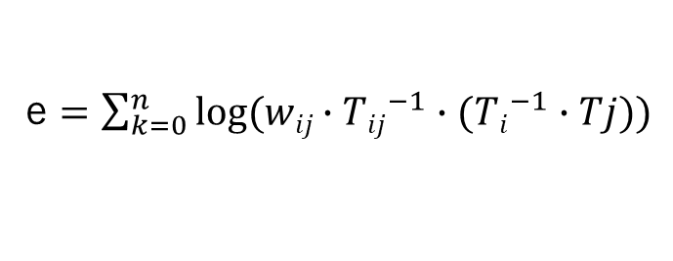
Add weights
4
Why do we add weights?
Weights allow edges to be rated in their confidence and influence on the cost function and thus the optimization
T₃
w2
w1
T₂
e $=\sum_{k=0}^{n}{log({wij∙Tij}^{−1}∙({Ti}^{−1}∙Tj))}$
T₁
w3
w0
➔ High weights: Edge has high impact on cost function
(vice versa for low weights)
T₀

Slide 14
Add weights
4
Initial edges
Lower weights, as the initial pose graph is to be optimized
Added edges
Higher weights, as these are the means of optimization
IR: Weights based on how well a newly found transform transforms
LC: Weights based on confidence of found LC

Slide 15
Apply PGO
5
Use added edges to optimize initial pose graph
Use adequate noise functions to handle outliers
Compare optimized node values (absolute poses) with GT

Slide 16
Error metrics
Commonly used error metrics in 3d UR reconstruction
Final Drift (FD): Offset of final frame compared to GT
Final Drift Rate (FDR): FD divided by trajectory length
Average error for relative transforms between frames
Average error for absolute poses
Maximum error in absolute poses
➔ Use these to compare optimized poses with GT
➔ Learn for fitting parameters or find heuristic for PGO

Slide 17
Setup
Models
DLCNet: FD of 17mm
<No name>: Approximate FDR of 15%
DualTrack (SODA): FD of 8mm
➔ Room for improvement
Data sets
FreehandUS data set: Training data for No-name-model
TUS-REC24 data set: TUS-REC challenge 2024
TUS-REC25 data set: TUS-REC challenge 2025
➔ Realistic, publicly available data sets with 3d UR frames and GT poses

Slide 18
Sources
[1] Chrissy A. Adriaans, Mark Wijkhuizen, Lennard M. van Karnenbeek, Freija Geldof, and Behdad Dashtbozorg. Trackerless 3d freehand ultrasound reconstruction: A review. Applied Sciences, 14(17):7991, 2024.
[2] Russell Buchanan et al. 3d freehand ultrasound using visual inertial and deep inertial odometry for measuring patellar tracking. 2024.
[3] Andrew H. Gee et al. Sensorless freehand 3d ultrasound in real tissue: speckle decorrelation without fully developed speckle. Medical image analysis, 10(2):137–149, 2006.
[4] Hengtao Guo, Sheng Xu, Bradford Wood, and Pingkun Yan. Sensorless freehand 3d ultrasound reconstruction via deep contextual learning.
[5] Qi Li et al. Tus-rec2024: A challenge to reconstruct 3d freehand ultrasound without external tracker.
[6] Loïc Tetrel, Hacène Chebrek, and Catherine Laporte. Learning for graph-based sensorless freehand 3d ultrasound. In Li Wang, Ehsan Adeli, Qian Wang, Yinghuan Shi, and Heung-Il Suk, editors, Machine Learning in Medical Imaging, volume 10019 of Lecture Notes in Computer Science, pages 205–212. Springer International Publishing, Cham, 2016.
[7] Paul F. R. Wilson et al. Dualtrack: Sensorless 3d ultrasound needs local and global context.
[8] Feng Youyang, Wang Qing, and Yang Gaochao. Incremental 3-d pose graph optimization for slam algorithm without marginalization. International Journal of Advanced Robotic Systems, 17(3), 2020.

