Slide 1
Pose Graph Optimization for Vision-Only Freehand 3D Ultrasound Reconstruction
Update 01.06.2026
Jannis Meyer

Slide 2
What did I do?
Enhance Image Registration (IR) (SimpleITK, rigid transform, only 2D so far!)
Metrics, optimizers, techniques, parameters
Evaluate IR on TUSREC24 validation data set (72 scans, no application to PGO here yet): Find frame poses only using IR
Writing Master Thesis
2

Slide 3
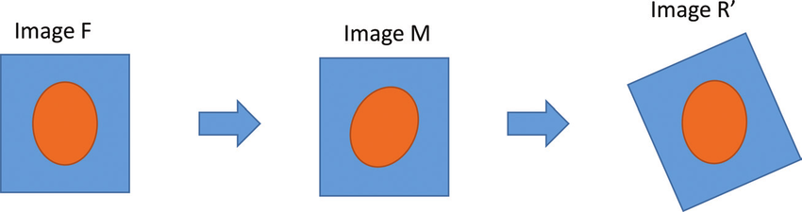
Image Registration: Basics
Find transform which makes one image align with another
Source: https://www.researchgate.net/figure/Basic-example-of-an-image-registration-procedure-F-is-the-target-image-M-is-the-image_fig4_320212021
F: fixed, M: moving
➔ SimpleITK: Finds T_{M➔F}
3

Slide 4
Image Registration: Combination of transforms
IR works in 2D and gives 3DoF transforms (x, y, yaw)
Volume reconstruction works in 3D and needs 6DoF transforms (x, y, z, pitch, yaw, roll)
➔ Combine 2D IR pose and 3D DualTrack pose:
IR
DualTrack
!
r₀ | r₁ | t_{x}
r₂ | r₃ | t_{y}
0 | 0 | 1
x, y, yaw
r₀ | r₁ | r₂ | t_{x}
r₃ | r₄ | r₅ | t_{y}
r₆ | r₇ | r₈ | t_{z}
0 | 0 | 0 | 1
r₀ | r₁ | r₂ | t_{x}
r₃ | r₄ | r₅ | t_{y}
r₆ | r₇ | r₈ | t_{z}
0 | 0 | 0 | 1
z, pitch, roll
4
4

Slide 5
Image Registration: SimpleITK
What works best so far (SimpleITK):
Metric: Mattes Mutual Information
Maximize information between fixed and moving image
Compute fixed, moving and joint PDFs over set of intensity bins, compute MI by summing over bins
50 histogram bins
Optimizer: Gradient Descent
Init with pose estimation from DualTrack (init with identity works almost equally well)
Learning rate 0.1, min. change 1e-4, 200 max. iterations
5

Slide 6
Image Registration: Results
TUSREC24 validation data set, 72 scans
DualTrack24: FDR 5.1%, GPE 4.9mm
IR: FDR 28.0%, GPE 9.9mm
6

Slide 7
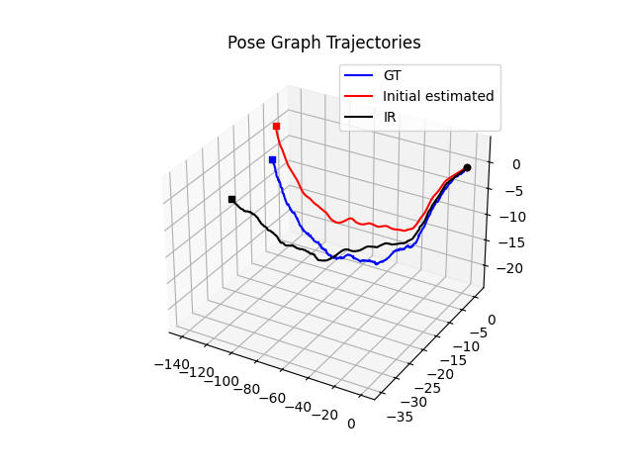
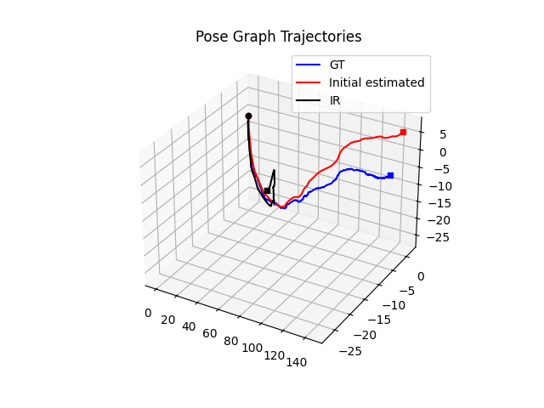
Image Registration: Results
7
Notes:
TUSREC24, one scan each
Only translation
General direction is fine
Again no jitter for DualTrack
IR retains jitter

Slide 8
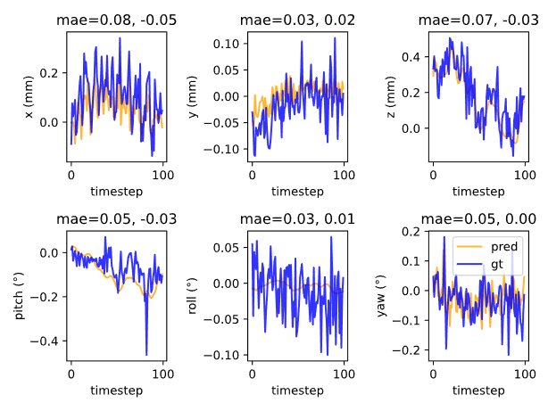
Image Registration: Results
Blue: GT
Yellow: IR
8
Notes:
TUSREC24, one scan, first 100 frames
general trend is fine
Note: z, pitch, roll from DualTrack: No jitter

Slide 9
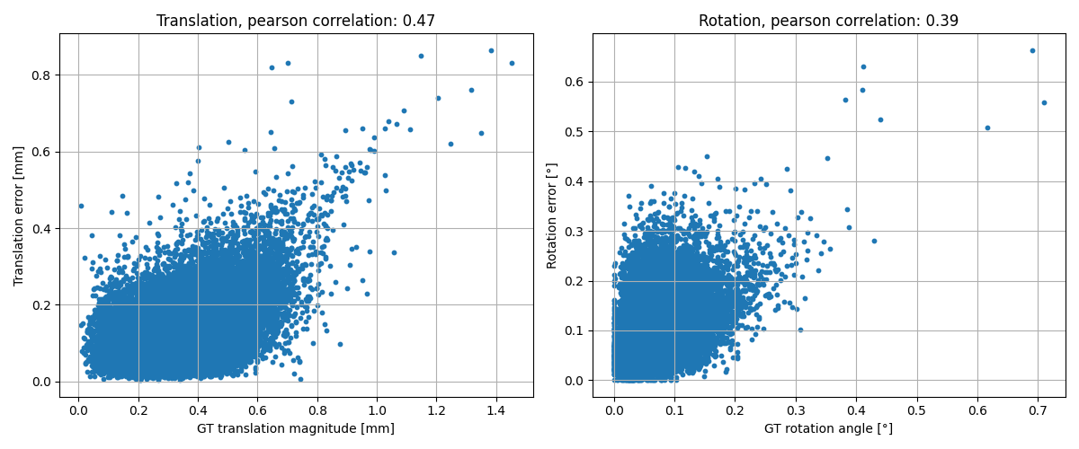
Image Registration: Results
Norm of translational vector Angle of the rotation
9
Notes:
TUSREC24, 72 scans
Slight correlation between transform magnitude and error, especially for large values

Slide 10
Image Registration: Problem
Problem:
2D IR does not account for out-of-plane motion (z axis) nor pitch and roll
y y
x
x z
➔ Features present in one picture are not necessarily present in the other (spawning feature problem)
➔ 2D IR cannot find a transform which makes the two images align perfectly
➔ GT transform will not yield a perfect error metric
10

Slide 11
Counter measures
Focus on center
Use only center for IR (SimpleITK: Region of Interest)
➔ Center 50% of both x and y
➔ Pixels near to the center are less affected by roll and pitch (center of rotation is the image center)
11

Slide 12
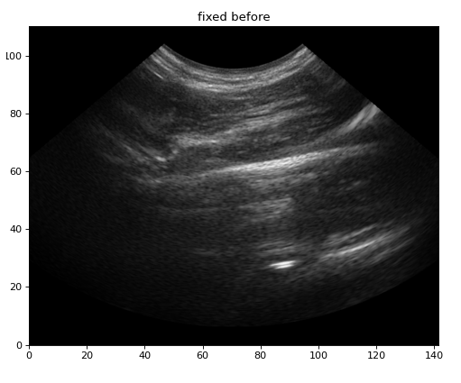
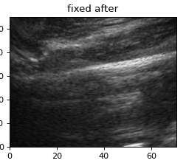
Counter measures
Focus on center
12

Slide 13
Counter measures
Patch and evaluate
Divide fixed and moving into patches
For every fixed patch:
Apply ref transform from DualTrack
Compare transformed fixed patch and corresponding moving patch
Consider for IR if similar (SimpleITK: Mask)
➔ 4x4 grid, Normalized Cross Correlation for comparison (value range [-1, 1]), threshold 0.7
➔ Patches with little similarity (due to a potential spawning feature) are discarded
13

Slide 14
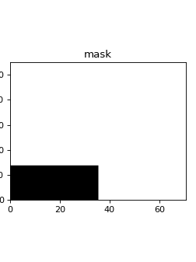
Counter measures
Patch and evaluate
Mask
White: keep
Black: discard
14

Slide 15
Counter measures
Focus on center
Improvement of >200% for FDR, GPE and run time for TUSREC24 validation data set
Patch and evaluate
Improvement of 5% for FDR, 1,5% for runtime
➔ But: IR still performs worse than DualTrack
DualTrack24: FDR 5.1%, GPE 4.9mm
IR with counter measures: FDR 11.4%, GPE 9.9mm
15

Slide 16
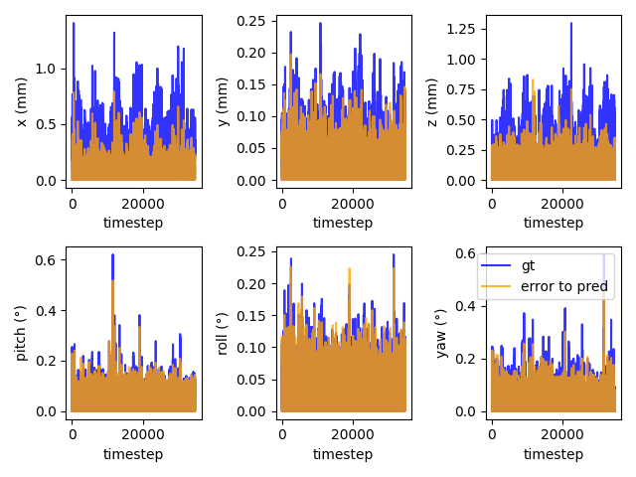
Error evaluations
Abs GT vs Abs Error
(DualTrack24 in-between Pred – GT, TUSREC24 72 scans combined)
➔ Again: Larger error for larger values
16

Slide 17
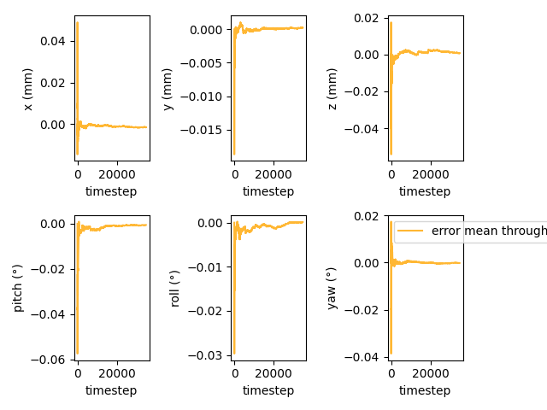
Error evaluations
Mean Error Through Time
(DualTrack24 in-between Pred – GT, TUSREC24 validation data set, all scans combined)
➔ Mean error of DualTrack is ~0 for all 6DoF
17
Notes:
translation: mm; rotation: angle

Slide 18
Error evaluations
GT vs Error mean absolute value for every 6DoF
(DualTrack24 in-between Pred – GT, TUSREC24 validation data set, all scans combined)
mm, º | X | Y | Z | Pitch | Yaw | Roll
GT | 0.244 | 0.0343 | 0.198 | 0.034 | 0.031 | 0.036
Error | 0.058 | 0.021 | 0.069 | 0.032 | 0.025 | 0.029
Ratio (Error/GT) | 23.8% | 61.2% | 34.8% | 94.1% | 80.6% | 80.6%
➔ Relative largest errors happen for y and pitch
➔ Larger relative errors for rotation than translation
18

Slide 19
Error evaluations: Speculations
➔ Images are 640x480 pixels (x, y)
➔ Less information on y axis, larger error for y and pitch
➔ Translation is easier to estimate as x and y are directly deductible from images
19

Slide 20
Next steps
Improve 2D IR
Combine with PGO
Jitter?
Error?
Try 3D IR
Write Master Thesis
20

