Slide 1
Pose Graph Optimization for Vision-Only Freehand 3D Ultrasound Reconstruction
Update 01.06.2026
Jannis Meyer

Slide 2
What did I do?
Enhance Image Registration (IR) (SimpleITK, only 2D so far!)
Metrics, optimizers, techniques, parameters
Evaluate IR on whole scans (no adaption to PGO here): Find frame poses only using IR
Writing Master Thesis
2

Slide 3
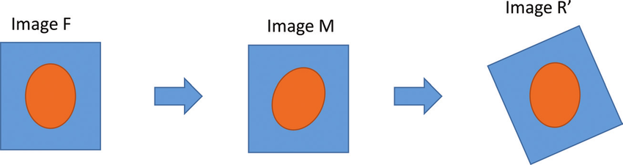
Image Registration: Basics
Find transform which makes one image align with another
Source: https://www.researchgate.net/figure/Basic-example-of-an-image-registration-procedure-F-is-the-target-image-M-is-the-image_fig4_320212021
F: fixed, M: moving
➔ SimpleITK: Finds T_{M➔F}
3

Slide 4
Image Registration: Combination of transforms
IR works in 2D and gives 3DoF transforms (x, y, yaw)
Volume reconstruction works in 3D and needs 6DoF transforms (x, y, z, pitch, yaw, roll)
➔ Combine 2D IR pose and 3D DualTrack pose:
IR
DualTrack
!
r₀ | r₁ | t_{x}
r₂ | r₃ | t_{y}
0 | 0 | 1
x, y, yaw
r₀ | r₁ | r₂ | t_{x}
r₃ | r₄ | r₅ | t_{y}
r₆ | r₇ | r₈ | t_{z}
0 | 0 | 0 | 1
r₀ | r₁ | r₂ | t_{x}
r₃ | r₄ | r₅ | t_{y}
r₆ | r₇ | r₈ | t_{z}
0 | 0 | 0 | 1
z, pitch, roll
4
4

Slide 5
Image Registration: SimpleITK
What works best so far (SimpleITK):
Metric: Mattes Mutual Information
Maximize information between fixed and moving image
Uses combination various probability distributions
Optimizer: Gradient Descent
Init with pose estimation from DualTrack (init with identity works almost equally well)
Extra: Multi Resolution
Perform IR on downsampled versions of fixed and moving and combine
Emphasize global features
Slight improvement of results
5

Slide 6
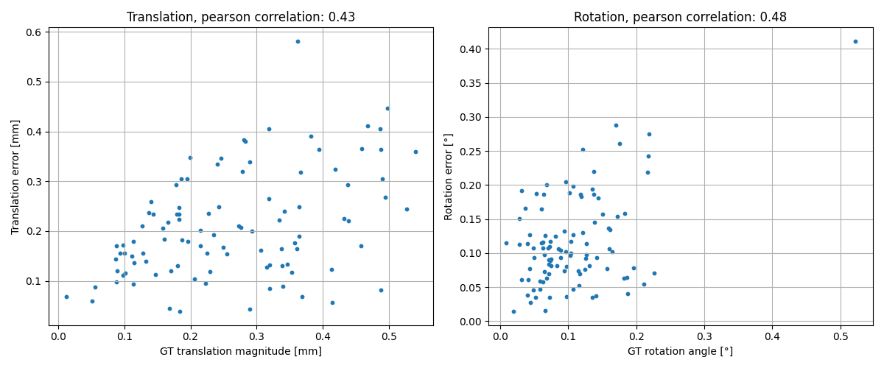
Image Registration: Results
Norm of translational vector Angle of the rotation
6
Notes:
One scan, first 100 frames
Slight correlation between transform magnitude and error

Slide 7
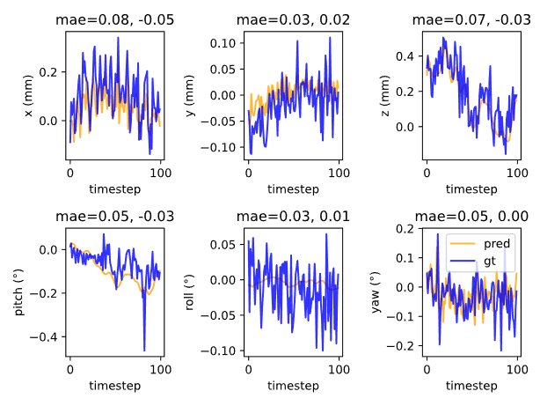
Image Registration: Results
Blue: GT
Yellow: IR
7
Notes:
general trend is fine
Note: z, pitch, roll from DualTrack: No jitter

Slide 8
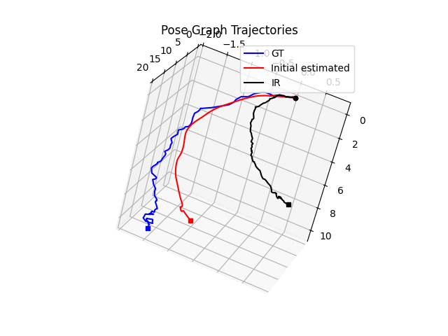
Image Registration: Results
8
Notes:
General direction is fine
Again no jitter for DualTrack
IR retains jitter

Slide 9
Image Registration: Problem
Problem:
2D IR does not account for out-of-plane motion (z axis)
y y
x
x z
➔ Features present in one picture are not necessarily present in the other
➔ 2D IR cannot find a transform which makes the two images align perfectly
➔ GT transform will not yield a perfect error metric
9

Slide 10
Next steps
Improve 2D IR
Combine with PGO
Try 3D IR
Write Master Thesis
10

