Slide 1
Pose Graph Optimization for Vision-Only Freehand 3D Ultrasound Reconstruction
Update 01.06.2026
Jannis Meyer

Slide 2
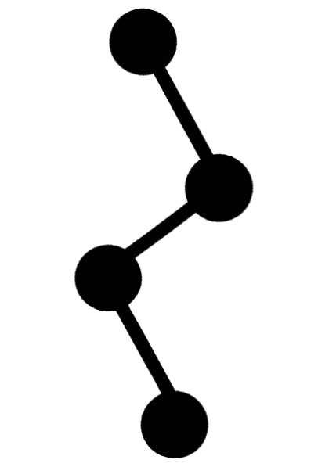
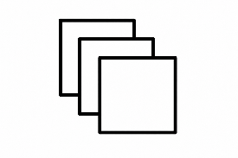

Reminder
T₃
Pose predictions
T_{i}
T_{i→i+1}
US Frames
FVs
T_{2→3}
T_{1→3}
T_{1→2}
T₂
US frames
T₁
T_{0→2}
T_{0→1}
T₀
TUSREC24/25
PGO
DualTrack (winner of TUSREC25)
2
Notes:
Reminder
US frames from TUSREC data for now
DT model for now
Get pose predictions and more from that
Build pose graph and optimize using extra constraints and weights

Slide 3
What did I do?
Set up DualTrack code
Set up TUSREC24/25 data
Implement PGO using GTSAM library
Implement LC
Implement IR using SimpleITK
Evaluations on DualTrack and TUSREC2/25 data with base PGO, LC, IR
Writing Master Thesis
3

Slide 4

Pose Graph Optimization
Optimization formula:
$e =\sum_{i,j=0}^{n}{log\left({Tij}^{−1}∙\left({Ti}^{−1}∙T_{j}\right)\right)}$ (no weights for simplicity)
➔ $e(x) =$ $\left\|r(x)\right\|2$, $x$ $≙$ set of variables to optimize
➔ $r\left(x+∆x\right)≈r\left(x\right)+J∆x$ , Jacobi matrix $J=\frac{∂r}{∂x}$, $r= \left(\begin{matrix}r_{0} \\ ⋮ \\ r_{k}\end{matrix}\right)$
➔ Linear optimization problem
➔ $J^{T}J∆x=−J^{T}r$ , compute $∆x$ for minimum $r$, update $x$, redo until $e$ converges
4
Notes:
More mathematical insights into PGO
Base optimization formula from last time
More general formulation
Linear optimization problem
Internal functionality of GTSAM

Slide 5

Pose Graph Optimization
Optimizer:
Levenberg-Marquardt: Additional factor to Jacobi-matrices for more control of optimization
${(J}^{T}J+$λ$J)∆x=−J^{T}r$
Weights:
Prior (first node): 6*10⁵
Rest: 6*10²
➔ Base line PGO, no individual weighting nor additional edges yet
5
Notes:
Parameters for PGO right now
No extra edges or weights

Slide 6
Loop Closure
def loop_closure(feature_vectors):
nns = find_nearest_neighbors(feature_vectors)
transforms = []
confidences = []
for el in nns:
if el.distance > threshold:
continue
valid, confidence, transform = register(el[0].image,
el[1].image,
el.ref_transform_dl)
if !valid:
continue
transforms.append(transform)
confidences.append(confidence+distance)
return transforms, confidences
6
Notes:
Parameters for PGO right now
No extra edges or weights

Slide 7
Image registration 1
def image_registration(frames):
transforms = []
confidences = []
frame_pairs = sample_pairs(frames, step_size=100)
for pair in pairs:
valid, confidence, transform = register(pair[0].image,
pair[1].image,
pair.ref_transform_dl)
if valid:
transforms.append(transform)
confidences.append(confidence)
return transforms, confidences
7
Notes:
Parameters for PGO right now
No extra edges or weights

Slide 8
Image registration 2
def register(image_1, image_2, ref_transform_dl):
reg = simpleItk.registration
reg.init(image_1, image_2, ref_transform_dl)
reg.metric = “mse”
metric_before = reg.get_metric()
transform = reg.register()
metric_after = reg.get_metric()
valid = true
confidence = metric_before - metric_after
if confidence > threshold:
valid = false
return valid, confidence, transform
8
Notes:
Parameters for PGO right now
No extra edges or weights

Slide 9
Pose graph optimization
graph = gtsam.graph()
graph.add_nodes(absolute_poses_dl)
graph.add_constraints(relative_transforms)
lc_constraints, lc_confidences = loop_closure(feature_vectors)
ir_constraints, ir_confidences = image_registration(images, ref_transforms_dl)
graph.add_constraints(lc_constraints,
lc_confidences,
ir_constraints,
ir_confidences)
new_absolute_poses = graph.optimize()
compare_metrics(absolute_poses_dl, new_absolute_poses, absolute_poses_gt)
9
Notes:
Parameters for PGO right now
No extra edges or weights

Slide 10
Error metrics in DualTrack
Final Drift Rate (FDR):
Error between pose prediction and GT of final frame (translation only)
Common error metric in 3D US reconstruction
Global Point Error (GPE):
“Average point error between the true position and the fully reconstructed trajectory estimate at each timestep”
Mentioned in DualTrack paper and TUSREC challenge
(Error equals Euclidian distance between estimated and GT point, regarding center and four corners)
10

Slide 11
Evaluations base pgo
 | DualTrack24 | DualTrack25 | DualTrack24 with PGO | DualTrack25 with PGO
TUSREC24 Validation Data (72 scans) | FDR: 5.1% GPE: 4.9mm (also stated in paper) | FDR: 28.5% GPE: 24.5mm | / | FDR: 28.6% GPE: 24.6mm
TUSREC25 Validation Data (six scans) | FDR: 488.8% GPE: 56.5mm | FDR: 72.9% GPE: 9.1mm (9.2mm stated in paper) | / | FDR: 72.5% GPE: 9.4mm
*FDR and GPE averaged over all scans
11
Notes:
See results
PGO on DT24 currently not possible as DT24 code doesn’t provide individual results for a single frame, just overall
No GPE for PGO results as I didn’t have the time yet to implement that

Slide 12
Evaluations LC and IR (DT25)
 | DualTrack25 | LC | IR
TUSREC24 Validation Data (72 scans) | FDR: 28.5% GPE: 24.5mm | FDR: 28.6% GPE: 24.6mm | FDR: 70.1% GPE: 60.1mm
TUSREC25 Validation Data (six scans) | FDR: 72.9% GPE: 9.1mm (9.2mm stated in paper) | FDR: 249.5% GPE: 51.4mm | FDR: 517.5% GPE: 80.8mm
*FDR and GPE averaged over all scans
12
Notes:
See results
PGO on DT24 currently not possible as DT24 code doesn’t provide individual results for a single frame, just overall
No GPE for PGO results as I didn’t have the time yet to implement that

Slide 13
Explanations of Results
Bad FDR for 25/25:
Complex scanning motion
TUSREC challenge rating does not evaluate FDR
Low performance for cross-evaluation:
Different TUSREC24 and TUSREC25 data sets
No calibration or retraining of models
Near-zero dis-/improvement from base PGO:
Base line, perfect consistency of graph
Very low performance for LC and IR:
Many parameters
Complex scanning motion
US domain
➔ So far any new constraint from LC or IR worsens results, the more extra constraints the worse
13

Slide 14
Next steps
Improve LC and IR:
Other libraries
Parameters + logic
Evaluate data: Where do biggest errors happen? What is DualTrack bad at?
Consider translation and rotation separately
Implement trajectory smoothing: find outliers in trajectory and smoothen, average multiple smoothed trajectories
If time: Evaluate on TUSREC training data
Writing Master thesis
14

Slide 15
Sources
https://github-pages.ucl.ac.uk/tus-rec-challenge/
https://arxiv.org/pdf/2509.09530/
https://borglab.github.io/gtsam/
https://borglab.github.io/gtsam/nonlinearoptimizer/
https://borglab.github.io/gtsam/betweenfactor/
15

