Slide 1
Pose Graph Optimization for Vision-Only Freehand 3D Ultrasound Reconstruction
Proposal for Master Thesis
Jannis Meyer

Slide 2


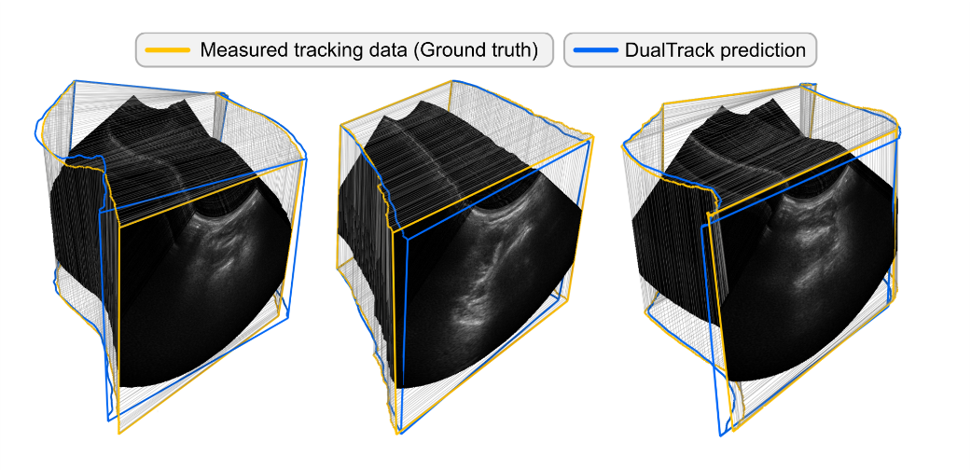
Introduction
3D Ultrasound (UR)
Expensive
Not always available
Limited resolution
3D UR Reconstruction
2D UR Images + Probe Pose = 3D Volume
Source: https://github.com/ImFusionGmbH/DualTrack
Notes:
There are 3d and 2d UR devices
3d allows for better overview and diagnosis
3d UR has lower resolution as more volume has to be scanned with the same UR beam
reconstruct volumetric data from freehand 2d UR + probe pose

Slide 3



How do we get the probes pose?
Tracking Probe
Speckle Decorrelation
Deep Learning (DL)
Oftentimes: Additional data from IMU, external sensor etc.
➔ Current research focusses on vision-only DL methods
➔ Main Problems: Drift, Generalizability, Reproducibility
Notes:
Tracking probe using cameras, electromagentic sensors etc.: hassle to setup, sensors can fail, interference
Speckle Decorrelation: Speckle is essentially blurry part of UR images, dependant on scanned tissue, motion can be estimated from how speckle changes: not always reliable, speckle filtering
DL: feed DL model images + maybe extra data, it then estimates poses
Problems: Drift (accumulated error in estimated trajectory vs. actual trajectory), G and R (no public data, perfect setups, )
Many models out there which are already pretty good (given only images are used)
Here my research comes into play: increase pose estimation quality retrospectively for given model estimations

Slide 4
Research proposal
Build a pose graph from estimated probe poses
Use Pose Graph Optimization (PGO) to increase pose estimation accuracy
Existing research: Use of external sensor or IMU data, tests on non-public data sets; implicit global consistency
➔ Vision-only; explicit attention to global consistency; usage of realistic, publicly available data
Research hypothesis
“PGO will improve pose estimation performance and consistency of vision-based DL methods for 3d UR reconstruction.”
Notes:
pose graph: nodes as poses at frames, edges as relative transforms/movement between those

Slide 5
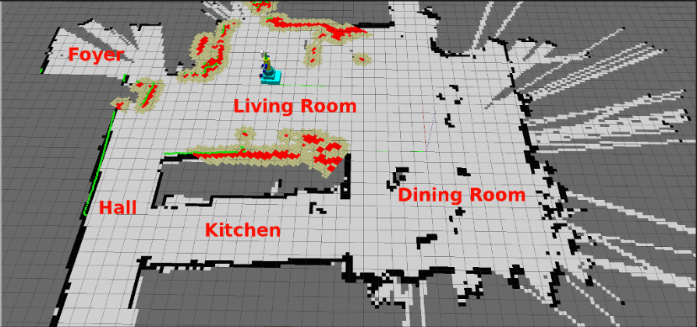
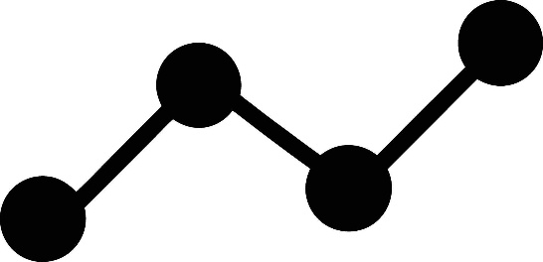
Pose Graph Optimization (PGO)
Simultaneous Localization and Mapping
(SLAM)
T₃
T_{2→3}
T_{1→2}
T₂
T₁
T_{0→1}
T₀
Source: https://sifsof.com/clinical-apps/simultaneous-localization-and-mapping-slam/
T_{i}: Pose at node i
T_{i→i+1}: Transform between nodes i, j

Slide 6
Pose Graph Optimization (PGO)
T_{i} / T_{i→i+1} : Six Degrees of Freedom (6DoF) Pose Matrix
T₃
r₀ | r₁ | r₂ | t₀
r₃ | r₄ | r₅ | t₁
r₆ | r₇ | r₈ | t₂
0 | 0 | 0 | 1
r_{i}: Rotation matrix
T_{2→3}
t_{i}: Translation vector
T_{1→2}
T₂
T₁
T_{0→1}
T_{i}: Absolute pose (relative to starting point)
➔ How do I rotate and translate to get from the starting point to the current node?
T_{i→i+1}: Relative transform between nodes
➔ How do I rotate and translate to get from one node to the next?
T₀
Notes:
What do nodes and edges even mean in a pose graph?
6dof matrix represents a pose: matrix multiplied with object will translate and rotate it by the given values
node: pose relative to starting point, edge: relative pose between two nodes

Slide 7
Methodology
1
Acquire pose predictions from DL model
Build initial pose graph
Add extra constraints
Add weights
Apply PGO
2
3
4
5

Slide 8
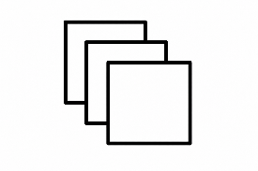
Acquire pose predictions from DL model
1
Pose predictions
absolute poses T_{i}
relative transforms T_{i→i+1}
UR Frames/Images
Feature vectors (FVs)
UR frames

Slide 9
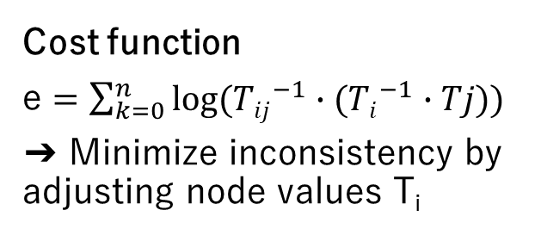
Build initial pose graph
2
Cost function
e $=\sum_{k=0}^{n}{log⁡({Tij}^{−1}∙({Ti}^{−1}∙Tj))}$
➔ Minimize inconsistency by adjusting node values T_{i}
T₃
T_{2→3}
T_{i}
T_{i→i+1}
T_{1→2}
T₂
T₁
Noise Model
Normal, Cauchy, Huber etc.
➔ Assume small inconsistencies in graph
T_{0→1}
T₀
!
This is not yet optimizable because of inherent consistency!
Notes:
build initial graph from estimated poses
cost function: check if edge and two node values are consistent -> minimize inconsistencies
noise model: assume small inconsistencies, distribution of inconsistency -> weighting of edges

Slide 10
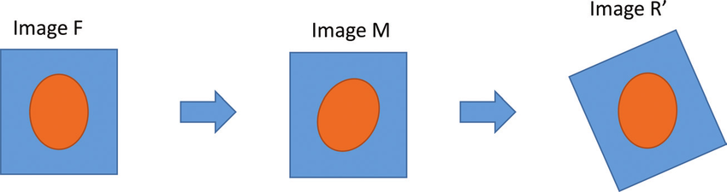
Detour
Image Registration (IR)
Find transform which makes one image align with another
Source: https://www.researchgate.net/figure/Basic-example-of-an-image-registration-procedure-F-is-the-target-image-M-is-the-image_fig4_320212021
➔ Add new edges between non-adjacent pairs of frame (i - j >= k, k > 1)
➔ Create redundancy
Notes:
quick detours before step 3
what we are doing here is essentially just IR with transform consisting of translation and rotation
add new edges

Slide 11
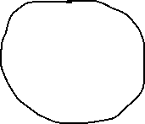


Detour
Loop Closure (LC)
Recognize already visited areas
Correct
GT
Estimate
LC

Slide 12


Detour
Loop Closure (LC)
Recognize already visited scan areas by comparing FVs of frames
T₃
T₃
T₃
T_{2→3}
T_{2→3}
T_{2→3}
T₂
T_{4→2}
T₄
T_{1→2}
T₂
T_{1→2}
T₂
T₁
T₁
T_{4→2}
T_{1→2}
T_{0→4}
T_{0→1}
T_{0→1}
T₄
T_{0→4}
T_{0→4}
T₁
!
T₀
!
T₀
T_{0→1}
T₀
FV T₄ ≈ FV T₂
T₄
➔ Add new edges between pairs of frames exhibiting a LC
➔ Correct graph

Slide 13
Add extra constraints
3
T₃
T₃
T_{2→3}
T_{2→3}
T_{1→3}
T_{1→2}
T₂
Image Registration (IR)
Loop Closure (LC)
T_{1→2}
T₂
T₁
T₁
T_{0→2}
T_{0→1}
T_{0→1}
T₀
T₀
Initial pose graph
Extended pose graph

Slide 14
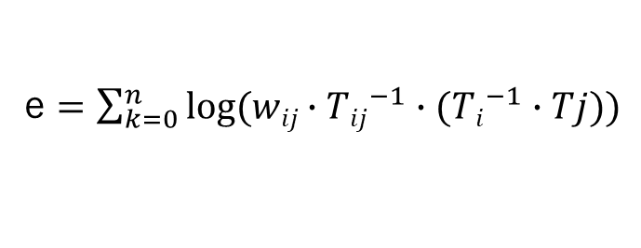
Add weights
4
Why do we add weights?
Weights allow edges to be rated in their confidence and influence on the cost function and thus the optimization
T₃
w2
w1
T₂
e $=\sum_{k=0}^{n}{log({wij∙Tij}^{−1}∙({Ti}^{−1}∙Tj))}$
T₁
w3
w0
High weights: Edge has high impact on cost function
(vice versa for low weights)
T₀

Slide 15
Add weights
4
Initial edges
Lower weights, as the initial pose graph is to be optimized
Added edges
Higher weights, as these are the means of optimization
IR: Weights based on how well a newly found transform transforms
LC: Weights based on confidence of found LC

Slide 16
Apply PGO
5
Use added edges to optimize initial pose graph
Compare optimized absolute poses (nodes) with GT

Slide 17
Error metrics
Commonly used error metrics in 3d UR reconstruction
Final Drift (FD): Offset of final frame pose compared to GT
Final Drift Rate (FDR): FD divided by trajectory length
Average error of relative transforms between frames (edges)
Average error of absolute poses (nodes)
Maximum error of absolute poses
➔ Use these to compare optimized poses with GT and initial DL estimations
➔Find heuristic for/learn PGO parameters
Notes:
many error metrics
Average edge error: How incorrect is the estimated motion?
Average node error: How incorrect are the estimated poses/postions?
useful selection listed here

Slide 18
Setup
Models
DLCNet: FD of 17mm
<No name>: Approximate FDR of 15%
DualTrack (SODA): FD of 8mm
➔ Room for improvement
Data sets
FreehandUS data set: Training data for No-name-model
TUS-REC24 data set: TUS-REC challenge 2024
TUS-REC25 data set: TUS-REC challenge 2025
➔ Realistic, publicly available data sets with UR frames, estimated and GT poses

Slide 19
Sources
[1] Chrissy A. Adriaans, Mark Wijkhuizen, Lennard M. van Karnenbeek, Freija Geldof, and Behdad Dashtbozorg. Trackerless 3d freehand ultrasound reconstruction: A review. Applied Sciences, 14(17):7991, 2024.
[2] Russell Buchanan et al. 3d freehand ultrasound using visual inertial and deep inertial odometry for measuring patellar tracking. 2024.
[3] Andrew H. Gee et al. Sensorless freehand 3d ultrasound in real tissue: speckle decorrelation without fully developed speckle. Medical image analysis, 10(2):137–149, 2006.
[4] Hengtao Guo, Sheng Xu, Bradford Wood, and Pingkun Yan. Sensorless freehand 3d ultrasound reconstruction via deep contextual learning.
[5] Qi Li et al. Tus-rec2024: A challenge to reconstruct 3d freehand ultrasound without external tracker.
[6] Loïc Tetrel, Hacène Chebrek, and Catherine Laporte. Learning for graph-based sensorless freehand 3d ultrasound. In Li Wang, Ehsan Adeli, Qian Wang, Yinghuan Shi, and Heung-Il Suk, editors, Machine Learning in Medical Imaging, volume 10019 of Lecture Notes in Computer Science, pages 205–212. Springer International Publishing, Cham, 2016.
[7] Paul F. R. Wilson et al. Dualtrack: Sensorless 3d ultrasound needs local and global context.
[8] Feng Youyang, Wang Qing, and Yang Gaochao. Incremental 3-d pose graph optimization for slam algorithm without marginalization. International Journal of Advanced Robotic Systems, 17(3), 2020.

