Slide 1
Concurrency
Exercise 2

Slide 2
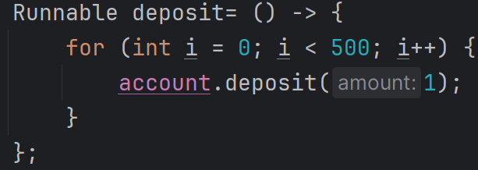
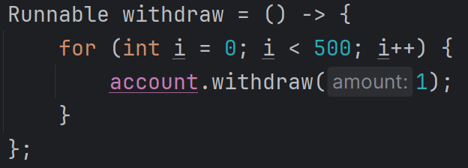
Problem 1

Slide 3

Problem 1

Slide 4
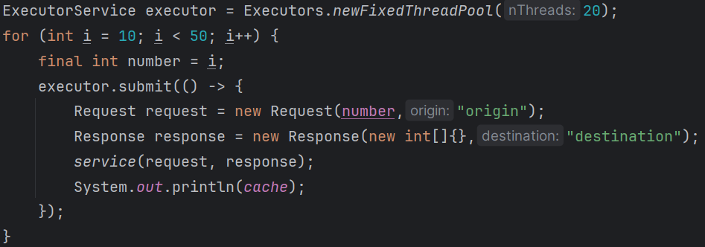
Problem 2

Slide 5
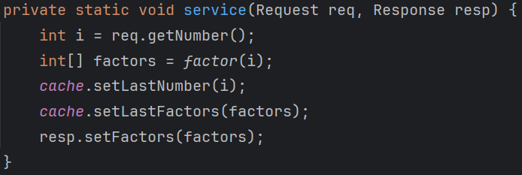
Problem 2

Slide 6
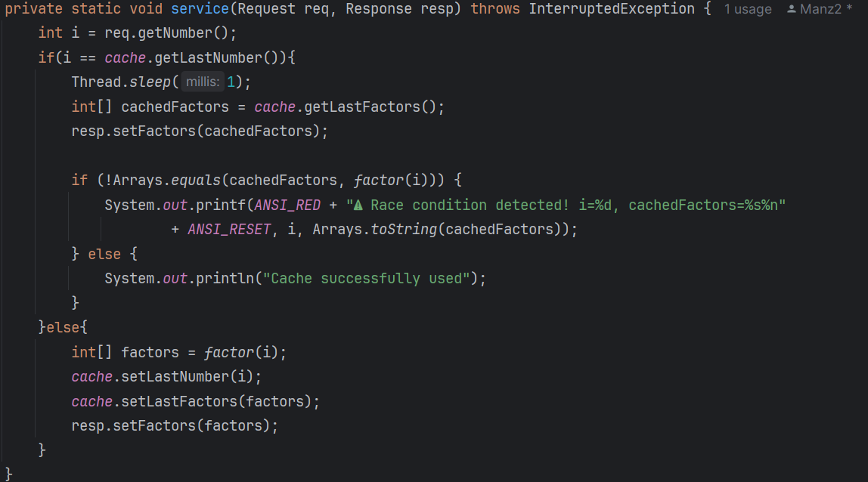
Problem 3

Slide 7

Problem 4

Slide 8

Problem 4

Slide 9
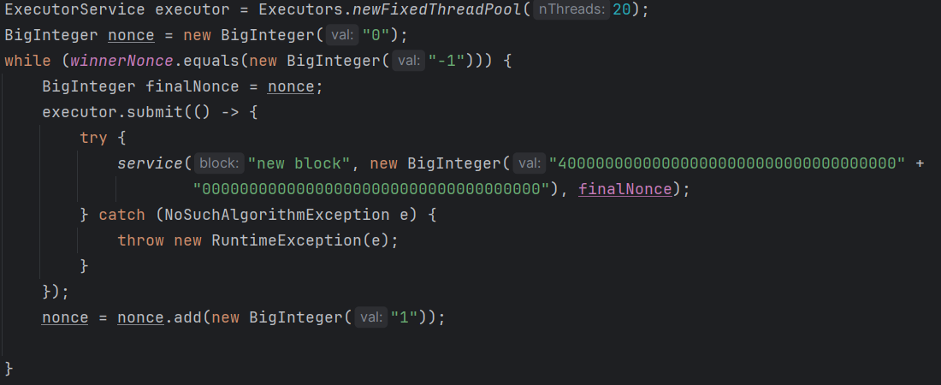
Problem 4

