Slide 1

Hackaburg 2025
complioty Challenge
Ignacy Alwasiak
Jannis Meyer
Tatsuki Monji

Slide 2


What does it do?
„Hey SecPrompt, tell me about device CVE-123!“
DB
„Sure, let me think…“
„CVE-123 has the following vulnerabilities: …“

Slide 3
Architecture
Graph RAG
Frontend
LangChain
Gemini
Neo4j DB
WebSocket

Slide 4
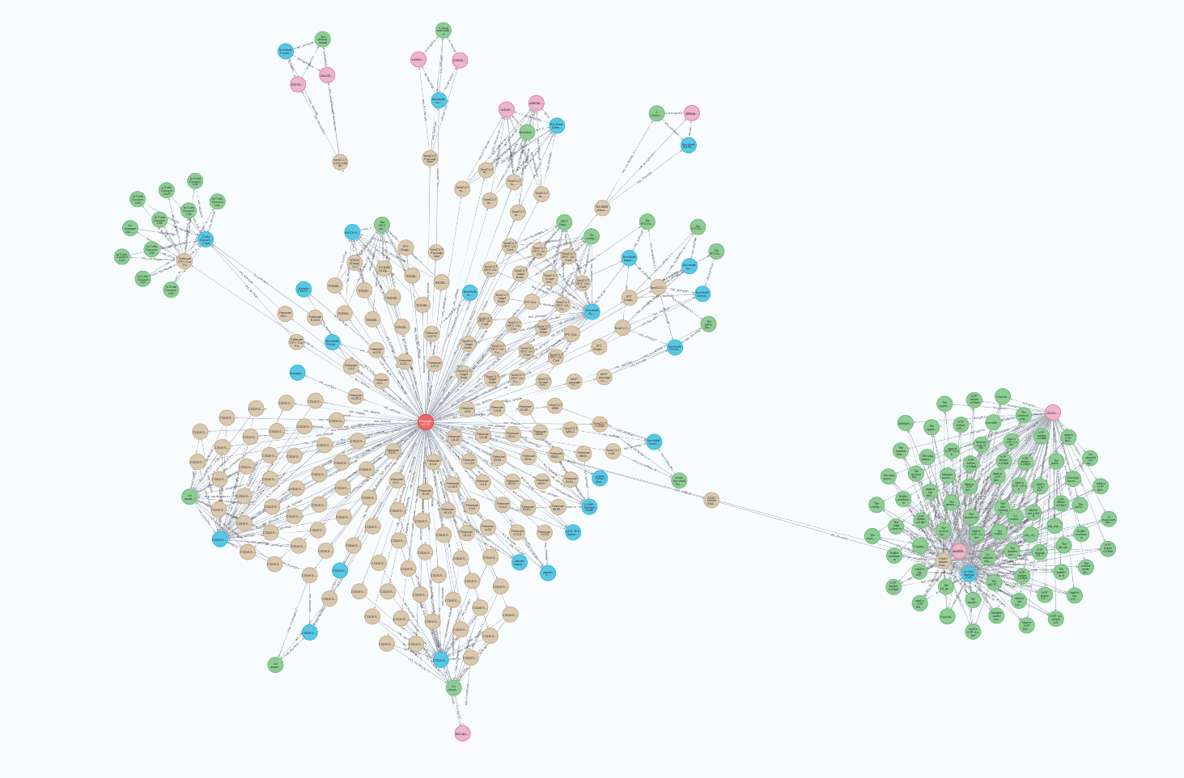
Neo4j Database

Slide 5


Retrieval-Augmented Generation (RAG)

Slide 6



Frontend & WebSocket

Slide 7
Thank you!
Ignacy Alwasiak
Jannis Meyer
Tatsuki Monji

