Slide 1
autoSense FullStack Developer
Take-home Exercise

Slide 2
Agenda
Requirement Analysis
Architecture
Implementation Decisions
Review

Slide 3
Requirement Analysis
“[…] build a simple web application that can display fuel stations on a map where the user (administrator) can add new stations and change some basic details of existing ones.”

Slide 4
Requirement Analysis - Backend
API key authentication
RESTful API for fuel stations
Create, Read, Update, Delete
Update can only change fuelstation name and the price of existing pumps
Tech
Node.js with Typescript
Express.js
MongoDB
Swagger for API Documentation
{
"id": "MIGROL_100041",
"name": "Migrol Tankstelle",
"address": "Scheffelstrasse 16",
"city": "Zürich",
"latitude": 47.3943939,
"longitude": 8.52981,
"pumps": [
{
"id": 10001,
"fuel_type": "BENZIN_95",
"price": 1.68,
"available": true
}, ]
}

Slide 5
Requirement Analysis - Frontend
Map that displays all existing fuel stations → GET ALL
Clicking of fuel station provides its details → GET
User can update fuel station name and pump prices → UPDATE
User can add a new station with all its details → CREATE
User can delete a fuel station → DELETE
User is assumed to be logged in → no login required
Tech
Vue.JS 3
Vuetify 3

Slide 6
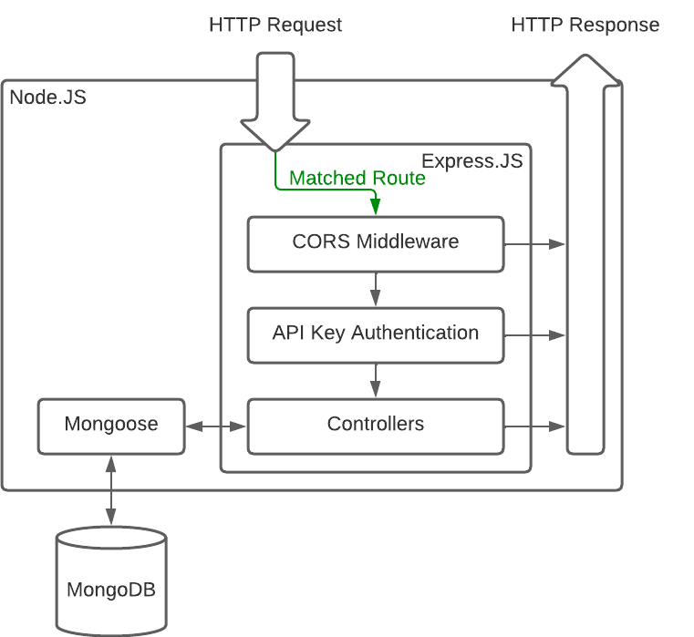
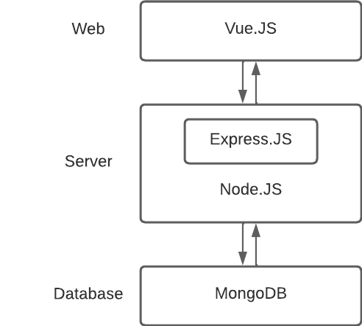
Architecture

Slide 7
Implementation Decisions - Backend
API Routing
'/fuelstations' → Create, GetAll
'/fuelstations/:id‘ → Get, Update, Delete
Fuel station Model
Mongoose schema
Pumps as subdocument of Fuelstation

Slide 8
Implementation Decisions - Backend
const fuelstationSchema = new Schema(
{
id: {
type: Schema.Types.String,
required: true,
unique: true,
},
name: {
type: Schema.Types.String,
required: true,
},
[...]
pumps: {
type: [pumpSchema],
required: false,
},
},
{
collection: 'fuelstations',
timestamps: true,
},
);
const pumpSchema = new Schema(
{
id: {
type: Schema.Types.String,
required: true,
},
fuel_type: {
type: Schema.Types.String,
required: true,
},
price: {
type: Schema.Types.Decimal128,
required: true,
},
available: {
type: Schema.Types.Boolean,
required: true,
},
},
{
timestamps: true,
},
);
Subdocument

Slide 9
Implementation Decisions - Backend
Business logic in controllers
Essentials
Input validation → Type safety
Error handling
Data consistency

Slide 10
Implementation Decisions - Frontend
Use map library Maplibre GL JS
Map type from maptiler
Main Vue component is map → MapVue
MapVue should get all fuel stations from backend and add them as markers to map
Popup of each marker gets populated with a div containing fuel station ID

Slide 11
Implementation Decisions - Frontend
Vue component for accessing, updating, and deleting fuel station details → ModifyFuelstationVue
ModifyFuelstationVue is mounted to popup div container → If user clicks popup, it will load the details of the clicked fuel station
Vue component for creating new fuel station → CreateFuelstationVue
Button to toggle fuel station creation mode → if active, clicking somewhere on the map adds a temporary marker and opens its popup where CreateFuelstationVue is mounted. If user submits the fuelstation is added and the map is reloaded. If user clicks on the map the marker gets removed and nothing happens.

Slide 12
Outlook
Implement End-2-End tests using cypress
Implement unit tests for backend and frontend
Fix data consistency for Update API endpoint, e.g., transactions (all-or-nothing)
Don’t force reload after adding new fuel station in frontend. Use seamless transition by adding new marker
Make popup always centered on display, so that users don’t have to move the map to see all its contents

