Slide 1

RESEARCH METHODS
R E S E A R C H M E T H O D S F O R C O M P U T E R
S C I E N C E

Slide 2

RESEARCH METHOD
The research method / methodology:
A description of how you obtained results, i.e. what you did to reach your conclusions
Convinces the reader of the validity of your conclusions
Proposal stage:
Explain what method you will use and how it will be applied in your study
Will you be collecting any data? What will you do with it?
Final report stage:
Report on what you actually did (i.e. tweak the description in
your proposal so that it accurately reflects what you did)

Slide 3
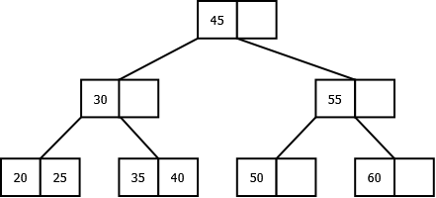

ASSESSING VALIDITY OF A RESEARCH FINDING
Example: Continental drift
In 1903 Alfred Wegener proposed the theory that continents drift
He noticed that the coastline of the Americas matched the coastlines of Africa & Europe, so he wondered whether they were once joined together
With a theory, he started looking for evidence:
The geology matched up on the edges (e.g. coal seams)
Matching up of fossils & animals
His theory was ridiculed by experts of the time (no theory on how it happens)
1953:Theory of plate tectonics finally led to acceptance of continental drift

Slide 4

ASSESSING VALIDITY OF A RESEARCH FINDING
Example: Guns & Crime
Research study A has shown that more guns means less crime
Research study B has shown that more guns means more crime
Which study do you believe?
Will a logical argument convince you?
A: More guns deters criminals, so results in less crime
B: More guns results in more deadly aggression, so more crime

Slide 5
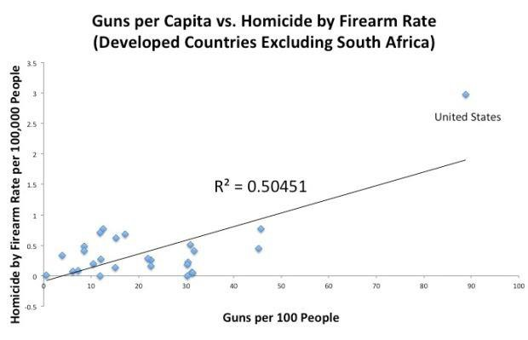
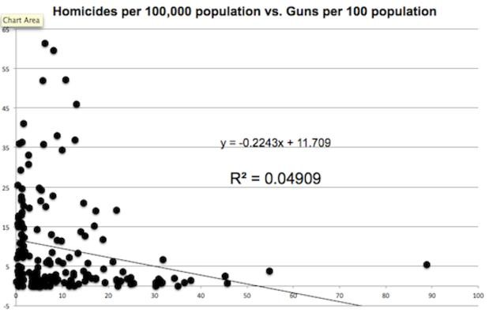
ASSESSING VALIDITY OF A RESEARCH FINDING
Example: Guns & Crime
Research study A has shown that more guns means less crime
Research study B has shown that more guns means more crime
Which study do you believe?
Will an empirical study convince you?
A: Study that shows a positive correlation between gun ownership and crime
B: Study that shows a negative correlation between gun ownership and crime

Slide 6

ASSESSING VALIDITY OF A RESEARCH FINDING
What affects whether research is accepted or not?
The context (current knowledge, opinions)
How research is done (the methods used)
You can’t do anything about the context
But you can do something about how you do your research
The methods that you use must be acceptable to the research community that you work in

Slide 7
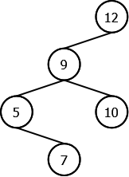
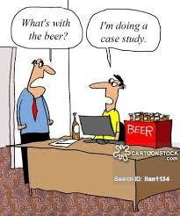
COMMON COMPUTER SCIENCE RESEARCH APPROACHES
Many different approaches are used in Computer Science
Some of the more common ones are:
Literature Surveys
Models
Languages
Prototypes
Algorithms
Mathematical proofs
Experiments / Evaluations
Case Studies
Arguments
A research project may combine a number of these approaches

Slide 8
COMMON COMPUTER SCIENCE RESEARCH APPROACHES
Example
A research project that proposes a new language for specifying GUIs
Literature survey on related languages that points out the need for the new language
Language definition: specification of the syntax and semantics
Prototype: may construct a prototype compiler / environment for the language
Experiment: may conduct an experiment that compares the construction time of a user interface using the new system and another existing system
Evaluation: may conduct an evaluation of system by typical users (developers)

Slide 9

LITERATURE SURVEYS
Provide an overview of the literature in a particular aspect of a topic
All research studies will have a limited literature survey
Extended literature survey is when it is the main focus of the research
Requires a lot of reading
Although no “new” contribution in terms of results, extended literature
surveys should provide new perspectives on the field
New structure to the topic (classification or taxonomy)
A new way of understanding the topic
Identification of gaps in the field
It is all about classification and linking
You cannot classify something that you do not understand well
Surveys are extremely useful for other researchers
Look for published surveys (STARs) in your topic

Slide 10
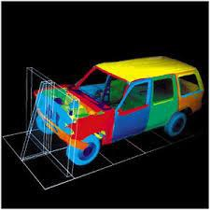
MODELS
Useful because they are usually easier to understand than the real thing being modelled
Important aspects are abstracted
Detail that is not central to the problem is left out
Often used to propose a new idea
Alternative to implementing the whole system / process
Example: a new reference architecture for some domain
Can be proposed formally or informally
Formal: Mathematical models
Informal: Diagram
If the main contribution is the proposal of a model, then it IS necessary to
demonstrate the merits of the new model
“Remember that all models are wrong; the practical question is how wrong do they have to be to not be useful.” – George E.P Box

Slide 11

LANGUAGES
A new language can be proposed to clarify some aspect of the research
Example: A new type of database may require a new language
The syntax and semantics must be defined (maybe not completely)
Should indicate from literature why other languages are insufficient

Slide 12
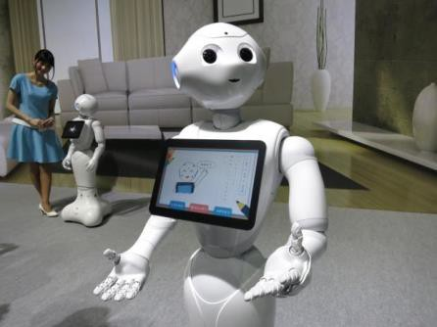
PROTOTYPES
Although programming on its own is not research, prototypes can
form part of the research process
Types of prototypes used in research:
“Proof-of-concept” prototype:
Prototype demonstrates that a proposed model can be implemented
Note: not really a proof
Prototypes for experimentation:
Create a prototype to make observations & run experiments (either on the
software itself or on users using the software)
Exploratory research:
Create a prototype to learn lessons from the process of creating the
prototype (for a particular environment, for example)
Can be used to discover new knowledge

Slide 13

ALGORITHMS
Sometimes the purpose of a study is to propose a new algorithm for a specific problem:
The algorithm may be for a problem for which there does not exist an algorithm yet
The algorithm may be a better algorithm than the existing algorithms. In this
case it needs to be shown that it is better.
Requires simulations
Or proof in the case of a computational complexity angle.
Sometimes an algorithm is not the major thrust, but is part of the research
How to report on an algorithms is not always obvious:
What notation to use?
What level of detail to give?
Look at examples of papers in that field to see what is normally done

Slide 14
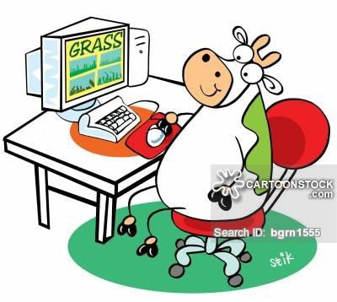
EXPERIMENTS
Main idea is to try something and note what happens:
Exploratory experiment:
Play around with something to see what happens
Experiment to test a theory:
Design an experiment
Conduct experiment
Observe results
Experiment to empirically validate a theory/hypothesis (typically simulations):
Design statistical experiment
Formulate hypotheses
Conduct experiment
Collect data
Process data
Test hypotheses

Slide 15
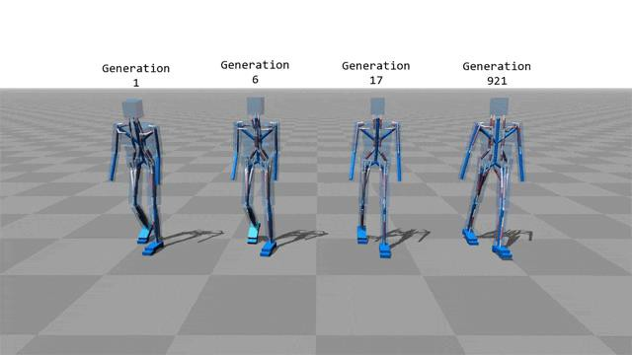
EXPERIMENTS (CONT.)
Statistics is an important part of experimentation:
Descriptive statistics (measures & graphs)
Formulating & testing hypotheses
Testing correlation
Are the results statistically significant?

Slide 16
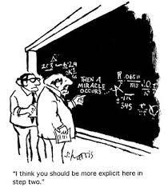
MATHEMATICAL PROOFS
If a mathematical proof is correct, it cannot be disputed
Examples of things that can be proved:
Computability & algorithmic complexity
Correctness
Combinatorics & graph theory
Behaviour of an algorithm (such as a stochastic algorithm)

Slide 17
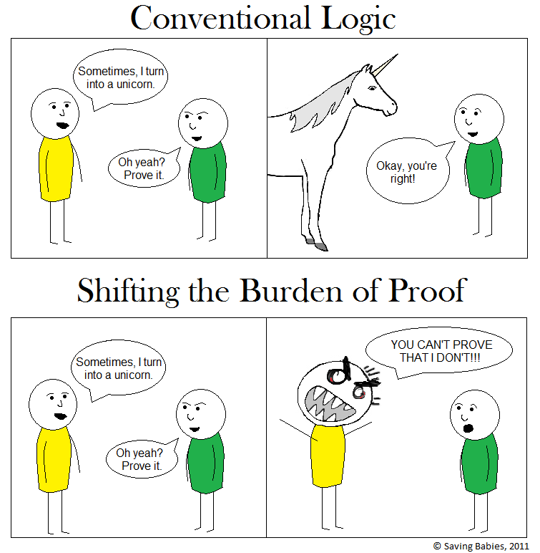
MATHEMATICAL PROOFS (CONT.)
Before any statement can be proved, it must be phrased in mathematical
notation, such as:
Sets, functions and relations
Propositional or predicate logic
Finite-state automata
Petri nets
Formal grammars
Specification languages
Mathematical deduction:
From a starting point (assumptions) use mathematical deduction to reach conclusions

Slide 18
MATHEMATICAL PROOFS (CONT.)
There are many techniques to valid mathematical proof.
The best approach depends on the statement to be proved.
There is often many ways of proving the same statement.
In this case people often use the most “elegant” way or he way that provides the most insight into to the mathematical statement.
This is however subjective

Slide 19
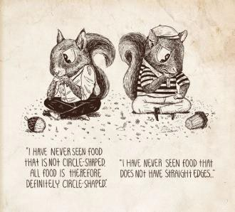
ARGUMENTS
All research requires some argumentation:
Argue that your proposed model is better
Argue that your results support your claims
Argue that your experimental setup is valid for the study
When reasoning is used to back up your claims

Slide 20
ARGUMENTS
Common arguments:
The proposed model is simpler than existing models. Simplicity is a desirable characteristic of models.Therefore, the proposed model is better.
The experimental variable was different for the experimental control
groups. All other variables were the same for the two groups. Therefore, the observed differences between the two groups can be attributed to the experimental variable.
2
0

Slide 21

SURVEYS
Surveys are used to obtain information from the people in the field (for computer science, this would normally be the users)
Can range from highly structured questionnaires to unstructured interviews
Can also involve counting (e.g. incidents on the Internet)
If surveys involve people, will require ethical clearance!
Not often used in Computer Science

Slide 22

CASE STUDIES
A case study is an approach where you investigate a particular case in a structured way
The particular case may be worth investigating, but usually the aim is to extrapolate the findings to similar cases
Similar to survey:
Survey: Measures a few aspects of a large number of cases
Case study: Observes a large number of aspects of a few cases
Results can be qualitative or quantitative

Slide 23
EXAMPLE 1
Scenario: New protocols that have been described in literature
Research question: Are the protocols suitable for application in the given environment?
Possible approaches to research:
Case study as the main approach:
Carry out a literature survey on the application environment and on the protocols
Find a study on applying the protocol in the environment, study the case and report on it
Field experiment & prototype construction:
Carry out a literature survey as above
Construct a prototype & deploy it in a number of real-life situations
Observe the results and report on the findings (what was learnt from the exercise)

Slide 24
EXAMPLE 1 (CONT.)
Scenario: New protocols that have been described in literature
Research question: Are the protocols suitable for application in the given environment?
Possible approaches to research:
3. Argument as the main approach:
Carry out a literature survey as above
Argue, based on the known characteristics and restrictions of the protocol and on the requirements of the application, the suitability of the protocol
Whether the above approaches would constitute research or not will depend on the contribution:
– If the application is obvious, then none of the approaches would be regarded as research

Slide 25
EXAMPLE 2
Scenario: Some new paradigm (evolutionary-oriented programming) is used to develop software and has become very popular. Someone has argued that evolutionary- oriented databases (EOD) are not only possible, but also beneficial. Some models have been proposed for such databases.
Research question: What is the best way to do transactions in EOD databases?
Possible approaches to research:
Model & argument:
Study the literature on EOD models in depth and find that there are no
models for EOD transactions
Design a model of transactions in EODs
Argue that the model supports transactions & fits into the new paradigm
Model & prototype:
Conduct literature survey & design a model as above
Construct a prototype of the model
State that it is possible to implement the model & share lessons learnt from the implementation

Slide 26
EXAMPLE 2 (CONT.)
Scenario: Some new paradigm (evolutionary-oriented programming) is used to develop software and has become very popular. Someone has argued that evolutionary- oriented databases (EOD) are not only possible, but also beneficial. Some models have been proposed for such databases.
Research question: What is the best way to do transactions in EOD databases?
Possible approaches to research:
Prototype:
Conduct a literature survey and find a proposed model of transactions
Construct a prototype of the proposed model
State that it is possible to implement the model & share lessons learnt from the implementation
Mathematical proof:
Model the properties of the new database and transactions mathematically
Prove some properties of transactions in the new database mathematically
Which approach would you regard as the weakest? Why?

Slide 27

INDIVIDUAL EXERCISE
For your topic:
Which research methods will you use?
Why?
Your answer should come across clearly in your research proposal.

Slide 28
REFERENCES
“Information Technology Research: A practical guide for Computer Science and Informatics”, Martin S. Olivier, 3rd edition, 2009,Van Schaik.
Slides from Prof Katherine Malan (adapted for this lecture)

