Slide 1
Ping Flooding Prevention
ONOS Hackthon Report
Group-2

Slide 2
Outline
Requirement Analysis
Design Discussion
Implementation

Slide 3
One Ping APP
One Ping App
ONOS Controller
Device 1
Device 2
Device 3
Host 1
Host 2
Host1 first time ping host2 could pass, but the second or more time ping is dropped within 60s. And in the next 60s, another first ping is allowed, and second or more time ping is forbidden.

Slide 4
Requirement Analysis
mitigate the impact to the network for unnecessarily frequent or malicious pings
Design goals
Fulfill the basic functionality
One-ping-pass for each 60s interval
Reduce resource consumption
Avoid unnecessary packet exchange between controller-switch
Extend to more realistic usage scenarios
Multi-host, multi-switch

Slide 5
Outline
Requirement Analysis
Design Discussion
Implementation

Slide 6
Basic Design
Start
Initialization
For each received packet, loop
Differentiate 1st ping and other pings
Allow 1st ping and block other pings
Clean up at the end of 60s interval
The question:
Need controller to do the differentiation
Initialization
Ping Differentiation
Ping Handling
End

Slide 7
Solicit pings to controller: Adding 1st Flow Entry
Start
Initialization
By default, each ping to packetin to controller. Controller installs the default 1st Flow Entry to all the Switches
For each received packet, loop
Differentiate 1st ping and other pings
Controller to identify the 1st ping from the other pings
Allow 1st ping and block other pings
Controller to block all the other pings
Clean up at the end of 60s interval
The next question:
How to do the differentiation?
Initialization
Install packet-in FE
Ping Differentiation
Ping handling: pass/block
End

Slide 8
Differentiate 1st ping from the others: Adding first_flag
Start
Initialization
Set first_flag=1
By default, each ping to packetin to controller Controller installs the default 1st Flow Entry to all the Switches
For each received packet, loop
For each packet received
Check the value of first_flag and differentiate 1st ping from successors
update first_flag accordingly
Pass 1st ping and block other pings
Clean up
Reset first_flag=1
The next question:
Wasted resource for pings to be dropped at controller?
Initialization
Install packet-in FE
Set first_flag=1
Ping Differentiation
Check first_flag?=1
Ping Handling
Set first_flag=0
End

Slide 9
Issue #1: Each ping goes up to controller, consuming bandwidth between centralized controller and switches
One Ping App
Proposed Solution
ONOS Controller
Install Drop FE
Device
ONOS Controller
Life span of 60s
Packet_in*N
FE expires
Device 1
Device 2
Device 3
ICMP Packet-in again
…..
ICMP*N
Host 1
Host 2
Notes:
不配置下发Drop操作流表也可以实现OnePing的功能，但会造成大量的Packet_in报文，与节省网络资源的目的不符

Slide 10
Adding 2nd Flow Entry
Start
Initialization
By default, each ping to packetin to controller Controller installs the default 1st Flow Entry to all the Switches
For each received packet, loop
Differentiate 1st ping and other pings
Controller to identify the 1st ping from the other pings
Allow 1st ping and block other pings
1st ping: pass down to next switch
Other pings: block
2nd Flow Entry: Drop for the next 60s all the pings from the source
Clean up
Remove 2nd Flow Entry at the end of 60s
The next question:
What if pings are sent very frequent so that a second ping arrives before the installation and activation of the dropping FE accomplishes in the targeted switch?
Initialization
Install packet-in FE
Set first_flag=1
Ping Differentiation
Check first_flag?=1
Ping Handling
Set first_flag=0
Install drop FE
End

Slide 11
Issue #2: Controller needs to be prepared for consecutive packet-in pings before the dropping FE reaches the switch and become effective.
Problem Illustration
Solution
Start
Set first_flag=1
ONOS Controller
ICMP Packet_1
Device
Non-first Ping?
ICMP Packet_2
Y
N
Install Dropping FE
Install FE, drop subsequent ICMP packets from Host1
Drop
Set first_flag=0 in 60s.
End
End
Notes:
在连续报文这种极端情况下的处理解决方案 （当执行Drop动作的流表下发至Device前，控制器已经收到了两个或多个控制器报文）

Slide 12
Handling Rushing-in Pings
Start
Initialization
By default, each ping to packet-in to controller Controller installs the default 1st Flow Entry to all the Switches
For each received packet, loop
Differentiate 1st ping and other pings
Controller to identify the 1st ping from the other pings
Allow 1st ping and block other pings
1st ping: pass down to next switch
Other pings: block
2nd Flow Entry: Drop for the next 60s all the pings from the source
Clean up
Remove 2nd Flow Entry at the end of 60s
The next question:
Can we support regulation for multiple hosts?
Initialization
Install packet-in FE
Set first_flag=1
Ping Differentiation
Check first_flag?=1
Ping Handling
Set first_flag=0
Install drop FE
Drop other pings
End

Slide 13
Handling Multiple Hosts
Replace the bool flag with a recorded list for each src_mac, dst_mac pairs
Use it to check if the ping packet is the 1st ping or not
One Ping App
ONOS Controller
maintain a checklist for pinged (src_mac, dst_mac) pairs
Device 1
Device 2
Device 3
M
。。。
N
。。。
Host 1
Host 3
Host 2
Host 4

Slide 14
Handling Multiple Hosts
Start
Check if the received packet is icmp?
Initialization
By default, each ping to packetin to controller Controller installs the default 1st Flow Entry to all the Switches
Set record_list = null
For each received packet, loop
Differentiate 1st ping and other pings
Controller to identify the 1st ping from the other pings
Allow 1st ping and block other pings
1st ping: pass down to next switch
check the record_list for 1st pings, add it to the list if not present 2nd Flow Entry: Drop for the next 60s all the pings from the source and target macs
Clean up
Remove 2nd Flow Entry at the end of 60s
Flush the record_list at the end of 60s
Y
Acquire the Src_Mac and Dst_Mac for the arrived ping packet
Check it against the record_list for a match?
Y
N
Install an dropping FE, for matching packet of the same (src_mac and dst_mac) ICMP packets
Drop the packet
End
Add an entry for the (src_mac, dst_mac) to the record_list.
Flush the list every 60s
The next question:
What if there are multiple switches on the ping path?
End

Slide 15
Handling Multiple Switches
Start
Check if the received packet is icmp?
Initialization
By default, each ping to packetin to controller Controller installs the default 1st Flow Entry to all the Switches
Set record_list = null
For each received packet, loop
Differentiate 1st ping and other pings
Controller to identify the 1st ping from the other pings
Allow 1st ping and block other pings
1st ping: pass down to next switch
check the record_list for 1st pings, add it to the list if not present 2nd Flow Entry: Drop for the next 60s all the pings from the source and target macs
Clean up
Remove 2nd Flow Entry at the end of 60s
Flush the record_list at the end of 60s
Y
Acquire the Src_Mac, Dst_Mac and device_id for the arrviced ping packet
Check it against the record_list for a match?
Y
N
Install an dropping FE, for matching packet of the same (src_mac and dst_mac, device_id) ICMP packets
Drop the packet
End
Add an entry for the (src_mac, dst_mac, device_id) to the record_list.
Flush the list every 60s
The next question:
What if there are multiple switches on the ping path?
End

Slide 16
Two consecutive FEs for non-first pings
Allow to pass for a short time;
Block afterwards by the end of 60s.
LatencyMeasurePing
One Ping App
Start
Controller figures out if the packet is 1st ping?
Y
ONOS Controller
Y
Acquire the Src_Mac, Dst_Mac and device_id for the arrviced ping packet
Pass to next S
Check it against the record_list for a match?
End
Device 1
Device 2
Device 3
Y
N
Install an forwarding FE, for matching packet of the same (src_mac, dst_mac, device_id) ICMP packets for 1s.
Install an dropping FE for 59s.
Drop the packet.
Host 1
Host 2
End
OnePingApp delay measurement path
Add an entry for the (src_mac, dst_mac) to the record_list.
Flush the list every 60s
Original ping delay measurement path
End
Notes:
Ping功能的作用：1）验证端到端业务路径连通性；2）得到端到端业务路径时延；
OnePingApp解决方案返回的时延是经过控制器的时延（红色线）；
LatencyMeasurePing功能可以实现在减少Ping报文数量的前提下，返回业务路径时延（绿色线）；

Slide 17
Outline
Requirement Analysis
Design Discussion
Implementation

Slide 18
Building Blocks for Basic Implementation
Key Classes used
public interface PacketProcessor; //the main process for packet handling process
public interface PacketService; //the interface for packet handling
public interface FlowObjectiveService; //Service Interface for flow objective
Key Functions used
PacketService related
void addProcessor(PacketProcessor processor, int priority) // add a new processor to the main function
FlowObjectiveService related
void forward(DeviceId Id, ForwardingObjective forwardingObjective) // install the 1st and 2nd flow entry with a life span of 60 seconds

Slide 19
开始
Start
下发ICMP转发流表1，将ICMP报文上送控制器
flowObjectiveService.forward
控制器判断是否为ICMP报文
IsIcmp(Ethnet)
否
N
Y
是
ethnet.getSourceMAC;
packetContext.inPacket().receivedFrom().deviceId();
获取Src_Mac，Dst_Mac，Device_Id
转到FWD处理模块
FwdPacketProcess
结束
END
根据上述参数检查是否被ping过
if (hasPinged)
是
Y
否
N
下发流表，对匹配Src_Mac，Dst_Mac的ICMP报文执行Drop动作
中断操作，丢弃报文
flowObjectiveService.forward
packetContext.block();
将Src_Mac，Dst_Mac，Device_Id作为List加入是否被ping过的筛选模块，并设置生存周期为60s
hasPingedHost.add
(srcMac,dstMac,deviceId)
结束
End
转到FWD处理模块
FwdPacketProcess
结束
End

Slide 20
Simplifying the tasks for the Controller
Start
flowObjectiveService.forward
Controller might be loaded for the lookups into Record_list
Multi-keyed
Hash-mapping
Resource consuming
Controller→ single point of failure
Implementation Compromise
Eliminate the record_list from controller
The network might be allowing consecutive pings to pass during a short time period (before the 2nd FE is installed and take effection, but the controller is protected.
More simple, more realistic solution.
IsIcmp(Ethnet)
N
Y
ethnet.getSourceMAC;
packetContext.inPacket().receivedFrom().deviceId();
FwdPacketProcess
END
if (hasPinged)
Y
N
flowObjectiveService.forward
packetContext.block();
hasPingedHost.add
(srcMac,dstMac,deviceId)
End
FwdPacketProcess
End

Slide 21
Workaround for Hard-timeout
Start
Install the 1st FE
Packet-in for ICMP packets
Hard-timeout is expected to be set with 2nd FE
We assumed that requestPacket() supports hard-timeout
But the reality is
The forwarding ping request is always passed, while
The returning ping ack is always blocked
Something is wrong…
It is idle-time out which is supported
And with No NB API found for setting hard-timeout
We came up with a workaround
IsICMP?
N
Y
Acquire Src_Mac，Dst_Mac，Device_Id for the packet
Forward to FWD
End
Install 2nd FE, dropping ICMP packets matching (Src_Mac,Dst_Mac)
Override the 2nd FE
After 60s, install 3rd FE, packet-in ICMP packets matching (Src_mac, Dst_mac)
Outdated FE expires naturally and get deleted after idle_timeout.

Slide 22
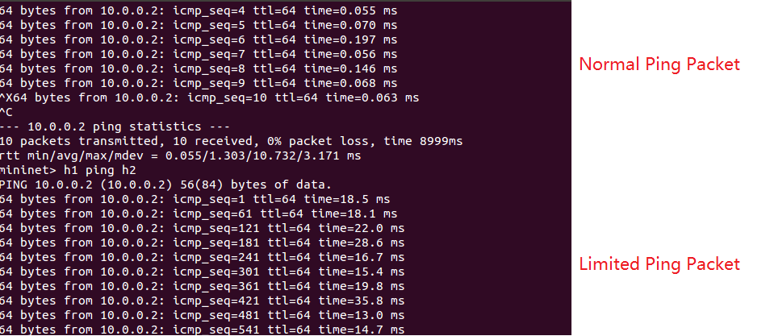
Demo Basic Functionality

Slide 23
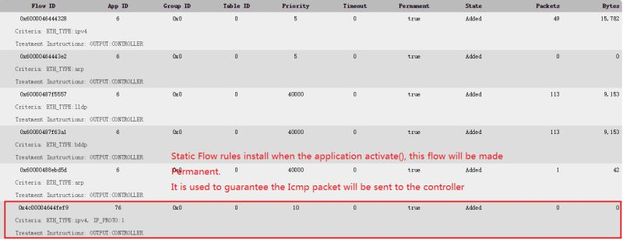
Demo 1st FE (Static Packet-in rule in Initialization Phase)

Slide 24
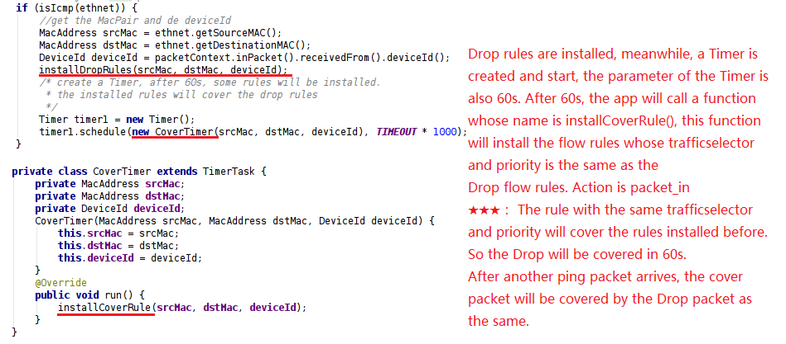
Demo Core code (FE Coverup Feature)

Slide 25
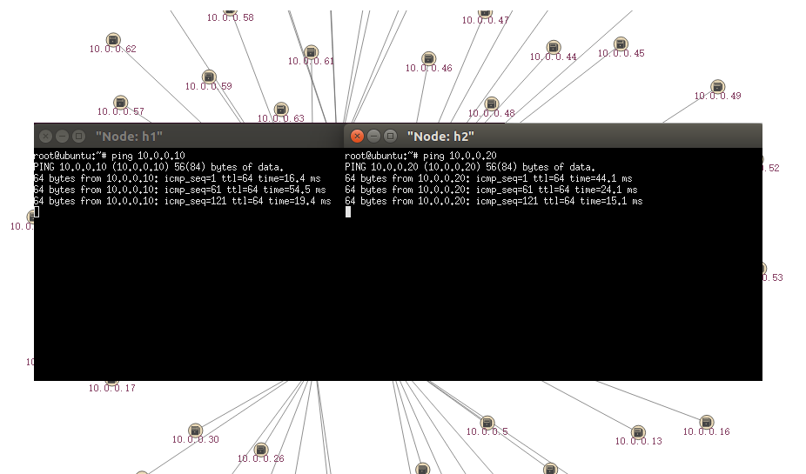
Demo Multi-Host and Multi-Device Feature

Slide 26
Demo Summary
Simplicity: FE cover-up feature
Network-friendly: reduced packet-in messages, reduced bandwidth consumption between controller and switches
Controller-friendly: rely on the data plane to enforce the policy, reduced local computation resource consumption to the controller
Scalability: with a light-weight implementation on the controller side, the system scales better with the number of switches
Notes:
四个优点：
巧妙地利用了流表会cover的特性，选择了简单的实现方法 Simplecity
避免了packet_in的消息数量，减少了带宽的占用
将60s内通ping包的判断策略在数据平面上实现，控制器通过简单的流表策略即可实现，避免了复杂的计算，减轻了控制器的负担
4. 旧方法需要在控制层维护一个HushMap，大的拓扑的时候维护很困难

Slide 27

Thank you.

