Slide 1
Scientific question
Smartphone motion sensors as a proof‑of‑concept digital biomarker for gait stability
Can accelerometer and gyroscope signals distinguish normal walking from unstable walking?
Sensors
Cleaning
Features
Accelerometer
Gyroscope
split gaps
trim duration
resample 50 Hz
variability
jerk
peak intervals
Hypothesis: unstable walking causes more irregular and abrupt motion patterns.
Medical relevance: gait instability can be a signal for fall risk, balance problems, medication side effects, fatigue, or disease progression.
Answer
Compare digital biomarkers between walking conditions
Experiment 1: normal walking
Experiment 2: unstable walking
1
2
2
8.88s
participant
conditions
phone sensors
matched analysis window
Study design
Two short walking recordings were analyzed from the uploaded sensor JSON. Because the raw timestamps included a gap in experiment 1, the analysis uses continuous segments and relative sensor time instead of raw wall-clock duration.
Exercise 10 · Digital Biomarker
1/3
Notes:
Slide 1 introduces the scientific question and the experimental setup. Emphasize that this is a proof of concept rather than clinical validation.

Slide 2
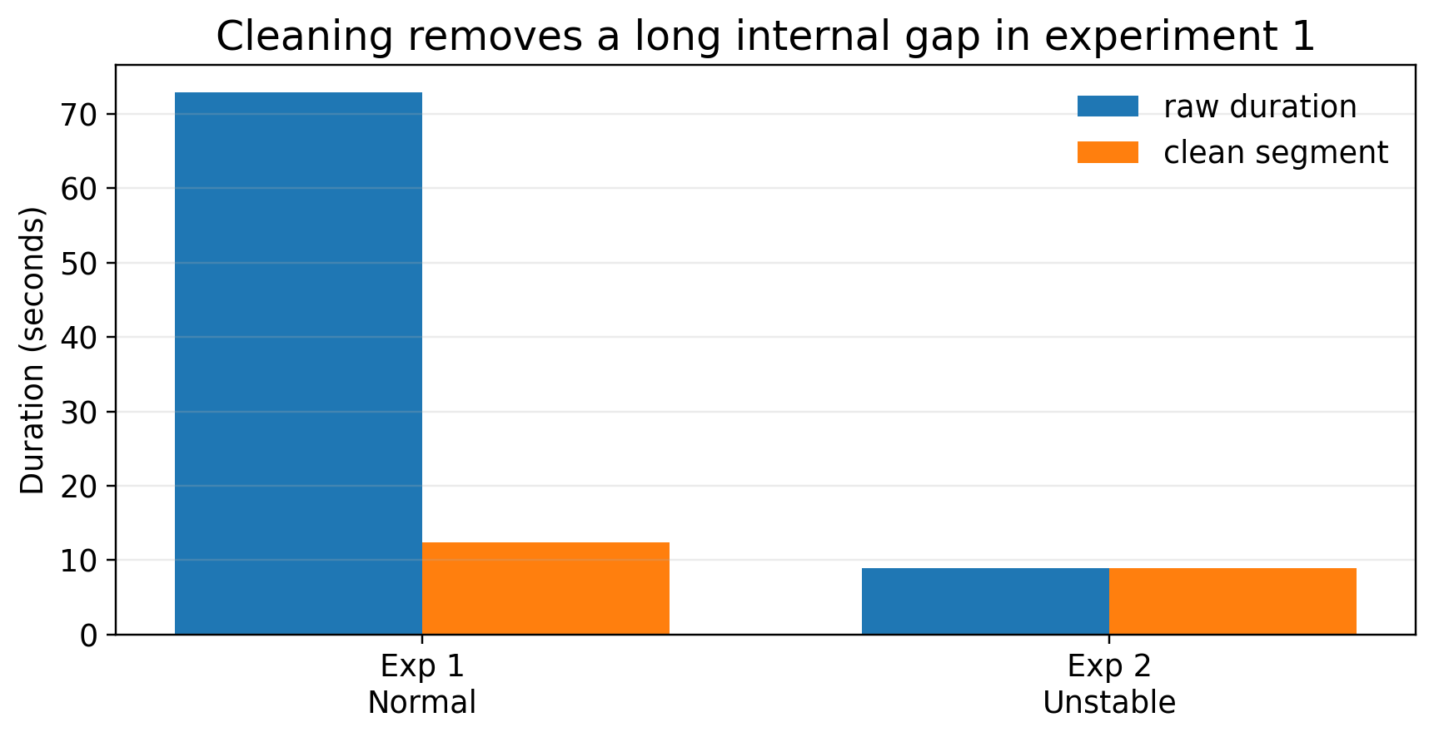
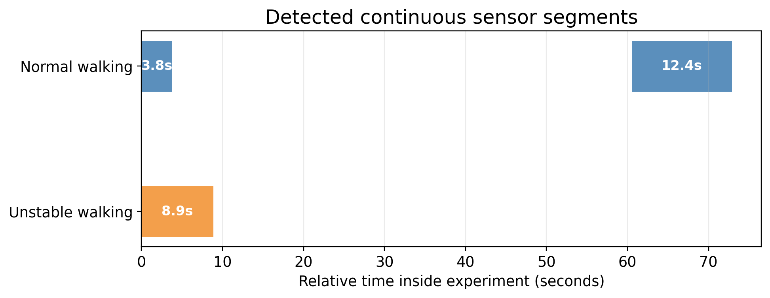
Sensors and preprocessing
The raw normal-walking recording contained a large gap; the analysis uses only clean continuous segments
Cleaning decision
12.37s
8.88s
≈51.5 Hz
50 Hz
A gap > 1 second starts a new segment. For each experiment, the longest usable continuous segment is selected.
normal clean segment
unstable clean segment
accelerometer rate
resampled analysis
Sensors used
Final comparison: both conditions are trimmed to the shared 8.88‑second window, so the feature values describe comparable time spans.
Primary: LSM6DSO Accelerometer for movement intensity, peak timing and jerk. Supporting: LSM6DSO Gyroscope for rotational instability.
Exercise 10 · Digital Biomarker
2/3
Notes:
Slide 2 explains why the normal walking sampling rate looked wrong. The raw duration was affected by a 56.7-second gap. After segment detection, both accelerometer rates are roughly 51 Hz.

Slide 3
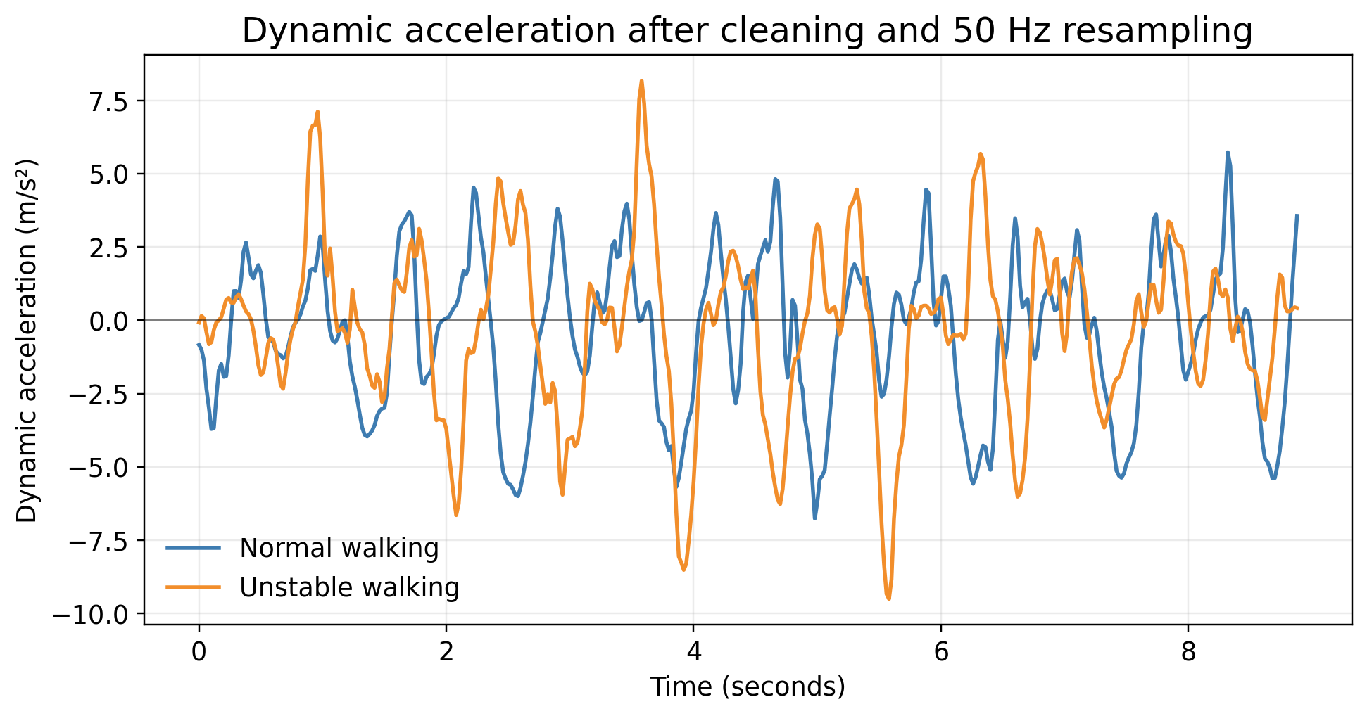
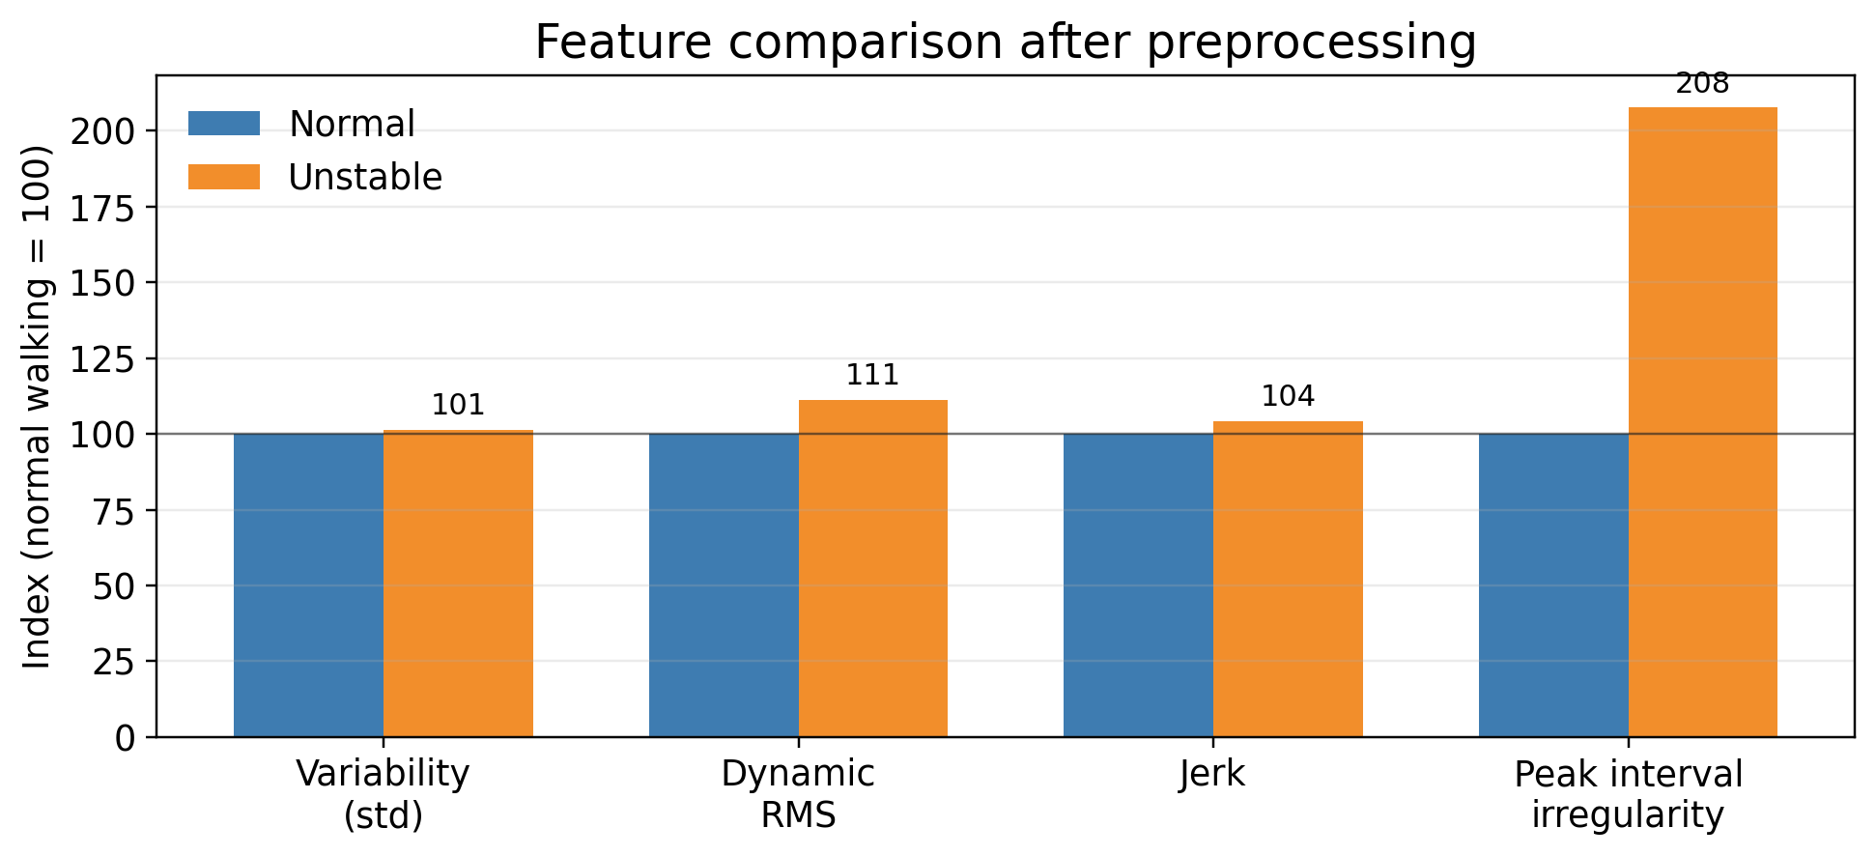
Analytics and results
Features are extracted from cleaned, aligned and resampled accelerometer signals
Key results from the notebook
Interpretation
0.37 vs 0.18
+48%
+11%
+4%
Unstable walking shows more irregular peak timing and larger movement spikes. This supports the idea that phone motion sensors can capture gait instability as a digital biomarker.
peak interval CV unstable vs normal
acceleration range
dynamic RMS
mean absolute jerk
Limitation: one participant and short trials, so this is a proof of concept, not clinical validation.
Exercise 10 · Digital Biomarker
3/3
Notes:
Slide 3 should be presented as the analytics answer. Explain the pipeline: magnitude calculation, baseline removal, feature extraction and feature comparison. The strongest result is peak interval variability, roughly doubled in unstable walking.

