Slide 1
"Statistical and Supervised machine learning models on a protein-ligand dataset“
Introduction to Python, Term 2025W, Lambton College, Ottawa, Ontario.
Prof. Mohammad Anvaripour
Jans Alzate-Morales and Nafis Ahmed, 17th April, 2025.

Slide 2

Dataset & Features
Protein-ligand binding:
Collected from a publication from J. Am. Chem. Society (https://pubs.acs.org/doi/10.1021/ja512751q)
The authors reported a dataset of 212 ligands with experimental affinity (Exp. dG) against 8 different proteins.
The binding free energies (Pred. dG) are obtained using computational methods like FEP (Free Energy Perturbation) and molecular dynamics simulations.
Variables:
Nine physicochemical features obtained with RDkit: Molecular Weight (MW), HBD, HDA, Volume, TPSA, LogP, numberAtoms, rotatablebonds, Lipinskiviolations.
Two binding free energy features: “Exp. dG” and “Pred. dG” in kcal/mol.

Slide 3
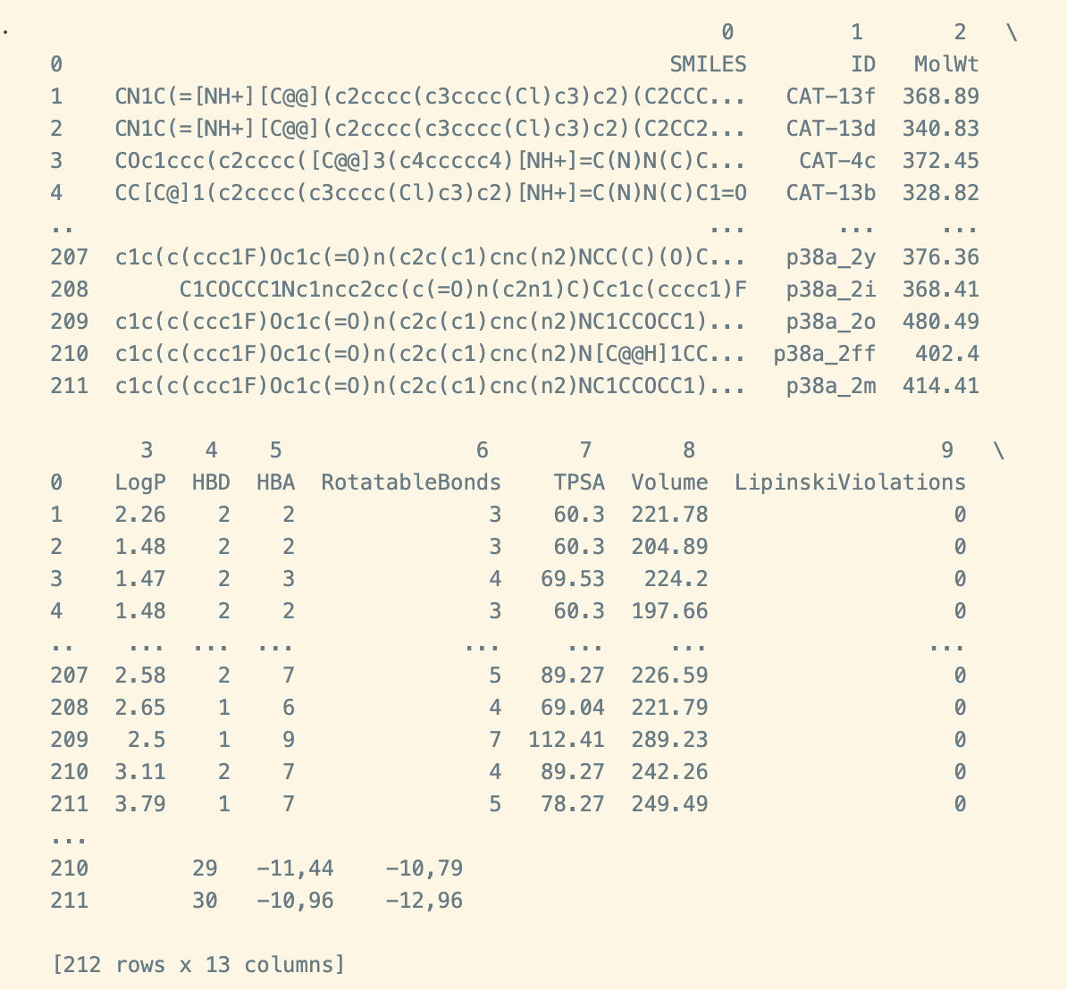
Objectives:
Scrum 1 and 2 —> To select the dataset and perform some exploratory data analysis.
—> To create a correlation matrix and mutual information, feature selection and pruning.
Scrum 3 —> To apply a supervised machine learning model to classify dataset.
Key Topics:
Regression analysis, Correlation matrix analysis, feature selection and pruning.
Understanding of Python scripts and handling of Python libraries.
Application and interpretation of supervised machine learning algorithm (Gaussian Naive-Bayes classifier).

Slide 4
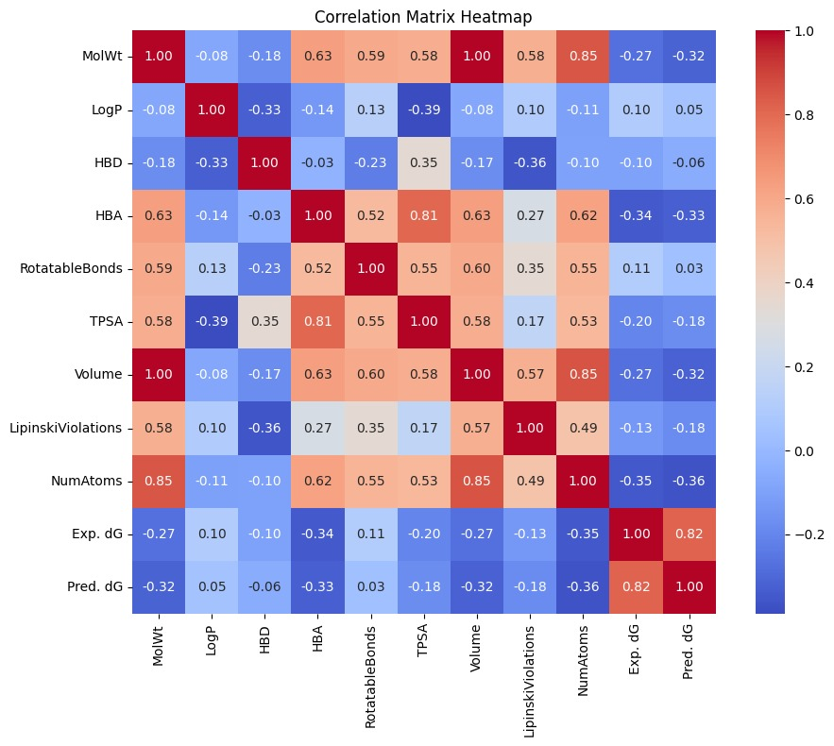
Results:

Slide 5
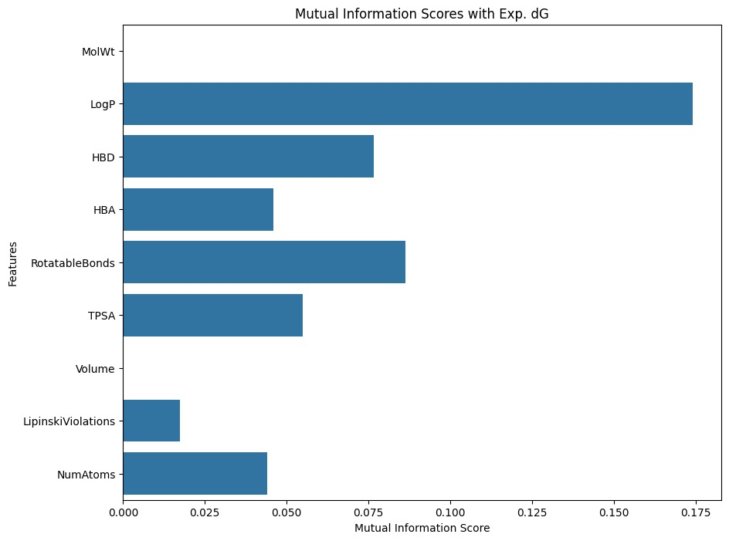
Results:

Slide 6
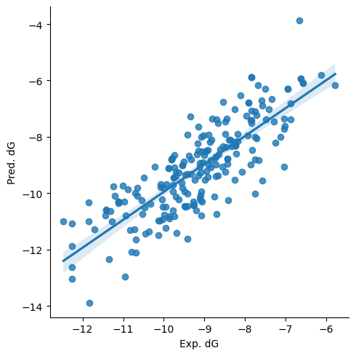
Results:
Regression analysis:
Two features were selected for regression analysis: “Exp.dG” and “Pred. dG”.
Pearson correlation coefficient obtained was 0.83.
This result means that one would predict the exp. activity of a new compound using the binding free energy obtained computationally.

Slide 7
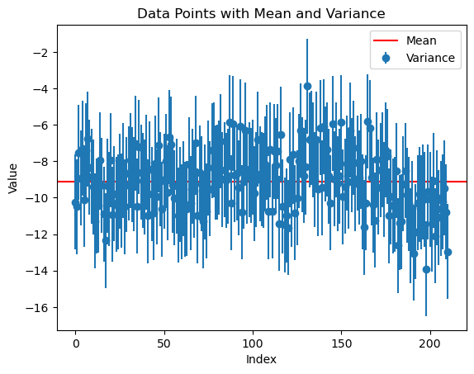
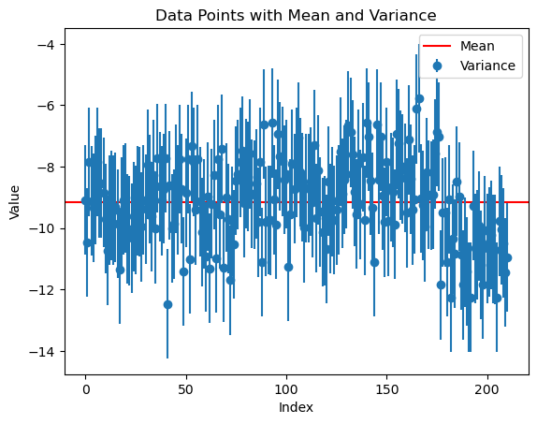
Results:
“Exp. dG”
“Pred. dG”
Variance and Covariance :
Two features analyzed: “Exp.dG” and “Pred. dG”. Their variance were 1.78 and 2.60 respectively.
Covariance for the same two features was 1.76. A positive value means a positive relationship between variables.

Slide 8
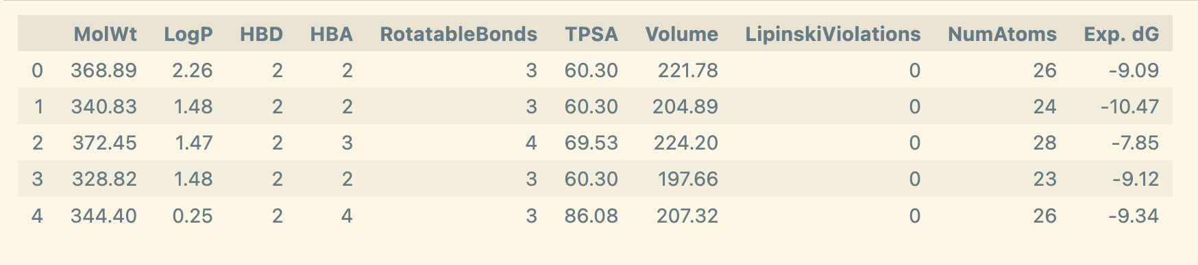
Results:
Gaussian Naive-Bayes classifier:
The target feature "Exp. dG" was converted into a binary variable where 1 means active and 0 means inactive. To do so, we established a threshold for "Exp. dG" values, where values below -7.0 kcal/mol were considered active (value 1); otherwise, the compound is inactive (value 0).
Some categorical and numerical features (columns) were dropped from the dataset because the Gaussian NB model deals only with numerical values. For instance, the features "SMILES", "ID", and "Pred. dG" did not take part in this analysis.
We checked the dataset to find missing data points.
The features were assigned to the X and Y axes. The features MolWt, LogP, HBD, HBA, RotatableBonds, TPSA, Volume, LipinskiViolations, and NumAtoms were assigned to the X-axis, and the target feature "Exp. dG" was assigned to the Y-axis.

Slide 9
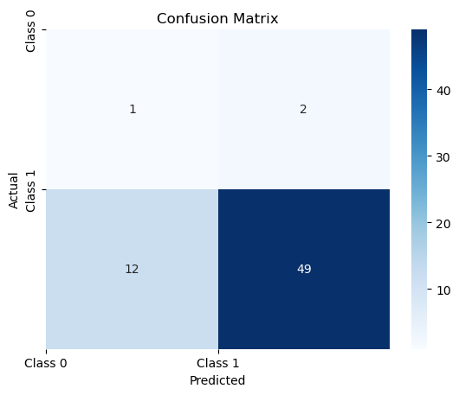
Results:
Gaussian Naive-Bayes classifier:
Then, the data set was split into training (70%) and test (30%) datasets, and the Gaussian NB classifier was applied to the training dataset using the scikit-learn module “sklearn.naive_bayes.”
The results suggest that the Gaussian NB classifier is accurate 78% and has an F1 score of 72%.
The confusion matrix can give a clearer picture of the predicted categories achieved by the Gaussian NB classifier.
From 64 compounds in the test dataset, 49 are predicted as TP, 12 as TN, 2 as FP, and 1 as FN.

Slide 10
Python scripts:
rdkit_descriptors.py
rdkit_descriptors.pyfrom rdkit import Chem
from rdkit.Chem import Descriptors, Lipinski, rdMolDescriptors
def calculate_descriptors(smiles):
mol = Chem.MolFromSmiles(smiles)
if mol is None:
return None
# Basic descriptors
mw = Descriptors.MolWt(mol)
logp = Descriptors.MolLogP(mol)
hbd = Lipinski.NumHDonors(mol)
hba = Lipinski.NumHAcceptors(mol)
rot_bonds = Lipinski.NumRotatableBonds(mol)
tpsa = Descriptors.TPSA(mol)
# Approximate volume (based on Labute ASA as a proxy for volume)
mol_vol = rdMolDescriptors.CalcExactMolWt(mol) / 1.66 # crude estimate (Å³)
# Number of Lipinski violations
violations = sum([
logp > 5,
hbd > 5,
hba > 10,
mw > 500
])

Slide 11
Python scripts:
rdkit_descriptors.py
# Number of atoms
natoms = mol.GetNumAtoms()
return {
'SMILES': smiles,
'MolWt': round(mw, 2),
'LogP': round(logp, 2),
'HBD': hbd,
'HBA': hba,
'RotatableBonds': rot_bonds,
'TPSA': round(tpsa, 2),
'Volume': round(mol_vol, 2),
'LipinskiViolations': violations,
'NumAtoms': natoms
}
# Example usage: batch process
input_file = "p38_ligands.smi"
output_file = "p38_output_descriptors.csv"
with open(input_file) as f, open(output_file, "w") as out:
headers = ["SMILES", "MolWt", "LogP", "HBD", "HBA", "RotatableBonds", "TPSA", "Volume", "LipinskiViolations", "NumAtoms"]
out.write("\t".join(headers) + "\n")
for line in f:
smiles = line.strip().split()[0]
result = calculate_descriptors(smiles)
if result:
values = [str(result[h]) for h in headers]
out.write("\t".join(values) + "\n")

Slide 12
Conclusions and perspectives
Key Takeaways:
In this term project, we could use the power of Python scripting to implement statistical and supervised machine learning models on a chosen dataset.
In our case, we could study a biological dataset comprising several compounds with bioactivity for eight proteins or molecular targets.
We developed a regression model with a good Pearson coefficient correlation to compare the experimental and computational binding free energies.
s. In a more challenging exercise, the dataset was complemented with several physicochemical features to implement a supervised machine learning model named Gaussian Naive Bayes classifier.
Future Work:
The classifier can be tested using several iterations with a random number and different proportions for training and test sets.
the metrics of the Gaussian NB model will be compared against another classifier available in the literature.

Slide 13

Thanks!
Sprints done, we deserve a beer!

