Slide 1
JavaScript
Joris Baiutti

Slide 2
Overview JavaScript
HTML/CSS/Javascript
Engine
Possibilities
Where should you use JavaScript
Runs mostly on client

Slide 4
JavaScript Versionen
ES5
ES6
ES7

Slide 5
How to run JavaScript

Slide 6
How to reference JavaScript
Inline
Script-Block
Separate File

Slide 7
Dev Tools
Chrome
Sublime Text https://www.sublimetext.com/
Visual Studio Code https://code.visualstudio.com/
IntelliJ https://www.jetbrains.com/idea/
Notepad ;)

Slide 8
Syntax like C or Java

Slide 9
Variables
ES5 var x; var y = 10; var z = “Hello”;
ES6 let, const
let no re-declaring, different Scope
const no re-declaring, no re-assignment

Slide 10
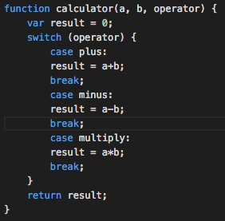
If, else if, Switch
if(true){do stuff}
else if(true){do other stuff}
else {do everything else}

Slide 11
Loops
for (i = 0;i < 10;i++){console.log(i);}

