Slide 2
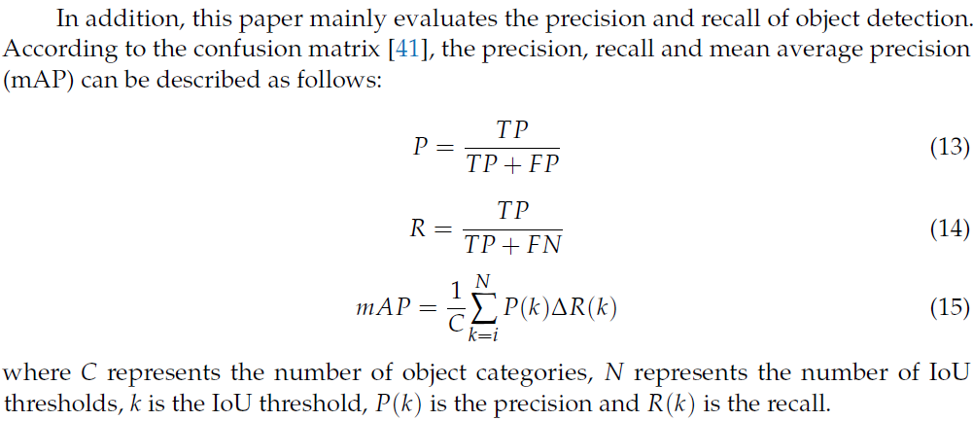
Notes:
https://www.mdpi.com/2072-666X/12/11/1273/pdf

