Slide 1

Major work
Part 01
Type Example
Part 02
Learn SSE

Slide 2
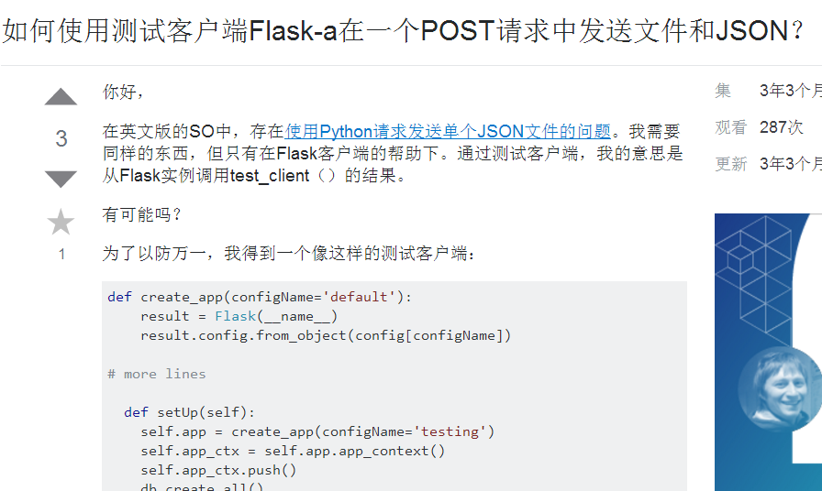
1.Type Example(Question Type)
Question Type 1 : related to the original question and solved part of problem, but does not completely solve.

Slide 3
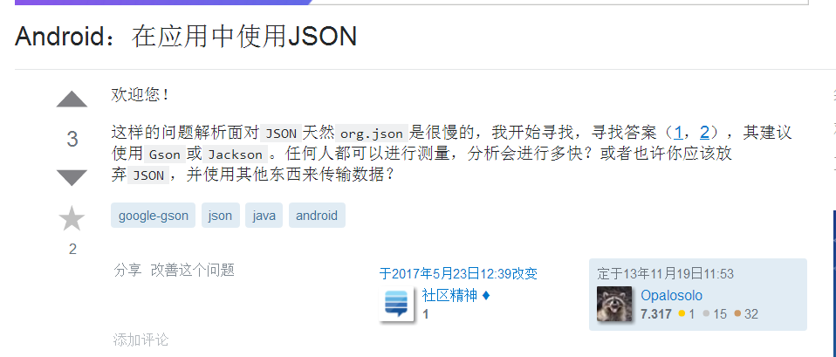
1.Type Example(Question Type)
Question Type 2 : This link is the answer of the original question, but the author raises new problem on this LQ basis.

Slide 4
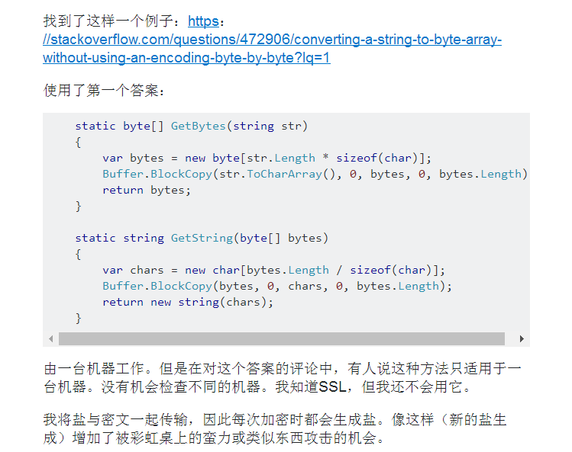
1.Type Example(Question Type)
Question Type 3 : This link is the answer of the original question, but the author does not understand some content/ has doubts/ use with problem/ will not use.

Slide 5
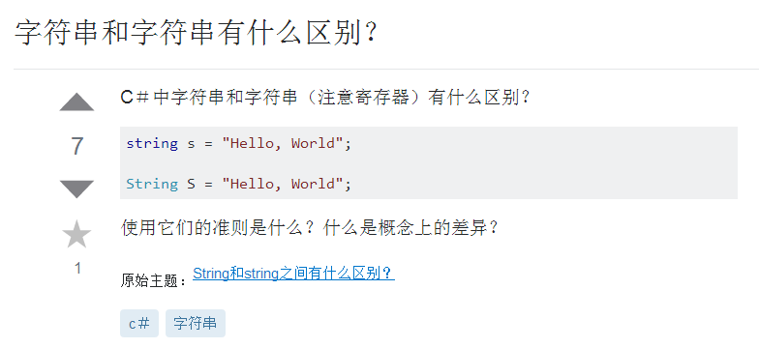
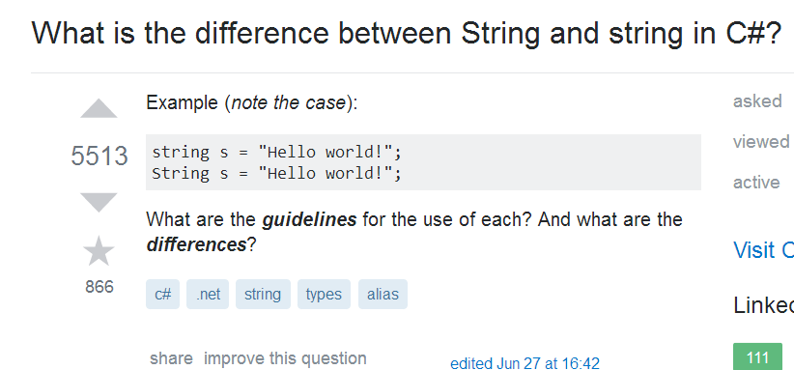
1.Type Example(Question Type)
Question Type 4 : Duplicate problem with ESO.
(The left picture is RSO, the right one is ESO.)

Slide 6
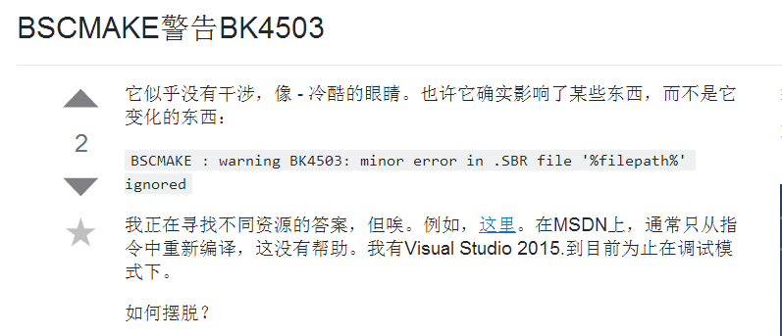
1.Type Example(Question Type)
Question Type 5: related to the original question but does not solve the problem.

Slide 7
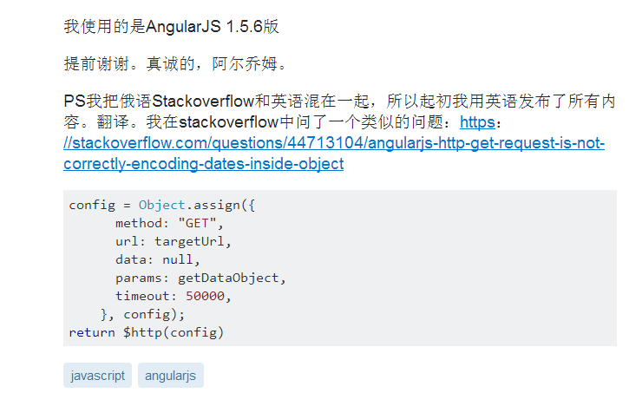
1.Type Example(Question Type)
Question Type 6 : Duplicate problem with ESO.

Slide 8
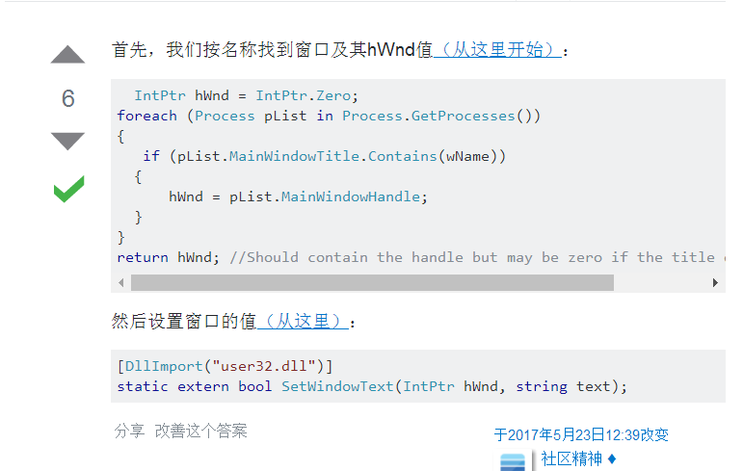
1.Type Example(Answer Type)
Answer Type 1 : related to the author’s question, and helpful in solving the problem/ solving part of the author’s problem.

Slide 9
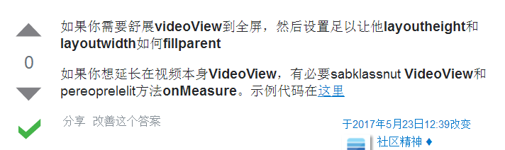
1.Type Example(Answer Type)
Answer Type 2 : related to the author's question, given the specific example / example code.

Slide 10
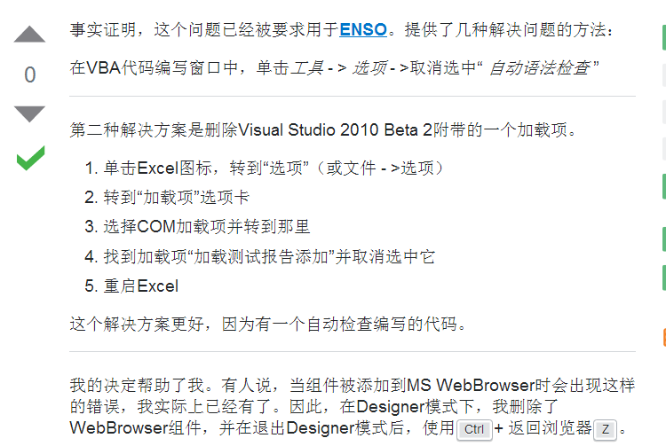


1.Type Example(Answer Type)
Answer Type 3 : This link is basically the same as the author's question / very similar / can completely solve the author's problem
The left picture is answer, the right are RSO and ESO questions, they are not Repeating.

Slide 11
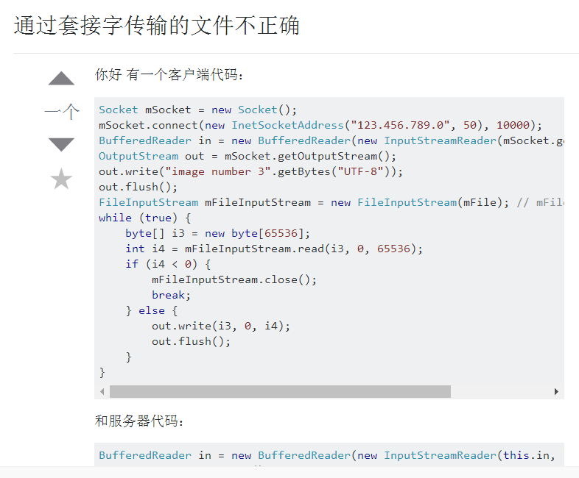
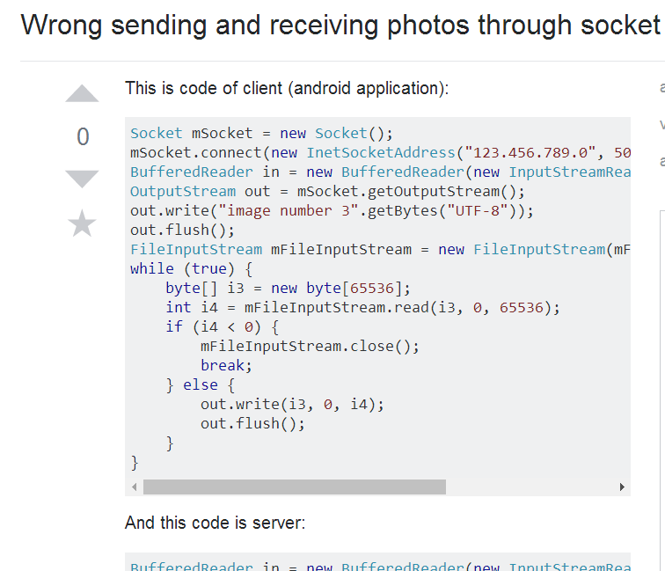
1.Type Example(Answer Type)
Answer Type 4 : Duplicate problem with ESO.

Slide 12
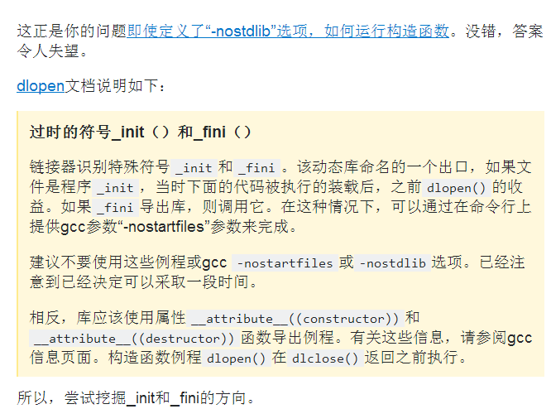
1.Type Example(Answer Type)
Answer Type 5 : related to the author's question, but it does not help to solve the problem.

Slide 13
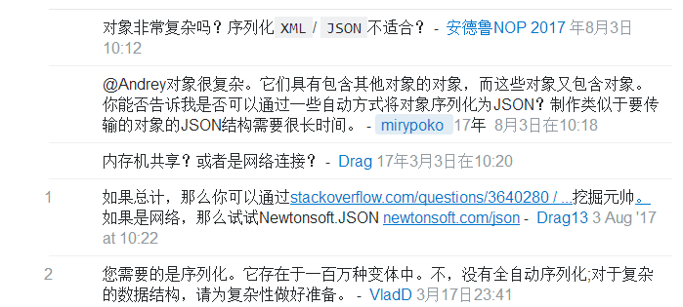
1.Type Example(Comment Type)
Comment Type 1: related to the author’s question, and helpful in solving the problem.

Slide 14
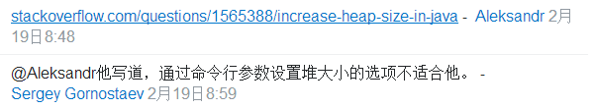
1.Type Example(Comment Type)
Comment Type 2: related to the author's question, but it does not help to solve the problem.

Slide 15
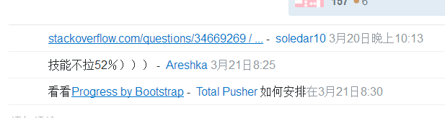
1.Type Example(Comment Type)
Comment Type 3 : related to the author's question, but can not know if there is help, the commenter only posts the link and has no description.

Slide 16
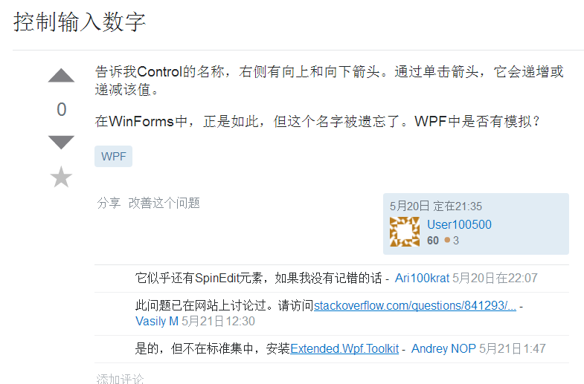
1.Type Example(Comment Type)
Comment Type 4: Duplicate problem with ESO, and can answer the author's question .

Slide 17
2.Learn SSE
I looked at the pattern of training data, and I used the rawdata-crosslingual model, trying to build the RSO to ESO training data. I only set up the own training set and run the original training set, but I didn't run the own training set.
I don't know how to build English training set.

Slide 18
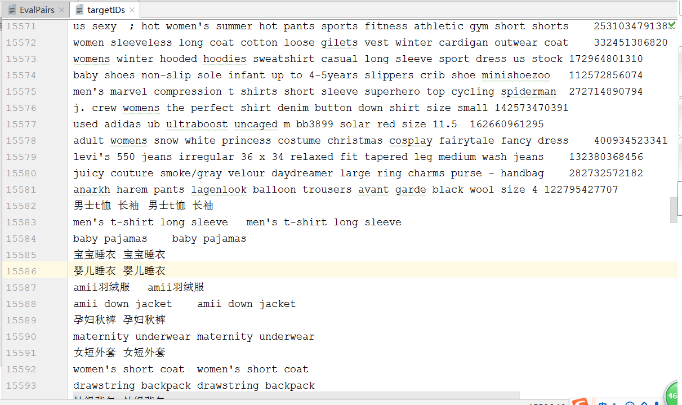
Original training set（ rawdata-crosslingual ）
quantity :32061

Slide 19
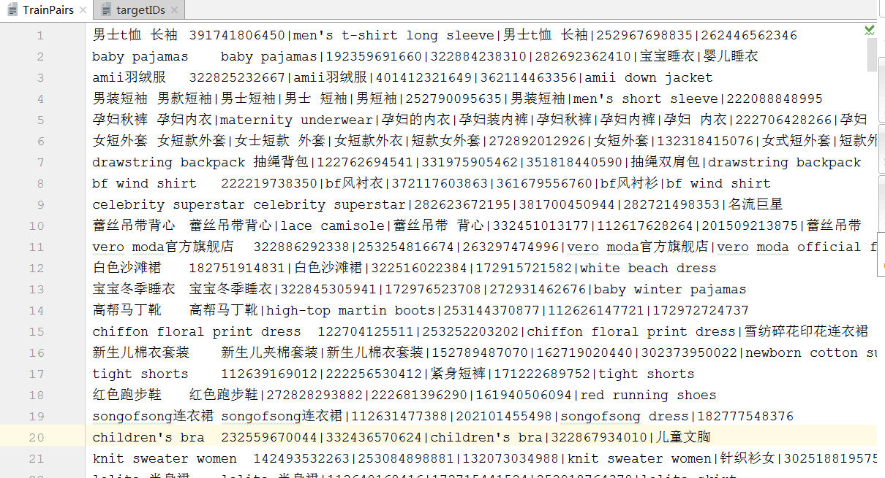
Original training set（ rawdata-crosslingual ）
quantity :16491

Slide 20
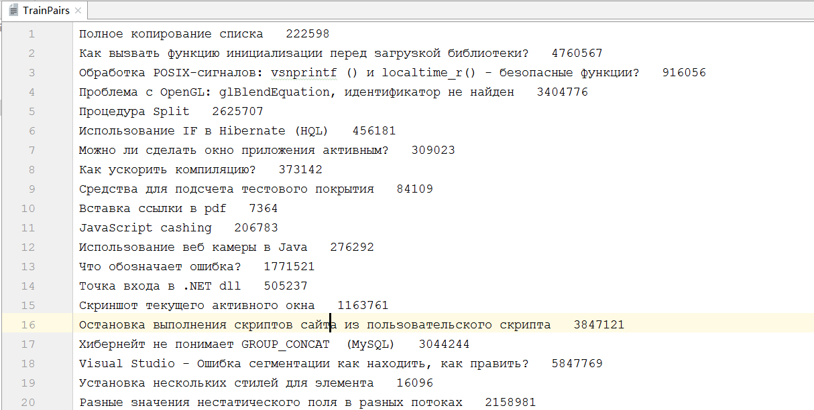
My own training set（ rawdata-crosslingual ）
quantity :6093

Slide 21
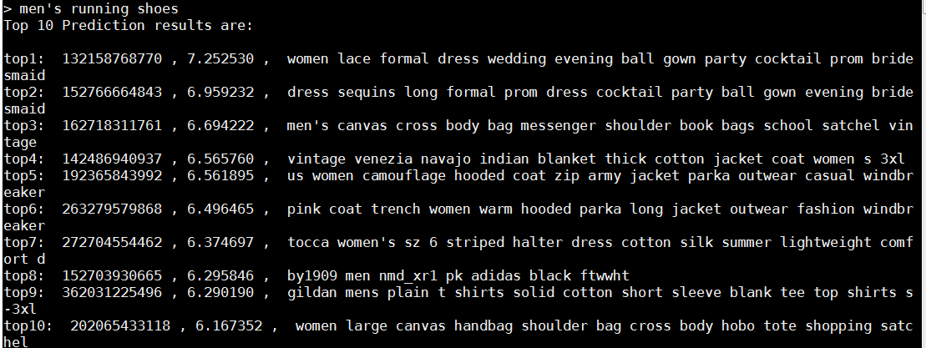
The prediction using the original training set（ rawdata-crosslingual ）

