Slide 1

Major work
Part 01
Rebuild Data
Part 02
Read The Code

Slide 2
1.Rebuild Data
targetIDs：15,930,617
TrainPairs/EvalPairs：5348
Test_Data：500
targetIDs ：contains all the ESO titles.
targetIDs Form：title +’\t’+ id
Test_Data ：randomly selected 500 from all RSO title which RSO contains link to ESO.
TrainPairs/EvalPairs： is all RSO title which RSO contains link to ESO minus Test_Data.
TrainPairs/EvalPairs / Test_Data
TrainPairs/EvalPairs / Test_Data Form：title + ‘\t’+id1|id2|id3
I removed duplicate data and merged ID of the same title.

Slide 3
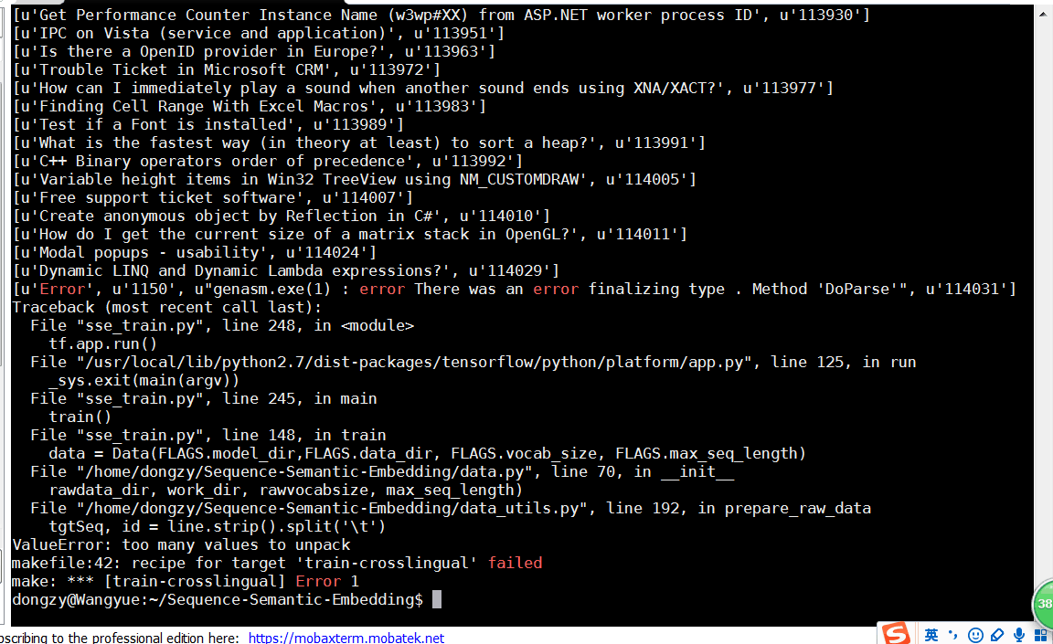
2.Read The Code
When I train the model there is any mistake so that the program has stopped. And I read the code to check the error.
eg:
The program split the line to two lists by '\t', but the some English titles has '\t' ,eg "Error 1150 genasm.exe(1) : error There was an error finalizing type . Method 'DoParse' ", so the program throw error and stop.

Slide 4
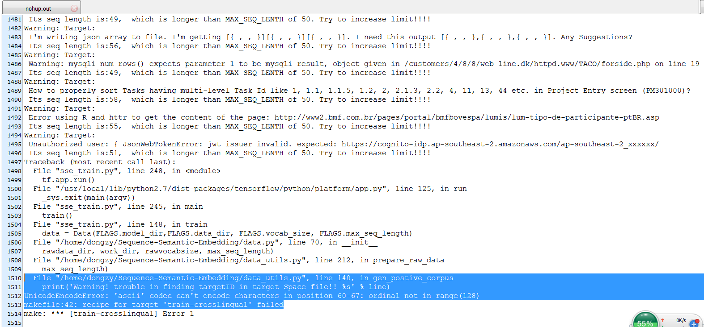
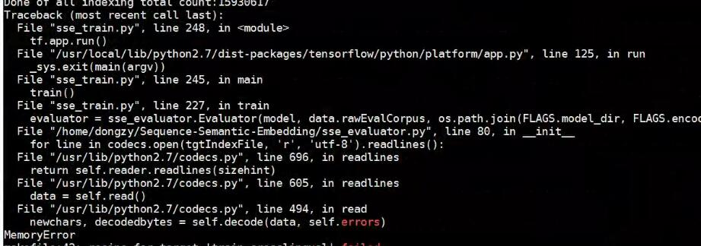
2.Read The Code
But I still have some error that I can't understand the code.

