Slide 1
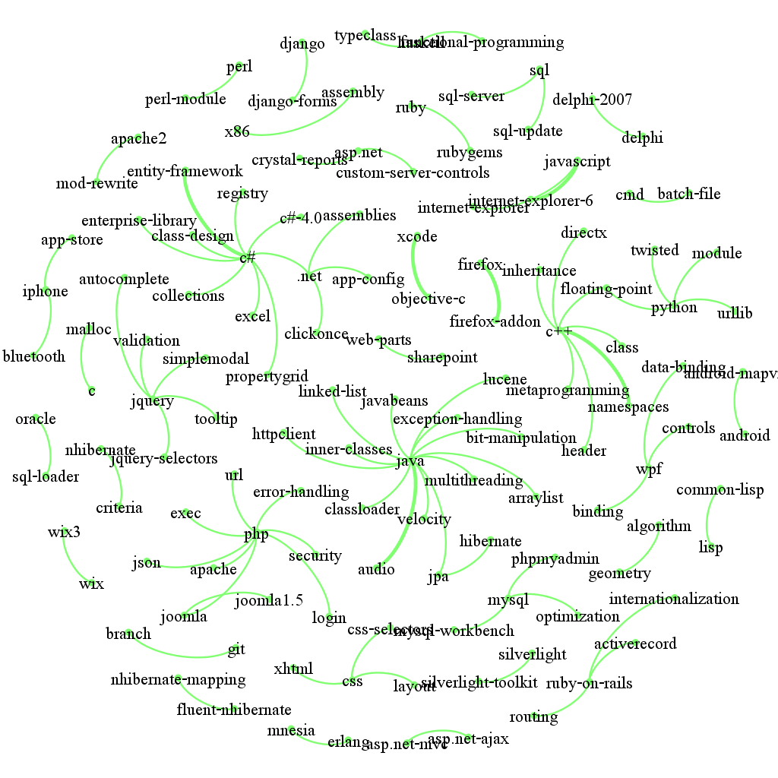
100 tag pairs’Gephi graph :

Slide 2
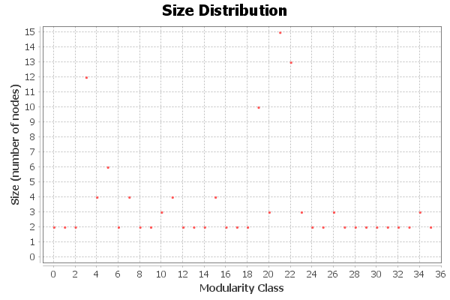
Cluster analysis :
Parameters:
Randomize: On Use edge weights: On Resolution: 1.0
Results:
Modularity: 0.928 Modularity with resolution: 0.928 Number of Communities: 36

Slide 3
Sentences：:
Parataxis：
Some fun things Having a PHP and MySQL Application that works well with German and French but now needs to support Russian and Chinese.
I ve been developing a website PHP+MySQL for a while now and for the last few months I ve been working with Coda directly to the server as the website was not officially online.
Inclusion relation：
datetime is a python module that contains datetime class that has a method now ..
In python you can use datetime.strptime method from datetime module
Since django datetime field is a representation of a datetime.datetime python instance I like to make sure that I have a valid instance before inserting into the database.
I have a wpf program in c# that has a combobox with various colors to choose from.
A lot of languages have web counterparts. JSP for Java Rails for Ruby Django for Python etc. 、
I m trying to use Java Hibernate.
similarity relation：
C# is very similar to Java in syntax but not really in style.
Example 1 dissociates the query variable from the MySQL result.
Another alternative is to embed Python in your C++ program.
In my experience there are two easy ways to call into C code from Python code.
You can avoid having to use strtotime or getdate in PHP by using MySQL’s UNIX_TIMESTAMP function.

