Slide 1

Major work
Part 01
Learn Neural Network
Part 02
Read The Code

Slide 2
1.Learn Neural Network
I learn the neural network on video and blog.
And I learn the CNN.

Slide 3
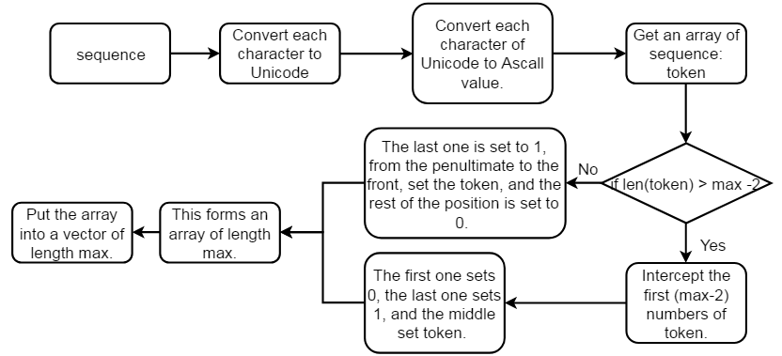
The process of generating a word vector:

Slide 4
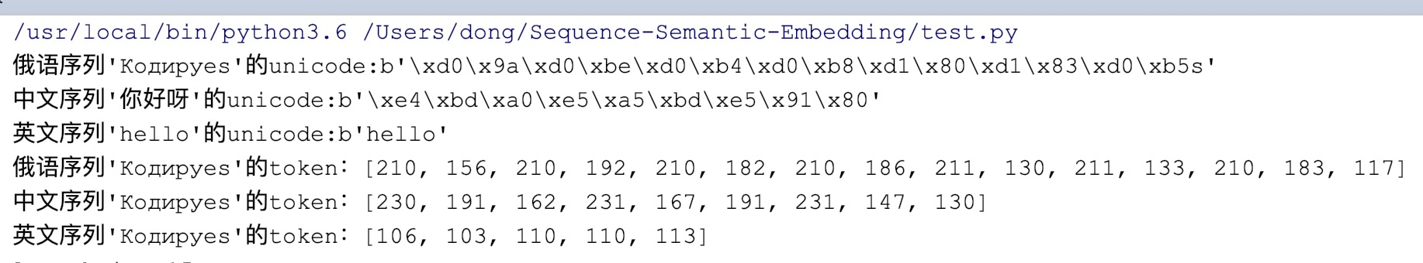
The process of generating a word vector:
English letters are directly converted to Ascll code values and +2. Chinese corresponds to 3 Unicode values, and Russian corresponds to 2. They convert the two digits after x from hexadecimal to decimal and +2.
Eg: d0 from hexadecimal to decimal is 208.
9a from hexadecimal to decimal is 154.
h Ascll code values is 104.
Finally, get a token with an indefinite length.

Slide 5
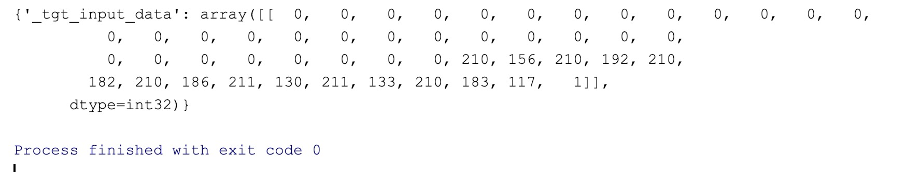
The process of generating a word vector:
Next, combine an array of length max.Determine whether the length of the token exceeds max-2.
If yes, intercept the length of max-2, the first digit of the array is set to [PAD_ID]---1, the last digit is set to [EOS_ID]---0, the intermediate fill length is max- 2 tokens.
If no, the last digit is set to [EOS_ID], the second last digit to the front, set to token, and the rest is set to [PAD_ID].
Finally, get an array of length max.

Slide 6
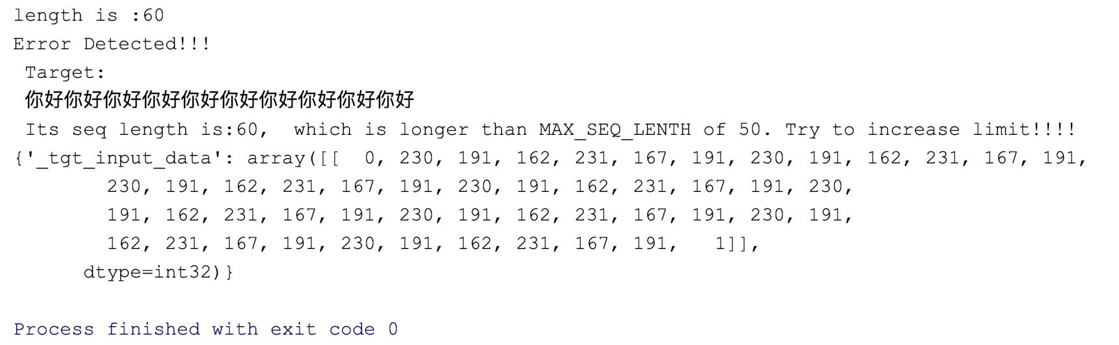
The process of generating a word vector:
This is a exmaple of length oversized, the seq is“你好你好你好你好你好你好你好你好你好你好“, its token is: [230, 191, 162, 231, 167, 191, 230, 191, 162, 231, 167, 191, 230, 191, 162, 231, 167, 191, 230, 191, 162, 231, 167, 191, 230, 191, 162, 231, 167, 191, 230, 191, 162, 231, 167, 191, 230, 191, 162, 231, 167, 191, 230, 191, 162, 231, 167, 191, 230, 191, 162, 231, 167, 191, 230, 191, 162, 231, 167, 191]

Slide 7
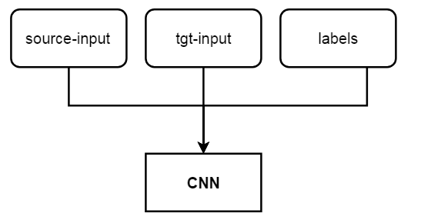
The process of training:
There are 3 training inputs: source-input, tgt-input, labels.
source-input: The encoded source sequence. Group the vectors into a matrix.
tgt-input: The encoded target sequence corresponding to the id of the source-input. Group the vectors into a matrix.
Labels: The positive and negative sample numbers that are randomly set for each vector.
When training, take batch_size data in sequence.
Combine the two matrices, each row is a Pairs.

