Slide 1
20181112
Part1：186 frequent tag pairs
Part2：some sentences’ example

Slide 2
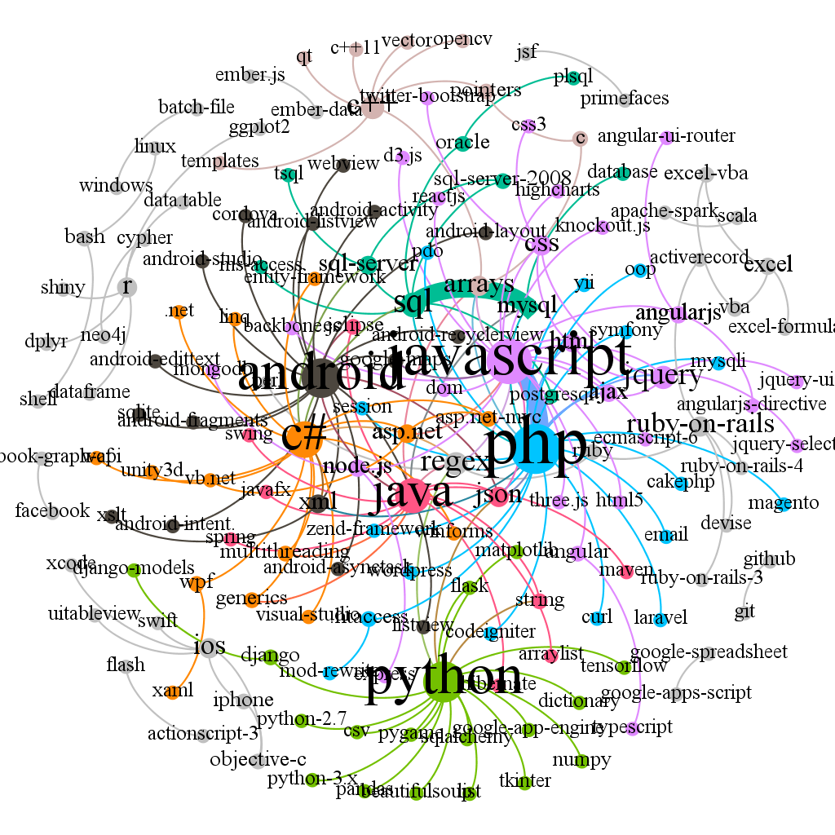
Support count 2000
Confidence value 0.5
Get 186 tag pairs.

Slide 3
Support count，confidence value，tag pairs
100,0.5,4564
500,0.5,867
1000,0.5,399
2000,0.5,186
2000,0.8,185

Slide 4
Eg:
27703230
php yii2
php composer.phar require kartik-v/yii2-money
php composer.phar | require | kartik-v/yii2-money
30180492
php yii2
php composer.phar require kartik-v/yii2-mpdf
php composer.phar |require| kartik-v/yii2-mpdf
29549133
apache .htaccess
For example, I have the following .htaccess file in the root of a virtual server apache 2.4.
htaccess file | is in | root of virtual server apache 2.4

Slide 5
26954682
javascript html
I am working on a Spring MVC and I want to insert javascript into the html output for analytics purpose.
I | insert javascript into | html output
27467647
javascript html
My javascript is inside an html file called register.html.
My javascript | is inside | html file
27697809
javascript html
Invalid html will affect performance of javascript.
html | will affect | performance of javascript
Invalid html | will affect | performance of javascript

Slide 6
28039256
javascript html
The html element is generated by javascript code dynamically.
html element | is generated by | javascript code
28255406
javascript html
Use javascript for populate view html.
Use javascript | populate | view html
28833821
javascript html
The html input element is created in javascript.
html input element | is created in | javascript

Slide 7
30235918
apache .htaccess
There you have a guide for .htaccess mod_rewrite with apache.
htaccess mod_rewrite | is with | apache
30613239
apache .htaccess
.htaccess files are specific for apache server, but you are running grunt, so all .htaccess files are ignored.
htaccess files | are specific for | apache server

Slide 8
Conclusion：
Require
Is in
Is with
Is inside
Insert into
Is generated by
Is created in
Are specific for

