Slide 1
Android UI design
Jilin University

Slide 2
Reporting on work--Jiangxue
Check whether there are any problems with the script extracted from the data volume. The number of pictures extracted after modification is 4363.
The method of feature extraction is changed to HSV image histogram statistics, and the bins is modified to 32. After the contrast experiment, hierarchical clustering is adopted, and the effect of adjusting the number of clusters to 50 is relatively good. But still did not achieve the desired effect.

Slide 3
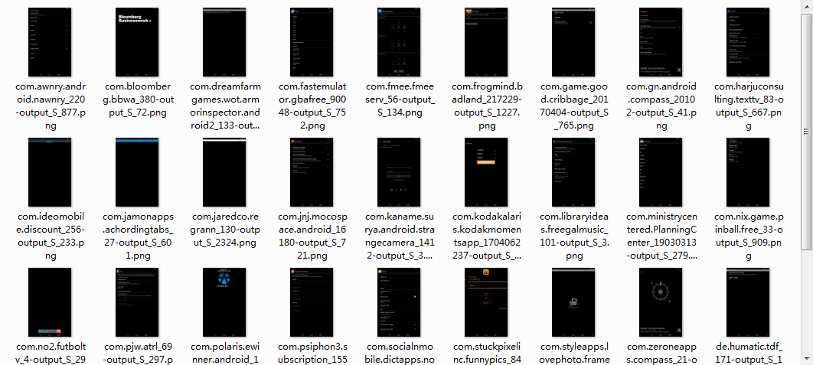
hierarchical+hsv+32bins

Slide 4
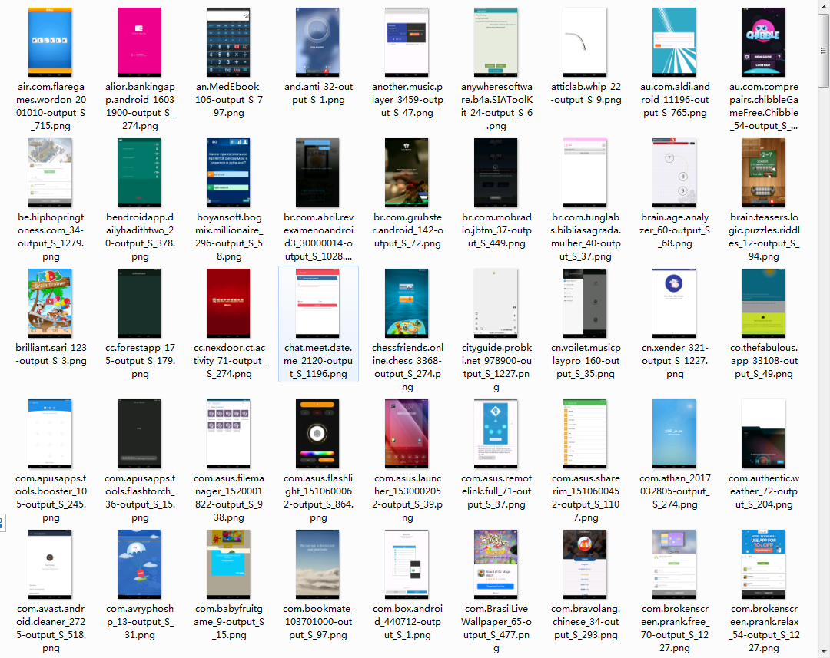
hierarchical+hsv+32bins

Slide 5
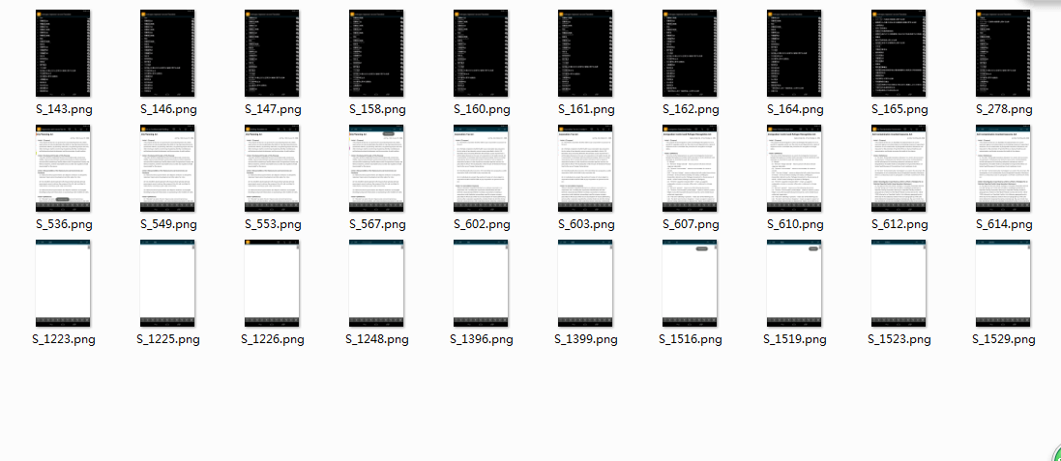
A comparative experiment of small datasets is done. The images in the dataset are as follows:

Slide 6
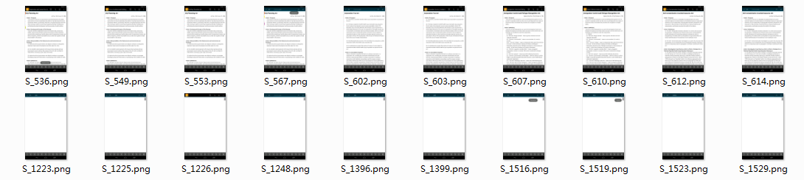
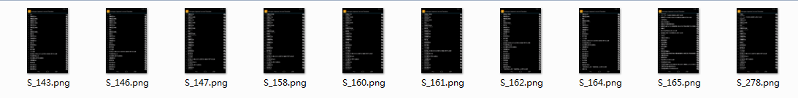
First, by adjusting the parameters of DBSCAN.
eps=0.001,min_samples=10：
label=0
label=1

Slide 7
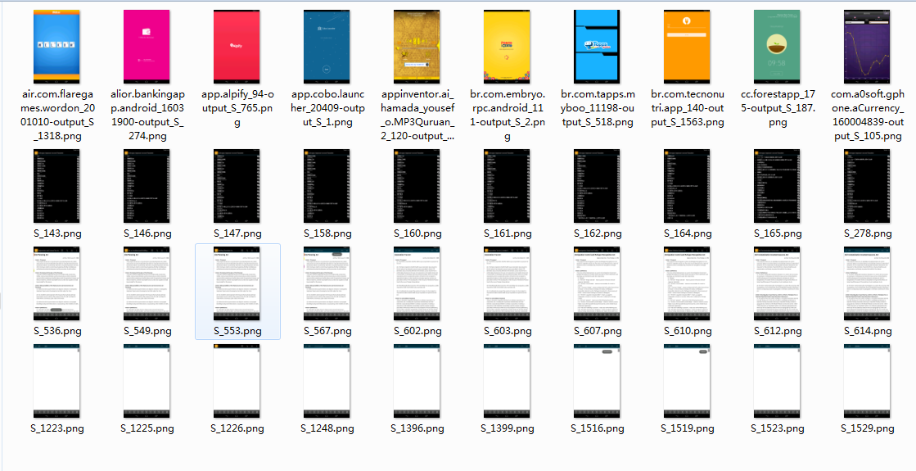
New data are added as follows:

Slide 8
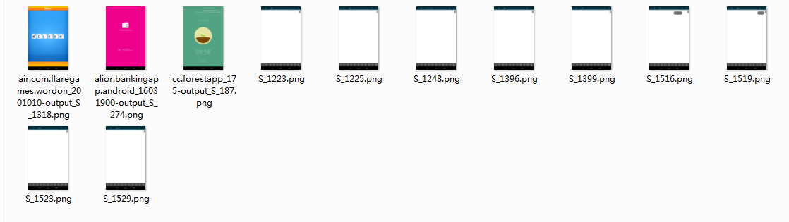
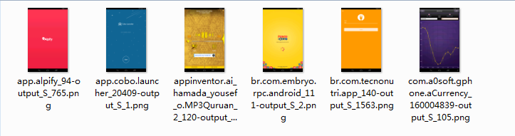
label=0
label=1

Slide 9
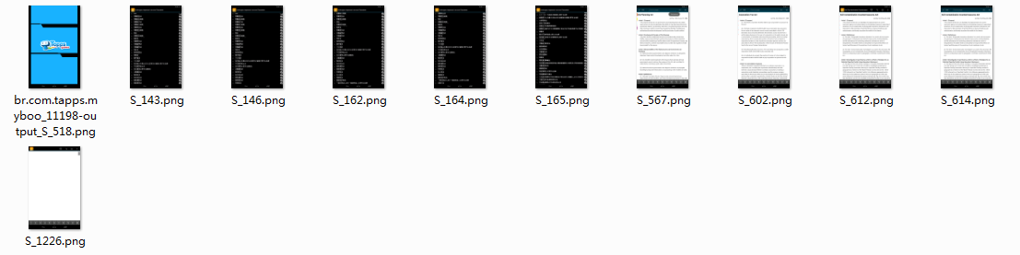
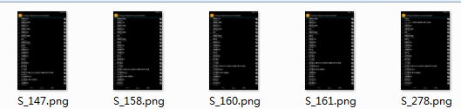
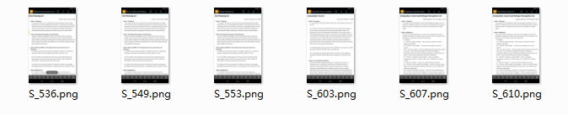
label=1
label=2
label=3

Slide 10
Question:
In this experiment, the feature extraction is based on the statistics of HSV distribution in each bins by histogram, focusing on the similarity of two images in each region. If the naked eye looks at two similar pictures, but the calculation is staggered by a bins, this will affect the experimental results.

