Slide 1
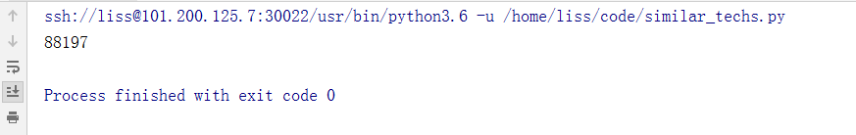
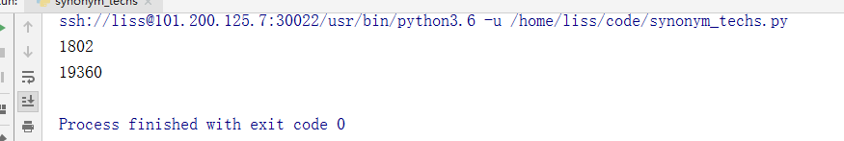
Similar_techs count :
Synonym_techs count and len(synonym_techs):

Slide 2
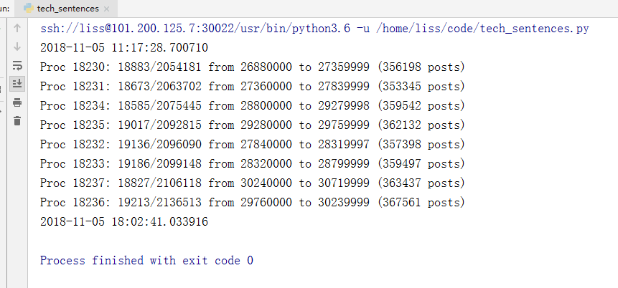
Tech_sentences.py
[26880000, 27360000, 27840000, 28320000, 28800000, 29280000, 29760000, 30240000] 3360000条数据
os.getpid(), compa_sent_count, total_sent_count, start, current_id, post_count

Slide 3
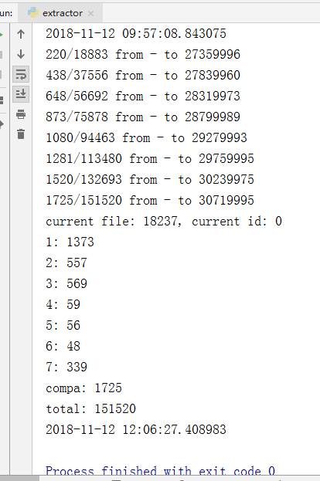
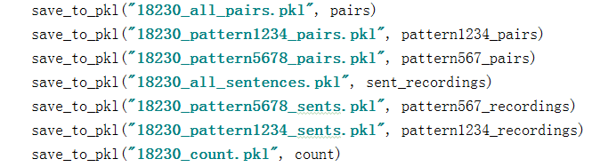
Extractor.py
extracts comparative sentences based on different patterns
count["compa"], count["total"],current_id

Slide 4
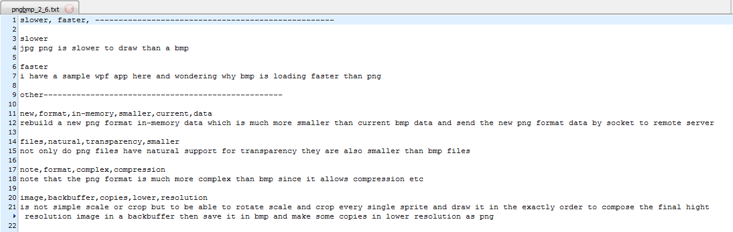
extract_tech_pairs_aspects.py
pairs = [("3des", "aes"), ("png", "bmp"), ("g++", "gcc"), # < 10
("postgresql", "mysql"), ("udp", "tcp"), # >100
("quicksort", "mergesort"), # 50 ~ 100
("vmware", "virtualbox"), ("datamapper", "activerecord"), ("sortedlist", "sorteddictionary"), # 10 ~ 15
("testng", "junit"), ("jruby", "mri"), # 15 ~ 20
("rsa", "aes"), ("compiled-language", "interpreted-language"), ("google-chrome", "safari"), ("heapsort", "quicksort")] #20 ~ 50
Sentence data："data", "relations.pkl"

Slide 5
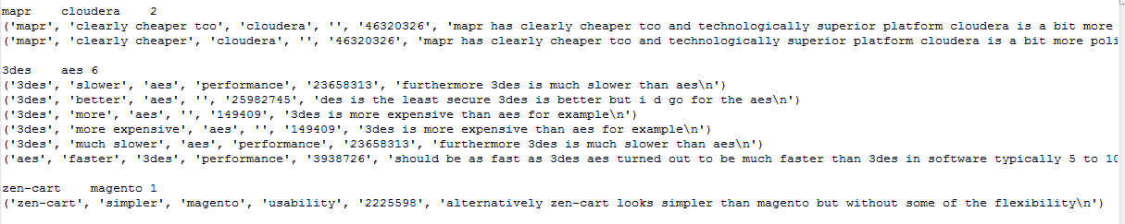
Relation.txt
ta, comp, tb, "", id, sentence
18230_all_pairs.txt
sentence

Slide 6
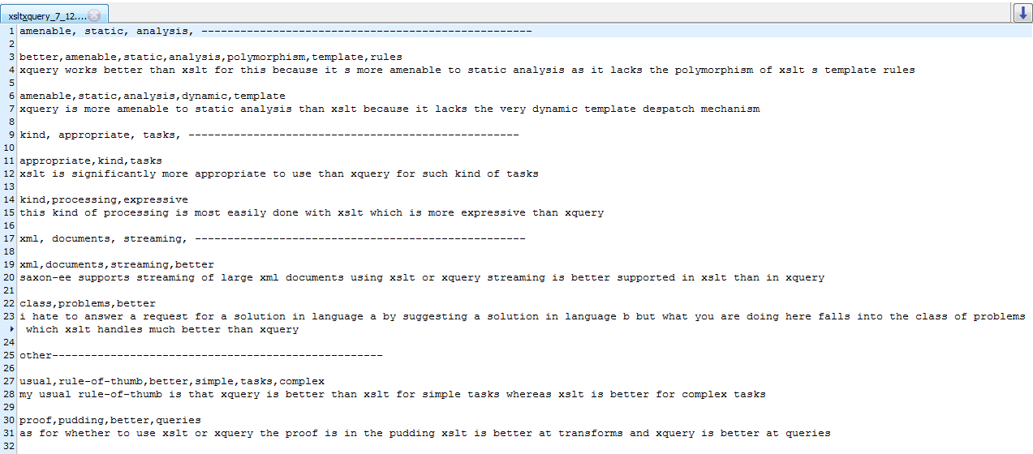
Detector.py
data", "relations.pkl
Use tf-idf
xslt&xquery_7_12.txt

Slide 7
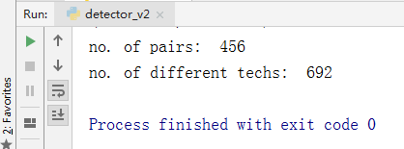
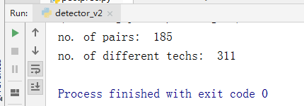
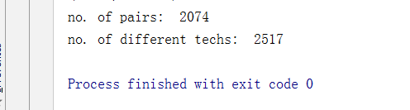
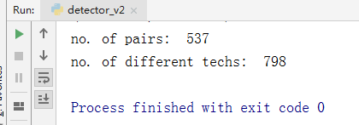
Detector_v2.py
"out", "new_pattern1234_pairs.pkl"
18230_pattern1234_pairs.pkl
18230_pattern5678_pairs.pkl
18230_all_pairs.pkl

Slide 8
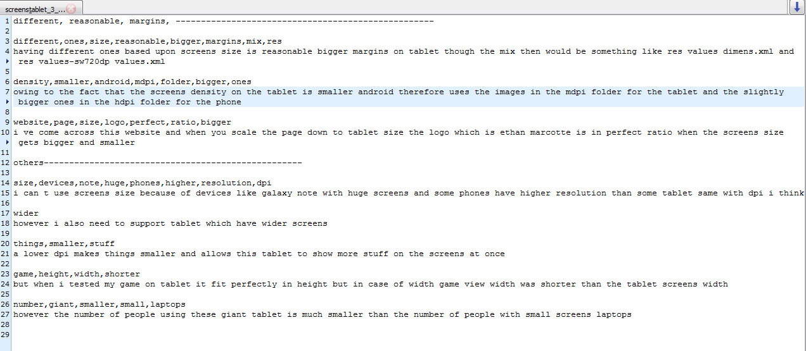
screens&tablet_3_8.txt

Slide 9
没有看懂分类句子模式有什么作用

