Slide 1
Android UI design
Jilin University

Slide 2
Reporting on work--Jiangxue
Write two scripts. The first function is to extract the duplicate UI from the data set. The second function is to pick up a picture in each APP folder.
Upload the original data set to the server and run the second script to get a data set containing 4314 UIs.
The DBsacn clustering is completed, and the parameter adjustment process is recorded.
Hierarchical clustering is used to record the parameter adjustment process.
K-means clustering, parameter adjustment process record

Slide 3
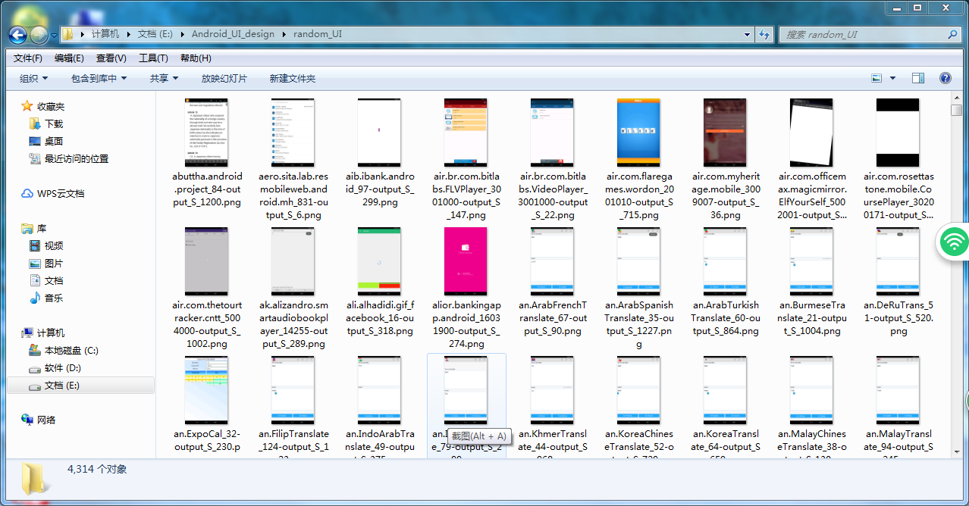
Selected UI data sets

Slide 4
DBscan clustering parameter reference record
Adjustable parameters：eps,min_samples
结果：全部UI图片归为一类
第二次：将eps调为0.0000001，min_samples不变
可将图片分类，分类的标签结果如下，
 | eps | min_sample | The number of clusters | Noise point number | Abnormity point
1 | 0.5 | 5 | 1 | 0 | 4314
2 | 0.0000001 | 5 | 42 | 57 | 3467
3 | 0.0000001 | 10 | 21 | 3387 | 362
4 | 0.00000001 | 5 | 57 | 1008 | 1090

Slide 5
Summary of records
According to DBscan clustering principle, when the number of clusters is small, the number of clusters can be adjusted by reducing EPS or increasing min_sample.
Normally, when EPS = 0.5 and min_sample = 5, only one kind of data set can be classified. So when min_sample is unchanged, the data set can be classified by setting EPS to 0.0000001, but at this time, there is a problem that a cluster is too large. So when EPS is unchanged, increase min_sample to 10, reduce the number of clusters by half, and the maximum cluster is only about 300, but there are too many noise points. In the third test, in order to reduce the number of noise points, min_sample was set to the default value of 5, and EPS was reduced ten times to 0.00000001. The number of clusters increased significantly, although the number of noise points decreased, but still very large.

Slide 6
Hierarchical clustering parameter recording
The number of clusters is n_clusters.
Connection measurement options, cluster spacing calculation method affinity='euclidean'
Connection method linkage='complete'
Adjustable parameter: n_clusters
 | n_clusters | Abnormity point
0 | 5 | 3498
1 | 50 | 1532
2 | 100 | none

Slide 7
Summary of records
The selected hierarchical clustering method is Agglomerative Clustering in sklearns, which is a bottom-up agglomerative clustering method.
The number of adjustable parameters is set to 5 and 50100 respectively.
When set to 5, there is a problem of too large a cluster. According to DBscan clustering results, the cluster number is set to 50, and the maximum cluster number contains 1532 data sets. After observation, although the cluster number is large, most UIs are very similar. In the third test, a comparative experiment was set up, and the number of clusters was set to 100. There was no problem that the number of clusters was too large.

Slide 8
KMeans clustering parameter reference record
Adjustable parameters：n_clusters
 | n_clusters | Abnormity point
0 | 5 | 2815
1 | 50 | none
2 | 100 | none

