Slide 1

Tag--pairs
python iteration 21
c# asp.net 3287
flex air 85
asp.net iis 202
svn version-control 203
c# .net 2863
asp-classic vbscript 62
asp.net dynamic-data 50
flex actionscript-3 539
sql-server full-text-search 72
sql mysql 2009
svn merge 55
asp.net authentication 64
html css 3541
mysql database 320
html semantic-markup 21
user-interface usability 31
c# winforms 1545
python floating-point 28
python unicode 74
php oop 474
sql-server indexing 54
php mysql 4526
python urllib 28
asp.net vb.net 565
algorithm puzzle 23
php syntax 88
c# multithreading 531
c embedded 36
sharepoint workflow 58
php pdf 83
wpf data-binding 159
asp.net webforms 115
sql-server backup 27

Slide 2
Tag--pairs
objective-c cocoa 780
javascript browser 91
c# reflection 356
regex perl 415
c# nhibernate 231
c# constructor 47
c# serialization 102
php encoding 39
php email 313
sql-server replication 44
wordpress themes 25
cocoa macos 177
opengl textures 34
opengl glut 29
xml xslt 636
open-source licensing 79
asp.net-mvc model-view-controller 110
sql-server reporting-services 114
php regex 1380
javascript google-maps 321
php session 423
haskell functional-programming 53
java ant 141
continuous-integration cruisecontrol.net 25
wpf listbox 40
unit-testing tdd 70
javascript regex 976
sql oracle 635
apache mod-rewrite 296
svn repository 35
c# wpf 828
java serialization 154
reporting-services reportingservices-2005 79
git branch 67

Slide 3
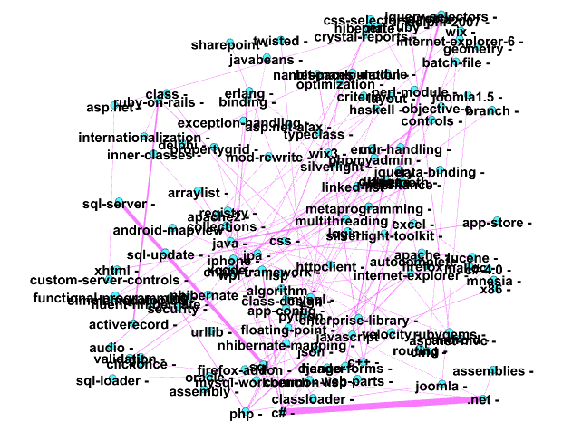
Tag--pairs

Slide 4
Words
Parallel relation：
Since this is an air application i figure i will throttle via server-side since i can do it from either the server itself iis 6 or the web service asp.net c#.
I ve tried to write a string replace function in c which works on a which has been allocated using malloc .
Since this is an air application i figure i will throttle via server-side since i can do it from either the server itself iis 6 or the web service asp.net c#.
My preferred programming environment is .net and c#.
what would be better is if there was some tool that could connect to both sql server and mysql then do a copy.
html files seem to be the best choice you then just have to deal with different browsers css and stuff.

Slide 5
Words
Parallel relation：
some people may think that this is unnecessary but plenty of people browse with addons like noscript or with javascript simply turned off in their browser settings.
the rest of the editing package such as the xml editor and xslt debugger is solid so it could be worth a try.
if you correctly markup your html code there is no need for javascript .
oracle has got an online tutorial about sql injection.
with svn i can t have local source control if i m not connected to the repository yes i know about svk or about ways to copy the repo .
it s an extra command though git commit commits locally whereas git push origin master pushes the master branch to the remote named origin .
Notes:
强化学习和有监督学习的不同在于教师信号。强化学习的教师信号是动作的奖励，有监督学习的教师信号是正确的动作。

Slide 6
Words
Parallel relation：
by default php stores the session data in a file in the os s temp directory.
you can have your client state as some javascript object and when you want to save the state you serialize the object using json and base64 encoding .
postgresql also accepts escape string constants which are an extension to the sql standard.
having a php and mysql application that works well with german and french but now needs to support russian and Chinese .
i primarily use asp.net vb.net with sql server 2000.
if it was me i would probably try to fetch the timezone using clientside javascript and then submit it to the server using ajax or something.
unfortunately when it comes to memory management in flash actionscript there isn t a whole lot you can do .

Slide 7
Words
include relation：
i ve been given a database with nearly 300 tables in it and i need to turn this into a mysql database at what point does a mysql database start to lose performance.
what is the best way to display flash content in a c# winforms application.
syntax highlighting for a boatload of languages including c++ and php i m using it for ruby python and php myself.
is there a tool out there that will let me select specific tables and then create a database diagram for me based on a mysql database.
in asp.net 2.0 viewstate is saved by.
in java terms that means apart from not being able to call methods on int you cannot store int or other non-object types in collections list map etc.
not an answer but a warning my company bought the 2007 infragistics asp.net controls just for the grid and we regret that choice .

Slide 8
Words
include relation：
it can be convenient to use this to create a python list containing the values returned.
the solution to this question really doesn t matter what programming language you re using as long as there s some way to modify windows registry settings.
these classes are all controls that are written to be compiled for either wpf or silverlight 2.0.
when trying to see if a certain key exists within a dictionary in python python s version of a hash table there are two ways to check.
well it seems with c# 3.0 properties default implementation the decision is taken for you.
pragmatic unit testing in c# with nunit by andy hunt and dave thomas with matt hargett.
i ve read that it is possible to add a method to an existing object not in the class definition in python in python monkey patching generally works by overwriting a class or functions signature with your own .

Slide 9
Words
include relation：
this warning is there because java is not actually storing type information at run-time in an object that uses generics（泛型）.
python from cmath import exp pi.
you can have your client state as some javascript object and when you want to save the state you serialize the object using json and base64 encoding .
this started with junit in the java world and has become a best practice in php as well with simpletest and phpunit .
what are some guidelines for maintaining responsible session security with php .
when i was first learning java we had to make yahtzee and i thought it would be cool to create custom swing components and containers instead of just drawing everything on one jpanel .

Slide 10
Words
是什么
include relation：
looks like you can use vss2svn to pipe the source safe repo into a subversion repository then use the very nice git-svn to pull into a local git repo .

