Slide 1

Major work
Part 01
Extract Link
Part 02
Analysis Link
Part 03
Learn About SSE

Slide 2
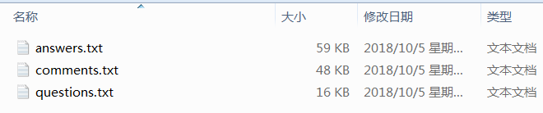
1.Extract Link
添加
I have extracted the link from RSO to ESO, including the questions, the answers, and the comments.
The extraction method uses database query operations and regular expressions.
I stored the extracted data in 3 txt texts.

Slide 3
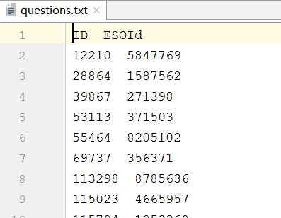
2.Analysis Link—①Analysis Link of Questions
Link of Questions (LQ)Total : 889
Questions Total：228006
The ratio of LQ to Questions : 0.390%
I immediately extracted 50 LQ to analyze their categories and I found the following types:
1: related to the original question and solved part of problem, but does not completely solve.
2: This LQ is the answer of the original question, but the author raises new problem on this LQ basis.
3: This LQ is the answer of the original question, but the author does not understand some content/ has doubts/ use with problem/ will not use.
4: Duplicate problem with ESO.
5: related to the original question but does not solve the problem.
6: This LQ is the question which the author quoted himself question at ESO.

Slide 4
第i条 | Id of RSO | Id of ESO | Type
21 | 211812 | 6822440 | 1
28 | 226647 | 7356820 | 1
41 | 264309 | 7040022 | 1
47 | 273005 | 17830227 | 2
91 | 395370 | 5104765 | 2
102 | 416231 | 12297861 | 3
107 | 419054 | 7074 | 4
111 | 420027 | 6469361 | 5
113 | 420363 | 29902715 | 5
115 | 420890 | 237807 | 1
144 | 435193 | 24642040 | 1
153 | 441914 | 20471311 | 5
160 | 443581 | 6038236 | 3
167 | 445077 | 4817933 | 3
182 | 456126 | 472906 | 3
207 | 473837 | 34232656 | 3
219 | 477742 | 31342684 | 5
255 | 496920 | 35631295 | 后者已被删除
292 | 509979 | 9767952 | 1
328 | 522436 | 2969348 | 1
337 | 528254 | 37058219 | 3
346 | 530239 | 27862346 | 5
354 | 535377 | 34398023 | 1
371 | 543833 | 2778638 | 3
380 | 547482 | 38407760 | 4
382 | 548127 | 19463978 | 1
385 | 549173 | 38857192 | 1
387 | 551122 | 537593 | 1
390 | 551725 | 29398237 | 1
461 | 593005 | 35818436 | 3
491 | 611959 | 388483 | 4
500 | 614254 | 3533539 | 1
518 | 626264 | 11227809 | 4
530 | 629089 | 24082524 | 4
547 | 636970 | 16804093 | 1
586 | 660729 | 2827393 | 1
599 | 670221 | 44103024 | 5
611 | 682666 | 44713104 | 6
645 | 710886 | 6359848 | 3
687 | 734380 | 279749 | 1
694 | 741913 | 19480778 | 1
697 | 744596 | 36109946 | 1
719 | 756989 | 28364837 | 1
775 | 810266 | 46965523 | 3
782 | 814245 | 48944875 | 5
810 | 833030 | 19466374 | 5
825 | 836563 | 50515162 | 6
853 | 848471 | 12128458 | 3
870 | 863175 | 8049520 | 3
888 | 875368 | 50686243 | 1
额外：６１4 | 682926 | 7245710 | 1
2.Analysis Link—①Analysis Link of Questions
The table on the right is 50 LQs randomly selected,
the table below is the result of analysis.
Type | Quantity | Percentage
1 | 12 | 42%
2 | 2 | 4％
3 | 12 | 24％
4 | 5 | 10％
5 | 8 | 16％
6 | 2 | 4％

Slide 5
2.Analysis Link—①Analysis Link of Questions
Conclusion
(1)Type 1,2 and 3 are helpful to the author, but for various reasons, the author has asked question. Type 1,2 and 3 accounted for 70%, that is, in the RSO question, reference ESO link, a large percentage of LQs are helpful to the author.
(2)Type 4 is duplicate problem, simply copied from ESO to RSO. Type 4 accounted for 10%, it can be considered that some LQs are to help Russians who do not understand English
(3)Type 5 is that author avoid the respondent to reply to such unsolvable answers. Type 5 accounted for 16%, these LQs can also help authors in another aspect.
(4)Type 6 is that author quoted his own question in ESO, but the type 4 ratio is small.

Slide 6
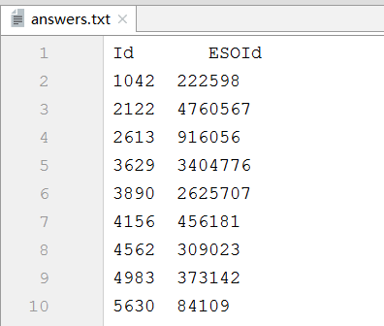
2.Analysis Link—②Analysis Link of Answers
Link of Answers(LA)Total : 3444
Answers Total：265565
The ratio of LA to Answers: 1.297%
I immediately extracted 50 LA to analyze their categories and I found the following types:
1: related to the author’s question, and helpful in solving the problem/ solving part of the author’s problem.
2: related to the author's question, given the specific example / example code.
3: This LA is basically the same as the author's question / very similar / can completely solve the author's problem
4: Duplicate problem with ESO.
5: related to the author's question, but it does not help to solve the problem.

Slide 7
第i条 | Id of RSO | Id of ESO | Type
４６ | 37495 | 665406 | 2
１５３ | 114583 | 855763 | 1
２０１ | 139203 | 1502590 | 2
２９２ | 185869 | 6278093 | 1
３２６ | 196679 | 6440386 | 1
３５６ | 206462 | 4434027 | 2
４５３ | 245746 | 9371238 | 3
４５８ | 248094 | 13136229 | 2
４９１ | 261326 | 6106859 | 3
５９３ | 315616 | 227897 | 2
７０１ | 385088 | 1144894 | 1
８２３ | 418384 | 29789877 | 3
８２８ | 419056 | 7074 | 4
９９５ | 437387 | 369026 | 2
１０６２ | 448565 | 8661915 | 3
１１４６ | 458367 | 10553625 | 1
１１５１ | 458874 | 7571370 | 3
１２０６ | 467797 | 29582571 | 1
１２２０ | 469434 | 33895762 | 3
１２４７ | 473098 | 7120813 | 1
１３６５ | 491227 | 9498422 | 1
１３８３ | 494914 | 826212 | 1
１３９５ | 495744 | 29029827 | 1
１４９６ | 511604 | 10374520 | 1
１５５９ | 520517 | 28963514 | 1
１６１０ | 527618 | 1164138 | 3
１８０６ | 558358 | 24868226 | 3
１８６９ | 566349 | 3218910 | 1
１９４８ | 580365 | 1732348 | 1
１９４９ | 580530 | 1359018 | 1
１９９２ | 586841 | 500864 | 1
２００３ | 587490 | 40442168 | 4
２０５０ | 597498 | 9970545 | 1
２１９１ | 620451 | 13547639 | 1
２２６１ | 633163 | 21621077 | 3
２３９２ | 651270 | 15191129 | 1
２４９８ | 671120 | 41570359 | 1
２６１７ | 697025 | 6045384 | 3
２６７５ | 708559 | 10505057 | 1
２６９２ | 712303 | 917610 | 1
２７８１ | 728490 | 42625804 | 3
２８５４ | 744644 | 13604090 | 1
２８９０ | 752656 | 23879567 | 3
２９９５ | 772658 | 43557977 | 3
３００６ | 776395 | 21655367 | 1
３０５１ | 787674 | 27465135 | 1
３０７３ | 791741 | 494143 | 1
３１４７ | 810315 | 4905743 | 1
３２５９ | 835685 | 2586598 | 1
３４２４ | 873480 | 12327348 | 1
2.Analysis Link—②Analysis Link of Answers
The table on the right is 50 LAs randomly selected,
the table below is the result of analysis.
Type | Quantity | Percentage
1 | 29 | 58%
2 | 6 | 12％
3 | 13 | 26％
4 | 2 | 4％
5 | 0 | 0％

Slide 8
2.Analysis Link—②Analysis Link of Answers
Conclusion
(1)Type 1 is partially helpful in solving the problem. Respondents often link ESO related questions and attach their own unique answers. This type of situation is the most common, accounting for 58%.
(2)In the type 2, after answering the question, the respondent attaches the link of the relevant instance implementation. Such link includes code, picture, etc., which helps the questioner to solve the problem better, and is actually similar to the role of Type 1. Type 2 accounting for 12% .
(3)In the type 3, there is a very similar question and answer in the ESO. The respondent has linked this question and answer, and can completely solve the author's problem without repeating it. Type 3 accounting for 26% .
(4)Type 4 is completely consistent with the LQ type 4, accounting for 4% .
(5) Type 5 situation has also been encountered, but it is not found in the 50 randomly selected, so the probability is very low.

Slide 9
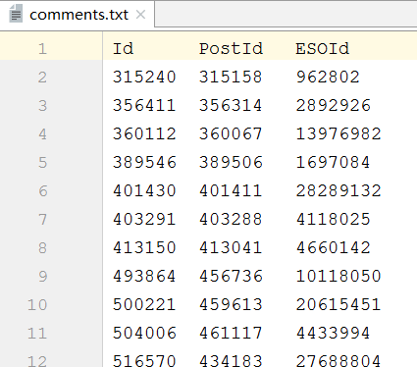
2.Analysis Link—③Analysis Link of Comments
Link of Comments(LC)Total : 1760
Comments Total：940645
The ratio of LA to Comments: 0.187%
I immediately extracted 50 LC to analyze their categories and I found the following types:
1: related to the author’s question, and helpful in solving the problem.
2: related to the author's question, but it does not help to solve the problem.
3: related to the author's question, but can not know if there is help, the commenter only posts the link and has no description.
4: Duplicate problem with ESO, and can answer the author's question

Slide 10
第i条 | Ｉｄ | ＰｏｓｔＩｄ | Id of ESO | Type | Score
１７ | 624366 | 512888 | 6184752 | 1 | 0
６４ | 978354 | 672404 | 3160691 | 1 | 0
８６ | 983798 | 674599 | 3149355 | 1 | 0
１５０ | 998840 | 680991 | 4175534 | 1 | 0
１５９ | 1000806 | 681897 | 1555262 | 3 | 0
１９３ | 1009857 | 685757 | 44853171 | 1 | 0
２３１ | 1020691 | 303698 | 190396 | 1 | 0
２５７ | 1029613 | 693120 | 21271835 | 1 | 0
２９８ | 1041682 | 701418 | 3640280 | 1 | 1
３４２ | 1051211 | 705935 | 7306214 | 1 | 1
３５３ | 1054471 | 707364 | 37738106 | 1 | 1
３６０ | 1056854 | 707721 | 14319967 | 2 | 0
３７２ | 1058849 | 709212 | 21120999 | 2 | 0
４８７ | 1086460 | 721165 | 162331 | 1 | 0
５４０ | 1101137 | 727707 | 1844156 | 1 | 1
５９６ | 1113649 | 732791 | 24296390 | 1 | 0
６３９ | 1122541 | 736578 | 4284663 | 1 | 0
８６７ | 1189615 | 765234 | 46988102 | 1 | 0
８７２ | 1189821 | 765332 | 3825668 | 3 | 0
９１７ | 1200471 | 769304 | 2584678 | 3 | 0
９２１ | 1201421 | 770141 | 28189371 | 1 | 0
９２９ | 1203395 | 771035 | 143174 | 1 | 0
９３７ | 1204950 | 771722 | 4480879 | 1 | 0
９５１ | 1211619 | 774856 | 2042269 | 1 | 0
９５７ | 1214101 | 775993 | 37916940 | 1 | 2
９７０ | 1217762 | 777712 | 15485735 | 1 | 0
１０３４ | 1237947 | 786955 | 1565388 | 2 | 0
１０６５ | 1244634 | 790355 | 1152260 | 1 | 0
１１４６ | 1267758 | 802310 | 34669269 | 3 | 0
１１９８ | 1278935 | 807760 | 42936222 | 1 | 0
１２６８ | 1298341 | 817022 | 8982645 | 4 | 1
１２７７ | 1302585 | 818885 | 8076539 | 1 | 0
１２８０ | 1303116 | 819292 | 14904378 | 1 | 2
１３５３ | 1321689 | 828032 | 1341010 | 1 | 0
１３７３ | 1325997 | 753354 | 23994338 | 1 | 0
１３７５ | 1327399 | 830848 | 841293 | 4 | 0
１３８０ | 1327984 | 831116 | 2189452 | 1 | 0
１４８２ | 1356625 | 844825 | 26474482 | 1 | 1
１４８４ | 1356906 | 844956 | 5251010 | 1 | 0
１４８７ | 1357075 | 845046 | 20769723 | 1 | 0
１５２０ | 1365166 | 848848 | 30476257 | 1 | 0
１５４４ | 1368409 | 850282 | 44773296 | 1 | 0
１５７２ | 1377187 | 854494 | 13102045 | 1 | 0
１５７７ | 1379218 | 856097 | 48144030 | 2 | 0
１６０５ | 1384832 | 858782 | 38987 | 1 | 0
１６４２ | 1394357 | 863166 | 98650 | 1 | 0
１６９１ | 1406149 | 813762 | 15072264 | 3 | 0
１６９５ | 1406746 | 868788 | 341264 | 1 | 0
１７０７ | 1410422 | 870540 | 166221 | 3 | 0
１７４５ | 1418550 | 874277 | 35134013 | 1 | 1
2.Analysis Link—③Analysis Link of Comments
The table on the right is 50 LCs randomly selected,
the table below is the result of analysis.
Type | Quantity | Percentage
1 | 38 | 76%
2 | 4 | 8％
3 | 6 | 12％
4 | 2 | 4％

Slide 11
2.Analysis Link—③Analysis Link of Comments
Conclusion
(1) Type 1 is completely consistent with the LA type 2, accounting for 76% .
(2)In the type 2,The commenter's link is replied to by other commenter such as "he wrote that the option of specifying the size of the heap through command line arguments is not suitable for him.“Type 2 accounting for 8% .
(3)In the type 3, the commenter only posted the URL of the link, there is no other description, and no one responded and no one liked it, so it is impossible to really judge whether it is useful. Type 3 accounting for 12% .
(4)Type 4 is completely consistent with the LQ type 4, accounting for 4% .

Slide 12
3.Learn about SSE
I am looking the README.md at SSE on github, But I am busy with the previous work, I have not finished reading.

