Slide 1

Major work
Part 01
Type Example
Part 02
Train crosslingual of SSE
Part 03
Demo crosslingual of SSE
Part 04
SSE Visualization

Slide 2
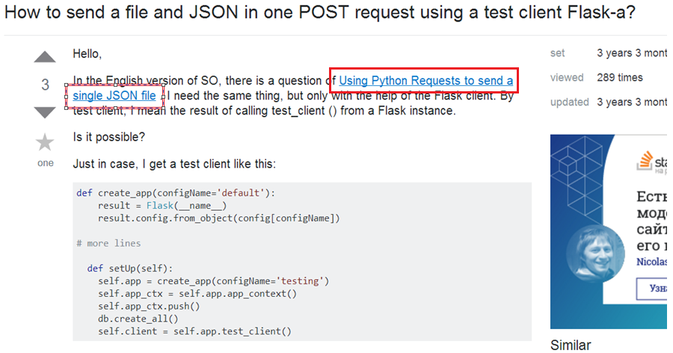
1.Type Example(Question Type)
Question Type 1 : related to the original question and solved part of problem, but does not completely solve.
Red box is the link from ESO to RSO

Slide 3
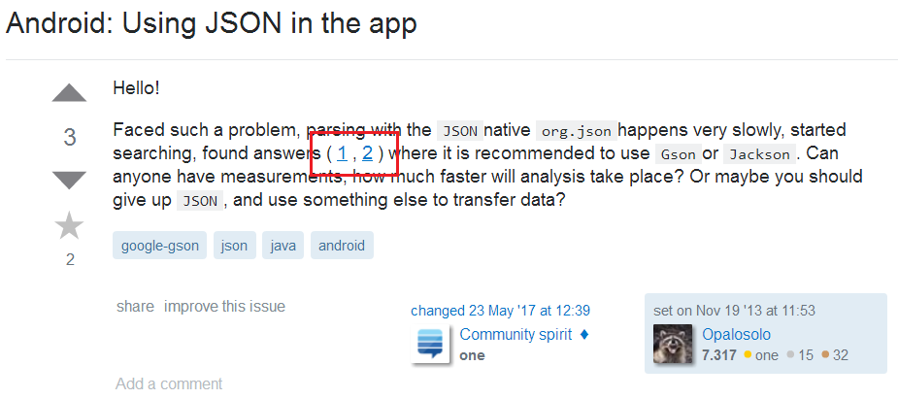
1.Type Example(Question Type)
Question Type 2 : This link is the answer of the original question, but the author raises new problem on this LQ basis.

Slide 4
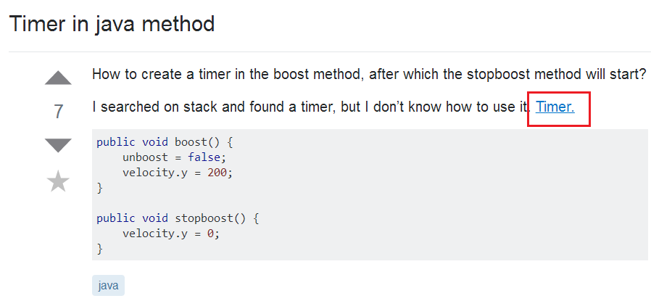
1.Type Example(Question Type)
Question Type 3 : This link is the answer of the original question, but the author does not understand some content/ has doubts/ use with problem/ will not use.

Slide 5
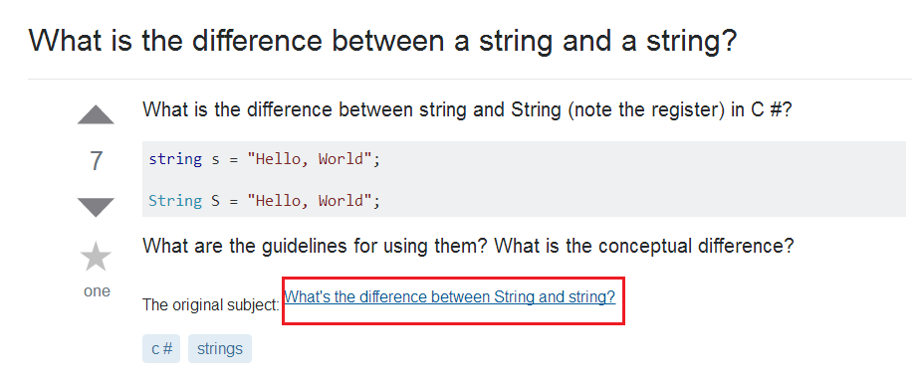
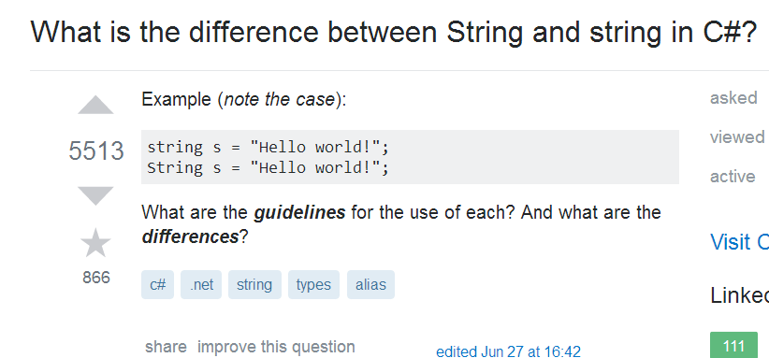
1.Type Example(Question Type)
Question Type 4 : Duplicate problem with ESO.
(The left picture is RSO, the right one is ESO.)

Slide 6
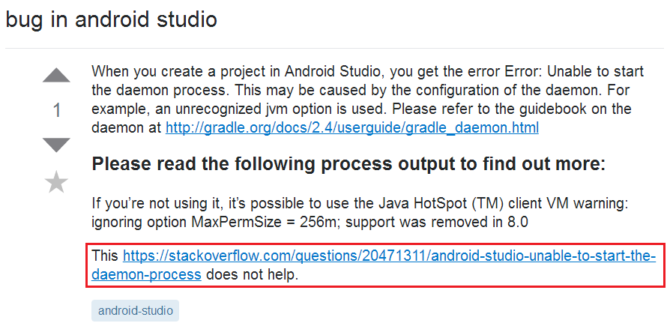
1.Type Example(Question Type)
Question Type 5: related to the original question but does not solve the problem.

Slide 7
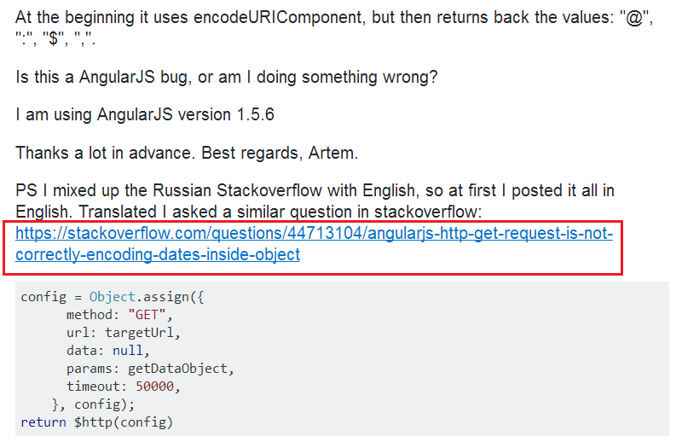
1.Type Example(Question Type)
Question Type 6 : the author quoted himself question at ESO.

Slide 8
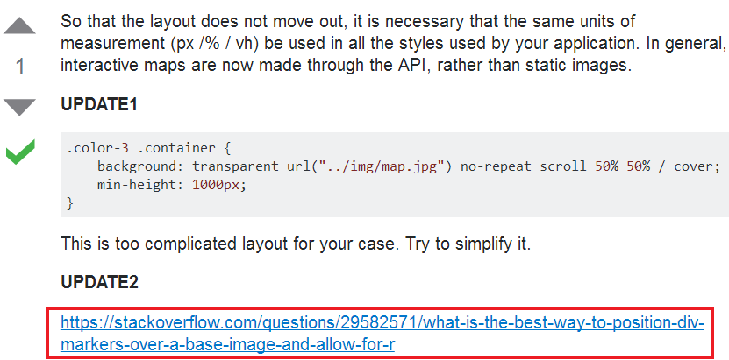
1.Type Example(Answer Type)
Answer Type 1 : related to the author’s question, and helpful in solving the problem/ solving part of the author’s problem.

Slide 9
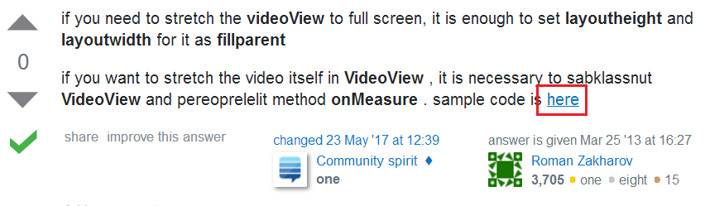
1.Type Example(Answer Type)
Answer Type 2 : related to the author's question, given the specific example / example code.

Slide 10
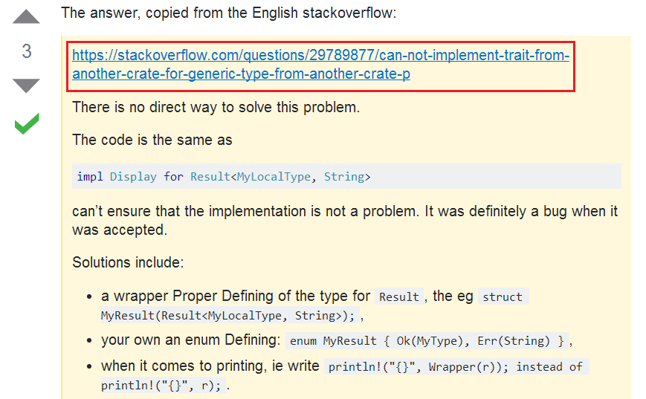
1.Type Example(Answer Type)
Answer Type 3 : This link is basically the same as the author's question / very similar / can completely solve the author's problem
The left picture is answer, the right are RSO and ESO questions, they are not Repeating.

Slide 11
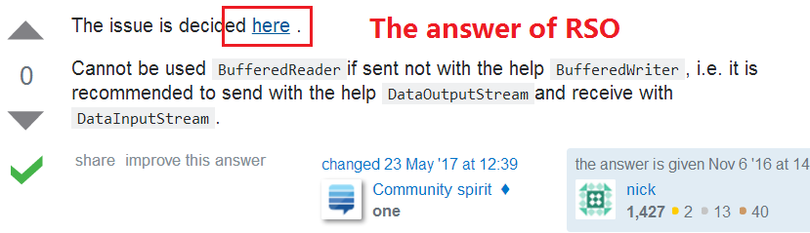
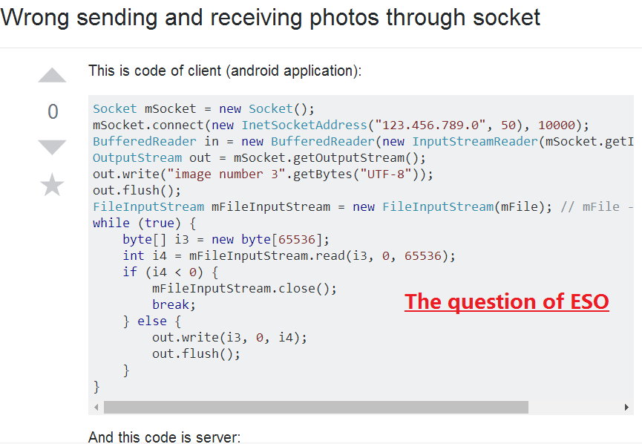
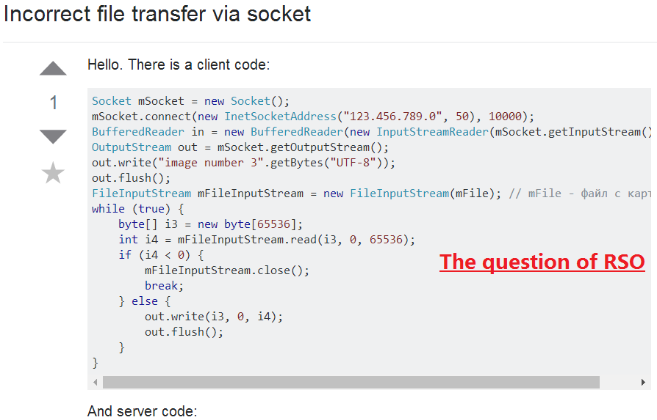
1.Type Example(Answer Type)
Answer Type 4 : Duplicate problem with ESO.

Slide 12
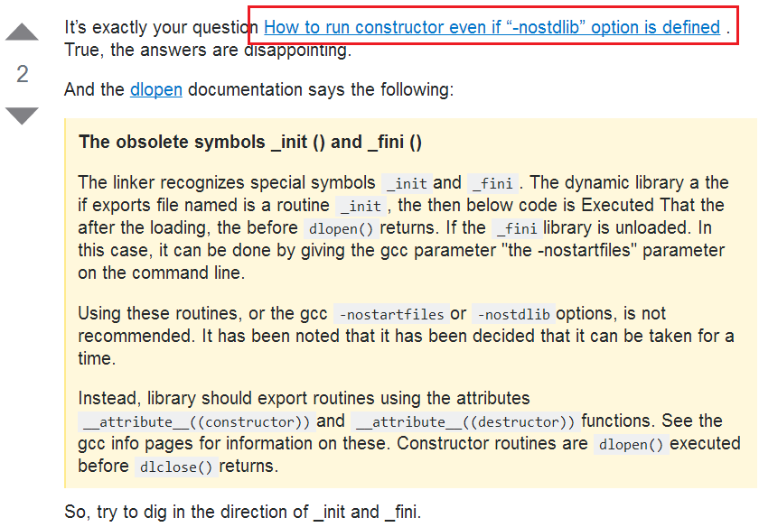
1.Type Example(Answer Type)
Answer Type 5 : related to the author's question, but it does not help to solve the problem.

Slide 13
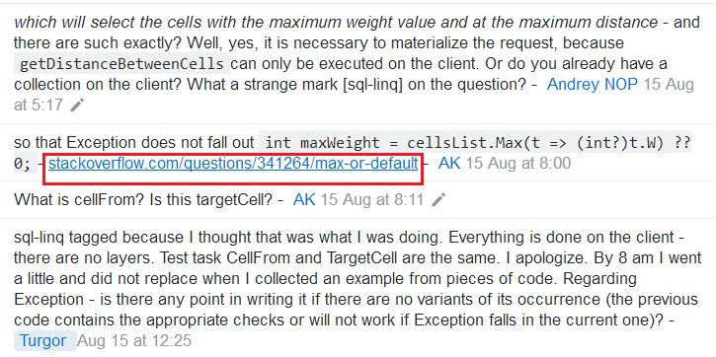
1.Type Example(Comment Type)
Comment Type 1: related to the author’s question, and helpful in solving the problem.

Slide 14
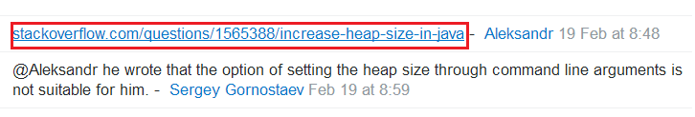
1.Type Example(Comment Type)
Comment Type 2: related to the author's question, but it does not help to solve the problem.

Slide 15
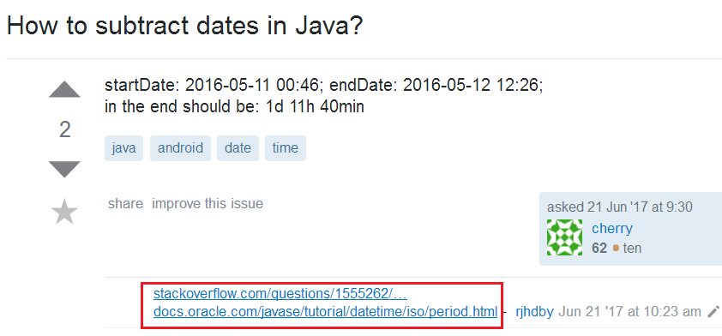
1.Type Example(Comment Type)
Comment Type 3 : related to the author's question, but can not know if there is help, the commenter only posts the link and has no description.

Slide 16
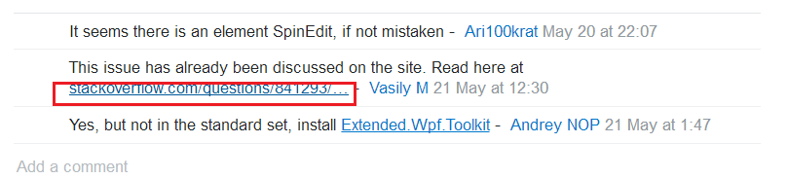
1.Type Example(Comment Type)
Comment Type 4: Duplicate problem with ESO, and can answer the author's question .

Slide 17
2.Train crosslingual of SSE— Lrean the input/output
The train input file of SSE: rawdata-crosslingual/DataSet.tar.gz
rawdata-crosslingual/DataSet.tar.gz contains 3 files named as TrainPairs, EvalPairs and targetIDs.
The preprocessing of input:
1.Extract Texts and Ids of 3 files, using split('\t') function, then produce source seq corpus with Texts of 3 files.
2.Read the corpus and compute a dictionary of token counts, then generate vocabulary file.
3.Encode the data of TargetIDs as text + id + encoded form, the encoding_size is 50, then create encoded TargetSpace Data.
4. Using encoder and encoded TargetSpace Data to creat positive Evaluation/ Training corpus.
The train output file of SSE: models-crosslingual
models-crosslingual contains 77 files, they are training result.

Slide 18
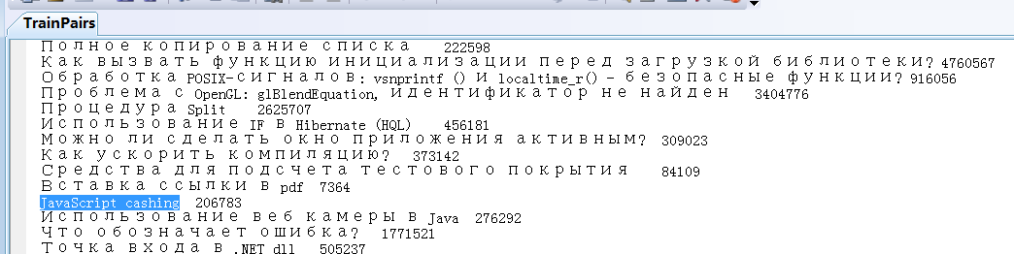
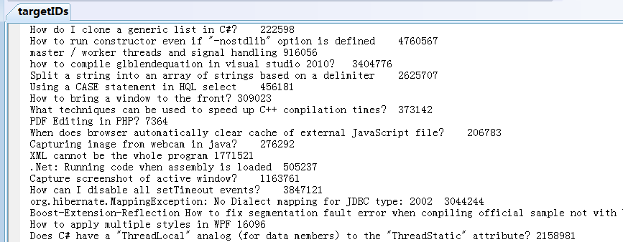
2.Train crosslingual of SSE— Run with my own data
targetIDs:5668
TrainPairs/EvalParis:6093

Slide 19
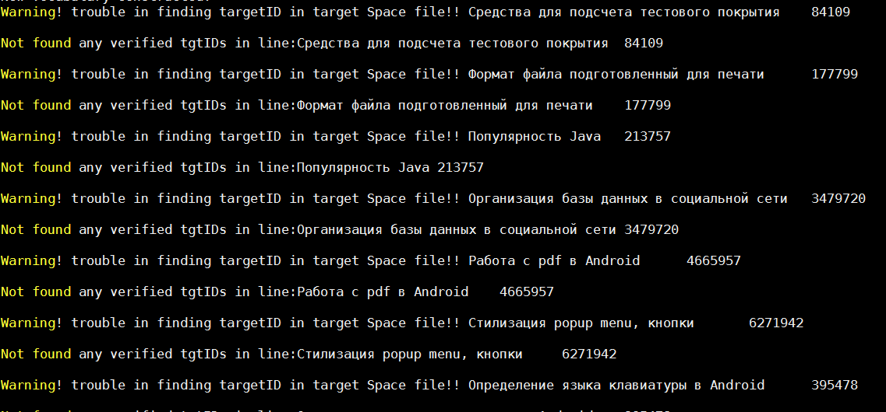
2.Train crosslingual of SSE— Run with my own data
During the training, there are 351 warnings that the targetID could not be found.

Slide 20
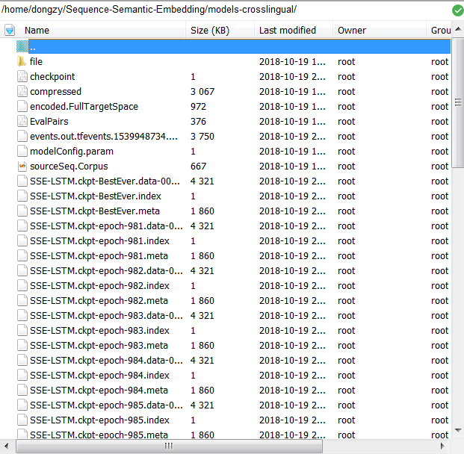
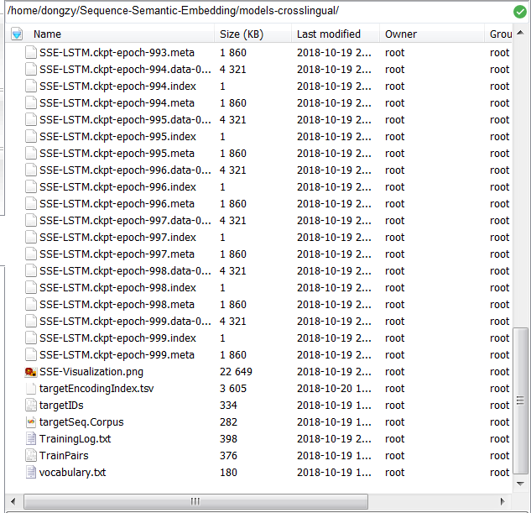
training result: models-crosslingual

Slide 21
3.Demo crosslingual of SSE— Lrean the input/output
The demo input of SSE: a sentence entered by the user
The preprocessing of input:
1. load full set target Index data, calculate targetEncodings.
2. Calculate sourceEncodings for the input sentence.
3. Matrix multiplication of the target Encoding with each Encoding in the target.
4. Sort of results
The demo output of SSE: 10 sentences with the highest similarity.

Slide 22
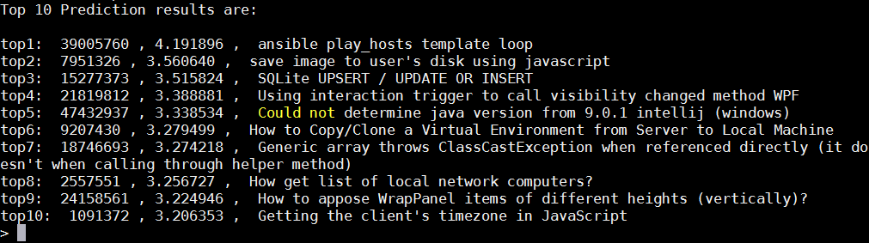
3.Demo crosslingual of SSE— Run with my own data
The test result of my own data.

Slide 23

4. SSE Visualization

Slide 24
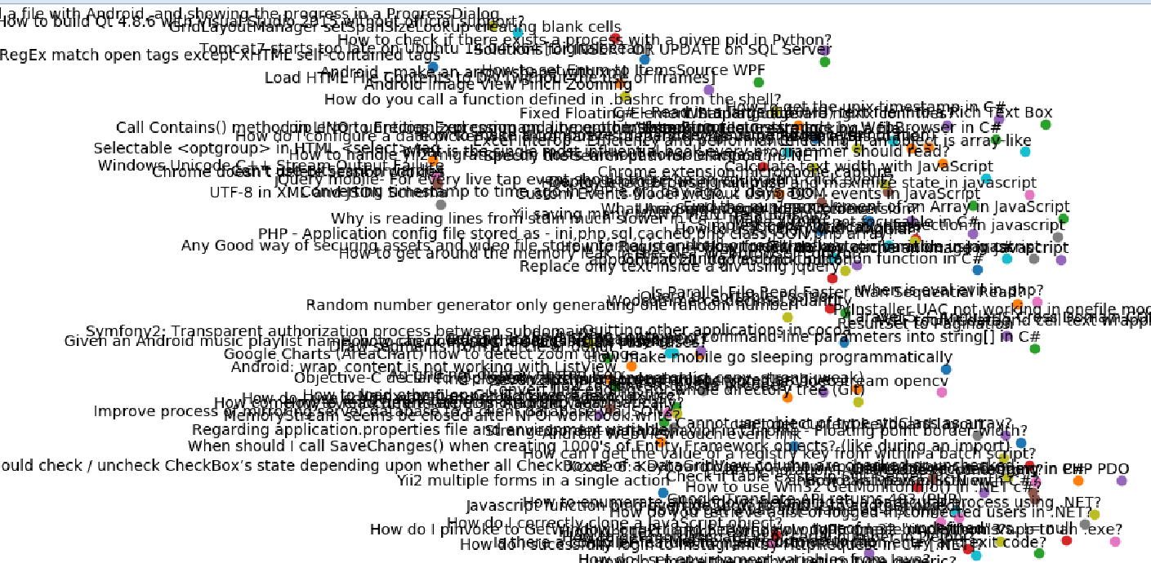
4. SSE Visualization

