Slide 1
WORK one：
1.Look for python-related tag data
2.The data obtained from the query is used for model training
3.Select some sentences from the documentation that we can use for testing

Slide 2
1.DATA QUERY
select body from Posts where PostTypeId = 2 and score > 1 and ParentId in (select Id from Posts where PostTypeId = 1 and Tags like '%python%')
The total number is 583588

Slide 3
question
1.The meaning of parameters in the json configuration file
2.The function of the eval.py executed under run.sh
3.What is the circular evaluation of eve.py for?

Slide 4
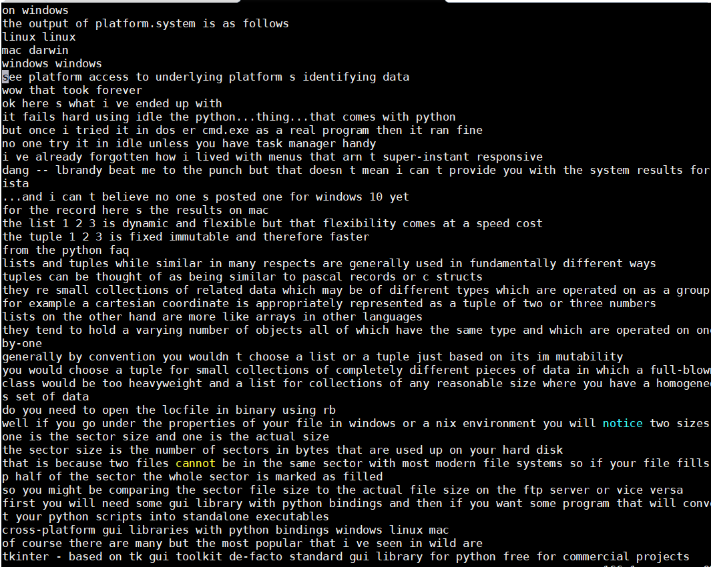
1.Preprocessed data

Slide 5
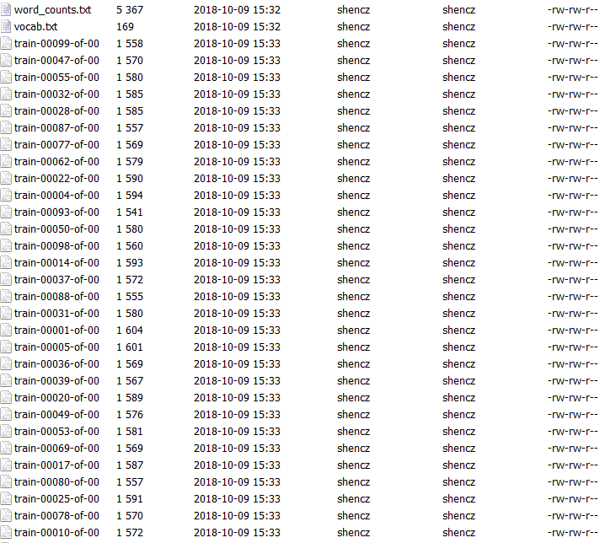
Training data

Slide 6
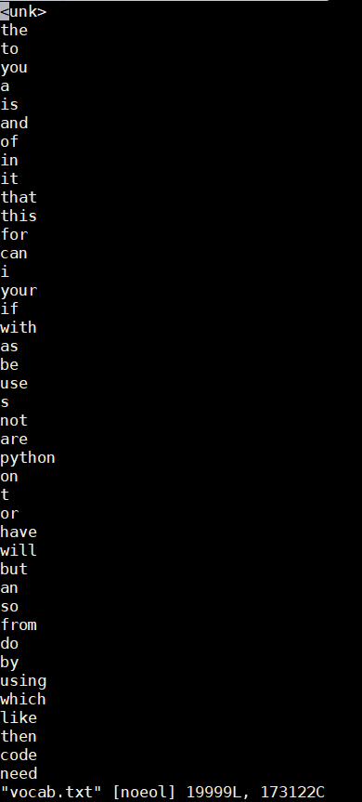
dictionary

Slide 7
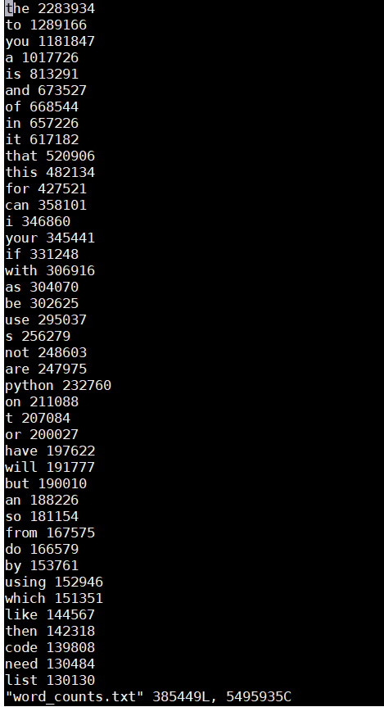
Word frequency

Slide 8
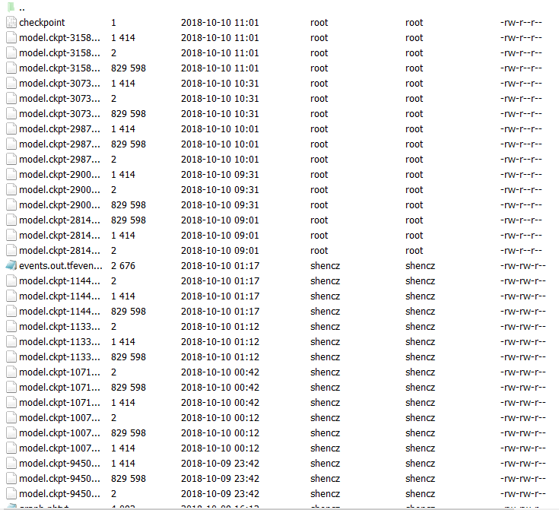
result

Slide 9
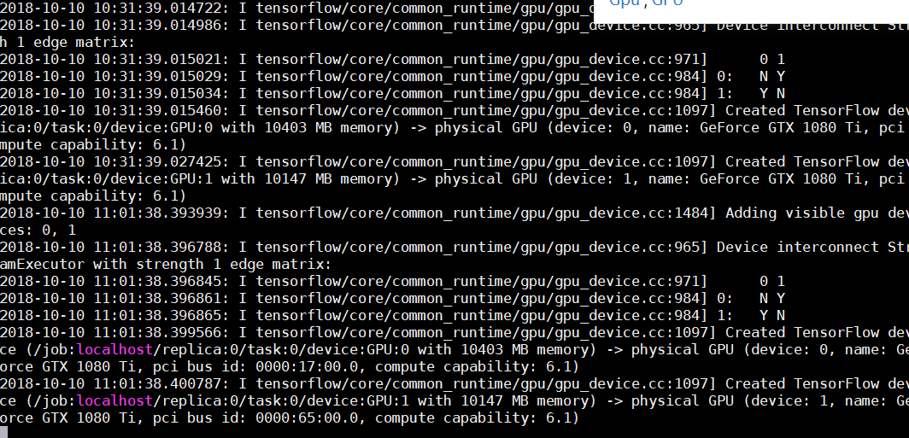
eval.py in runtime

