Slide 1

Major work
Part 01
Read paper
Part 02
Read code
Part 03
Data import database

Slide 2
Read paper
Skim the contents of the paper
This week I read the contents of the paper briefly.
Read the 6 chapters carefully
This week I read sixth sections of the paper carefully. In particular, methods for comparing related problems.
And I feel the author's method is perfect, so I don't know how to improve and perfect this method.

Slide 3
Read code
I didn't understand the code.
The author's code is rather complicated and I can't understand it.

Slide 4
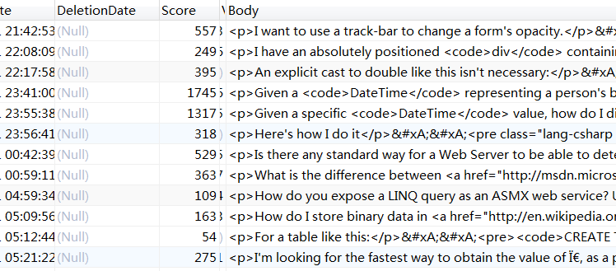
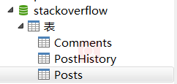
Data import database
Data import MySQL
Through the help of my elder sister, I have imported data into mysql.

