Slide 1
Android UI design
Jilin University

Slide 2
Reporting on work--Jiangxue
A script for filtering pictures
The function that this script can achieve is to traverse each app file in all existing datasets, randomly select a UI, and finally form a new dataset. Solved the problem that UI is empty and. Png files can not be opened in individual app folders in the data set.
Rename the filtered image as "app name _ picture name"
And store the path corresponding to UI in a list for later use

Slide 3
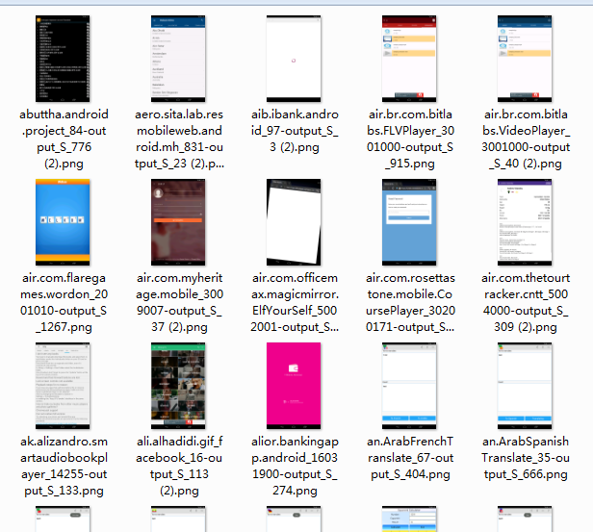

Slide 4
Using the K-means method for new data clustering
Set the K value to 20, 15, 10, 5, respectively, where the K value is 15 and the effect is relatively good. However, there are still problems in which one of the four categories accounts for the vast majority of problems.
Query dbscan algorithm related data. At the end of the algorithm, core points, boundary points and noise points will be generated. How to classify the noise points generated during the clustering process.

