Slide 1
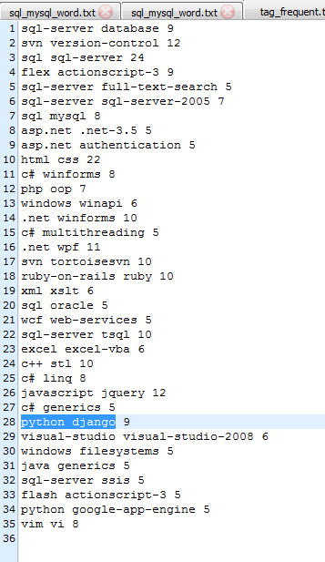
Frequent tags ：

Slide 2
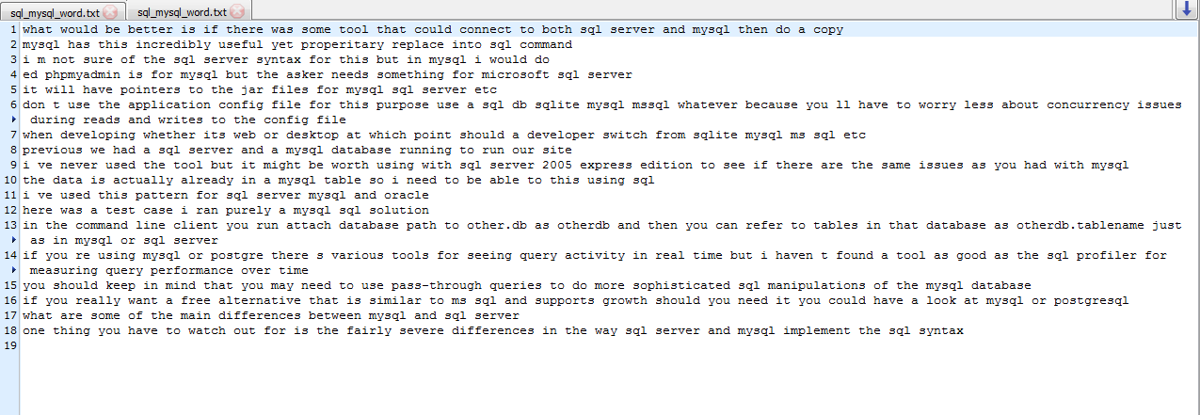
Sentences about mysql-sql：

Slide 3
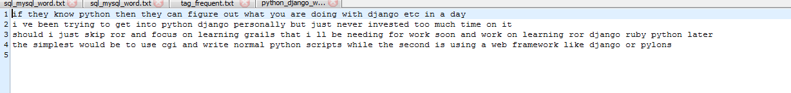
Sentences about python-django：

Slide 4
Question:
The clause is not very good，or the punctuation is removed.

