Slide 1
few primitives | is in | java
salt | is | public
string | is | fancy
way | upgrade | versioning
hash | is in | database int
load | is in | same scenario customizing
i | prefer | int string double etc
long standing flaws | is in | cvs
i | make | new text file
string value | is in | sql server 2005
cvs | is in | grid
you | mocking | ianimals seeing as you don t
step 2 | is in | your approach
you | mocking yet | ianimals seeing as apparently you don t
you | mocking | ianimals

Slide 2
few primitives | is in | java
salt | is | public
string | is | fancy
way | upgrade | versioning
hash | is in | database int
load | is in | same scenario customizing
i | prefer | int string double etc
long standing flaws | is in | cvs
i | make | new text file
string value | is in | sql server 2005
cvs | is in | grid
you | mocking | ianimals seeing as you don t
step 2 | is in | your approach
you | mocking yet | ianimals seeing as apparently you don t
you | mocking | ianimals

Slide 3
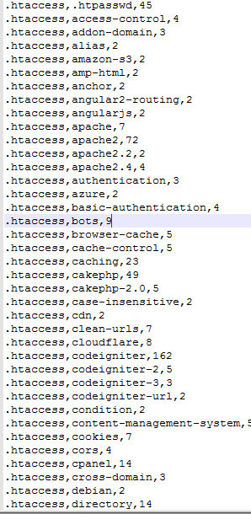

Slide 4
How to get similar-techs ?
In paper, using sentence training model，mining tag category, establish similar-techs knowledge. But I don't understand what their relationship.
In code, similar-techs from cateInGroups_freqabove10_600_10_1_sg_v1.txt and synonymAbbreviation_manualCheck.txt . I don't understand where the two documents come from.

Slide 5
The content of the paper third chapter is clear.
WmdSimilarity or Girvan-Newman algorithm and TF-IDF
The concrete implementation of the algorithm has not yet been understood.
In the running of code ,about of stanford CoreNLP serve code for a is good and bad.

