Slide 1
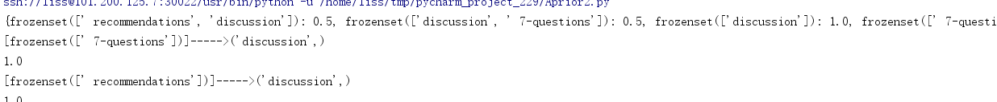
have relationship tags:
Learning association rule mining,understanding the principle,
input and output.
Learning teacher's paper, understand TechLand website function.
know the mining technology landscape from stack overflow.
Use Simple algorithm Apriori analysis tags relationship.

Slide 2
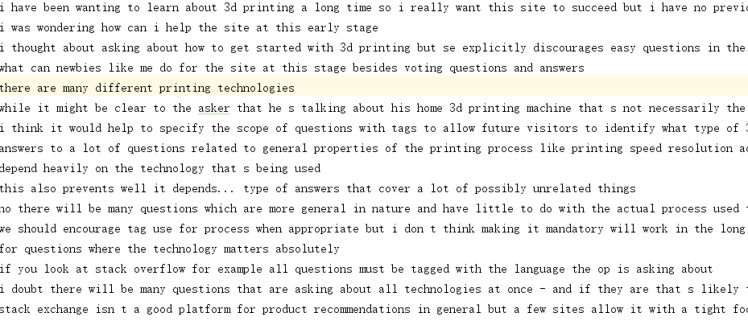
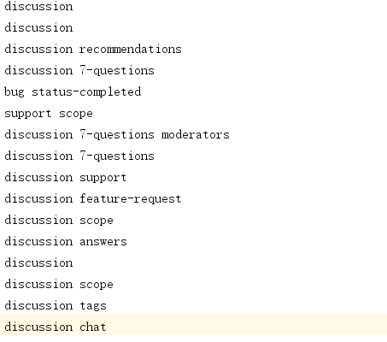
空白演示
Separate sentence and tags result：

