Slide 1




HPCA 2025 Tutorial
Topic 5. Choco-Q: Commute Hamiltonian-based QAOA for
Constrained Binary Optimization
Lab
JanusQ
Cloud
Speaker: Liqiang Lu
College of Computer Science and Technology
Zhejiang University (ZJU)
https://janusq.github.io/HPCA_2025_Tutorial/
HPCA 2025
Notes:
Hello everyone, I’m Liqiang Lu from Zhejiang University . Today, I’m excited to present our work on Choco-Q: Commute Hamiltonian-based QAOA for Constrained Binary Optimization. In this work, we investigate how commutative Hamiltonians can improve both the efficiency and practicality of solving constrained binary optimization problems on quantum hardware.

Slide 2
Outline of Presentation
Background and challenges
Overview of Choco-Q
Choco-Q characterization and calibration
Experiment
API of Choco-Q
Notes:
First, I will introduce the background and challenges.

Slide 3

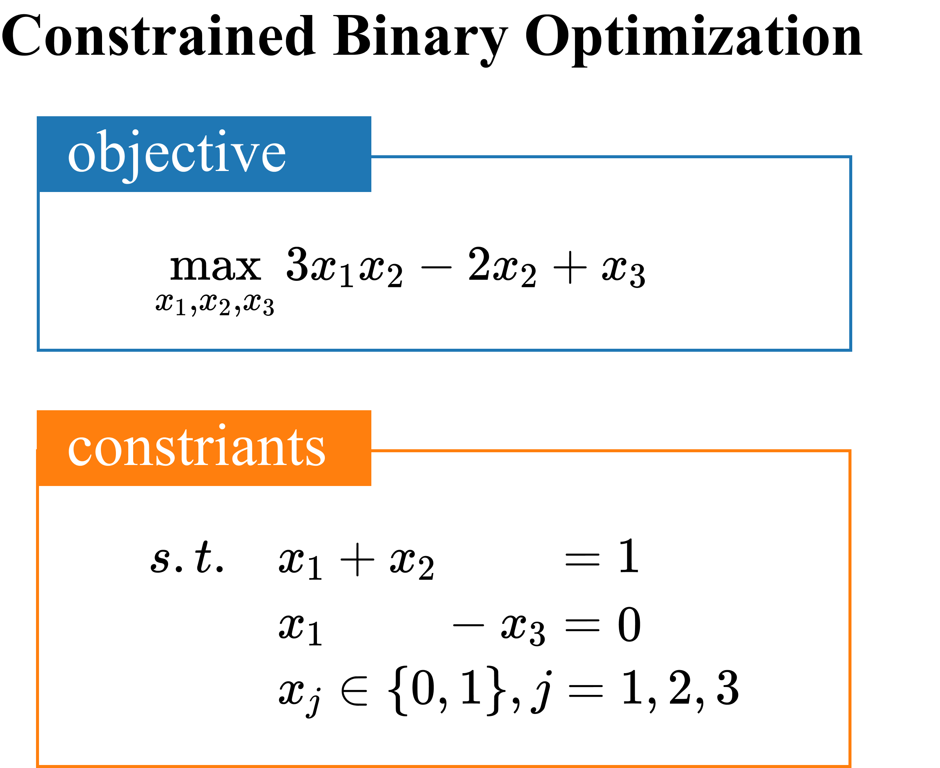
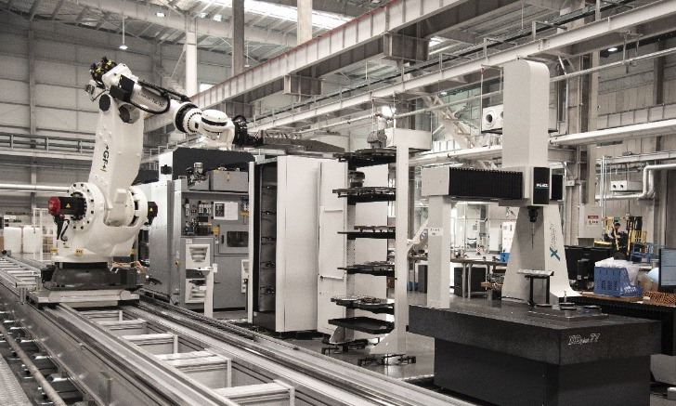

Application of Constrained Binary Optimization
Facility location
Routing planning
project scheduling
portfolio optimization
Notes:
The constrained binary optimization is to find an assignment of binary variables that minimize or maximize the objective function under the constraints. Typically, the constraints usually comprise multiple linear equations.
The representative applications of this problem includes facility location, routing planning, project scheduling, and portfolio optimization.

Slide 4
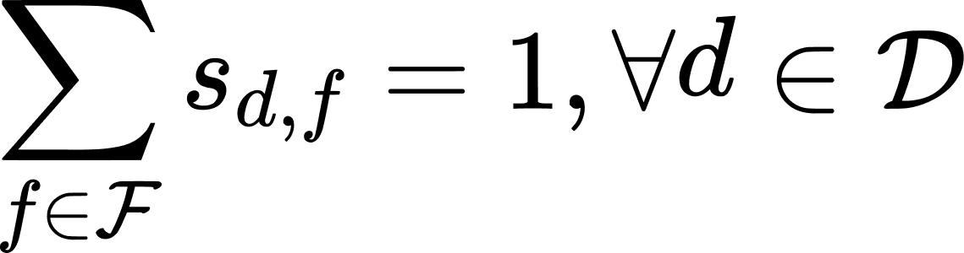

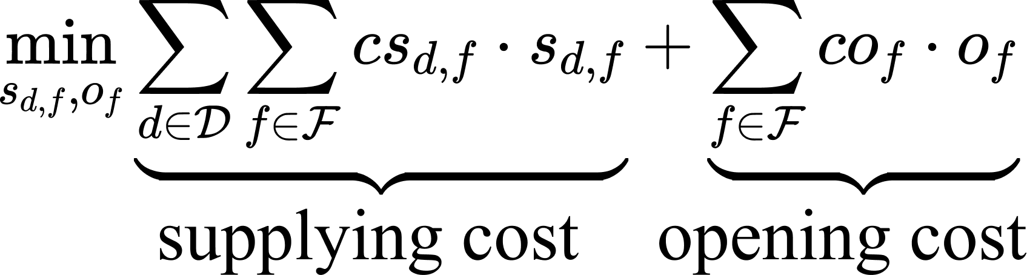
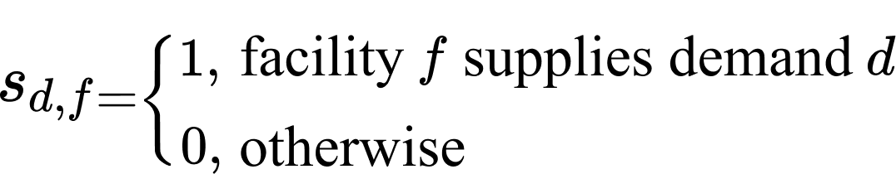
Example: Facility location Problem
Variable Definition
Constraints
There are facilities to supply the demands.
The costs including opening the facilities and supply demands.
Each demand can only be assigned to one facility
An unopened facility cannot supply any demand
Whether to open facility
objective
Minimize the cost of opening facilities and supplying demands
How to assign demands
Notes:
For example, in facility location problem, the facilities is used to supply the demands. We need to decide whether to open a facility and how to assign demands. These decisions are represented by the binary variables. The goal is to minimize the total cost while satisfying several constraints. The constraints include each demand can only be assigned to one facility, and an unopened facility does not supply any demand. These constraints can be represented by the equations with binary variables. The total costs including opening the facilities and supply demands. The cost can be also represented by the binary variables. In the end, we formulate this facility location problem as a constrained binary optimization problem.

Slide 5
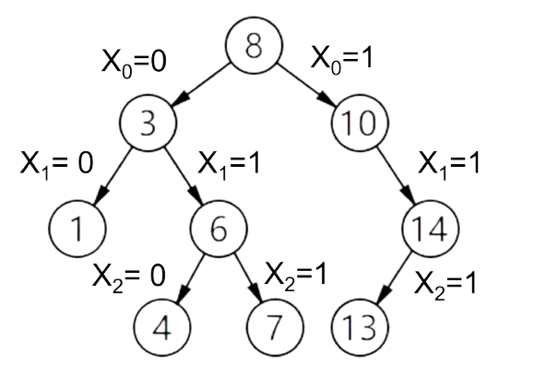
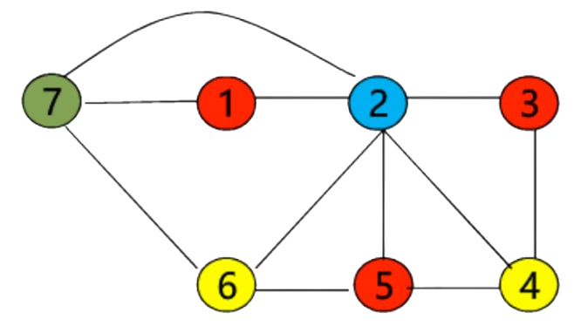
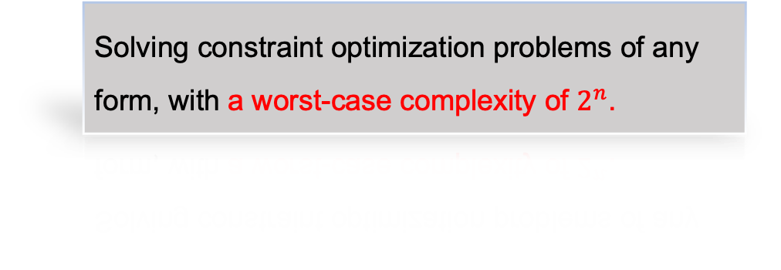
Classical Solving Methods
Exact algorithms
Approximation algorithms
branch and bound method.
greedy method
Construct a binary tree based on the variable values.
Color the vertices sequentially, ensuring that adjacent vertices are assigned different colors.
Solving constraint optimization problems of any form, with a worst-case complexity of $2^{n}$.
Need artificially designed for particular problems. No guarantee for global optimality.
NP-Hard problem, and the classical algorithms for exact solutions have exponential complexity.
Notes:
Constrained binary optimization problem can be solved by classical computer. Classical methods include approximation algorithms and exact algorithms. Exact methods like branch and bound method suffer from exponential complexity. Approximation algorithms like greedy method require problem-specific designs and do not guarantee global optimality.

Slide 6
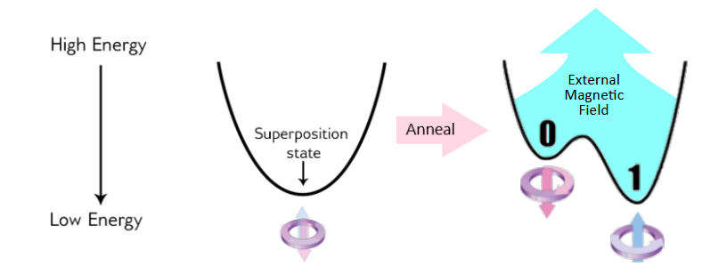
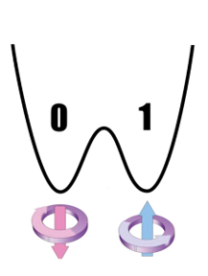
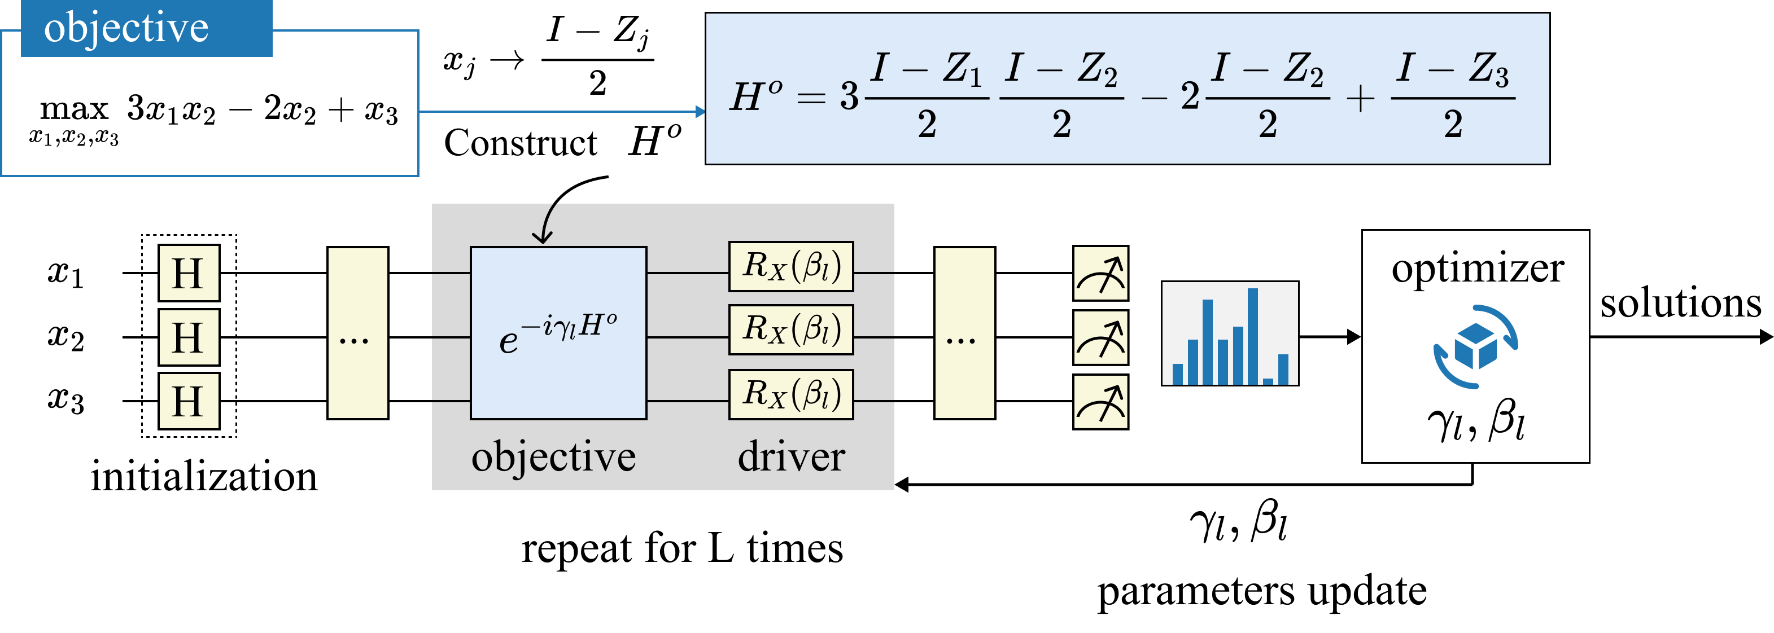
Quantum approximation optimization algorithm
Adiabatic Evolution
绝热演化
Driver Hamiltonian
Objective Hamiltonian
Adiabatic evolution
Simple and easy to prepare
The objective to be optimized
Quantum approximation optimization algorithm (QAOA)
Notes:
To address the limitations of classical methods, Quantum approximation optimization algorithm is introduced. It is inspired by adiabatic evolution and provides an alternative way to solve constrained optimization problems efficiently.
Adiabatic Evolution starts from preparing a simple driver Hamiltonian. Under the adiabatic condition, the Hamiltonian is smoothly converted to the objective Hamiltonian. Inspired by this, QAOA use repeated simulation of driver Hamiltonian and objective Hamiltonian to construct a variational quantum circuit. The classical optimizer is used to update the parameters. After optimization, Measuring the circuit will give the solutions.
为了解决经典方法的局限性，引入了QAOA。该方法受到绝热演化的启发，为求解约束优化问题提供了一种新的思路

Slide 7
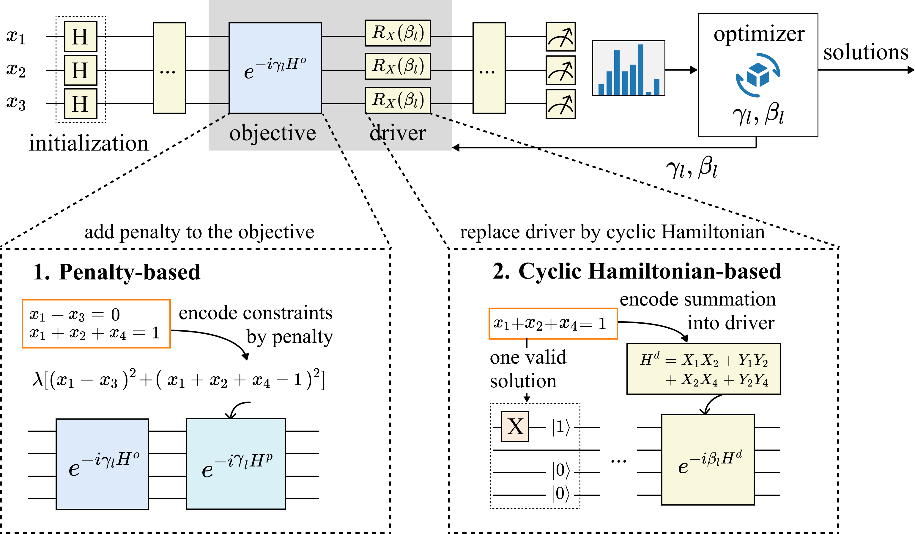
QAOA for constrained optimization
Notes:
Existing QAOA algorithms handle constraints in two main ways.
The first approach incorporates constraints as penalty terms in the objective function. The constraints are transformed into quadratic term in the objective Hamiltonian.
The second approach utilizes cyclic Hamiltonians to enforce multi-qubit summation constraints.
现有的 QAOA 算法主要有两种方法来处理约束问题。
第一种方法是将约束作为惩罚项加入目标函数，但这种方法存在两个问题：一是惩罚系数的选择较为困难，二是约束的维持效果往往不理想。
第二种方法是基于循环哈密顿量（cyclic Hamiltonian），用于实现多比特求和型约束。这种方法虽然能够在一定程度上保证约束满足，但它只能处理求和型约束，应用范围较为有限。

Slide 8
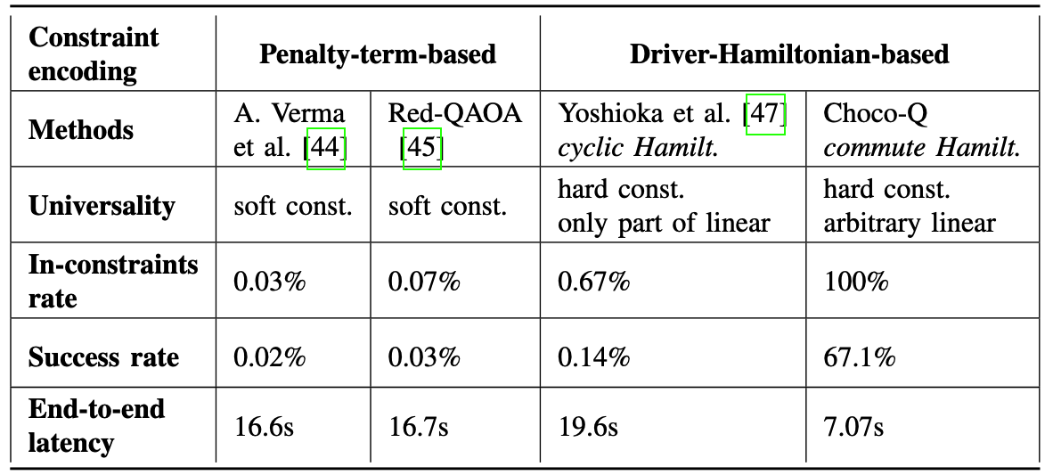
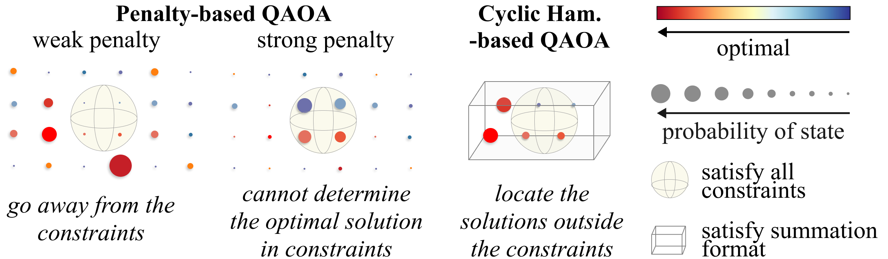
Limitations of Current Methods
Notes:
However, Penalty-term based method cannot determine an appropriate penalty strength and it often fails to effectively enforce constraints. Thus, we can see in this table, the in-constraints rates are lower than one thousandth. Although the Cyclic Hamiltonian-based method can improve the in-constraints rate, it is limited to summation-format constraints. Thereby, its success rate is quite low.

Slide 9
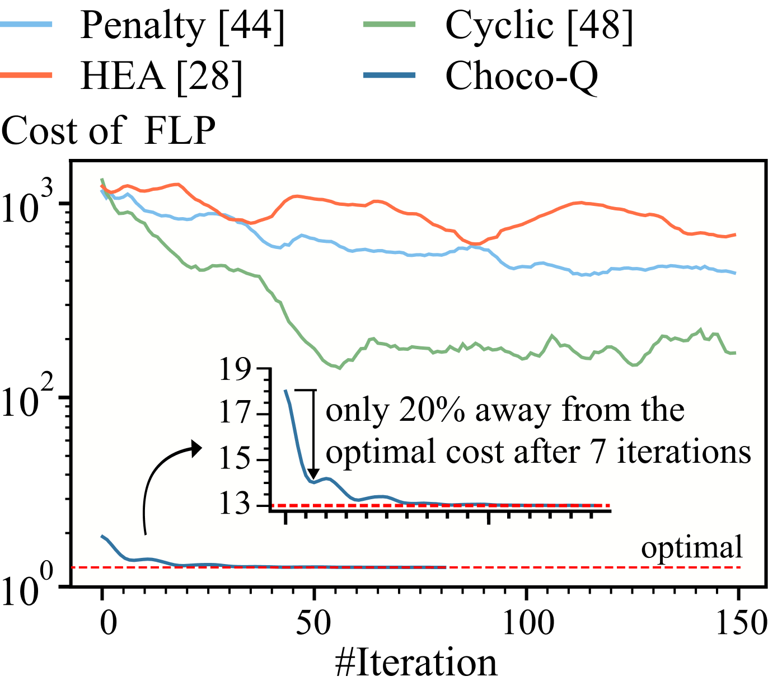
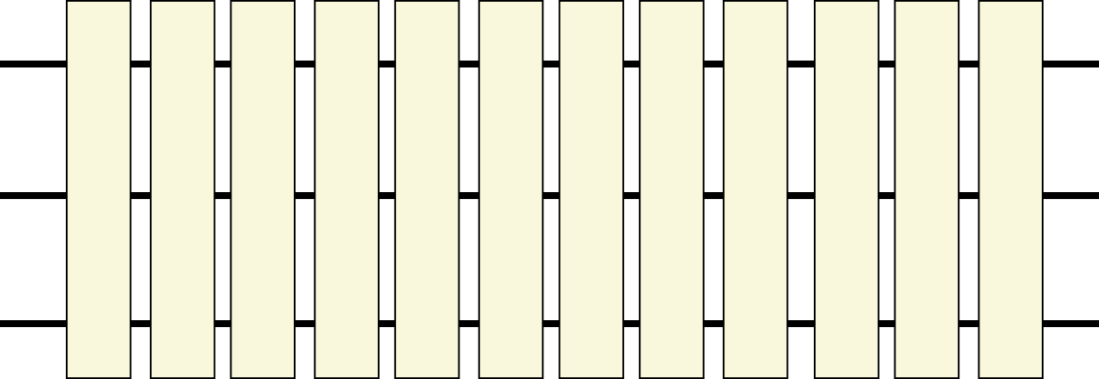
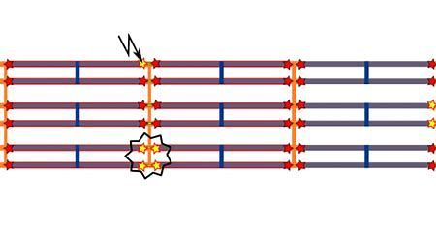
Limitations of Current Methods
Challenges in real word computer
experimental result
Large circuit depth
50 bits yielding more than 1040 layers of quantum gates
Real-world noise
The noise further exacerbates the difficulty of optimizing the parameters
The optimization process is extremely unstable and difficult to converge to the optimal solution
Notes:
Besides, existing algorithms typically require a large number of QAOA layers to theoretically achieve the optimal solution. However, this introduces two major challenges:
First, large circuit depth makes it difficult to deploy in real-world quantum hardware due to noise, resulting in unstable computation.
Second, as the number of QAOA layers increases, the number of parameters grows accordingly. This complex parameter space makes the optimization process difficult to converge, which limits practical effectiveness.
In a word, current quantum approaches face many challenges, such as low in-constraints rates, low success rates, and long end-to-end latency.
现有算法往往需要大量的 QAOA 层才能在理论上获得最优解。然而，这带来了两个主要问题：
首先，电路深度过大，在真实量子硬件的噪声环境下难以实际部署，导致计算结果不稳定。
其次，参数空间过于复杂，随着 QAOA 层数的增加，优化所需的参数数量也随之增长，导致优化过程难以收敛，使得理论上的优势难以转化为实际效果。

Slide 10
Outline of Presentation
Background and challenges
Overview of Choco-Q
Choco-Q characterization and calibration
Experiment
API of Choco-Q
Notes:
To handle these challenges, we propose Choco-Q, a formal and universal framework for constrained binary optimization problems.

Slide 11
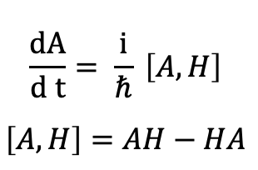
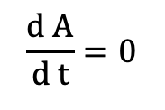

Heisenberg picture
Heisenberg Picture
Variation
System Hamiltonian
$$\frac{dA}{d t}= \frac{i}{ℏ} \left[A,H\right]$$
$$\left[A,H\right]=AH−HA$$
Arbitrary operator
If A Commutes with H
$$\left[A,H\right]=0$$
$$\frac{d A}{d t}=0$$
The operator is unchanged
Notes:
Our work is inspired by the Heisenberg picture. If System Hamiltonian ‘H’ and Arbitrary operator ‘A’ commute, arbitrary operator remains unchanged during the evolution process.
我们从海森堡绘景中得到启发，只要 H 和 A 对易，那么该算符在演化过程中不会发生变化。

Slide 12



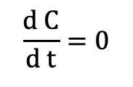
Heisenberg picture
Heisenberg Picture
Apply to constrained binary optimization
Variation
System Hamiltonian
Object Hamiltonian + Driver Hamiltonian$H^{d}$
$$\frac{dA}{d t}= \frac{i}{ℏ} \left[A,H\right]$$
$$\left[A,H\right]=AH−HA$$
Always commute
Expect to commute
Arbitrary operator
Constraints operator$C$
If A Commutes with H
$$\left[A,H\right]=0$$
$$[C,H^{d}]=0$$
$$\frac{d A}{d t}=0$$
$$\frac{d C}{d t}=0$$
The operator is unchanged
Constraints are satisfied
Notes:
Correspondingly, we apply this concept to constrained binary optimization. we find that if driver Hamiltonian commutes with the constraints operator, the constraints are always satisfied in the evolution.

Slide 13

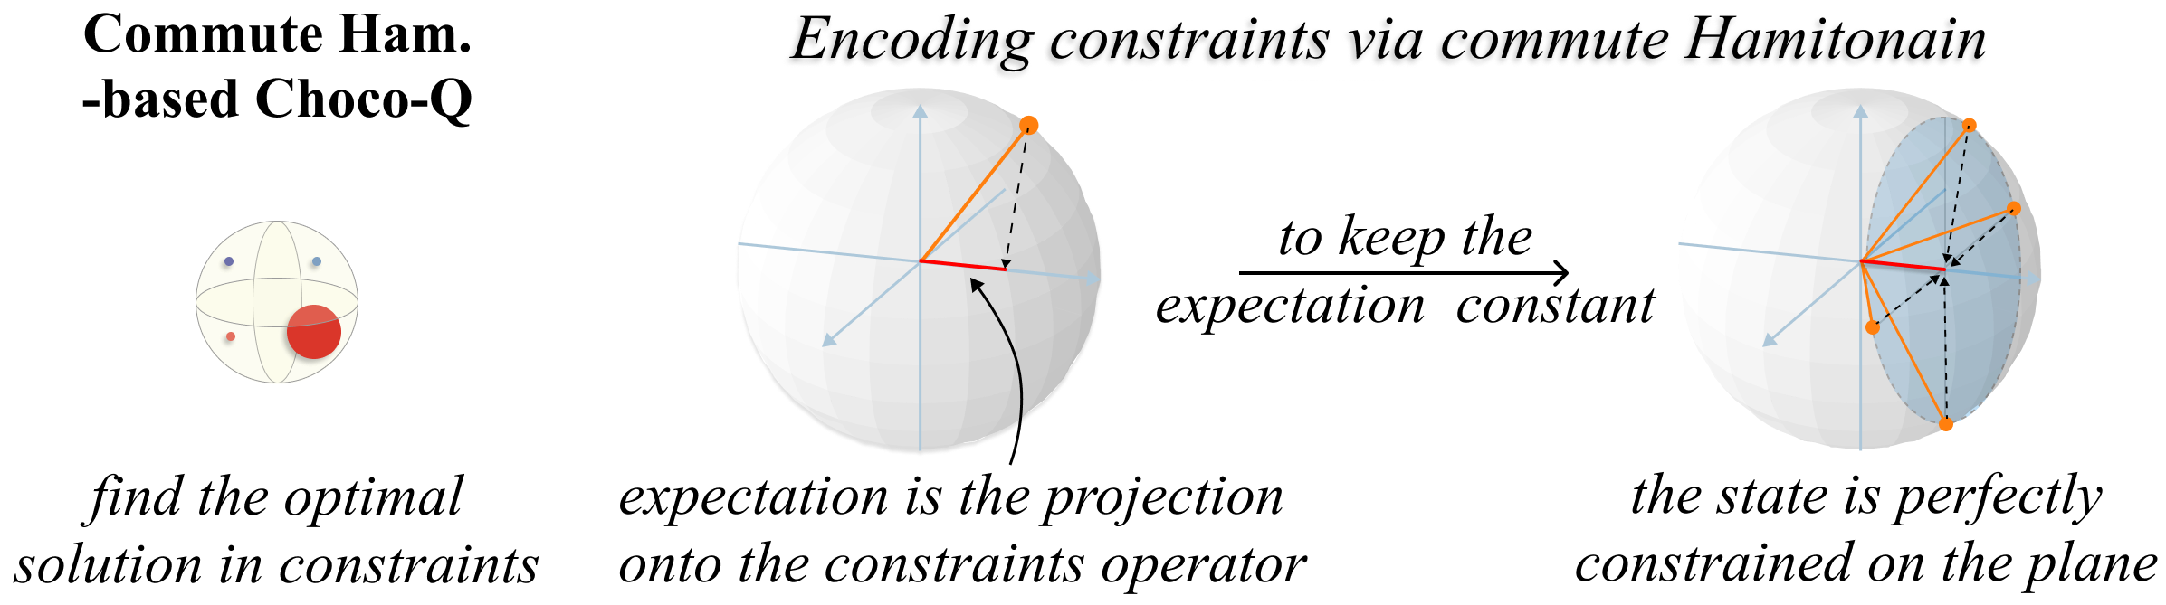
Commute Hamiltonian formulation
The Hamiltonian commutes with constraints operator
Notes:
We can interpret this as the projection of the operator always remaining on the same plane, ensuring that the quantum state perfectly satisfies all constraints.

Slide 14
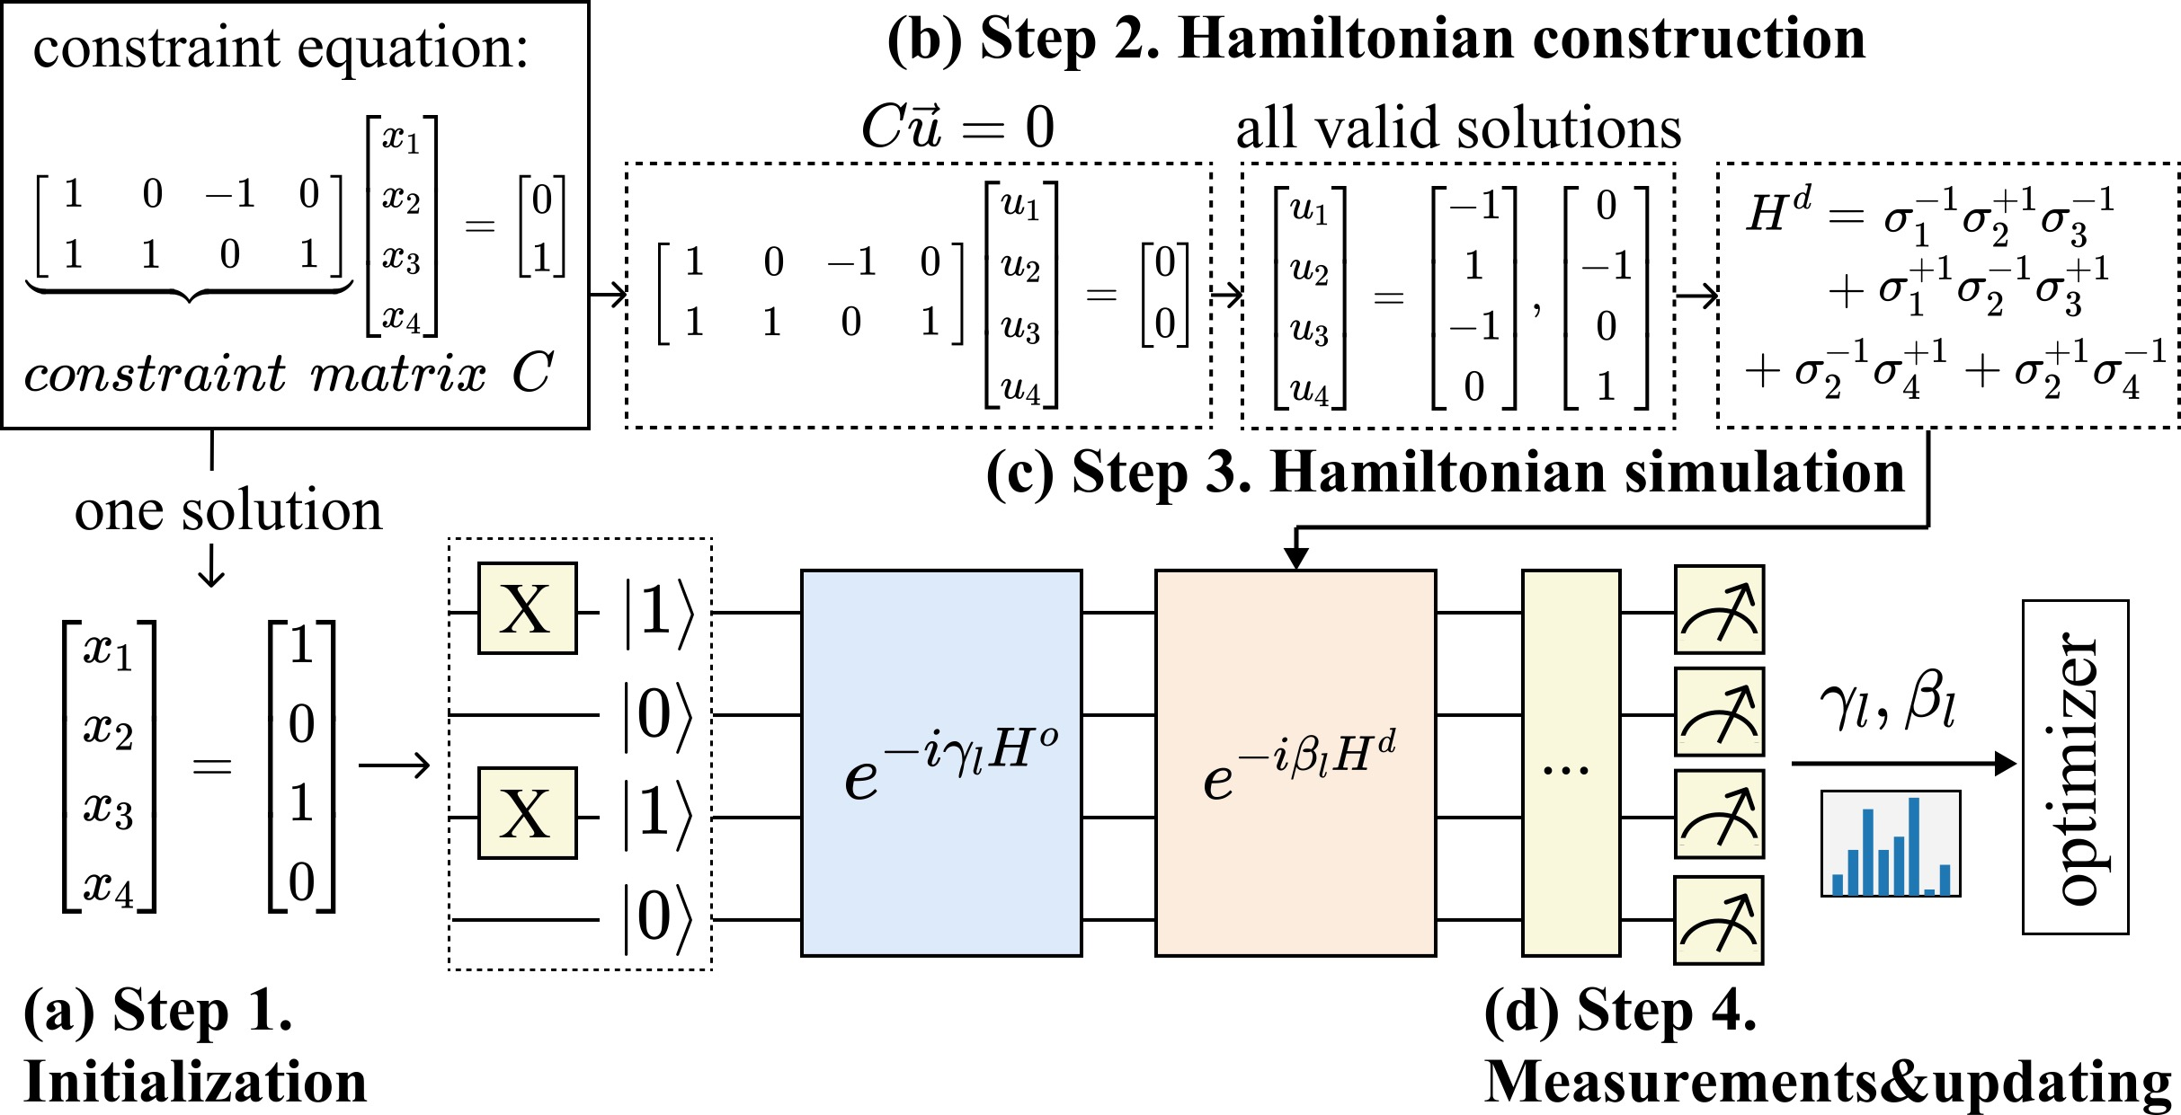
Circuit Implementation
Notes:
In circuit implementation, we first select a solution under constraints as the initial state.
在电路实现上，首先选取一个可行解作为初始态。

Slide 15
Circuit Implementation
Notes:
Secondly, we construct the driver Hamiltonian based on the constraints equation of the problem.

Slide 16
Circuit Implementation
Notes:
再对其进行哈密顿量模拟，并将其施加到量子电路中。
Then, we perform Hamiltonian simulation and apply the unitary of Hamiltonian to the quantum circuit.

Slide 17
Circuit Implementation
Notes:
然后通过测量并对变分量子电路进行参数优化，以获得更优的解。
In the end, we perform measurements and optimize the parameters to obtain a better solution.

Slide 18
Outline of Presentation
Background and challenges
Overview of Choco-Q
Choco-Q Optimization
Experiment
API of Choco-Q
Notes:
However, due to unitary decomposition overhead and large circuit depth, the commute Hamiltonian is still not deployable in current hardware.
Next, we will present our optimization methods to solve these challenges.

Slide 19
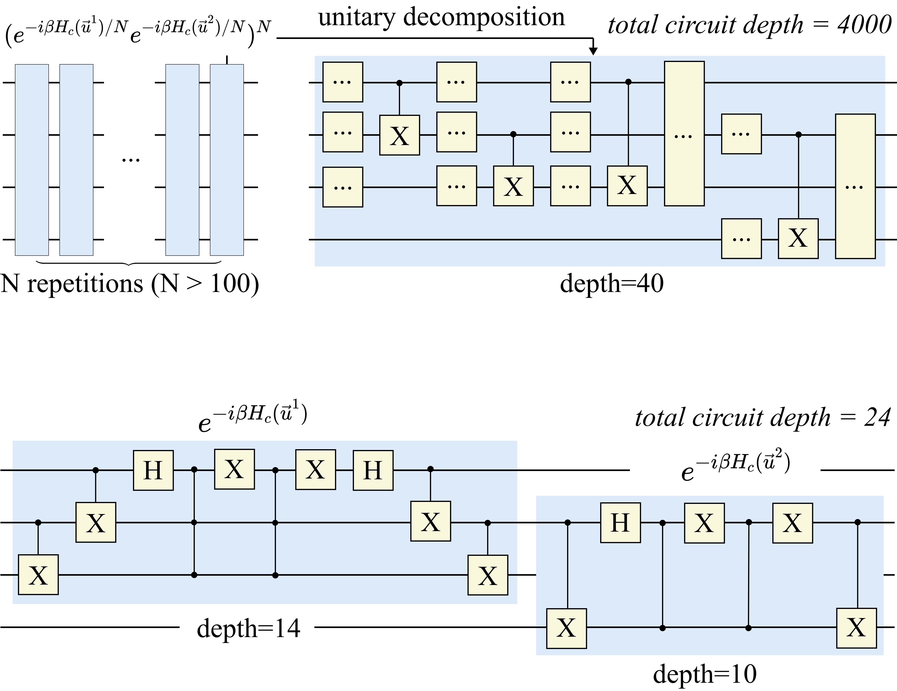
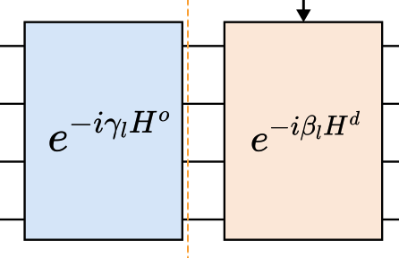
Hamiltonian Serialization
Prior method：
Trotter decomposition
Notes:
First, we propose Hamiltonian serialization to decompose the complex Hamiltonian.
Previous methods rely on Trotter decomposition, which requires repeated approximations and results in extremely deep circuits.
首先，我们提出了哈密顿量序列化方法。先前的方法基于 Trotter 分解，需要反复进行近似计算，导致电路深度极大。

Slide 20
Hamiltonian Serialization
Prior method：
Trotter decomposition
Our method：Serialization
Notes:
Our method transforms a large Hamiltonian into a series of equivalent smaller Hamiltonians, enabling further decomposition.
我们的方法通过将大哈密顿量转换为一系列等效的小哈密顿量，从而提供了进一步分解的可能性。

Slide 21
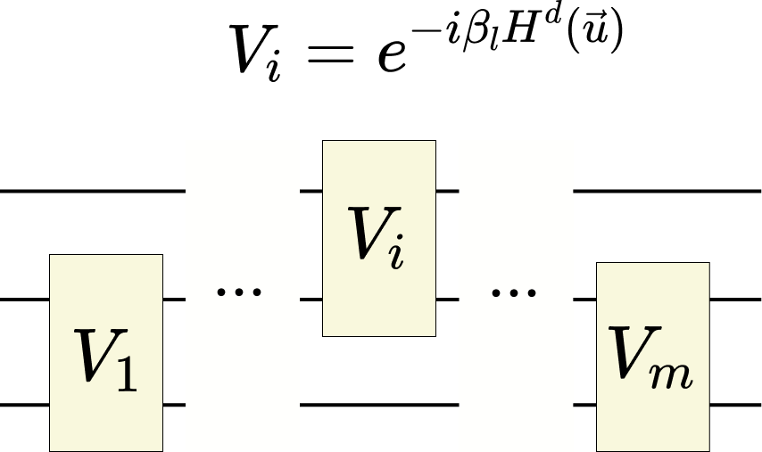
Hamiltonian Decomposition
Hamiltonian Serialization
Notes:
The second optimization is to decompose each small Hamiltonian in the sequence to reduce circuit complexity and improve computational efficiency.
第二步，我们对每个序列中的哈密顿量进行分解，以降低电路复杂度并提高计算效率。

Slide 22
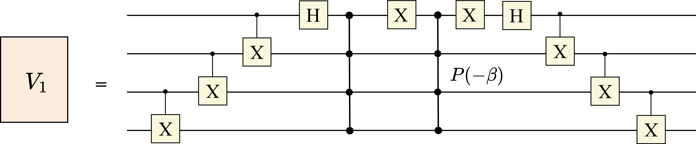
Hamiltonian Decomposition
Hamiltonian Serialization
Linear decomposition by Phase gate
Notes:
通过多控门，我们实现了哈密顿量的线性分解，从而优化了电路结构。
By leveraging multi-controlled gates, we achieve a linear decomposition of the Hamiltonian, optimizing the circuit structure.

Slide 23
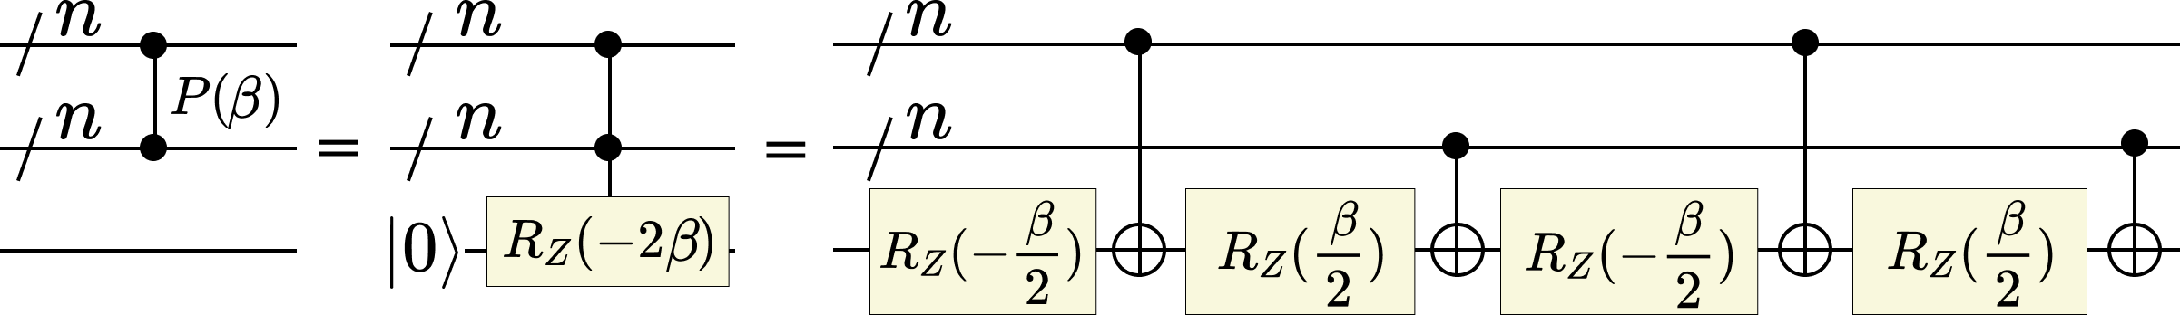
Hamiltonian Decomposition
Hamiltonian Serialization
Linear decomposition by Phase gate
Linear decomposition of Phase gate
Notes:
再通过相位门的线性分解，实现了完整的对易哈密顿量线性分解优化，为硬件部署提供了可能。
The multi-controlled gates can be also decomposed in linear complexity. Thereby, we decompose the whole commute Hamiltonian in linear complexity.

Slide 24
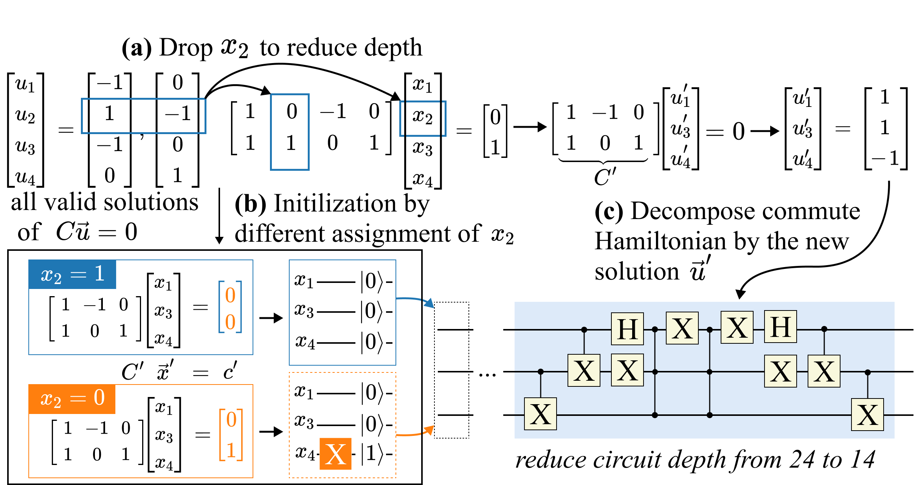
Variable Elimination
Notes:
On the other hand, by analyzing the cost of multi-controlled gates in the circuit, we eliminate the most expensive qubits, resulting in a shallower circuit that can be deployed on NISQ devices.
另一方面，我们通过分析电路中多控门的开销，针对代价最高的比特进行消除，从而构建更轻量级的电路，并成功部署在 NISQ 设备上。

Slide 25
Outline of Presentation
Background and challenges
Overview of Choco-Q
Choco-Q Optimization
Experiment
API of Choco-Q
Notes:
Next, we present the evaluations on Choco-Q.

Slide 26
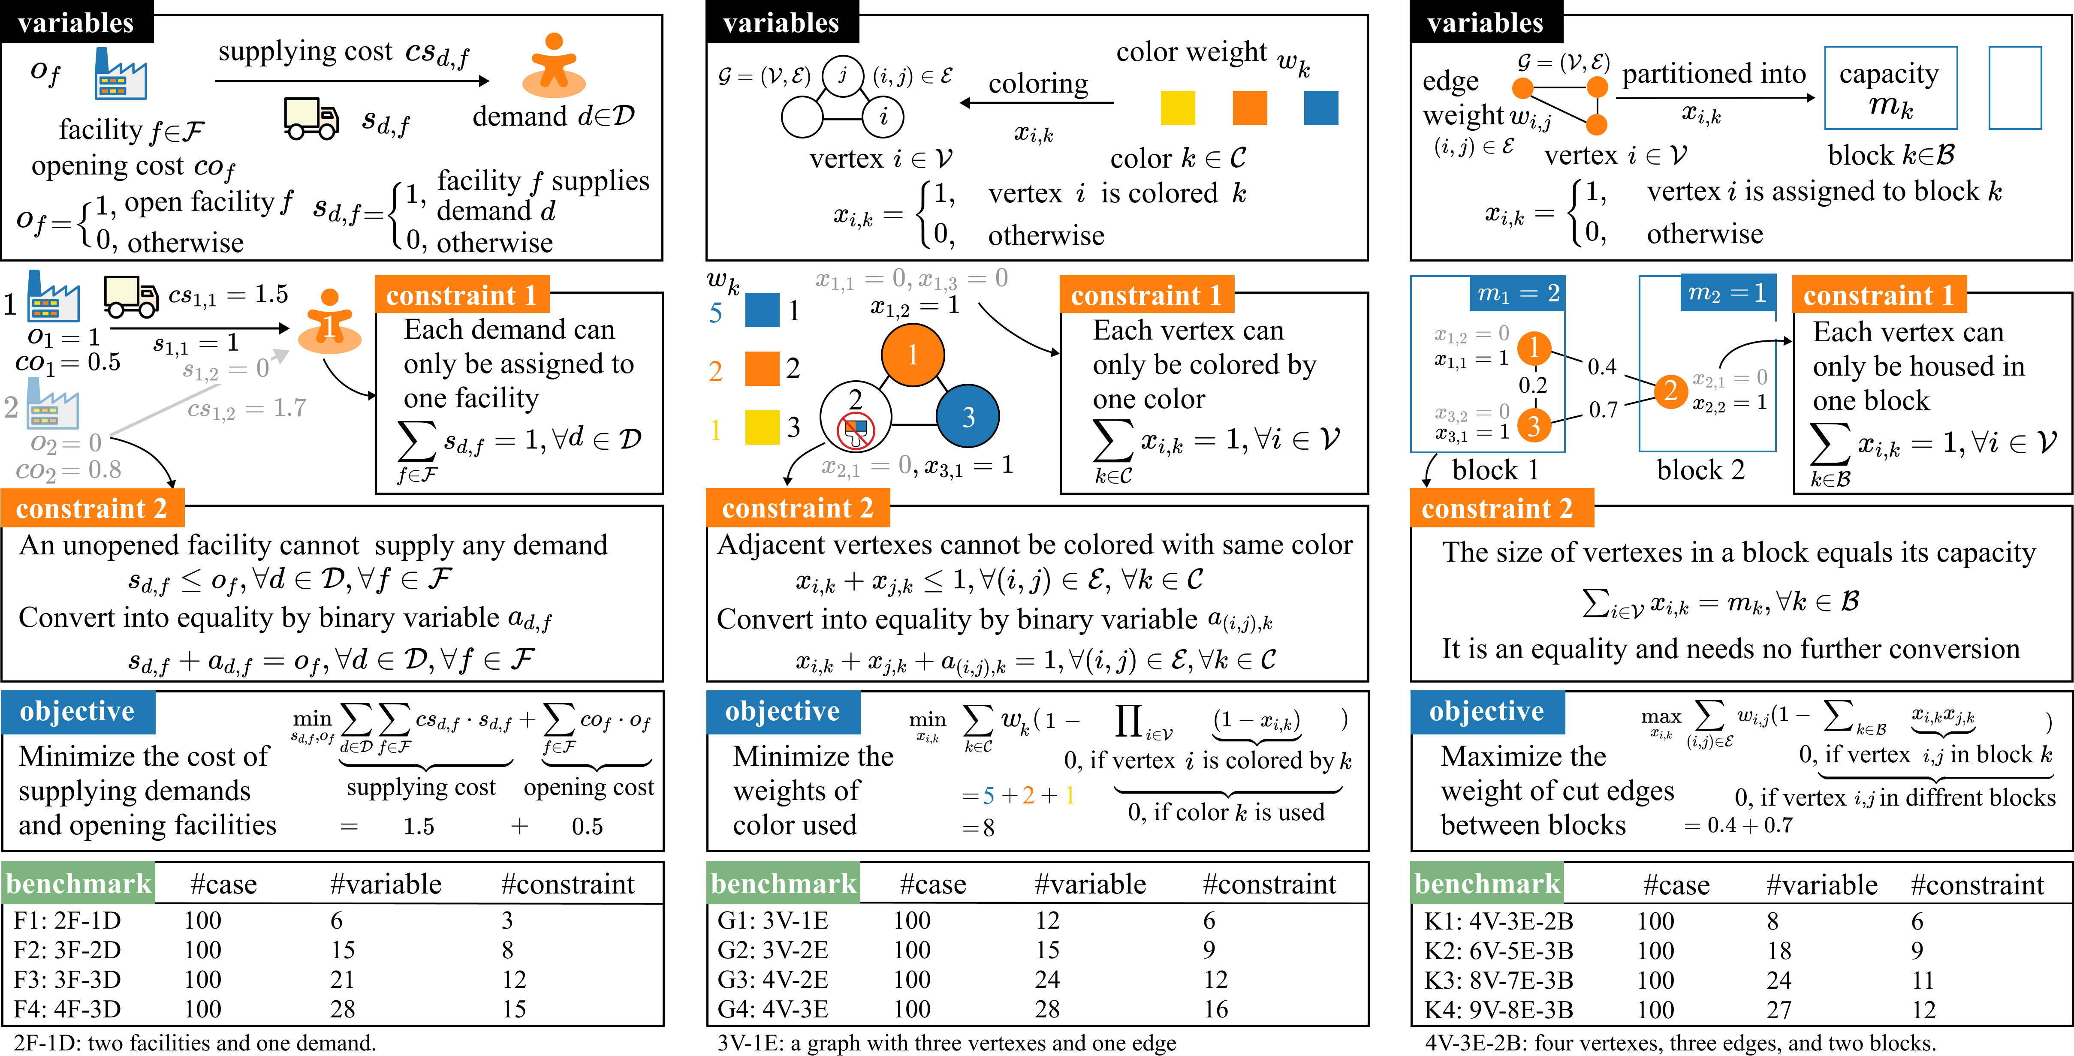
Experiment: benchmarks
Facility location
Graph coloring
K-partitioning
Notes:
Our experiments selected various binary optimization problems with different constraints, including facility location, graph coloring, and k-partitioning and so on.
我们的实验选取了多种具有不同约束的二元优化问题，包括设施选址、图着色和 k 分割等问题。

Slide 27
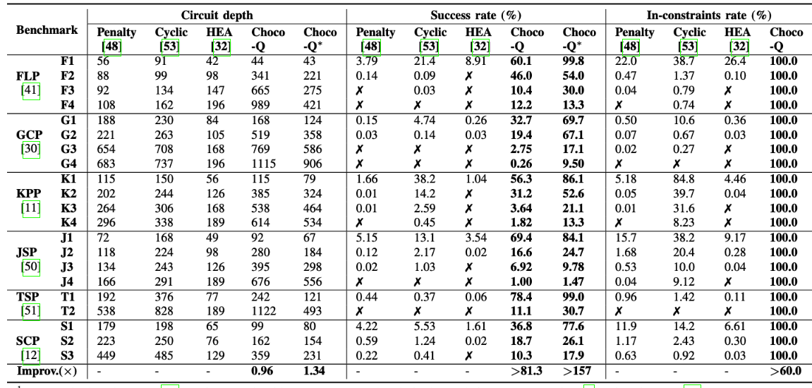
Noise-free Evaluation
Notes:
In noise-free experiments, we can see that the success rate of Choco-Q is one hundred and fifty-seven times higher than existing algorithms. The in-constraints rate of Choco-Q is one hundred percent, which verifies the validity of our theory.

Slide 28
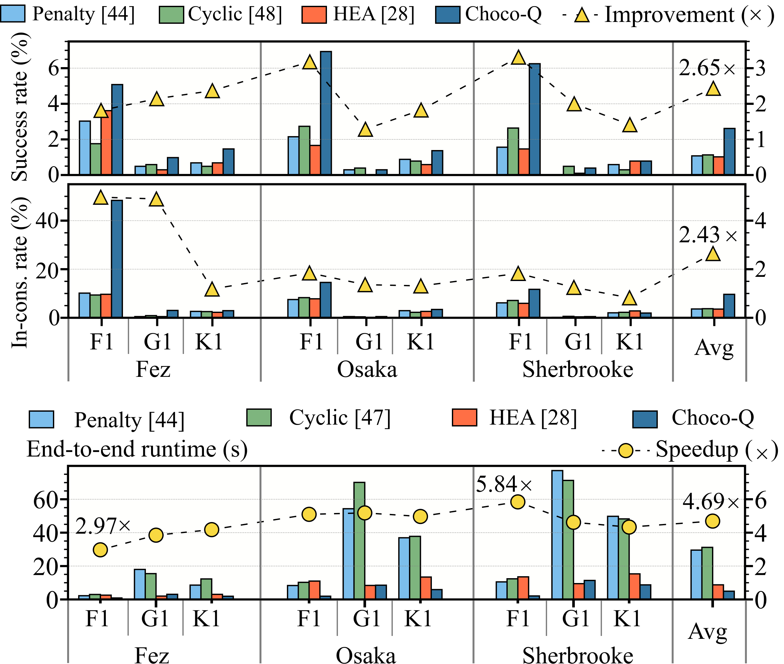
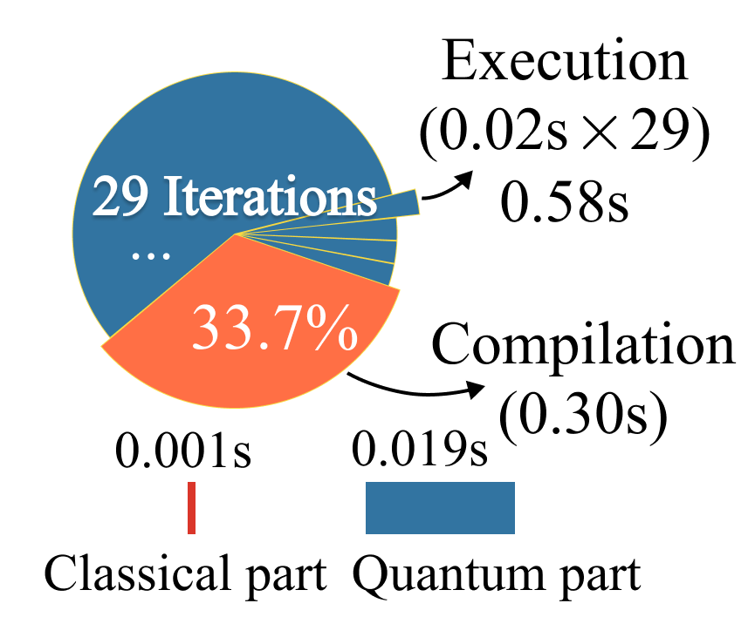
Evaluation on quantum computer
End-to-end Latency breakdown for F1 benchmarks on the Fez device.
Notes:
On the IBM quantum device, we validated the effectiveness of Choco-Q. Experimental results show that compared to baseline methods, our approach improves the success rate by two point six five times, enhances in-constraints rate by two point four three times, and reduces end-to-end runtime by four point six nine times.
在 IBM 量子设备上，我们验证了该算法的有效性。实验结果表明，与基线方法相比，我们在成功找到最优解的概率上提升了 2.65 倍，在满足约束的能力上提升了 2.43 倍，同时端到端时延降低了 4.69 倍。

Slide 29
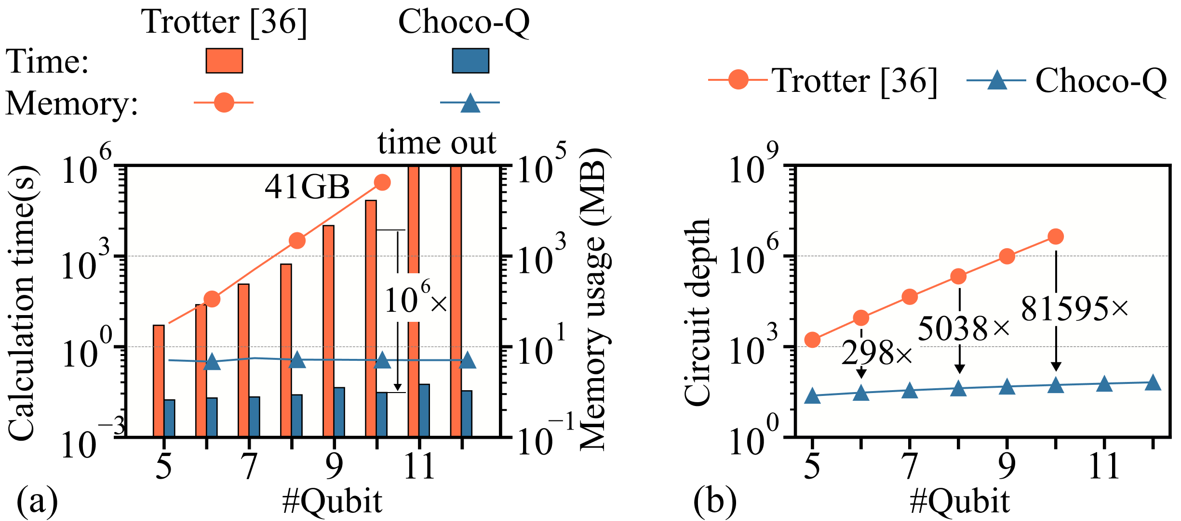
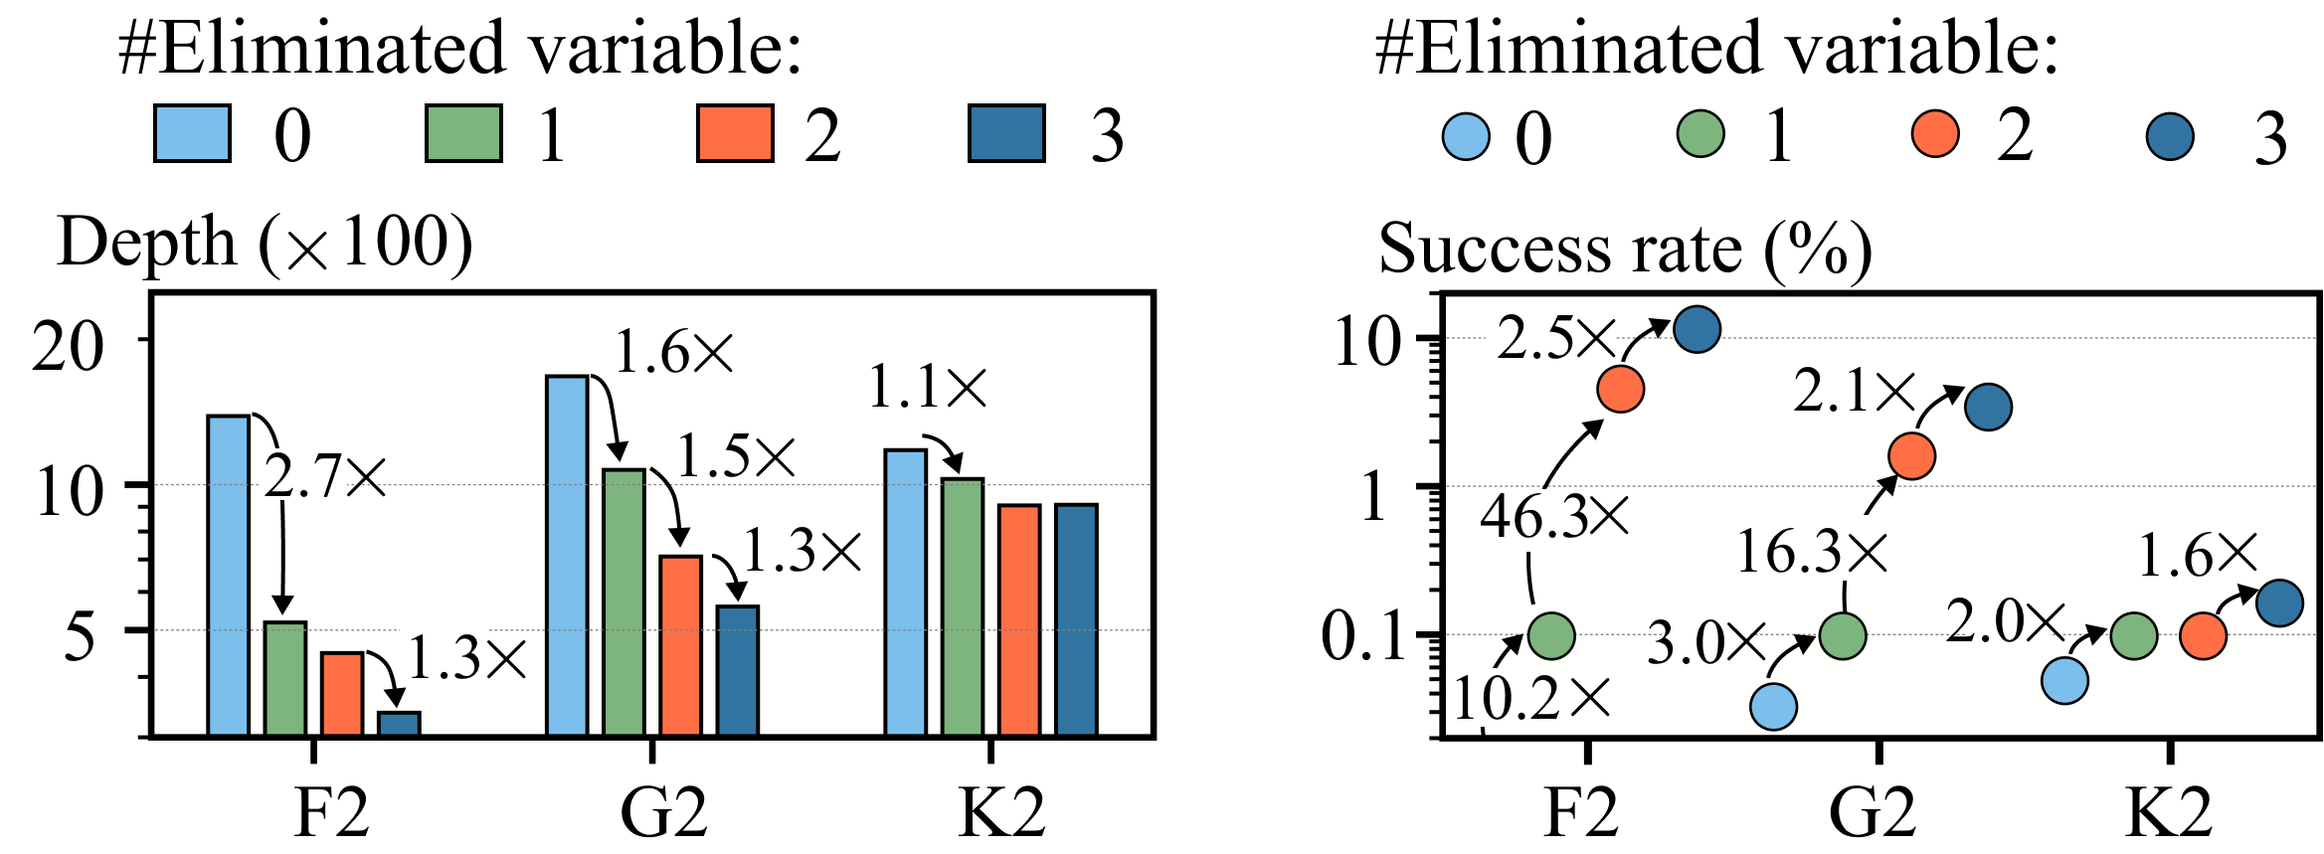
Detailed evaluation of techniques
Hamiltonian serialization &decomposition
Variable elimination
Notes:
We further analyze the effect of our optimization techniques. First, Hamiltonian serialization and decomposition significantly enhances compilation efficiency. The compilation time is reduced by million times and circuit depth is reduced by over eighty thousand times. This greatly lowers the execution overhead on quantum hardware.
Second, variable elimination further optimizes the circuit structure. Circuit depth decreases with the number of variables eliminated and the success rate increases accordingly.
首先，电路硬件编码技术 极大地提升了编译效率，使电路编译时间缩短了 10^6 倍，同时电路深度减少了 80,000 倍以上。这大大降低了硬件执行的开销。
其次，变量消除技术 进一步优化了电路结构。每消除一个变量，电路深度就能减少，成功率也相应提高，使得优化过程更加高效稳定。

Slide 30
Outline of Presentation
Background and challenges
Overview of Choco-Q
Choco-Q Optimization
Experiment
API of Choco-Q
Notes:
To facilitate practical use, we provide an easy-to-use API for Choco-Q. We will introduce how to use it to solving the constrained problems.

Slide 31
API of Choco-Q
File:
JanusQ/examples/ipynb/6_1_constrained_binary_optimization.ipynb
https://janusq.github.io/tutorials/demo/6_1_constrained_binary_optimization
from janusq.application.chocoq.chocoq.model import LinearConstrainedBinaryOptimization
from janusq.application.chocoq.chocoq.solvers.optimizers import CobylaOptimizer
from janusq.application.chocoq.chocoq.solvers.qiskit import ChocoSolver, DdsimProvider
m = LinearConstrainedBinaryOptimization()
x = m.addVars(5, name="x")
m.setObjective((x[0] + x[1])* x[3] + x[2], "max")
m.addConstr(x[0] + x[1] - x[2] == 0)
m.addConstr(x[2] + x[3] - x[4] == 1)
opt = CobylaOptimizer(max_iter=200)
aer = DdsimProvider()
solver = ChocoSolver(prb_model=m, optimizer=opt, provider=aer, num_layers=1)
state_list, prob_list, iter_count = solver.solve()
result_dict = {prob: state for state, prob in zip(state_list, prob_list)}
best_solution_prob, in_constraints_prob, ARG, iter_count = solver.evaluation()
configure the optimization problem
construct solver
solve by Choco-Q
Notes:
Now we introduce the API to solve constrained optimization problems with Choco-Q. The detailed example is in jupyter notebook.
First, you can definite a problem by the LcboModel class. This class integrate the function to add binary variable, set the objective, and add constratins. After definition, you can print this class to get the problem information. You can also call the optimize function to get the optimal cost from a classical solver.
To use Choco-Q to solve your problem. You should first declare the classical parameter optimizer, the simulator, and setup the ChocoSolver. The circuit_analyze function will print the basic information including circuit depth, width, number of gates. In the end, call the solve function to get the results from ChocoSolver.

Slide 32

Thanks for listening
Choco-Q: Commute Hamiltonian-based QAOA for
Constrained Binary Optimization
Debin Xiang†, Qifan Jiang†, Liqiang Lu*, Siwei Tan, and Jianwei Yin*
HPCA 2025
Notes:
Thanks for listening. Now we finish all five topics. The rest of the time is for questions and answers. Feel free to ask if you have any problem during experiencing JanusQ.

