Slide 1




ISCA 2026 Tutorial
Topic 5. AdaptDQC: Adaptive Distributed Quantum Computing
With Quantitative Performance Analysis (TC 2025)
Lab
JanusQ
Cloud
Speaker: Liqiang Lu
College of Computer Science and Technology
Zhejiang University (ZJU)
https://janusq.github.io/Janus4/
Notes:
Good morning, everyone. Today I will report our TC 2025 work, AdaptDQC: Adaptive Distributed Quantum Computing With Quantitative Performance Analysis. The core question is how to compile one quantum circuit for different distributed quantum computing architectures while optimizing the metric the user actually cares about.

Slide 2
Outline of Presentation
- Background and challenges
- Overview of AdaptDQC
- Graph formulation and adaptive compiler
- Experimental evaluation
- Code walkthrough
Notes:
Here is the structure of the talk. I will first explain why distributed quantum computing is needed and why existing compilers are limited. Then I will introduce the AdaptDQC framework, the spatial-temporal graph formulation, the adaptive compiler, the experimental results, and finally the code path in the tutorial notebook.

Slide 3
01
Background and Challenges
Three requirements for practical DQC compilation
AdaptDQC maps circuits, metrics, and hardware into one optimization loop.
- R1: unified description
- R2: quantitative performance evaluation
- R3: adaptive optimization strategy
Notes:
This concludes the background section. The three requirements are unified description, quantitative performance evaluation, and adaptive optimization. The rest of the talk explains how AdaptDQC implements these three requirements.

Slide 4
Why Distributed Quantum Computing?
DQC Motivation
DQC targets coupled width-depth-noise limits
A. Single chip
limited width and depth
Single-chip bottleneck
Depth
B. Partition
subcircuits fit smaller QPUs
Width
Noise
C. Execute
higher local fidelity
Large task must be partitioned
D. Reconstruct
recover global result
circuit
QPU A
global result
QPU B
QPU C
Compiler quality decides whether DQC reduces the bottleneck.
Notes:
The motivation starts from the NISQ limitation. A single large quantum chip suffers from noise, crosstalk, and limited coherent depth. Distributed quantum computing tries to divide a large circuit into smaller subcircuits, execute them on smaller QPUs, and reconstruct the global result. This creates a compiler problem, which determines the system cost of the total DQC system.

Slide 5






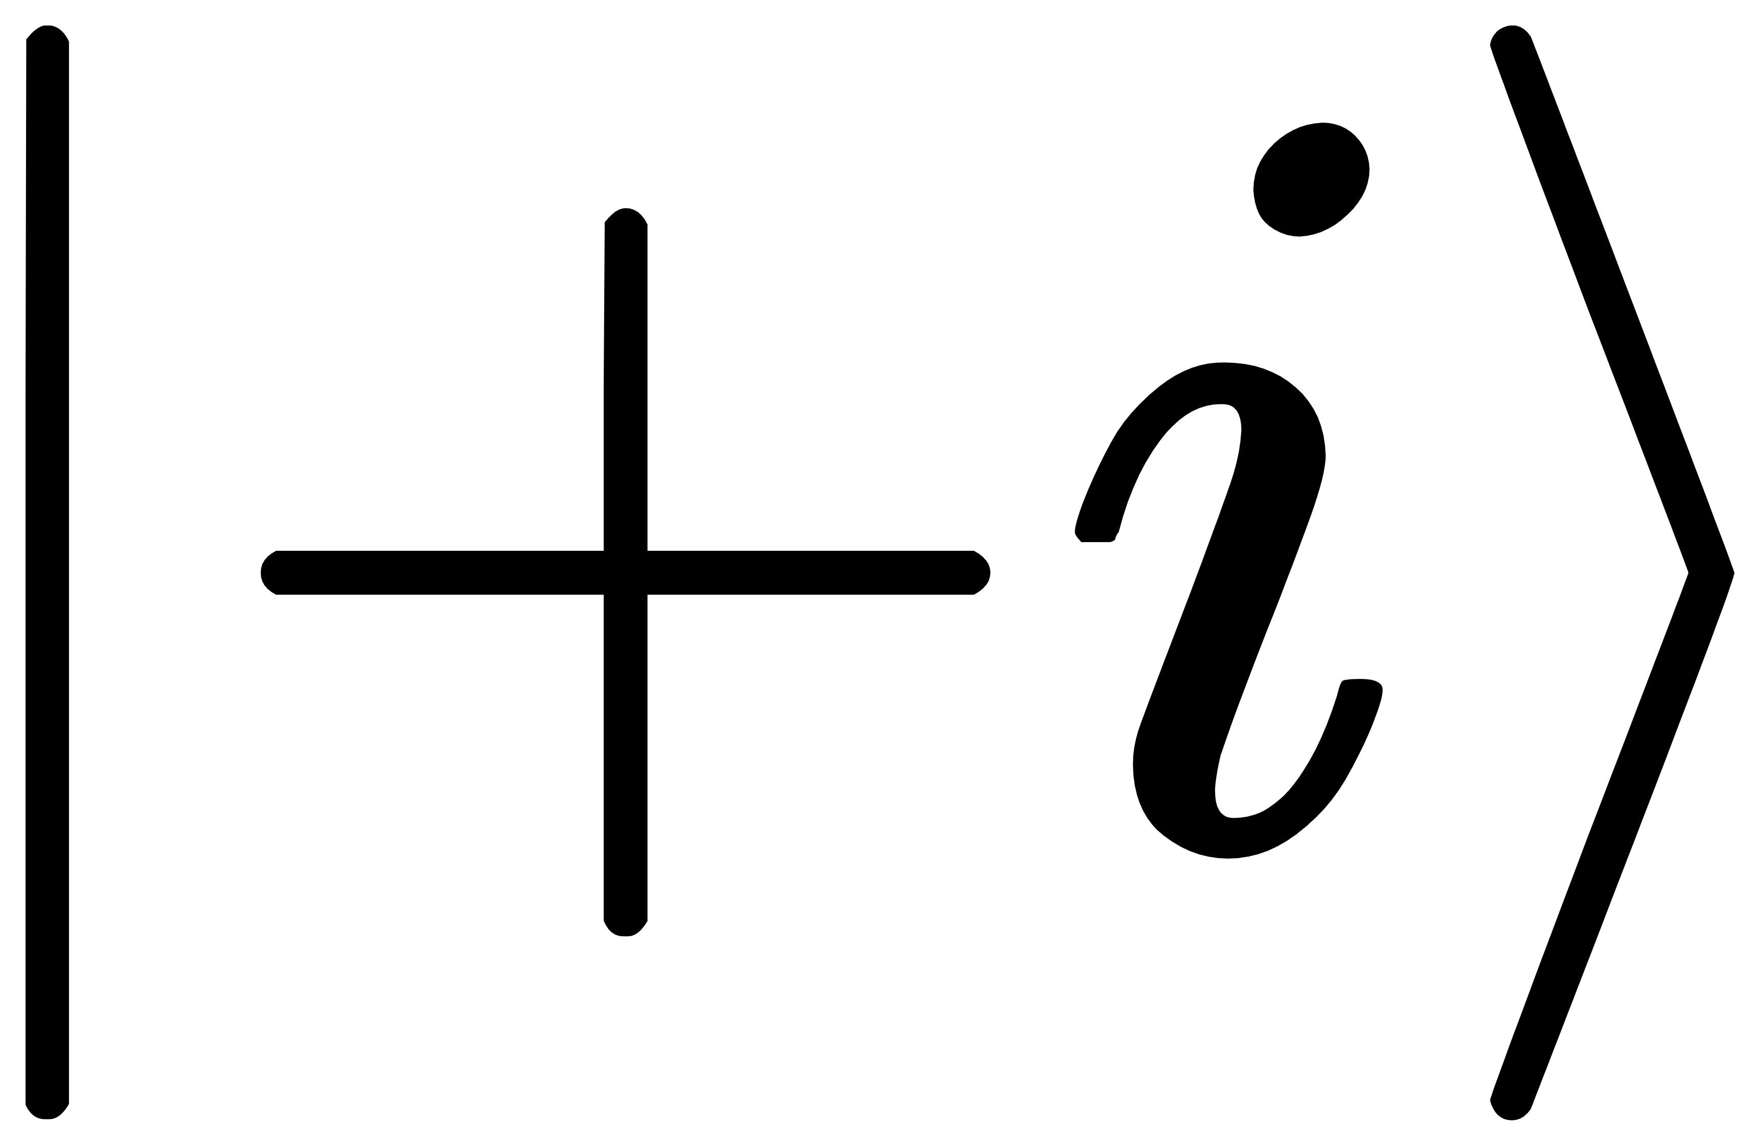
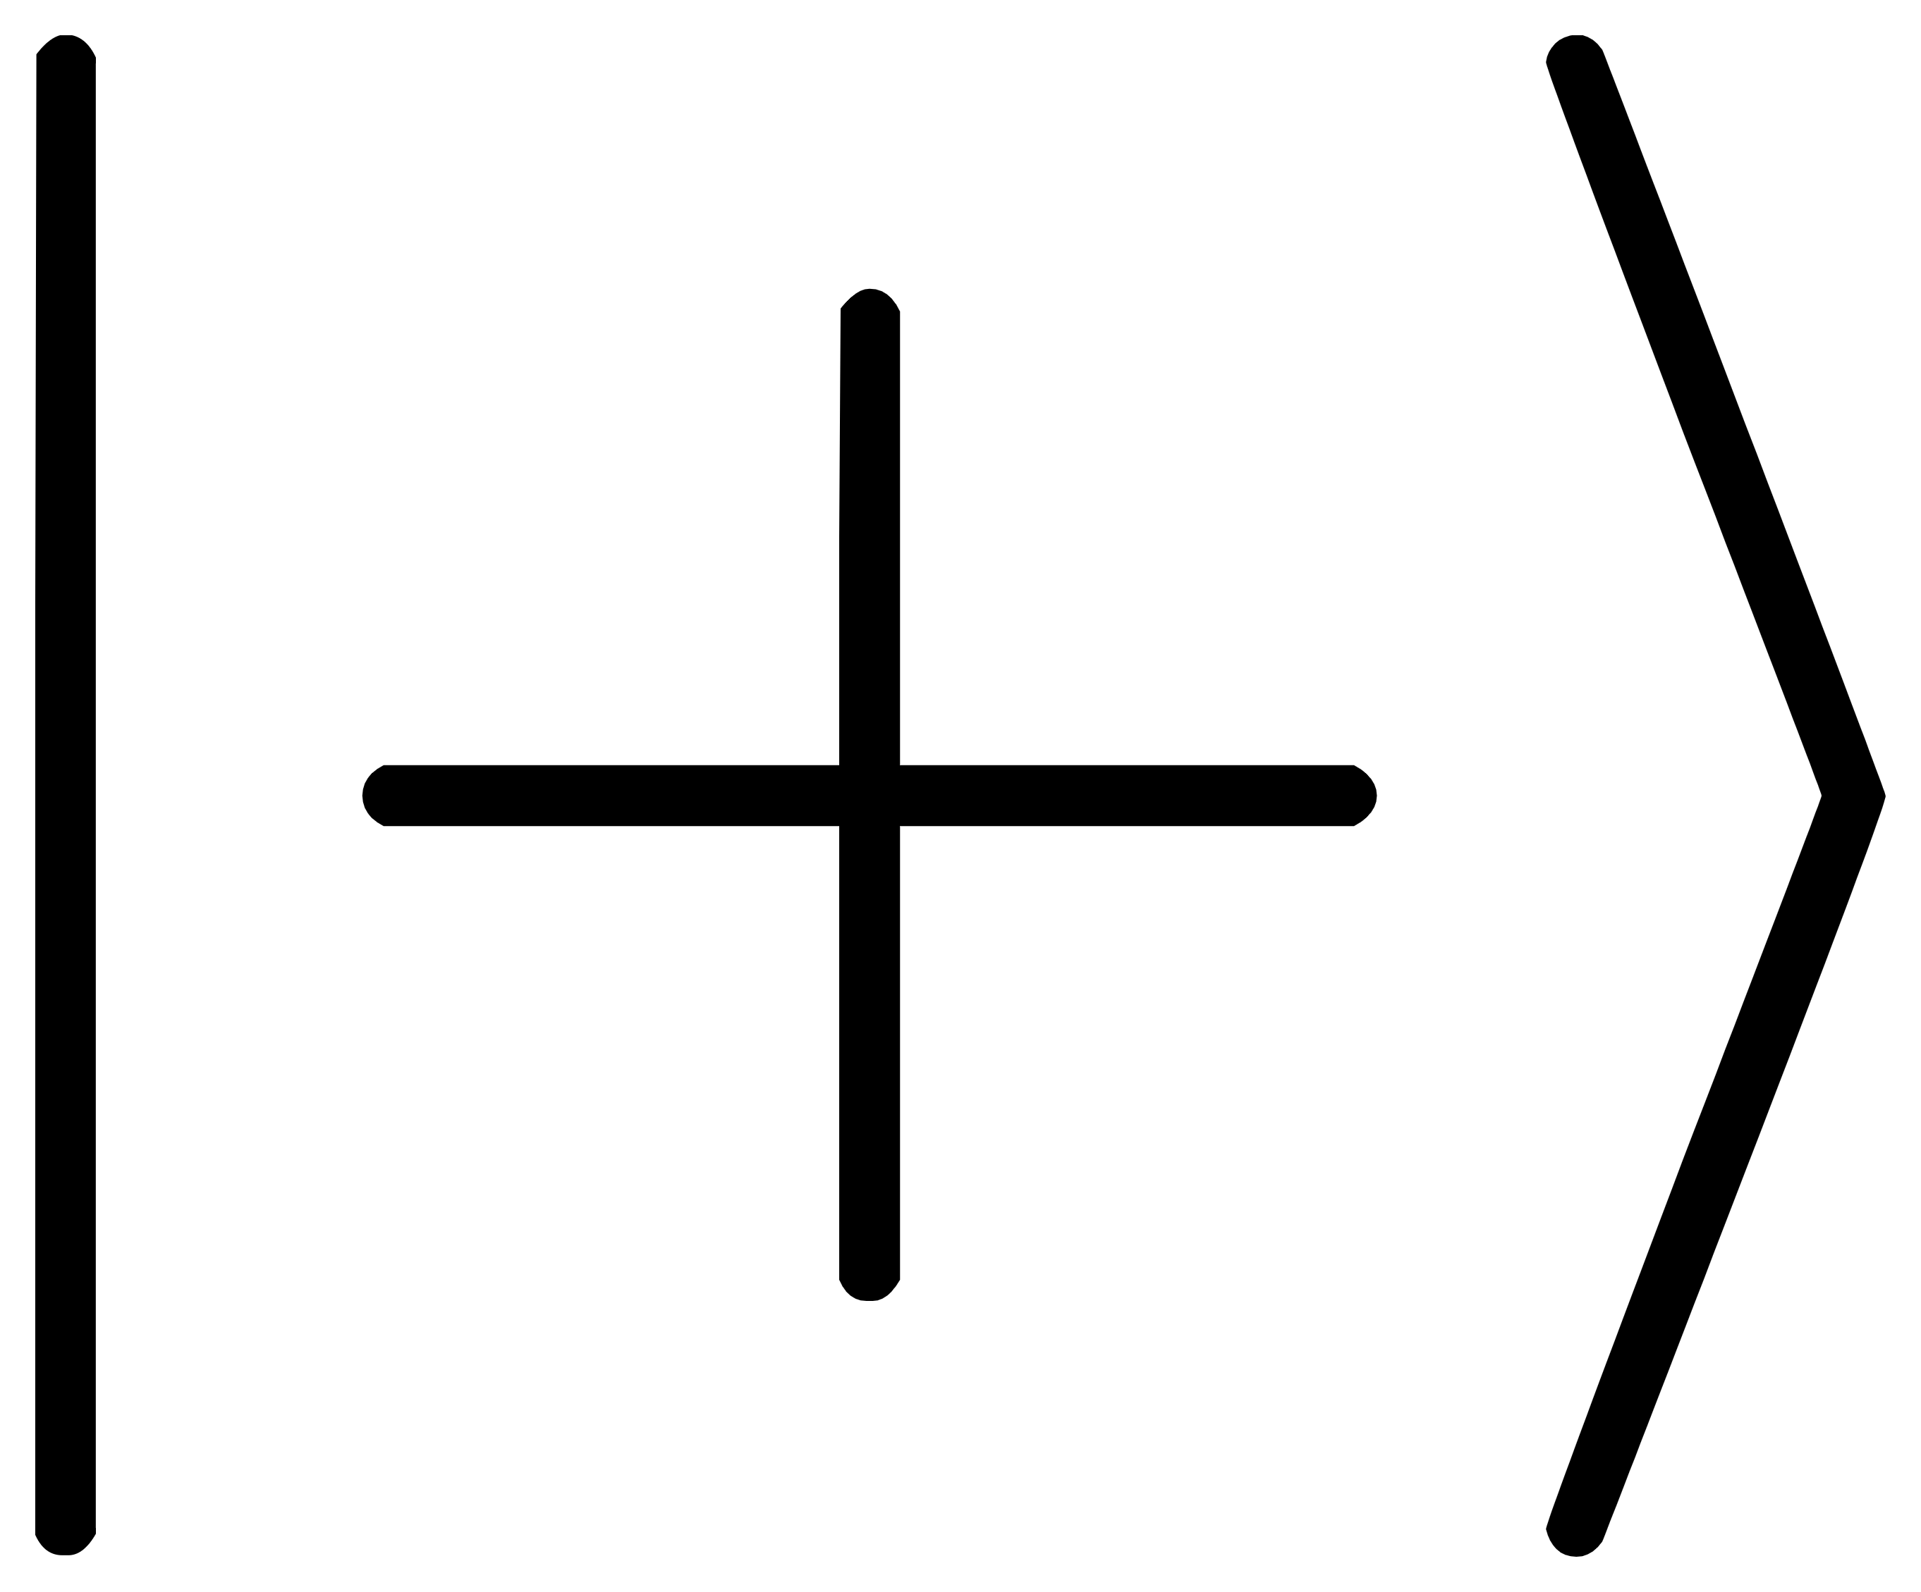


There are different communication architectures
Classical communication
Quantum Link
R_{x}
T
S
Tensor compute
R_{x}
T
S
QPU₁
X,Y,Z,I
QPU₁
Qubit Comm
H
X
R_{x}
H
X
R_{x}
Quantum teleportation
QPU₂
QPU₂
S
Z
R_{x}
X
H
S
Z
R_{x}
X
H
R_{x}
T
S
R_{x}
T
V
S
Tensor compute
QPU₁
QPU₁
H
X
R_{x}
H
X
R_{x}
Gate Comm
U
classical communication
QPU₂
S
Z
R_{x}
H
QPU₂
S
Z
R_{x}
X
H
Quantum network
Notes:
There are two major inter-chip communication mechanisms.

Slide 6
ICC Mechanisms Create Different Cost
QubitComm
wire partition
GateComm
gate partition
Notes:
QubitComm cuts qubit wires and reconstructs the probability distribution with multiple basis measurements and initializations. GateComm cuts remote gates and uses EPR resources and teleportation. They expose very different costs, so a compiler optimized for one mechanism is not automatically good for the other.

Slide 7
Compilation Problem from DQC Pipeline
DQC Pipeline
Partition
Map
Run
circuit
subcircuits
QPU layout
Results
Where to cut
How to map
Which ICC
Gate partition
Qubit Mapping
Classical link
Qubit partition
Gate scheduling
Quantum link
These decisions are coupled
Compilation Problems
Notes:
This slide shows the divide-and-conquer view. We start with a quantum circuit, split it into subcircuits, map those subcircuits to QPUs, communicate between them, and reconstruct the global result. The compiler must decide the partitioning, the mapping, and the communication mechanism together because these decisions interact.

Slide 8
Existing Compilers Cover Only Slices of the Design Space
Works |  | CutQC | QMPI | Autocom | Hypergraph | ZX calculus | AdaptDQC
methods |  | Qubit cut with tensor reconstruction | Quantum network programing language | Quantum network communication optimization | Quantum network qubit mapping | Gate cut with tensor reconstruction | Adaptive DQC evaluation and hybrid compilation
QubitComm
GateComm
performance | Comm
系统性能评估 | Latency
 | Fidelity
 | Topology
Y
Y
Y
Y
Y
Y
Y
Y
Y
Y
Y
Y
Y
Y
Y
Y
Y
Y
Y
Missing link: one model that supports many systems and many goals.
Notes:
Prior systems each cover only part of this design space. CutQC supports QubitComm and communication optimization. HyperGraph and AutoComm support GateComm, and AutoComm also considers latency. AdaptDQC is designed to support both communication architectures and all three objectives: communication, latency, and topology.

Slide 9
Outline of Presentation
- Background and challenges
- Overview of AdaptDQC
- Graph formulation and adaptive compiler
- Experimental evaluation
- Code walkthrough
Notes:
We now move to the overview of AdaptDQC. The main point is that AdaptDQC is not a single fixed partitioning heuristic. It is a framework that connects the circuit, the hardware, the communication architecture, and the optimization objective through one graph-based loop.

Slide 10
AdaptDQC Organizes DQC as a Layered System
AdaptDQC System Architecture
Circuit
Graph model
Optimize
Evaluate
The performance engine closes the loop before hardware execution.
Notes:
The framework has three layers. First, DQC formulation converts the circuit and distributed system into SDHG, TDAG, and CG. Second, the performance analysis engine computes topology, latency, and communication metrics. Third, the compiler uses these metrics to guide partitioning and optimization, then outputs distributed circuits.

Slide 11
Graph Formulation Gives Each Decision a Place
Three Graph Views
SDHG
TDAG
CG
qubit-space relations
gate-time dependencies
chip connection
topology
latency
communication
Notes:
The key modeling decision is to separate space, time, and chips. SDHG represents spatial qubit relations, TDAG represents temporal gate dependencies, and CG represents chip-level communication. This separation allows the compiler to evaluate the same partition under different objectives.

Slide 12
SDHG: Spatial View of Qubit Relations
What changes in DQC?
wire cut duplicates qubits
remote gate adds EPR resources
topology cost becomes measurable
Spatial objective: reduce d(G_subcircuits, G_chips), i.e., the SWAP burden induced by hardware layout.
Notes:
SDHG focuses on qubits. Qubits are nodes, gates are edges, and communication constructs add nodes or edges. For QubitComm, a cut wire duplicates the qubit for reconstruction. For GateComm, remote gates introduce EPR-related qubit resources. This graph is also where topology compatibility with the physical chip is evaluated.

Slide 13
TDAG: Temporal View of Execution Dependencies
GateComm latency
TDAG example
= sum on the longest TDAG path
QubitComm Latency
Latency model
= max subcircuit latency
Notes:
TDAG focuses on time. Gates become nodes and qubit wires become dependency edges. If the compiler inserts teleportation operations, they also appear in TDAG, which means the latency model can capture the critical path impact of remote communication.

Slide 14
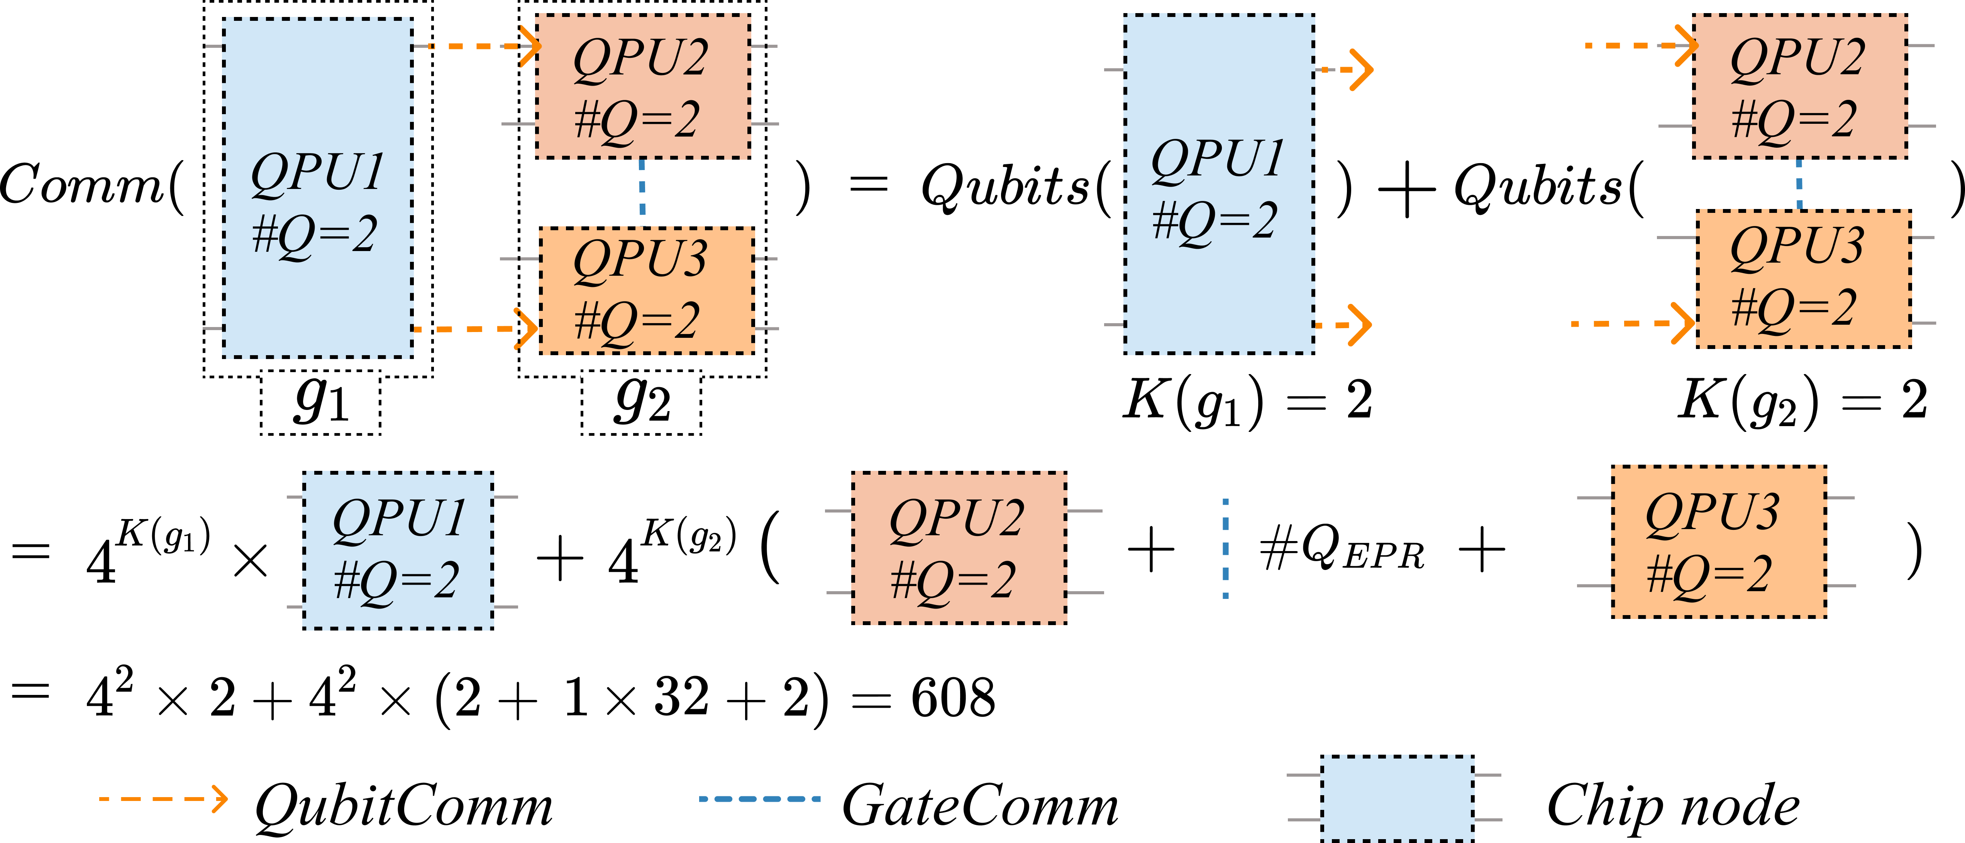
CG: Chip-Level Communication Graph
Communication model
Compiler Uses CG To
count EPR resources
count cut-wire workloads
select hybrid architecture
balance global metrics
Notes:
CG abstracts the distributed system at chip level. Each node is a chip or partitioned subcircuit, and edges record whether communication is QubitComm or GateComm. This is the graph used to aggregate communication resources, including cut-wire workloads and EPR pairs.

Slide 15
Performance Engine Converts Graphs Into Optimization Signals
Topology SDHG
Communication CG
Candidate DQC plan
Latency TDAG
The same partition is scored by several metrics before execution, so optimization can adapt to the user's goal.
Notes:
The performance engine computes three families of metrics. Topology is a distance between the subcircuit graph and the physical chip graph. Latency is derived from TDAG, either as the critical path for GateComm or max subcircuit latency for QubitComm. Communication is computed from EPR resources or the exponential cut-wire reconstruction workload.

Slide 16
Adaptive Compiler Pipeline
Compilation Algorithm
Compiler Loop
1. Simplify
compress TDAG
2. Cluster
initial solution
3. Tune
metric feedback
4. Generate
subcircuits
Notes:
The adaptive compiler has four steps. First it simplifies the graph by merging simple dependencies. Then it clusters the graph to create an initial distributed solution. Next it performs reverse tuning from coarse graphs back to fine graphs. Finally it reconstructs executable distributed subcircuits.

Slide 17
Outline of Presentation
- Background and challenges
- Overview of AdaptDQC
- Graph formulation and adaptive compiler
- Experimental evaluation
- Code walkthrough
Notes:
We now enter the detailed compiler section. I will explain how the abstract compiler maps to QubitComm, GateComm, HybridComm, adaptive objective selection, and topology-aware mapping.

Slide 18
QubitComm Path: Cut Wires, Execute Bases, Reconstruct
1. Cut wire
2. Expand bases
3. Run subcircuits
4. Contract
fit QPU width
I/X/Y/Z + states
local execution
global distribution
QubitComm Reconstruction Redrawn
p(m) = sum_Phi 1/2 p_Phi x p(m | Phi)
cut
I
X
Y
Z
tensor contract
Cost pressure: O(4^K) reconstruction workload
K cuts -> 4^K basis-entry expansion before reconstruction
Source: Xiang et al., IEEE TC 2025, Eq. (1), Eq. (5)-(7).
Compiler
Notes:
For QubitComm, the compiler cuts wires so subcircuits fit the target QPU width. Around each cut, it evaluates basis measurement and initialization combinations, then uses classical tensor contraction to reconstruct the final distribution. The communication cost grows with the number of cuts, so the compiler tries to reduce cuts while respecting other metrics.

Slide 19
GateComm Path: Remote Gates Become Teleportation Work
Circuit Lane
QPU Communication Lane
H
QPU 1
EPR
q0
q1
CX
CX
q2
Rz
communication resource
q3
M
EPR pair + classical link
remote CX
path
QPU 2
latency pressure
Source: Xiang et al., IEEE TC 2025, Sec. II-A and V; Fang et al., Sci. China Inf. Sci. 2023 [24].
Compiler
Notes:
For GateComm, the compiler handles remote gates. If the two qubits of a gate live on different chips, the gate is lowered using EPR resources and teleportation-style operations. The latency objective is especially important here because remote gates can sit on the TDAG critical path.

Slide 20
HybridComm: Two-Stage Compilation
HybridComm Compilation Redrawn
sub A
1. Wire-cut stage
global circuit
outer wire cut
sub B
split global circuit into medium subcircuits
inner GateComm
2. GateComm stage
compile oversized subcircuits over physical chips
objective: communication | latency | topology
3. Metric selection
choose communication, latency, or topology target
Source: Xiang et al., IEEE TC 2025, Abstract and Sec. VI-B.
Compiler
Notes:
HybridComm composes the two mechanisms. It first uses wire cutting to divide the global circuit into medium-size subcircuits. If one subcircuit is still too wide for the physical chip, GateComm is used inside that subcircuit. This hybrid architecture is what gives AdaptDQC stronger average results.

Slide 21
Adaptive Objective Selection Changes the Best Mapping
Candidate Plan Space
Objective-Dependent Choice
A
low depth / high EPR
min EPR
Plan C
B
balanced
min depth
Plan A
C
low EPR / high depth
Source: tutorial/adaptdqc_tutorial.ipynb, section 6.
Compiler
Notes:
This slide illustrates adaptive objective selection. The same candidate allocations can be evaluated by EPR-pair count or by compiled depth. When the objective changes from communication to latency, the chosen allocation can change. This is the behavior reproduced in the tutorial notebook.

Slide 22
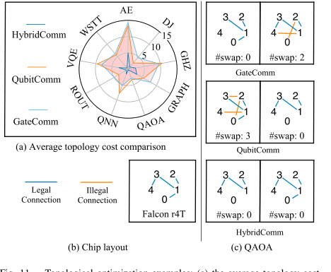
Topology Awareness: Match Subcircuits to Hardware
Paper Topology Result
Compiler Interpretation
legal edges execute directly
illegal edges require SWAPs
HybridComm gives flexible subcircuit topology
Topology cost = SWAP overhead after hardware mapping
Source: Xiang et al., IEEE TC 2025, Fig. 11; IBM Quantum devices [40].
Compiler
Notes:
Topology awareness is another part of the AdaptDQC contribution. A partition with a low communication count may still map poorly to hardware and require SWAP gates. By comparing the subcircuit topology against the chip topology, AdaptDQC can prefer partitions that are easier to execute on real hardware.

Slide 23
Outline of Presentation
- Background and challenges
- Overview of AdaptDQC
- Graph formulation and adaptive compiler
- Experimental evaluation
- Code walkthrough
Notes:
Now we move to the experimental results. The main thing to watch is that AdaptDQC improves both single-architecture settings and the hybrid setting, but the strongest message is that hybrid communication benefits from the unified model.

Slide 24
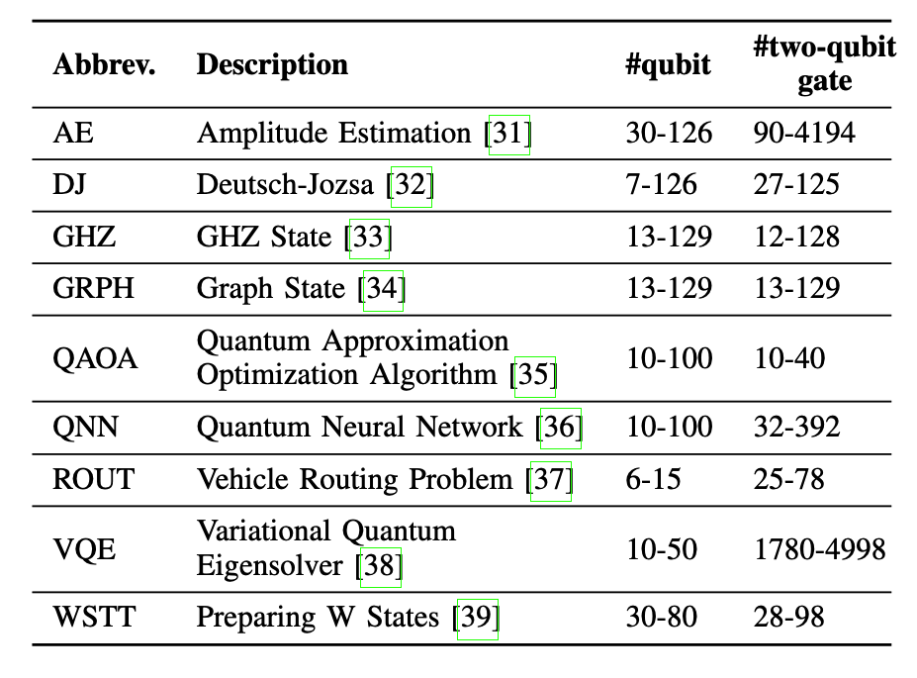
Evaluation Design: Algorithms x Architectures x Metrics
Benchmarks
Baselines
Metrics
communication
CutQC
ASPLOS’22
latency
HyperGraph
PRL
topology
AutoComm
MICRO’23
compile time
real machine
Source: Xiang et al., IEEE TC 2025, Sec. VI.
Evaluation
Notes:
The evaluation covers multiple benchmark circuits, including AE, DJ, GHZ, graph-state, QAOA, QNN, routing, VQE, and W-state. The comparisons are organized by architecture: CutQC for QubitComm and HyperGraph plus AutoComm for GateComm. The paper evaluates communication, latency, topology, compilation time, and real-machine behavior.

Slide 25
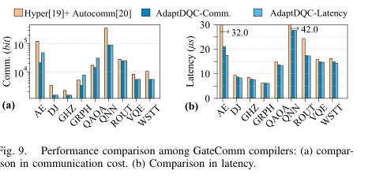
figData.pdf
Single-Architecture Results
GateComm Comparison
QubitComm vs CutQC
QubitComm vs CutQC
42.5%
15.4x
latency
reduction
communication
reduction
GateComm vs HG+AutoComm
GateComm vs HG+AutoComm
26.3%
18.2%
communication
reduction
latency
reduction
Improves both supported single-ICC paths.
Source: Xiang et al., IEEE TC 2025, Fig. 8-9 and Sec. VI-B.
Evaluation
Notes:
Under single-architecture comparisons, AdaptDQC reduces latency by 42.5 percent and communication by 15.4 times in QubitComm compared with CutQC. For GateComm, it reduces communication by 26.3 percent and latency by 18.2 percent compared with HyperGraph plus AutoComm.

Slide 26
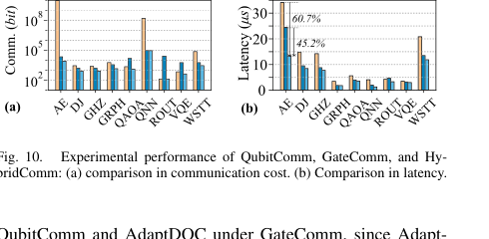
HybridComm: Largest End-to-End Gains
Hybrid vs Single ICC
35.4%
38.4%
average communication
reduction
average latency
reduction
Why it works
HybridComm avoids excessive wire cuts and excessive remote teleportation.
Architecture adaptivity is the main result, not a side detail.
Source: Xiang et al., IEEE TC 2025, Fig. 10 and Sec. VI-B.
Evaluation
Notes:
HybridComm gives the largest average end-to-end gains. The paper reports a 35.4 percent communication reduction and a 38.4 percent latency reduction compared with single ICC architectures. The reason is that HybridComm can avoid both excessive wire cuts and excessive remote-gate teleportation.

Slide 27
Real-World Runs Validate the Reconstruction Path
IBM Cloud Emulation
subcircuits run on a 5-qubit Falcon r4T device
chi-square tracks distance from noiseless ground truth
dominant error comes from hardware execution noise
Notes:
The real-world experiment uses IBM quantum hardware in a time-division way to emulate distributed execution. The key observation is that the reconstruction path remains practical and that the dominant error comes from quantum execution noise rather than classical tensor reconstruction.

Slide 28
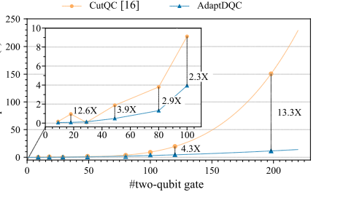
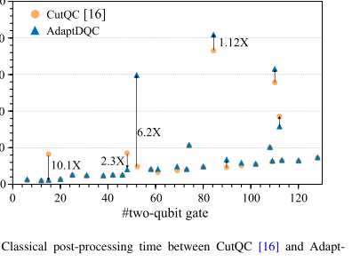
Overheads and Ablation Explain Where AdaptDQC Pays Off
Compilation Time
Post-Processing
Reverse Tuning Ablation
comparable tensor cost
98.5% comm. / 56.4% latency gain
smoother scaling than CutQC
Source: Xiang et al., IEEE TC 2025, Fig. 13-15 and Sec. VI-D-F.
Evaluation
Notes:
The overhead analysis adds nuance. AdaptDQC compiles more smoothly than CutQC for larger QubitComm cases, and post-processing time is comparable overall. The ablation also shows that reverse tuning is important: it reduces communication by 98.5 percent and latency by 56.4 percent on average in the reported setting.

Slide 29
Key Takeaways for the Report
Model
Compiler
SDHG + TDAG + CG
space, time, chip communication
Clustering + reverse tuning
objective-driven refinement
Architecture
Evidence
HybridComm composes
wire cuts and remote gates
Benchmarks + IBM runs
communication, latency, topology gains
Main message: AdaptDQC is a metric-aware compiler framework, not just a new partitioning heuristic.
Source: Xiang et al., IEEE TC 2025, Abstract and Sec. VIII.
Conclusion
Notes:
To summarize, AdaptDQC contributes a unified model, an adaptive compiler, and experimental evidence across architectures and objectives. The takeaway is that distributed quantum computing compilation should be metric-aware and architecture-aware at the same time.

Slide 30
Code Walkthrough I: QubitComm End-to-End
1. Build circuit and reference setup
qpu = QPU(width=2)
circuit = QuantumCircuit(3)
2. Cut wires into QPU-sized subcircuits
partition_cutter = CutWire(circuit, qpu=qpu)
solution = partition_cutter.cluster_cut()
3. Build compute graph, execute subcircuits, and check error
compute_graph = generate_compute_graph(counter=solution.counter)
run_solution = run_cutter.run_cut_circuit(eval_mode="sv")
L1_error = float(abs_delta.sum())
Source: tutorial/adaptdqc_tutorial.ipynb, sections 1-4.
Code
Notes:
The last two slides connect the paper to the tutorial notebook. This first code slide follows the QubitComm path. It builds a small hardware-compatible circuit, sets QPU width to two, uses CutWire to partition the circuit, generates the compute graph, executes subcircuits with statevector simulation, and compares the reconstructed distribution with the full-circuit reference.

Slide 31
Code Walkthrough II: GateComm and HybridComm
1. GateComm API: count EPR pairs and compile teleportation circuit
gate_compiler = Partcompile(circuit, allocation)
epr_num, epr_circuit = gate_compiler.get_epr_circuit()
teleportation_circuit = gate_compiler.compile_with_teleportion()
2. Adaptive objective: choose by communication or latency
communication_choice = min(plans, key=lambda p: p["epr_pairs"])
latency_choice = min(plans, key=lambda p: p["compiled_depth"])
3. HybridComm: wire cut first, then GateComm inside wide subcircuits
hybrid_solution = CutWire(hybrid_circuit, qpu=wire_stage_qpu).cluster_cut()
compiler = Partcompile(subcircuit, allocation)
compiled_circuit = compiler.compile_with_teleportion()
Source: tutorial/adaptdqc_tutorial.ipynb, sections 5-7.
Code
Notes:
The second code slide covers GateComm, adaptive objective selection, and HybridComm. Partcompile exposes EPR-pair cost and teleportation compilation. The notebook then evaluates candidate allocations under communication and latency objectives, and finally demonstrates a hybrid flow where wire cutting is followed by GateComm inside a wide subcircuit.

