Slide 1



ISCA 2026 Tutorial
Topic 4. AdaptDQC: Adaptive Distributed Quantum Computing
With Quantitative Performance Analysis (TC 2025)
Lab
JanusQ
Cloud
Speaker: Debin Xiang
College of Computer Science and Technology
Zhejiang University (ZJU)
https://janusq.github.io/ISCA_2026_Tutorial/home
Notes:
Good morning, everyone. I am Liqiang Lu from Zhejiang University. Today I will present AdaptDQC, our TC 2025 work on adaptive distributed quantum computing. The main question is simple. How can we run a circuit when one quantum chip is too small or too noisy?

Slide 2
Outline of Presentation
- Background and challenges
- Overview of AdaptDQC
- Adaptive compiler
- Experimental evaluation
- AdaptDQC API
Notes:
Here is the route for the talk. The outline begins with background and challenges, then moves to the overview of AdaptDQC.
Then I introduce the AdaptDQC overview. The key idea is to describe different communication choices using graph-based models.
After that, I explain the adaptive compiler. It simplifies, clusters, and then tunes the graph according to the target metric.
Finally, I show the experimental evaluation and the AdaptDQC API. I will show how to connect the paper ideas to concrete workflows.

Slide 3
Why Distributed Quantum Computing?
DQC Motivation
DQC targets coupled width-depth-noise limits
A. Single chip
limited width and depth
Single-chip bottleneck
Depth
B. Partition
subcircuits fit smaller QPUs
Width
Noise
C. Execute
higher local fidelity
Large task must be partitioned
D. Reconstruct
recover global result
circuit
QPU A
global result
QPU B
QPU C
Compiler quality decides whether DQC reduces the bottleneck.
Notes:
The motivation starts from a single-chip bottleneck. A larger circuit may exceed the width, depth, or noise budget of one QPU.
Distributed quantum computing splits the task across several smaller QPUs. In the diagram, one circuit becomes work for QPU A, QPU B, and QPU C.
The system then executes these pieces and reconstructs the global result. That makes the compiler central to the whole pipeline.
A poor split can create too much communication. A good split keeps the subcircuits feasible and preserves the useful computation.

Slide 4





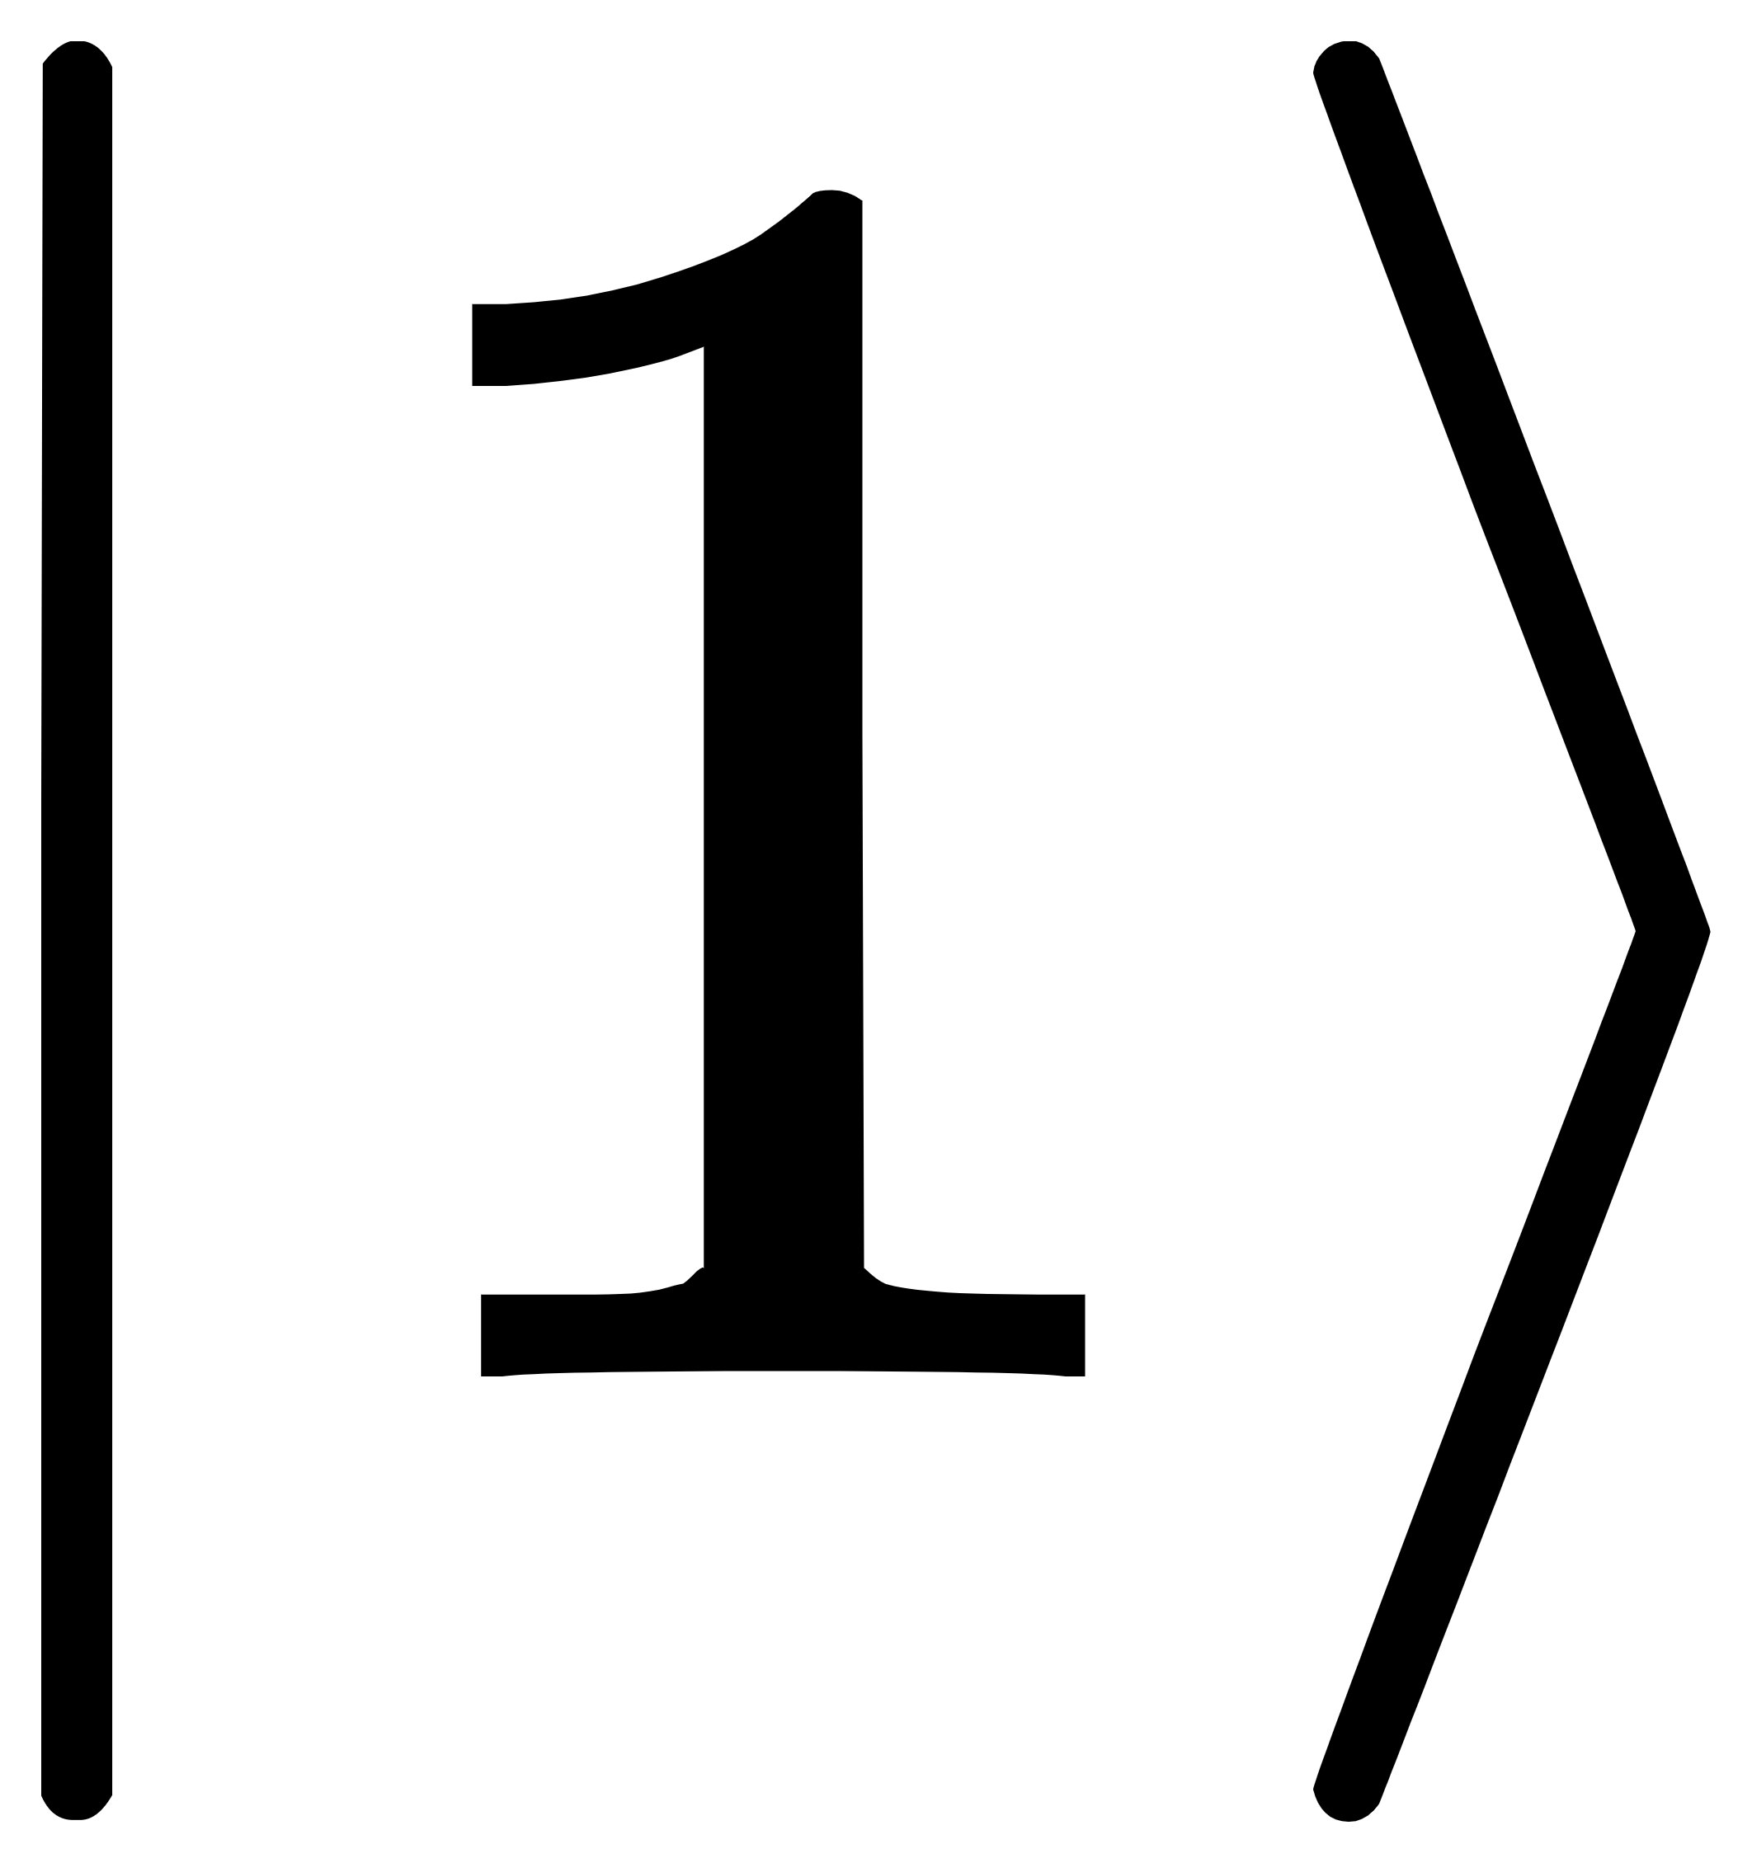
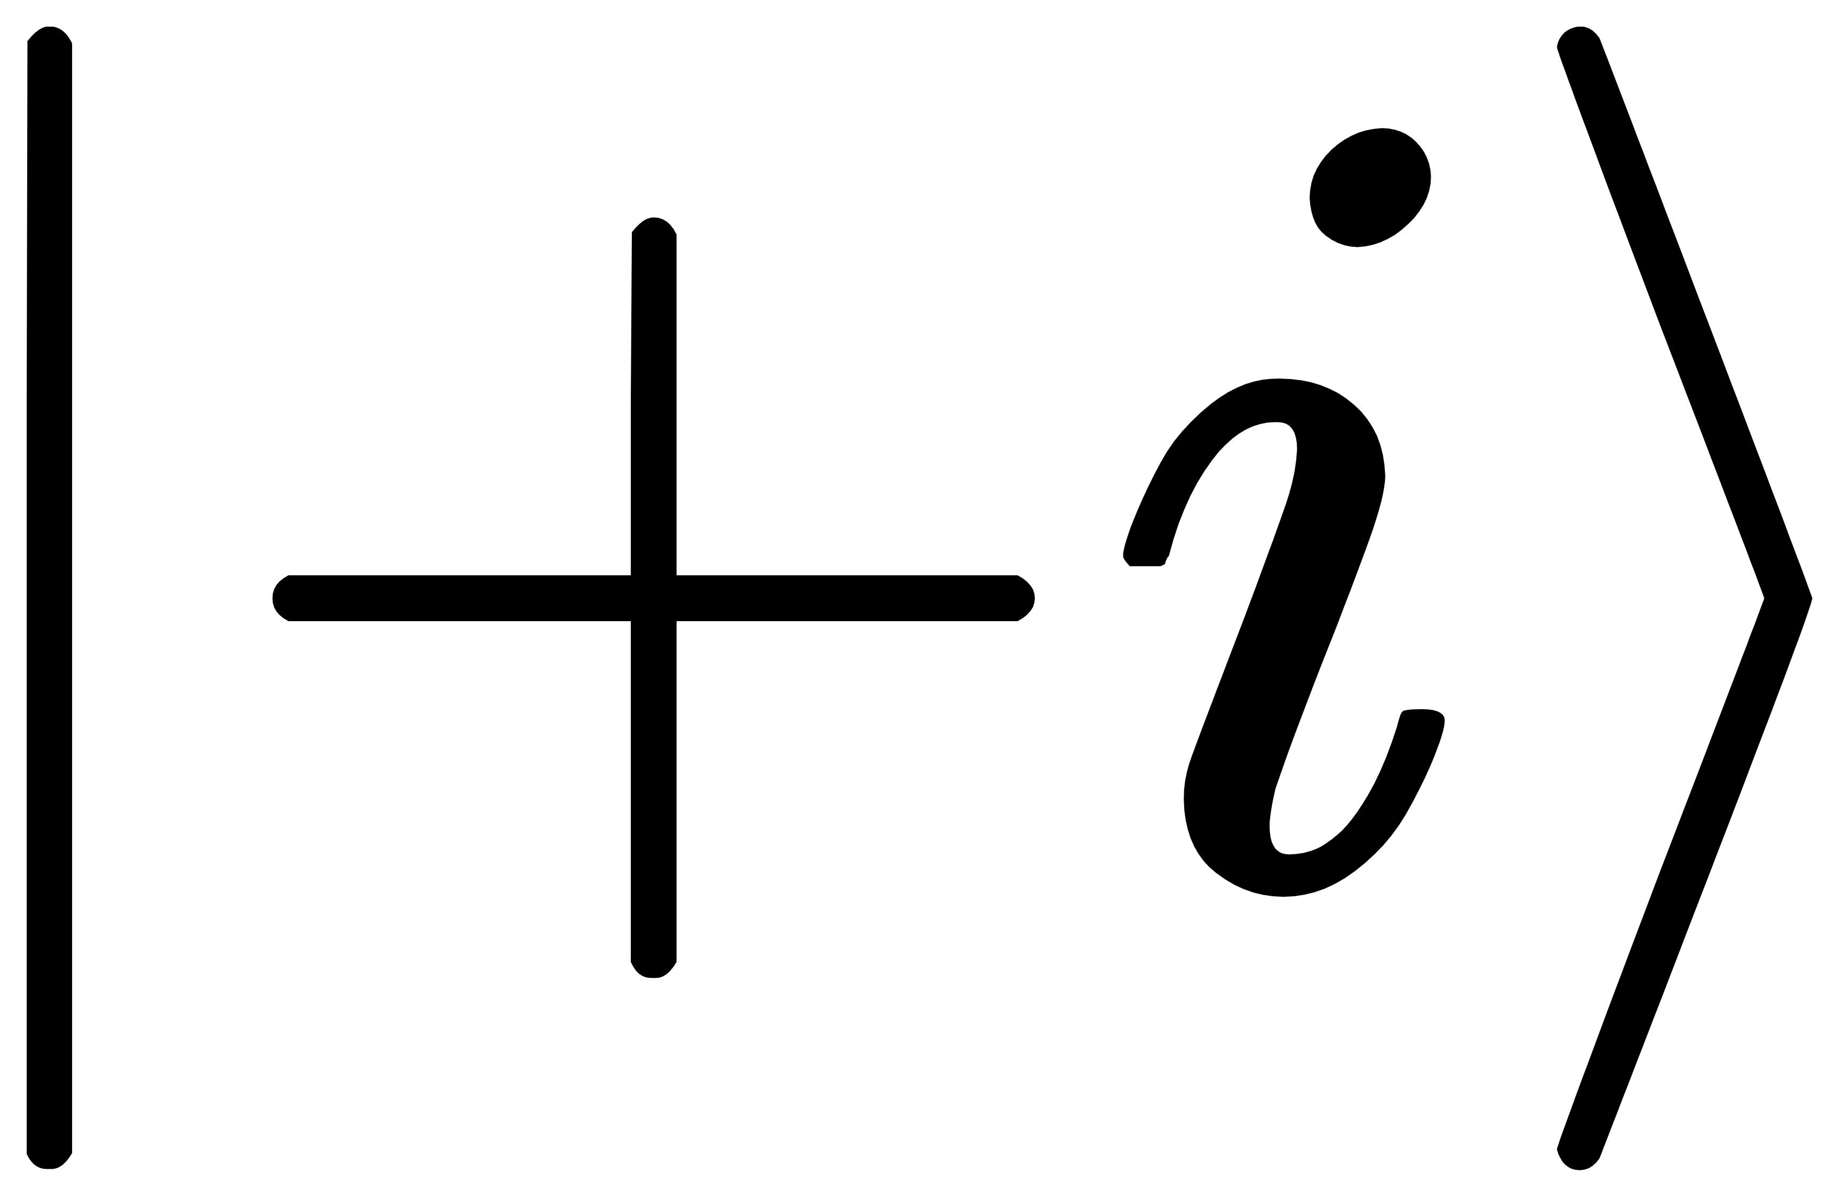
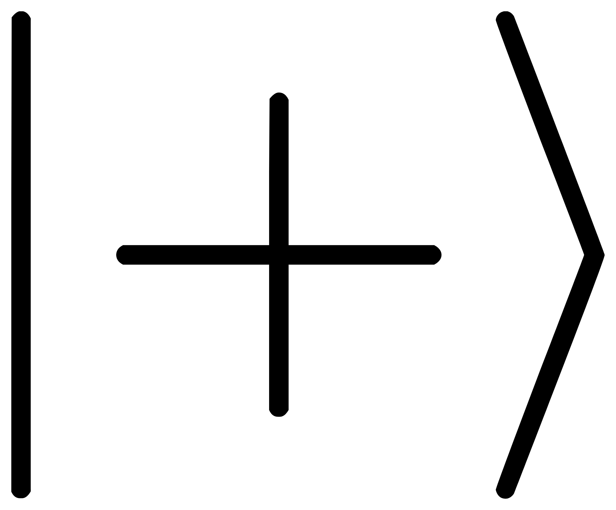


There are different communication architectures
Implementation of Communication
Classical communication
Quantum Link
R_{x}
T
S
Tensor compute
R_{x}
T
S
QPU₁
X,Y,Z,I
QPU₁
Qubit Comm
H
X
R_{x}
H
X
R_{x}
Quantum teleportation
QPU₂
QPU₂
S
Z
R_{x}
X
H
S
Z
R_{x}
X
H
Inter-chip communication (ICC) architecture
R_{x}
T
V
S
Tensor compute
R_{x}
T
S
QPU₁
QPU₁
H
X
R_{x}
H
X
R_{x}
Gate Comm
U
classical communication
QPU₂
S
Z
R_{x}
H
QPU₂
S
Z
R_{x}
X
H
Quantum network
Notes:
This slide separates two axes of Inter-chip communication. The rows show communication architecture, including Qubit Comm and Gate Comm. The columns show Implementation of Communication, including classical communication and quantum links.
In QubitComm with classical communication, we cut wires and use tensor computation to reconstruct the result. With a quantum link, the same qubit movement can be implemented through quantum teleportation.
GateComm is different. It keeps local qubits on chips and implements remote gates through tensor computation or a quantum network.
Thus, the same circuit can be compiled through several communication architectures.

Slide 5
Communication Architectures Create Different Costs
QubitComm
wire partition
GateComm
gate partition
Hybrid Comm
Wire and gate parition
Notes:
The example shows why the Communication Architectures matter. We distribute the same circuit onto two-qubit chips, but the cuts are different.
QubitComm uses wire partition. Here it creates five partitions, because cutting a wire separates a qubit timeline.
GateComm uses gate partition. It creates four partitions, because the remote two-qubit gate is handled as communication.
HybridComm can use both wire and gate partition. In this example it needs only two partitions.
The message is that the architectures choice changes the size of the distributed workload. It also changes reconstruction cost and latency.

Slide 6
Compilation Problem from DQC Pipeline
DQC Pipeline
Partition
Map
Run
circuit
subcircuits
QPU layout
Results
Where to cut
How to map
Which communication
Gate partition
Qubit Mapping
Classical link
Qubit partition
Gate scheduling
Quantum link
These decisions are coupled
Compilation Problems
Notes:
Now we can frame the compiler problem. The DQC pipeline starts with a circuit, partitions it into subcircuits, maps them to QPU layouts, runs them, and reconstructs results.
At each step, the compiler must answer a different question. Where should we cut? How should subcircuits be mapped? Which communication should be used?
These decisions are coupled.

Slide 7
Existing Compilers Cover Only Slices of the Design Space
Works |  | CutQC ASPLOS’21 | QMPI SC’21 | Autocom MICRO’22 | Hypergraph PRA’19 | ZX calculus Quantum’23 | AdaptDQC
methods |  | Qubit cut with tensor reconstruction | Quantum network programing language | Quantum network communication optimization | Quantum network qubit mapping | Gate cut with tensor reconstruction | Adaptive DQC evaluation and hybrid compilation
QubitComm
GateComm
 | Comm
系统性能评估 | Latency
 | Fidelity
 | Topology
Y
Y
Y
Y
Y
Y
Y
Y
Y
Y
Y
Y
Performance
Y
Y
Y
Y
Y
Y
Y
Requirements for practical DQC compilation
R1: unified description
R2: quantitative performance evaluation
R3: adaptive optimization strategy
Notes:
Existing compilers cover important parts of DQC, but they do not cover the full combination.
CutQC supports QubitComm and gives communication metrics. QMPI focuses on QubitComm latency. AutoComm targets GateComm communication and latency.
Hypergraph and ZX-calculus methods add useful structure. They still leave gaps in supported metrics and topology.
AdaptDQC is designed to cover QubitComm, GateComm, and performance metrics in one framework.
The requirements at the bottom summarize the goal. We need a unified description, quantitative performance evaluation, and an adaptive optimization strategy.

Slide 8
Outline of Presentation
- Background and challenges
- Overview of AdaptDQC
- Adaptive compiler
- Experimental evaluation
- AdaptDQC API
Notes:
The first part established the background and challenges. The next part explains the overview of AdaptDQC.
The goal here is to give every compilation decision a clear representation. Once the decision is represented, we can attach a cost model to it.
This overview also prepares the later compiler slides. The compiler becomes effective when the graph model exposes topology, latency, and communication signals.

Slide 9
AdaptDQC Overview
Circuit
Graph model
Performance evaluate
Optimizer
DQC hardwares
Notes:
AdaptDQC takes a circuit and first converts it into a graph model.
The performance analysis engine reads that model and estimates topology cost, communication cost, latency, and related metrics.
Those scores are then passed to the optimizer. The optimizer searches for a better partitioning and mapping choice.
The final solution is sent to the distributed quantum hardware.

Slide 10
Graph Formulation Gives Each Decision a Place
Three Graph Views
SDHG
TDAG
CG
qubit-space relations
gate-time dependencies
chip connection
topology
latency
communication
Notes:
The graph formulation assigns each decision to a different view.
The left panel starts from a circuit partition. Wire cuts and gate cuts both appear in the same distributed setting.
The SDHG captures qubit-space relations. It marks qubit nodes, EPR qubits, tensorization, and teleportation.
The TDAG captures gate-time dependencies. It shows which operations must wait for earlier operations.
The CG captures chip-level communication. It distinguishes QubitComm and GateComm across chip connections.
Together, these views connect topology, latency, and communication. This is why the latter optimizer can compare different ICC choices.

Slide 11
SDHG: Spatial View of Qubit Relations
What changes in DQC?
wire cut duplicates qubits
remote gate adds EPR resources
topology cost becomes measurable
Topology objective: $\min{d\left(G_{subcircuits},G_{chips}\right)}$
SWAP overhead induced by hardware layout.
Notes:
The SDHG is the spatial view of qubit relations.
For QubitComm, a wire cut duplicates a qubit state across subcircuits. Thus, the . A remote gate introduces EPR resources or an equivalent communication workload.
Because of this structure, the topology cost becomes measurable.
The objective compares the subcircuit graph with the chip graph. A better match reduces routing overhead.
The small diagrams at the bottom show why layout matters. If interacting qubits are far apart on hardware, extra SWAP gates appear.
Those SWAP gates increase depth and error.

Slide 12
TDAG: Temporal View of Execution Dependencies
GateComm latency
TDAG example
= sum on the longest TDAG path
QubitComm Latency
Latency model
= max subcircuit latency
Notes:
The TDAG is the temporal view. It records gate dependencies and shows which operations can run in parallel.
For GateComm, latency is computed along the longest dependency path. Remote gates add communication delay on that path.
For QubitComm, the latency is the maximum latency among the generated subcircuits.
This difference matters because two partitions can have similar communication counts but very different critical paths.
TDAG gives the compiler a direct way to score that timing effect.

Slide 13
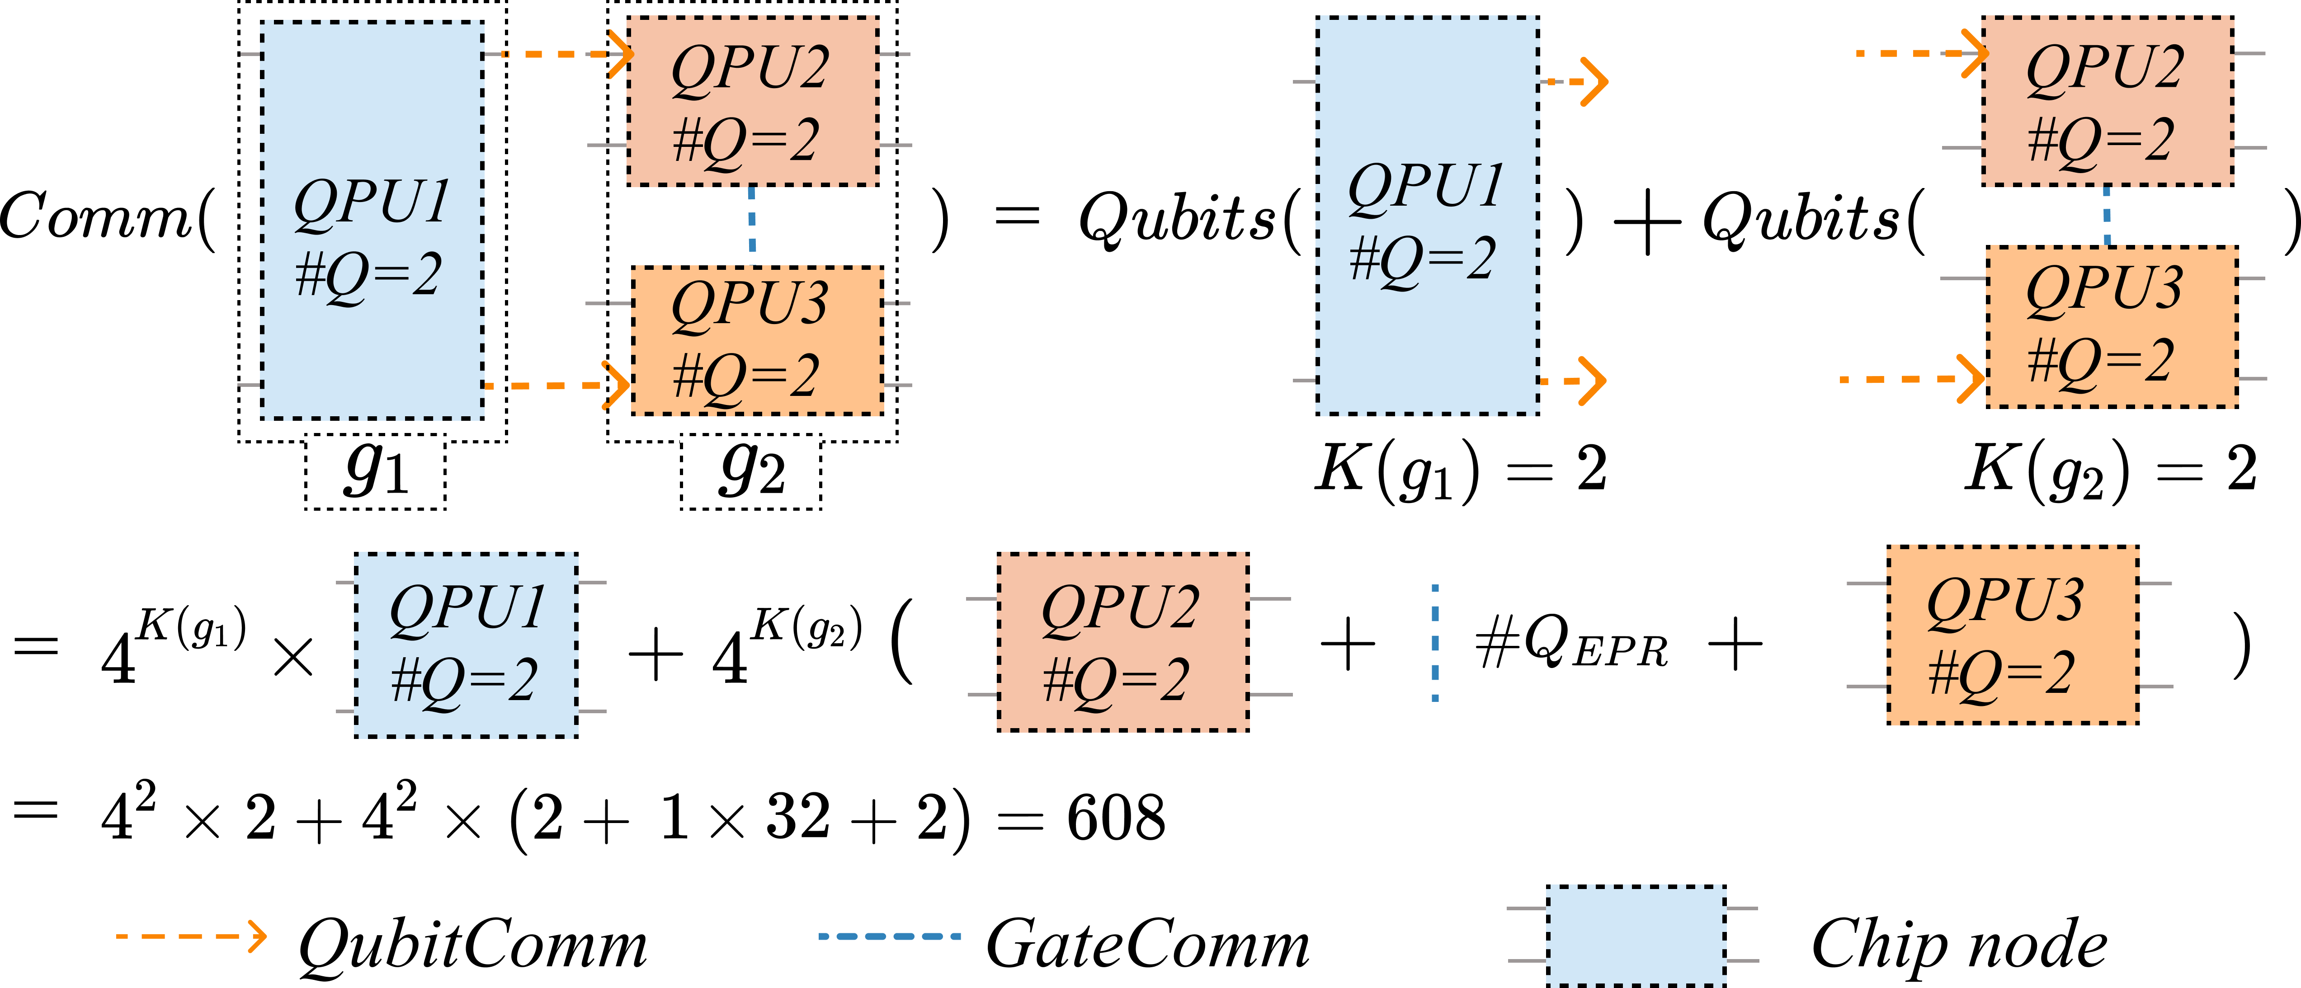
CG: Chip-Level Communication Graph
Communication model
Compiler Uses CG To
count EPR resources
count cut-wire workloads
select hybrid architecture
balance global metrics
Notes:
The CG is the chip-level communication graph. It can be used to calculate communication cost. For example, there are three QPUs connected by QubitComm arrows and GateComm links.
The communication counts two different costs. Wire cuts create a factor of four to the power of K. Gate communication adds EPR-pair demand.
In the example, K(g1) and K(g2) are both two, and the total communication cost becomes 608.
The compiler uses CG to count EPR resources, cut-wire workloads, select a hybrid architecture, and balance global metrics.
This graph is the bridge from local cuts to hardware-level communication.

Slide 14
Performance Engine Converts Graphs Into Optimization Signals
Topology SDHG
Communication CG
Performance Analysis
Engine
Latency TDAG
The DQC partition is scored by several metrics before execution, so optimization can adapt to the user's goal.
Notes:
The performance engine turns the three graphs into optimization signals.
Topology comes from the SDHG. Latency comes from the TDAG. Communication comes from the CG.
The Performance Analysis Engine combines these metrics before the circuit is executed.
This is useful because the compiler can compare candidate partitions without running every candidate on hardware.
That lets the optimizer adapt to the user goal, such as communication, latency, or topology.

Slide 15
Outline of Presentation
- Background and challenges
- Overview of AdaptDQC
- Adaptive compiler
- Experimental evaluation
- AdaptDQC API
Notes:
We now move from the model to the compiler.
The overview showed how AdaptDQC represents and scores a distributed circuit. The next question is how to find a good solution efficiently.
The adaptive compiler answers this with a multi-stage pipeline.
It first simplifies the graph, then clusters it, then uses reverse tuning to refine the result.
The final output is a set of executable subcircuits and communication decisions.

Slide 16
Adaptive Compiler Pipeline
Compilation Algorithm
Compiler Loop
1. Simplify
compress TDAG
2. Cluster
initial solution
3. Tune
metric feedback
4. Generate
subcircuits
Notes:
This slide gives the full compiler loop. The left side shows the algorithmic stages, and the right side summarizes the flow.
In graph simplification, AdaptDQC compresses the TDAG. This reduces the search space before clustering starts.
In graph clustering, it creates an initial solution. The clusters decide which gates and qubits stay together.
Reverse tuning then moves nodes when the performance engine predicts an improvement.
Finally, solution generation produces the subcircuits and the communication plan.
The key idea is feedback. The metric signal guides every refinement, so the compiler is aligned with the selected objective.

Slide 17
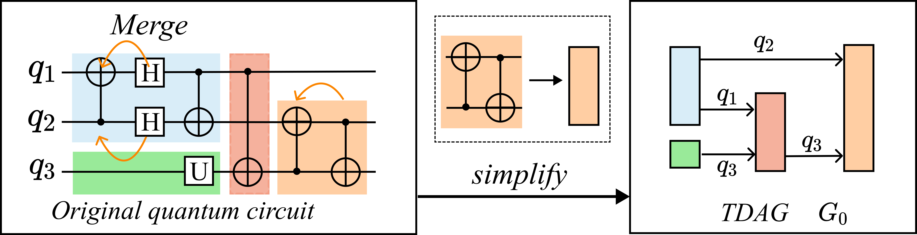
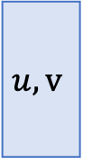


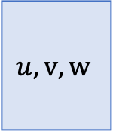
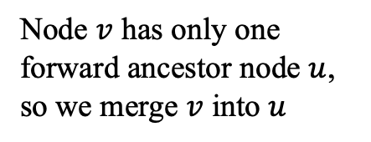


Graph Simplification
Node set to be merged:
$$𝒮=\{v∣∀v∈TDAG,|\{u∣\left(u,v\right)∈E\left(TDAG\right)\}|=1\}$$
Nodes that has only one forward ancestor node
Node $v$ has only one forward ancestor node $u$, so we merge $v$ into $u$
$$u$$
$$v$$
$$u,v$$
$$u,v,w$$
Same for $w$
$$w$$
Notes:
Graph simplification removes unnecessary detail while preserving dependencies.
The rule in the middle identifies a node with only one forward ancestor. Such nodes can be merged into the ancestor without changing the reachable order.
The same rule is applied to the following node when the condition holds.
The bottom example shows the effect. The original quantum circuit has many fine-grained gates.
After simplification, the TDAG G0 has fewer nodes and cleaner dependency structure.
This makes the next clustering step faster and less noisy.

Slide 18
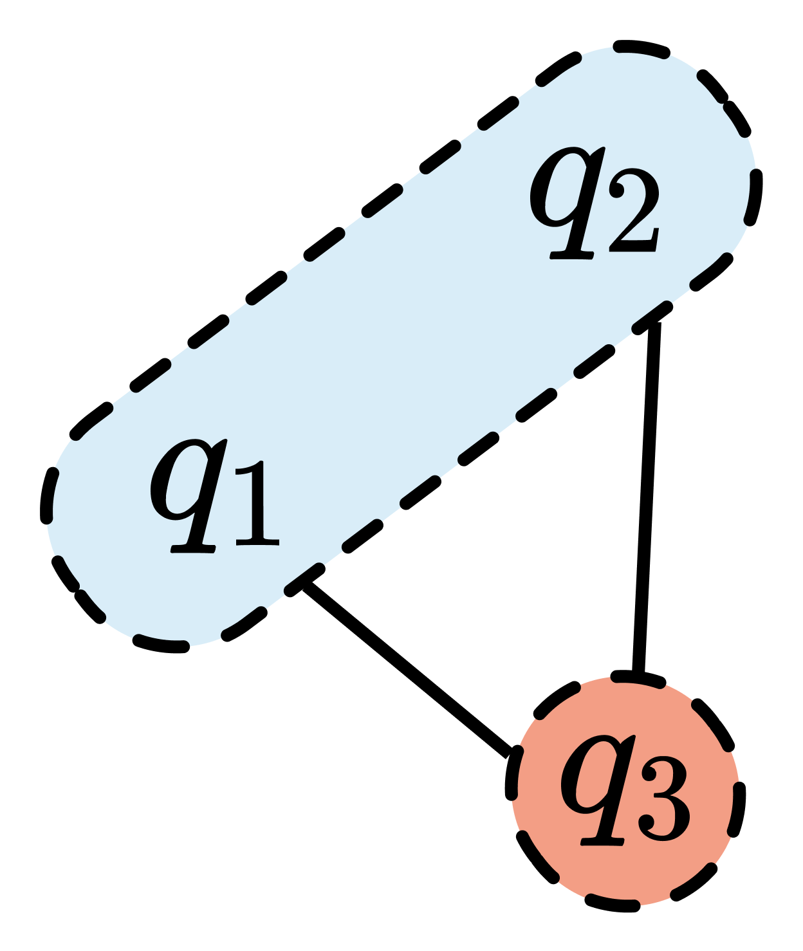
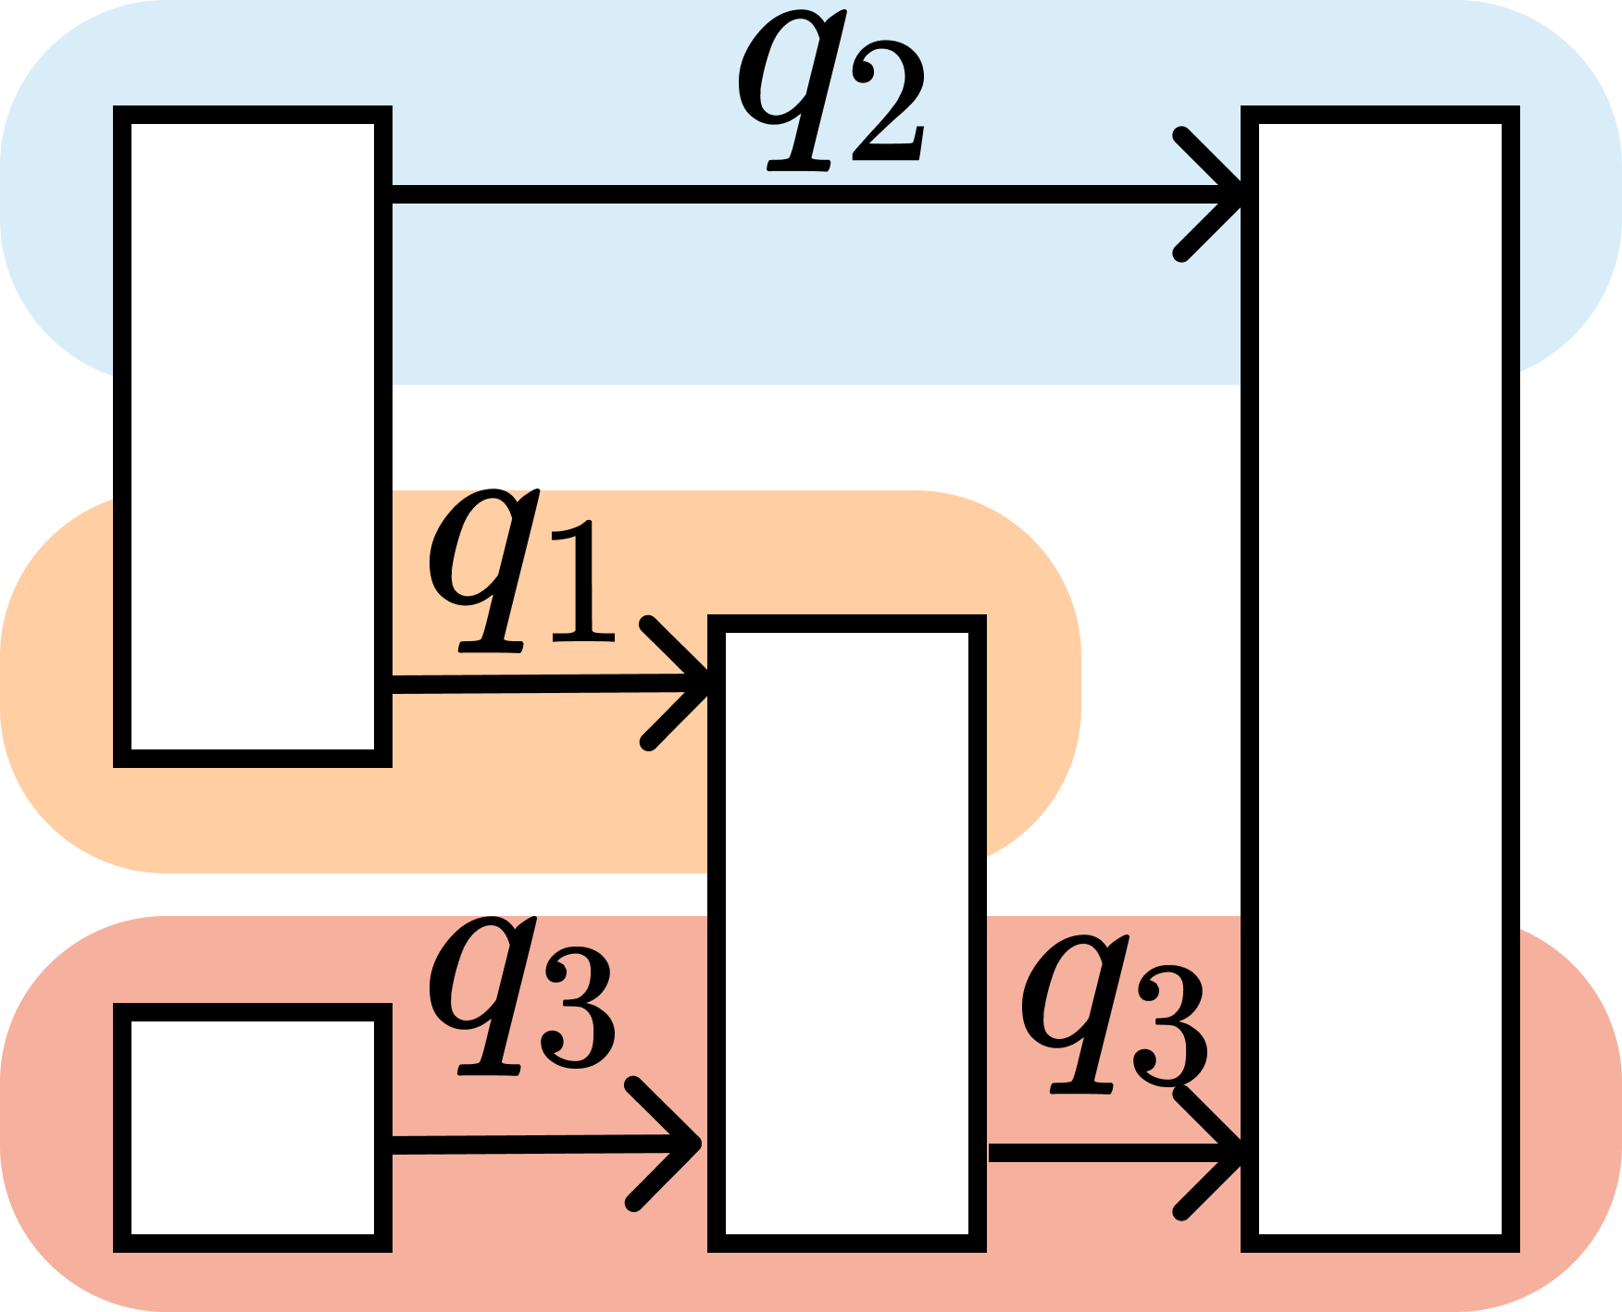
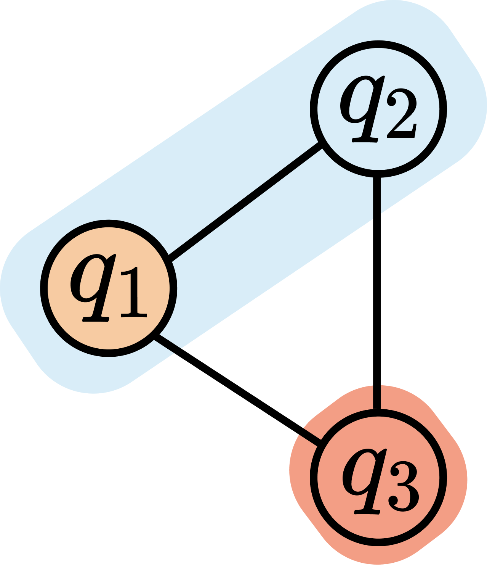
Graph Clustering
Node contains more gates
Node contains more qubits
1
Temporal clustering
2
Spatial clustering
TDAG
SDHG
CG
Connected nodes in TDAG are merged
Connected nodes in TDAG are merged
Each node maps to a chip
If the number of qubits in a node = the number of qubits in a chip, this node is fixed.
Otherwise, it needs to further clustered
Yes
#qubits in nodes < #qubits in chips?
No
Notes:
Graph clustering builds the initial distributed solution.
It starts with temporal clustering on the TDAG. Connected nodes are merged, so each cluster contains more gates and a clearer execution block.
Then AdaptDQC moves to spatial clustering through the SDHG. The goal is to group qubits that fit within available chip capacity.
The CG stage maps each node to a chip. If a node has too many qubits, it is clustered further.
The decision box checks whether the qubits in each node fit the chip sizes.
This connects graph structure to real hardware limits.

Slide 19
Reverse tuning
Iterative transverse from the last graph to the first graph and tuning each graph with node moving
graph mapping
Node moving
Last graph
previous graph
Optimized graph
map clusters to last graph
Loop tuning until reaching the original graph
Notes:
Reverse tuning refines the initial clustering.
The process starts from the last graph and maps changes back to the previous graph.
For each candidate move, the compiler asks whether the metric improves. If it improves, the node is moved.
Then the algorithm repeats the process on the earlier graph.
This reverse direction is useful because later graphs already contain hardware and communication information.
The loop continues until it reaches the original graph and no useful move remains.

Slide 20
Outline of Presentation
- Background and challenges
- Overview of AdaptDQC
- Adaptive compiler
- Experimental evaluation
- AdaptDQC API
Notes:
The next section evaluates whether these modeling and compiler choices help in practice.
I will cover the benchmark design, the baselines, and the metrics.

Slide 21
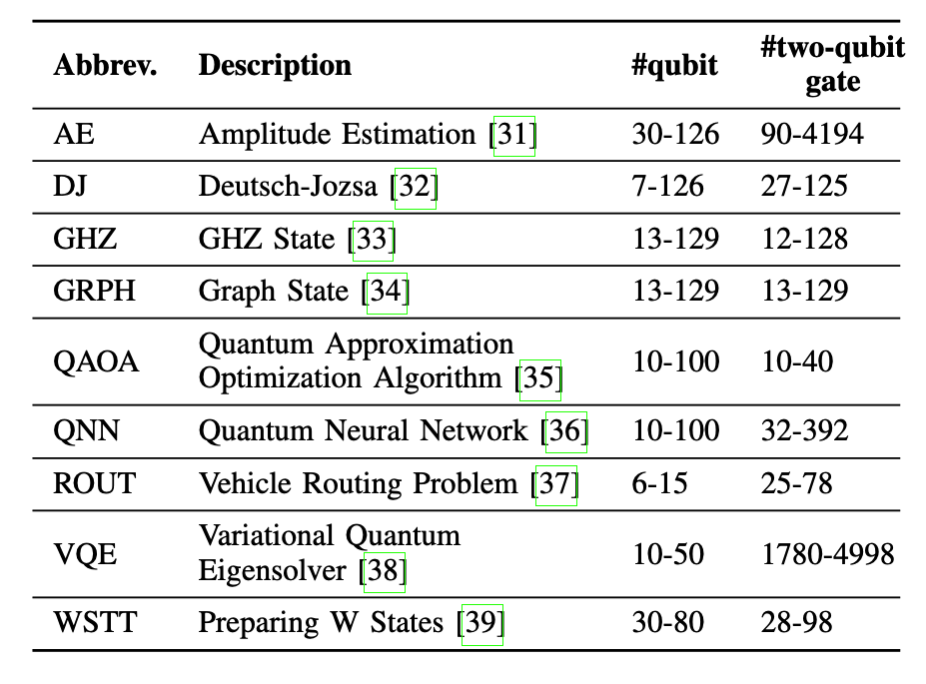
Evaluation Design: Algorithms x Architectures x Metrics
Benchmarks
Baselines
Metrics
communication
CutQC
ASPLOS’22
latency
HyperGraph
PRL
topology
AutoComm
MICRO’23
compile time
real machine
Source: Xiang et al., IEEE TC 2025, Sec. VI.
Evaluation
Notes:
The evaluation uses a broad benchmark set of quantum algorithms. The table covers circuits from small examples to more than one hundred qubits. It also varies the number of two-qubit gates. The baselines are CutQC from ASPLOS 2022, HyperGraph from PRL, and AutoComm from MICRO 2023.
The metrics cover communication, latency, topology, compile time, and real-machine behaviors.

Slide 22
Single-Architecture Results
GateComm Comparison
QubitComm vs CutQC
QubitComm vs CutQC
42.5%
15.4x
Latency reduction
Communication reduction
GateComm vs HyperGraph+AutoComm
GateComm vs HyperGraph+AutoComm
26.3%
18.2%
Communication reduction
Latency reduction
Improves both supported single-communication architectures paths.
Notes:
The single-architecture results compare AdaptDQC with the best-matching baseline for each communication architecture.
For QubitComm, AdaptDQC reduces latency by 42.5 percent compared with CutQC. It also reduces communication by 15.4 times.
For GateComm, AdaptDQC reduces communication by 26.3 percent compared with HG plus AutoComm.
It also reduces latency by 18.2 percent.
These results show that the graph model helps even when the compiler is restricted to one communication architecture.

Slide 23
HybridComm: Largest End-to-End Gains
35.4%
38.4%
Hybrid vs Single communication architecture
Average communication
reduction
Average latency
reduction
Why it works
HybridComm provides much more design space, compared with single communication architecture.
Notes:
HybridComm gives the largest end-to-end gains.
The comparison is now against single-communication architectures. The hybrid option can choose wire cuts, gate cuts, or a combination.
This larger design space leads to a 35.4 percent average communication reduction.
It also gives a 38.4 percent average latency reduction. This is because HybridComm can avoid the weaknesses of a single ICC mechanism.
It gives the optimizer more valid choices before the final partition is fixed.

Slide 24
Real-World Runs Validate the Reconstruction Path
IBM Cloud Emulation
Subcircuits run on a 5-qubit Falcon r4T device
Chi-square tracks distance from noiseless ground truth
Dominant error comes from hardware execution noise
Notes:
The real-world experiment checks whether the reconstruction path works outside pure simulation.
We use IBM Cloud and run subcircuits on a 5-qubit device.
The metric is chi-square distance from the noiseless ground truth.
The important observation is that reconstruction works, but the dominant error comes from hardware execution noise.
This is expected for current devices. It also explains why the compiler needs topology and latency awareness, along with communication counting.

Slide 25
Overheads and Ablation Study
Compilation Time
Post-Processing
Reverse Tuning Ablation
Smoother scaling than CutQC
Comparable tensor cost
98.5% comm. / 56.4% latency gain
Notes:
We also compare overheads and make an ablation study of the reverse tuning algorithm.
For compilation time, AdaptDQC scales more smoothly than CutQC as the problem size grows.
For post-processing, the tensor cost is comparable, so the main gains do not come from hiding reconstruction cost.
In the ablation study of reverse tuning, it can reduce 98.5 percent for communication and 56.4 percent for latency.

Slide 26
Outline of Presentation
- Background and challenges
- Overview of AdaptDQC
- Adaptive compiler
- Experimental evaluation
- AdaptDQC API
Notes:
We now move from experimental evaluation to the AdaptDQC API section. The goal is to connect the paper mechanisms to the repository.
First, I will show the project structure and explain where QubitComm, GateComm, metrics, and runtime code live. Then I will map the main API calls to the compiler workflow. The following code slides give concrete examples for QubitComm, GateComm, and HybridComm.

Slide 27
AdaptDQC Repository Structure
|-- adaptivedqc/
| |-- assessment/
| | |-- qpu.py QPU capacity, topology, latency
| | |-- Metrics.py gate latency and error metrics
| | `-- feature.py circuit feature extraction
| |-- hypridDQC/wireCut/
| | |-- cutWire.py QubitComm partition and execution
| | |-- cutSolution.py cut metadata and reconstructed bins
| | `-- cutter/ clustering, MIP, compute graph
| |-- assignQubit/
| | |-- compile.py GateComm EPR compilation
| | |-- partdqc.py allocation search wrapper
| | `-- optimizer/ GA, SA, FM, DQNN strategies
| |-- excute/runtime/ cloud/runtime hooks
| `-- verifity/ full-circuit reference checks
|-- tutorial/adaptdqc_tutorial.ipynb
|-- benchmark/ large-benchmark notes
`-- doc/ setup and gate-partition notes
Reading Notes
QubitComm lives in hypridDQC/wireCut
GateComm lives in assignQubit. Partcompile inserts EPR-style communication.
Assessment/ supplies width, topology, latency, and error signals.
The tutorial notebook is the best executable entry point.
QubitComm
GateComm
Metrics
Notes:
This slide replaces the placeholder AdaptDQC repo page with a source map. The assessment package provides the QPU model, topology information, latency, and error metrics.
The QubitComm implementation is under hypridDQC slash wireCut. That path includes CutWire, cut solutions, clustering, MIP support, and post-processing. The GateComm implementation is under assignQubit. Partcompile counts EPR pairs and builds teleportation-style circuits. The tutorial notebook is the recommended executable entry point for this section.

Slide 28
Code I: QubitComm End-to-End
1. Build circuit and reference setup
qpu = QPU(width=2)
circuit = QuantumCircuit(3)
2. Cut wires into QPU-sized subcircuits
partition_cutter = CutWire(circuit, qpu=qpu)
solution = partition_cutter.cluster_cut()
3. Build compute graph, execute subcircuits, and check error
compute_graph = generate_compute_graph(counter=solution.counter)
run_solution = run_cutter.run_cut_circuit(eval_mode="sv")
L1_error = float(abs_delta.sum())
Notes:
The first block builds a small circuit and a two-qubit QPU model. This sets the hardware capacity for the cutter.
The second block calls CutWire and then cluster_cut. That step finds a wire-cut solution sized for the QPU.
The third block builds the compute graph, runs the cut circuit in state-vector mode, and compares the reconstructed distribution with the reference result.
The helper generate_compute_graph stores the workload. run_cut_circuit uses eval_mode set to sv for state-vector execution.
The L1 error is the quick correctness check. The code maps directly to the QubitComm pipeline.

Slide 29
Code II: GateComm and HybridComm
4. GateComm API: count EPR pairs and compile teleportation circuit
gate_compiler = Partcompile(circuit, allocation)
epr_num, epr_circuit = gate_compiler.get_epr_circuit()
teleportation_circuit = gate_compiler.compile_with_teleportion()
5. Adaptive objective: choose by communication or latency
communication_choice = min(plans, key=lambda p: p["epr_pairs"])
latency_choice = min(plans, key=lambda p: p["compiled_depth"])
6. HybridComm: wire cut first, then GateComm inside wide subcircuits
hybrid_solution = CutWire(hybrid_circuit, qpu=wire_stage_qpu).cluster_cut()
compiler = Partcompile(subcircuit, allocation)
compiled_circuit = compiler.compile_with_teleportion()
Notes:
The second code snippet shows GateComm and HybridComm.
The GateComm block creates a Partcompile object from the circuit and allocation. It then counts EPR pairs with get_epr_circuit.
The next call, compile_with_teleportion, builds the teleportation circuit used by the API.
The adaptive block shows how to choose an objective. One choice minimizes epr_pairs for communication. Another minimizes compiled_depth for latency.
The HybridComm block first applies CutWire. Then it compiles each wide subcircuit with Partcompile.
This matches the paper's idea: wire cuts and remote-gate compilation can be composed under a single objective.

Slide 30


Thanks for listening
AdaptDQC: Adaptive Distributed Quantum Computing With Quantitative Performance Analysis
Notes:
Thanks for listening. The main message is that AdaptDQC turns distributed quantum compilation into a quantitative optimization problem.
The repository exposes this idea through QPU metrics, QubitComm wire cutting, GateComm EPR compilation, and HybridComm composition. These APIs make it possible to test different objectives and connect the paper's graph model to executable tutorial code.

