Slide 1




ISCA 2025 Tutorial
Topic 6. Experimental realization of the bucket-brigade quantum random access memory (Nature Physics)
Lab
JanusQ
Cloud
Speaker: Liqiang Lu
College of Computer Science and Technology
Zhejiang University (ZJU)
https://janusq.github.io/
Notes:
Hello everyone. I am Liqiang Lu from Zhejiang University. In Topic 7, I will present our experimental realization of the bucket-brigade quantum random-access memory, also called as QRAM. The main question today is how to implement and test QRAM on a real quantum device.

Slide 2
Outline of Presentation
Background and challenges
Overview of QRAM
QRAM optimization
Experiment
API of QRAM
Notes:
The presentation follows five parts. I will begin with the background and challenges that make QRAM important. Then I will give an overview of the bucket-brigade QRAM mechanism. The third part explains QRAM optimization, including routing and circuit-depth reduction. After that, I will discuss the experiment, error propagation, and error mitigation. Finally, I will briefly introduce the API of QRAM, so the implementation can be connected to practical circuit construction and simulation.

Slide 3
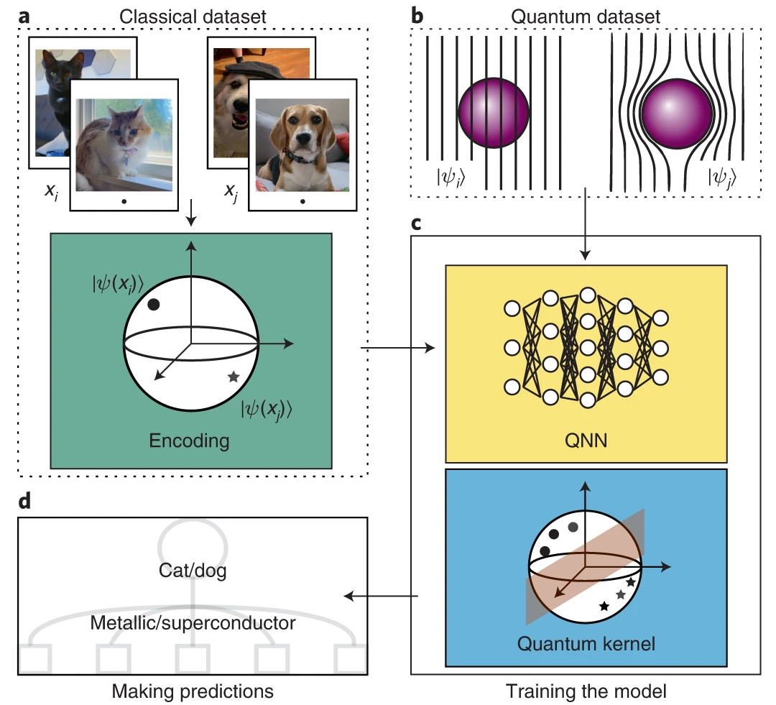
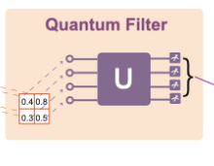
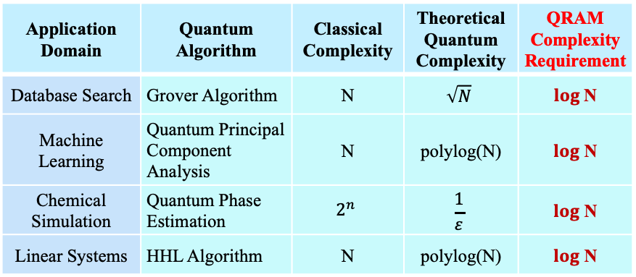
Quantum Computing Needs QRAM for Acceleration
Quantum computing uses superposition and entanglement to show acceleration potential.
Application Prospects
Example: Quantum Machine Learning:
Application Domain | Quantum Algorithm | Classical Complexity | Theoretical Quantum Complexity | QRAM Complexity Requirement
Database Search | Grover Algorithm | N | $$\sqrt{N}$$ | $log$N
Machine Learning | Quantum Principal Component Analysis | N | polylog(N) | $log$ N
Chemical Simulation | Quantum Phase Estimation | $$2^{n}$$ | $$\frac{1}{ε}$$ | $log$ N
Linear Systems | HHL Algorithm | N | polylog(N) | $log$ N
Quantum Circuit
High-dimensional quantum information representations enable up to exponential acceleration.
Quantum algorithms have acceleration potential in many domains, but all rely on QRAM implementation.
Notes:
Quantum computing uses superposition and entanglement to represent high-dimensional information, enabling up to exponential acceleration in domains such as database search, quantum machine learning, chemical simulation, and linear systems. The key point on this slide is the QRAM complexity requirement. Algorithms such as quantum principal component analysis and HHL need data access that scales close to polylog(N). Without QRAM, the loading of classical information can dominate the cost and hide the theoretical acceleration.

Slide 4
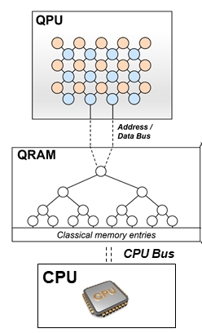
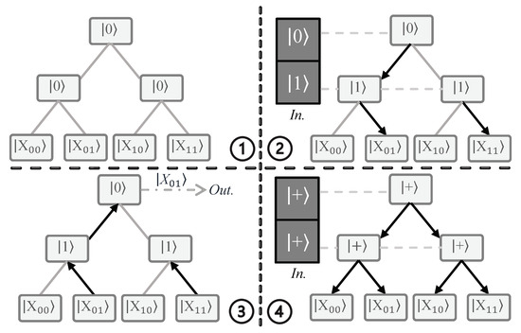

Definition of Quantum Random Access Memory
Comparison with Classical Random Access Memory
Classical RAM
Quantum RAM
Quantum address - classical memory - quantum data
Address input (n bits)
a₀a₁a₂a₃a₄
Classical data read out
Address Decoder
$2^{n}$address lines
(only 1 active)
Selected
Memory Cell Array
x₀₀
x₀₁
x₁₀
x₁₁
...
Classical address - classical data
Parallel loading of classical information into a quantum computer
Notes:
Classical RAM starts from a classical address. The address decoder activates one selected line in the memory cell array and reads out the corresponding classical data. Quantum RAM changes the interface: the address can be a quantum address, the memory remains classical, and the output becomes quantum data. That enables parallel loading of classical information into a quantum computer, which is the data-access model required by many quantum algorithms.

Slide 5
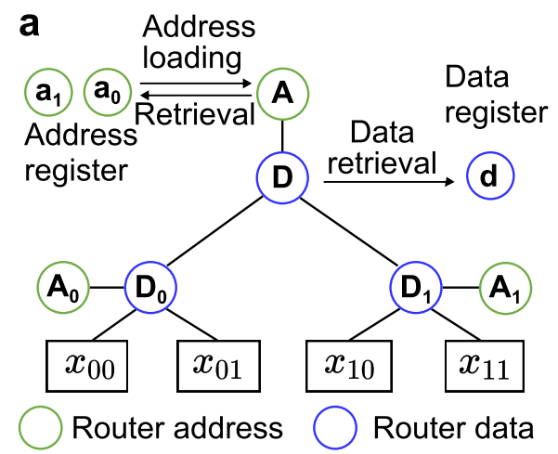
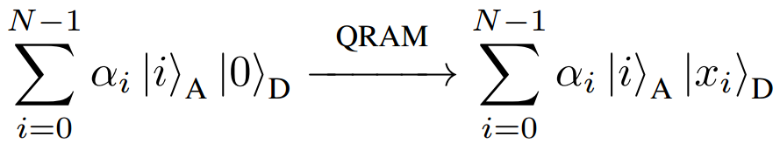
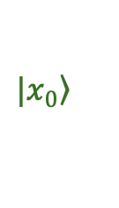
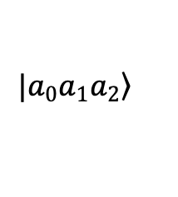

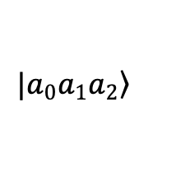
QRAM definition
Core Idea
Binary-tree QRAM enables O(log N) quantum data read/write.
Binary-tree routing
QRAM Functionality
Query address state input
Read data from QRAM
QRAM
$$|\left.a_{0}a_{1}a_{2}\right\rangle$$
$$|\left.a_{0}a_{1}a_{2}\right\rangle$$
$$|\left.0\right\rangle$$
$$|\left.x_{0}\right\rangle$$
Empty data bit to be written
Pre-stored data information
Auxiliary routing qubits organize quantum data in a binary tree.
Complete quantum data read/write in O(log N), breaking the O(N) data-access bottleneck.
Notes:
Here is the core idea from the Nature Physics work. A binary-tree QRAM uses auxiliary routing qubits to organize data access in a tree. The query address state enters the QRAM, an empty data bit is written through the selected path, and the pre-stored data information is read out. Because the path length scales with the tree depth, the complete quantum data read/write process can reach O(log N), breaking the O(N) data-access bottleneck of direct sequential loading.

Slide 6
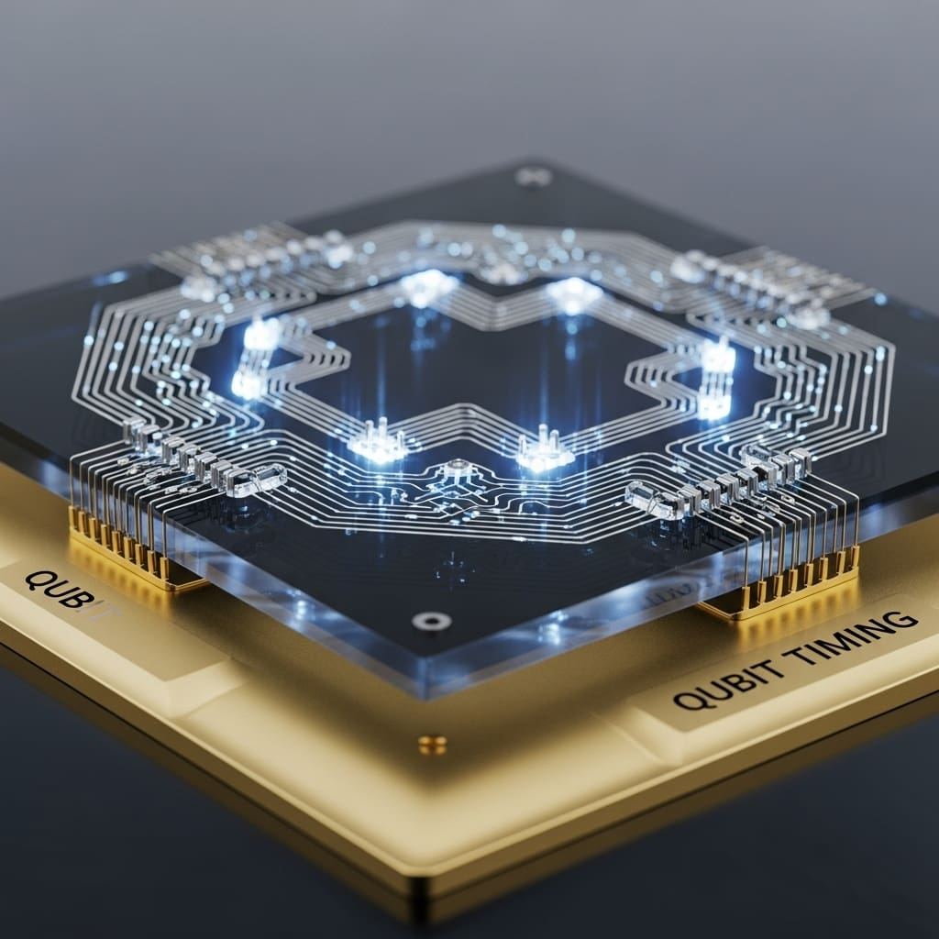
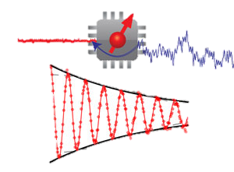
Challenges in Theory and Experiment
Theoretical Level
Experimental Level
1
Topology mismatch
2
Deep circuits
1
High control
requirements
2
Noise disruption
Binary Tree
A
C
L
R
Grid
Direct mapping causes exponential depth growth.
A quantum router needs to realize interactions among four qubits.
High-fidelity QRAM needs high-fidelity gates.
Noise disrupts correct
QRAM addressing.
Computer + Physics
QRAM is still theoretical;
it needs systematic architectural and hardware implementation.
Notes:
The implementation faces challenges at both the theoretical level and the experimental level. The first theoretical issue is topology mismatch: the ideal QRAM is a binary tree, while the chip is a grid. The second issue is deep circuits, because direct mapping causes exponential depth growth. Experimentally, each quantum router requires high control over interactions among four qubits, and noise buildup can disrupt correct QRAM addressing. These constraints motivate the architecture and optimization choices in the next sections.

Slide 7
Outline of Presentation
Background and challenges
Overview of QRAM
QRAM optimization
Experiment
API of QRAM
Notes:
We have now covered why QRAM is needed and why real-device implementation is difficult. The next section gives the overview of QRAM. I will focus on the routing picture first, then build up the two-layer example step by step, and finally connect the routing scheme to data loading, data readout, and the complete implementation circuit.

Slide 8

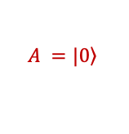





Routing Scheme of QRAM
Address-routing node qubits organize QRAM access paths.
Step 1
QRAM Address-Routing Branching Property
$$A =|\left.0\right\rangle$$
$$A$$
$$A_{0}$$
$$A_{1}$$
$$x_{00}$$
$$x_{01}$$
$$x_{10}$$
$$x_{11}$$
A = |0>: route to the left branch (same for A0/A1).
Notes:
In the bucket-brigade routing scheme, address-routing node qubits organize the access paths. For a routing node A in state |0>, the data bus is directed to the left branch. The same rule applies to the nodes A0 and A1 in the lower layer. The important branching property is that the QRAM data-readout route is fully determined by the input address state stored in these routing nodes.

Slide 9



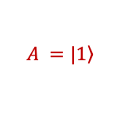

Routing Scheme of QRAM
Address-routing node qubits organize QRAM access paths.
Step 1
QRAM Address-Routing Branching Property
$$A =|\left.0\right\rangle$$
$$A$$
$$A =|\left.1\right\rangle$$
$$A$$
$$A_{0}$$
$$A_{1}$$
$$A_{0}$$
$$A_{1}$$
$$x_{00}$$
$$x_{01}$$
$$x_{10}$$
$$x_{11}$$
$$x_{00}$$
$$x_{01}$$
$$x_{10}$$
$$x_{11}$$
A = |0>: route to the left branch (same for A0/A1).
A = |1>: route to the right branch.
Notes:
The complementary case is A = |1>. In that case, the router sends the signal to the right branch. Together, A = |0> and A = |1> give the classical routing logic inside the binary tree. At this stage, the operation looks similar to a classical decision tree, but every routing node is implemented coherently, which allows the QRAM path to be controlled by a quantum address.

Slide 10




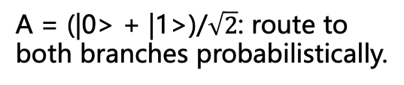

Routing Scheme of QRAM
Address-routing node qubits organize QRAM access paths.
Step 1
QRAM Address-Routing Branching Property
$$A =|\left.0\right\rangle$$
$$A =|\left.1\right\rangle$$
$$A =\frac{1}{\sqrt{2}} ( |\left.0\right\rangle +|\left.1\right\rangle )$$
$$A$$
$$A$$
$$A$$
$$A_{0}$$
$$A_{1}$$
$$A_{0}$$
$$A_{1}$$
$$A_{0}$$
$$A_{1}$$
$$x_{00}$$
$$x_{01}$$
$$x_{10}$$
$$x_{11}$$
$$x_{00}$$
$$x_{01}$$
$$x_{10}$$
$$x_{11}$$
$$x_{00}$$
$$x_{01}$$
$$x_{10}$$
$$x_{11}$$
A = |0>: route to the left branch (same for A0/A1).
A = |1>: route to the right branch.
A = (|0> + |1>)/$\sqrt{2}$: route to both branches probabilistically.
The QRAM data-readout route is fully determined by the input address state.
Notes:
Now consider a superposition address, A = (|0> + |1>) over the two routing choices. The routing operation can route to both branches probabilistically and coherently. The QRAM address-routing branching property is essential for quantum algorithms: the data-readout route follows all address components in superposition, while the route of each component is still determined by the corresponding input address state.

Slide 11
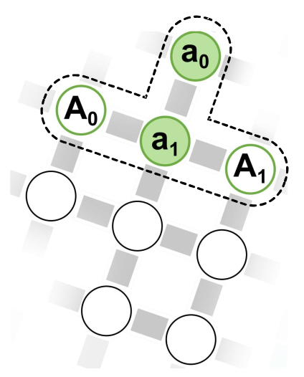




Routing Scheme of QRAM
Address bits determine the QRAM data-access path.
Step 2
Example: a 2-layer QRAM (2-bit address, 4 data bits)
Load the first address bit into the routing node
step1
Treat a0 as node A
=
Address bit
Empty address-routing qubit
Notes:
The 2-layer QRAM example makes the routing process concrete. We start with a 2-bit address and 4 data bits. In step1, we load the first address bit into the routing node and treat it as node A. The empty address-routing qubits in the second layer are prepared to receive the remaining address information. At this moment, the first bit chooses the upper-level branch of the binary tree.

Slide 12
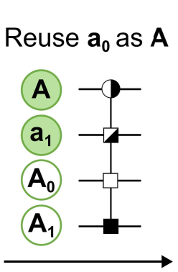
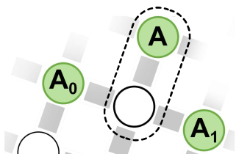
Routing Scheme of QRAM
Address bits determine the QRAM data-access path.
Step 2
Example: a 2-layer QRAM (2-bit address, 4 data bits)
Load the first address bit into the routing node
Load the second address bit into the routing node
step1
step2
Treat a0 as node A
=
Original address
Address bit
The original a1 information is routed to A0/A1 by a controlled-SWAP gate according to the first address bit.
Empty address-routing qubit
Notes:
Next, the original a1 address bit is routed into A0 or A1 by a controlled-SWAP gate, according to the first address bit. This is step2, where the second address bit is loaded into the appropriate routing node. The operation preserves coherence, so when the first address bit is in superposition, the information in a1 is distributed coherently across the corresponding A0/A1 routing positions.

Slide 13







Routing Scheme of QRAM
Address bits determine the QRAM data-access path.
Step 2
Example: a 2-layer QRAM (2-bit address, 4 data bits)
Load the first address bit into the routing node
Load the second address bit into the routing node
Address routing completed
step1
step2
Treat a0 as node A
$$A$$
=
$$A_{0}$$
$$A_{1}$$
$$x_{00}$$
$$x_{01}$$
$$x_{10}$$
$$x_{11}$$
Original address
The original a1 information is routed to A0/A1 by a controlled-SWAP gate according to the first address bit.
QRAM can determine the access path corresponding to the input address.
Address bit
Empty address-routing qubit
Notes:
Address routing completed means the path information is now stored in the tree. The first address bit has selected the upper branch, and the second address bit has selected the lower branch within that branch. At this point, QRAM can determine the access path corresponding to the input address. The two-layer QRAM therefore maps a 2-bit address to one of four data locations, or to a coherent superposition of those locations.

Slide 14
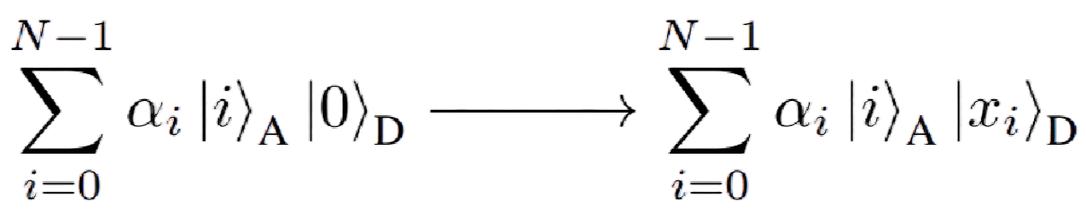
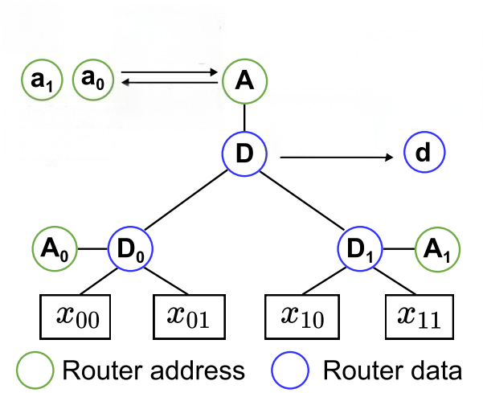
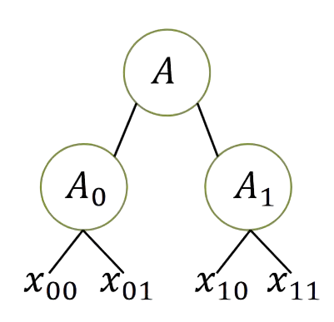

Routing Scheme of QRAM
Use data-routing qubits to load data without changing the address state.
Step 3
Most algorithms require the address state to remain unchanged during readout.
Address-routing node
Data-routing node
Address-routing nodes cannot load data directly.
Introduce data-routing qubit
Pair data-routing qubits with address-routing qubits to route data onto the data bus.
Notes:
The next issue is data access. Most algorithms require the address state to remain unchanged during readout, so the address-routing nodes cannot load data directly. The solution is to pair data-routing qubits with address-routing qubits. By introducing data-routing qubits, the QRAM can route the data bus along the selected path while keeping the address state available for retrieval at the end of the query.

Slide 15
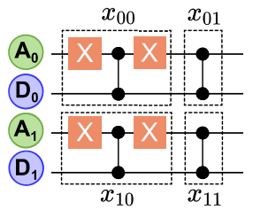
Routing Scheme of QRAM
Use data-routing qubits to load data without changing the address state.
Step 3
Data Readout
Data Retrieval
Data pre-written into QRAM
State preparation and CZ gates preload QRAM data onto |+> data-routing qubits.
Inverse gates return the accessed data to the data bus as a quantum state.
Notes:
With the data-routing qubits in place, we can preload and retrieve the data. During Data Readout, state preparation and CZ gates preload the QRAM data onto |+> data-routing qubits. The pre-stored QRAM data are encoded before the query. During Data Retrieval, inverse gates return the accessed data to the data bus as a quantum state. This completes the read path from stored classical data to quantum output.

Slide 16
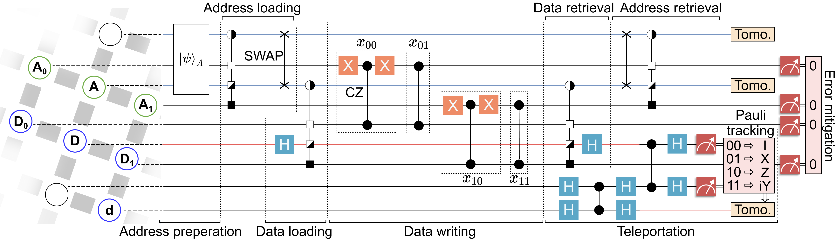
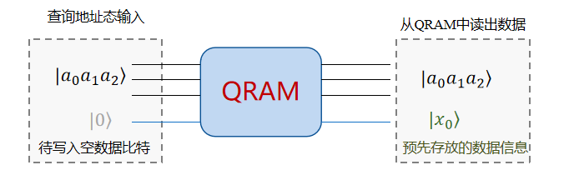
Real-Device Implementation of QRAM
Complete circuit implementation of QRAM
Output
Data read from QRAM
Query address
Complete quantum data read/write in O(log N)
Empty data qubit
Pre-stored data
Notes:
The complete QRAM implementation circuit combines the previous steps. The query address-state input enters the routing network, the blank target data qubit receives the accessed value, and the pre-stored data are read through the binary-tree routing structure. The important system-level claim is complete quantum data read/write in O(log N). With the overview established, we can now discuss how to make this circuit shallow enough for a real superconducting device.

Slide 17
Outline of Presentation
Background and challenges
Overview of QRAM
QRAM optimization
Experiment
API of QRAM
Notes:
We now move from the QRAM overview to QRAM optimization. The goal of this part is to reduce the resource cost of the routing architecture. I will first explain teleportation-based routing, which addresses the topology and communication problem, and then introduce the subspace-approximate routing architecture, which reduces the depth of the router circuit itself.

Slide 18
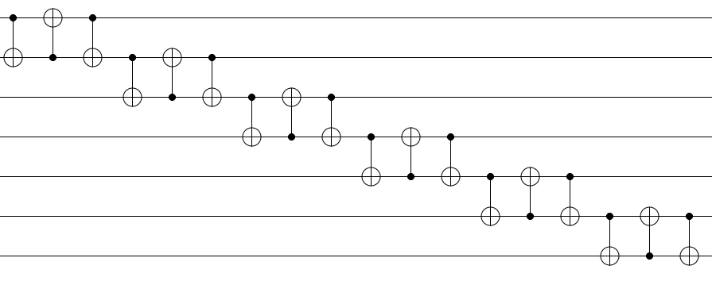
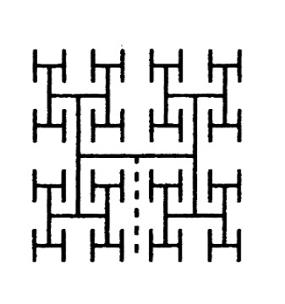
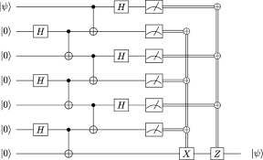
Teleportation-Based Routing Implementation
Overcome exponential circuit-depth growth through teleportation
Optimize 1
Routing path length grows exponentially with the number of layers.
Linear depth growth
Traditional SWAP routing
Teleportation routing
Constant depth
Optimal topology mapping: self-similar architecture mapping
Key issue: exponential routing length
Notes:
The first optimization is teleportation-based routing implementation. In Traditional SWAP routing, the routing path length grows exponentially with the number of QRAM layers, creating exponential circuit-depth growth. Teleportation routing changes the communication pattern. With a self-similar architecture mapping, long-distance routing can be converted into constant-depth teleportation steps, so the topology overhead no longer dominates the QRAM circuit depth.

Slide 19
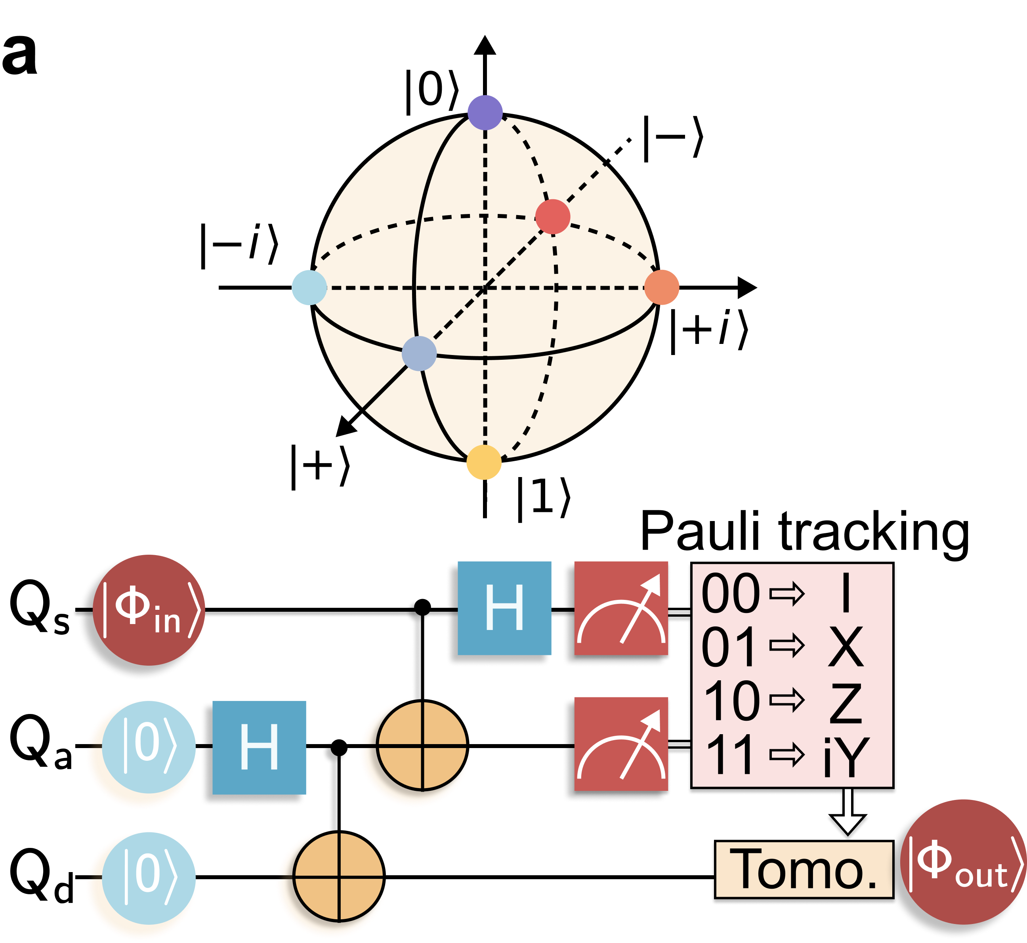
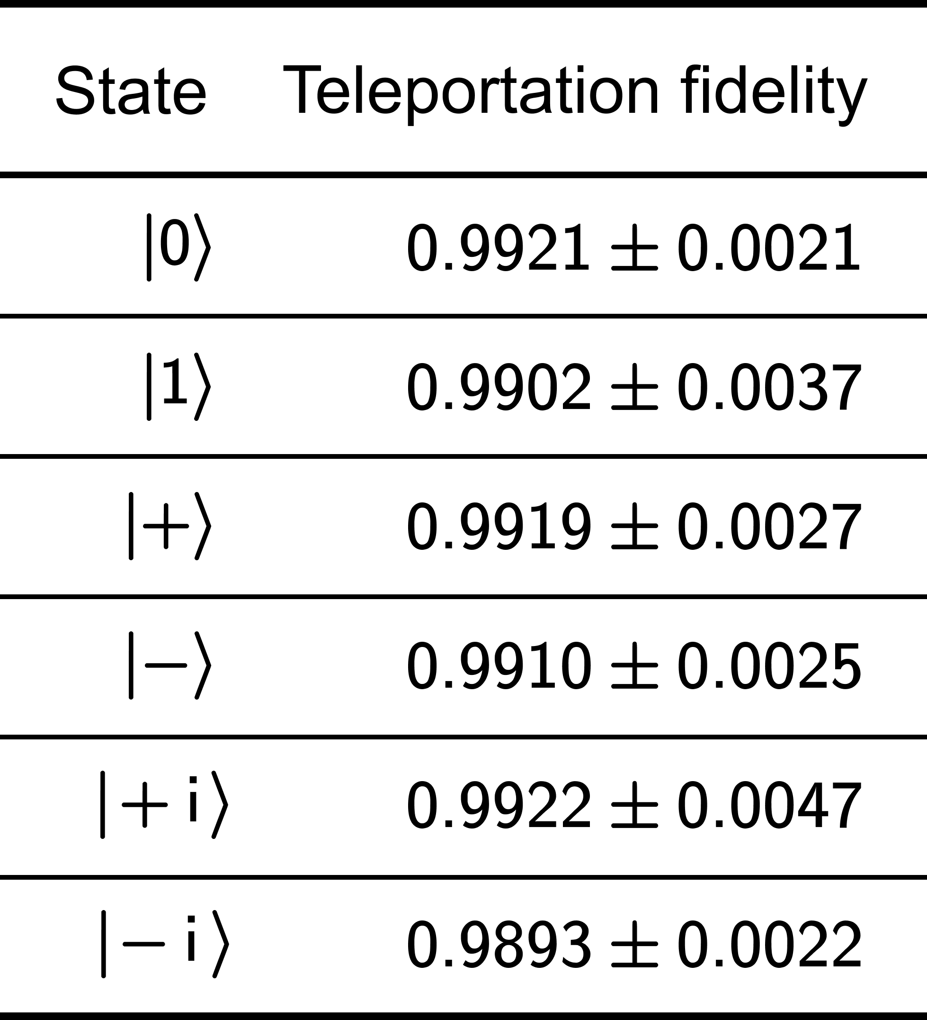
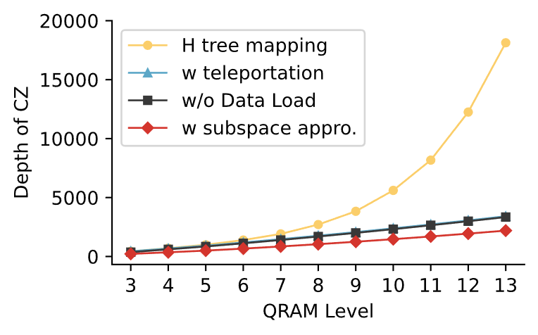

Teleportation-Based Routing Implementation
Teleportation fidelity reaches 0.99
Results
Depth remains linear
Experiments on different quantum basis states
20
State
Fidelity
SWAP-based routing architecture
15
Depth$×{10}^{3}$
10
Teleportation-based architecture
5
1
4
7
10
QRAM Layers
Notes:
The evidence on this page shows that the teleportation component is high quality. Experiments on different quantum basis states give teleportation fidelity around 0.99, and the depth curve shows that depth remains linear as QRAM layers increase. In contrast, the SWAP-based routing architecture grows much faster. This validates teleportation as a practical tool for routing implementation on the chip.

Slide 20
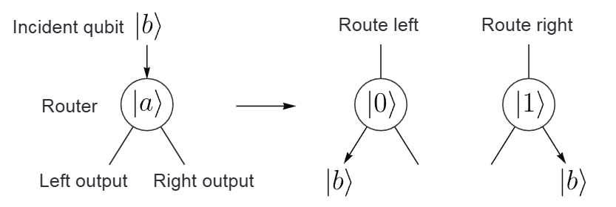
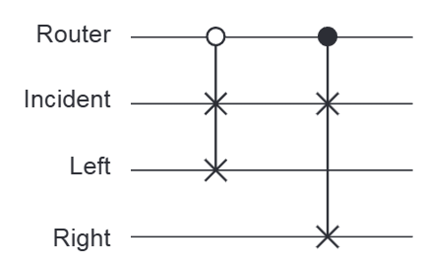
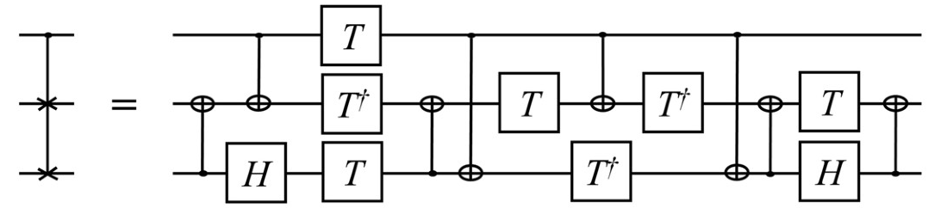
Routing Depth Optimization
MIT implementation based on CSWAP (Fredkin) architecture
Total: 16 CX gates and 14 T gates
Fredkin gate decomposition requires 8 CNOT gates
Notes:
The baseline router is the MIT implementation based on the CSWAP, or Fredkin, architecture. A Fredkin gate decomposition requires 8 CNOT gates, and the full routing construction shown here reaches a total of 16 CX gates and 14 T gates. That cost is high for superconducting hardware, where two-qubit gates are the main source of error. Reducing the CSWAP-style router depth is therefore a direct route to improving QRAM fidelity.

Slide 21
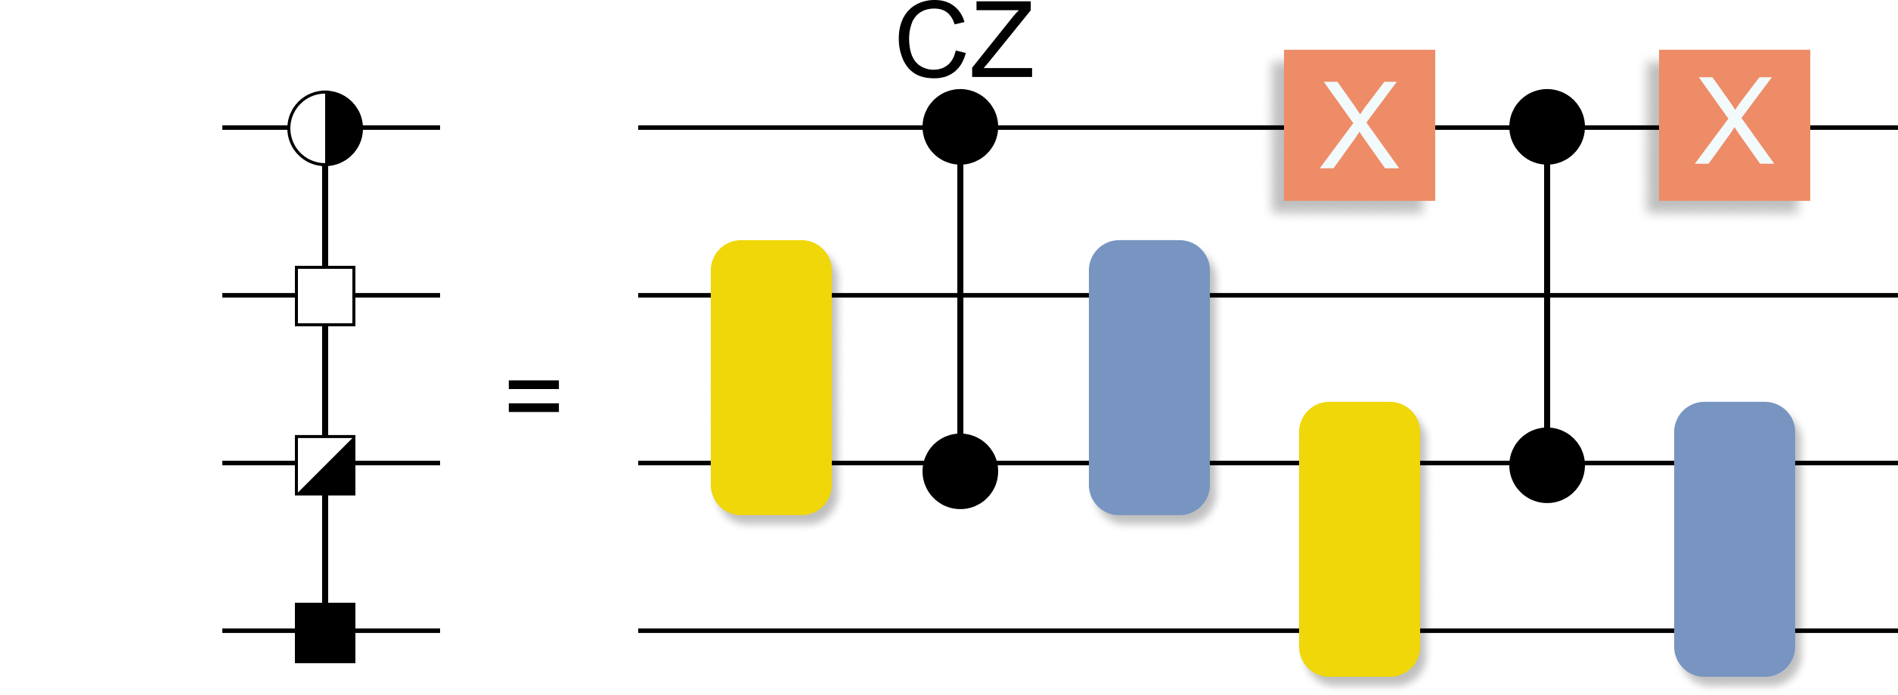
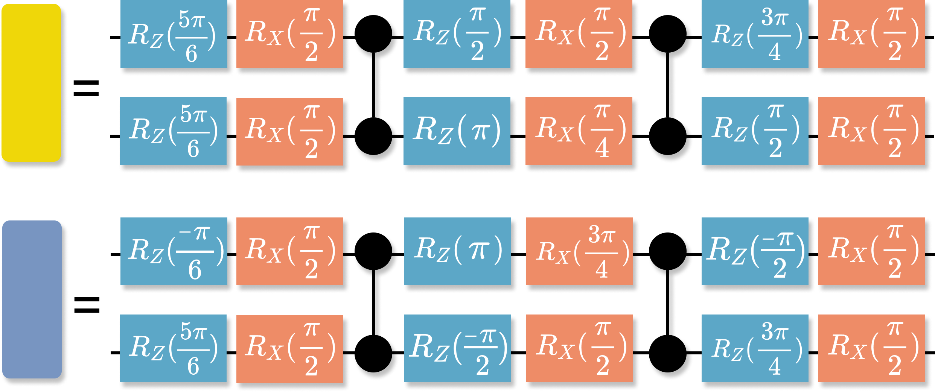
Routing Architecture Depth Optimization
Core Idea
Similar to program synthesis: find the optimal code (quantum circuit) while satisfying input-output requirements.
We propose a subspace-approximate routing architecture
Input quantum state
Total: 10 CX gates
Constraint equations for the unitary matrix
Search for a unitary matrix satisfying the constraints
Choose the shallowest unitary circuit
QRAM routing
Output quantum state
Functional Requirements
Program Synthesis
Optimal Program
router
incident
left
right
Notes:
We propose a subspace-approximate routing architecture. The key observation is that QRAM routing only needs to satisfy functional requirements on the relevant input and output subspace. Similar to program synthesis, we write constraint equations for the unitary matrix, search for a unitary matrix satisfying the constraints, and choose the shallowest unitary circuit. In this construction, the router can be implemented with a total of 10 CX gates.

Slide 22
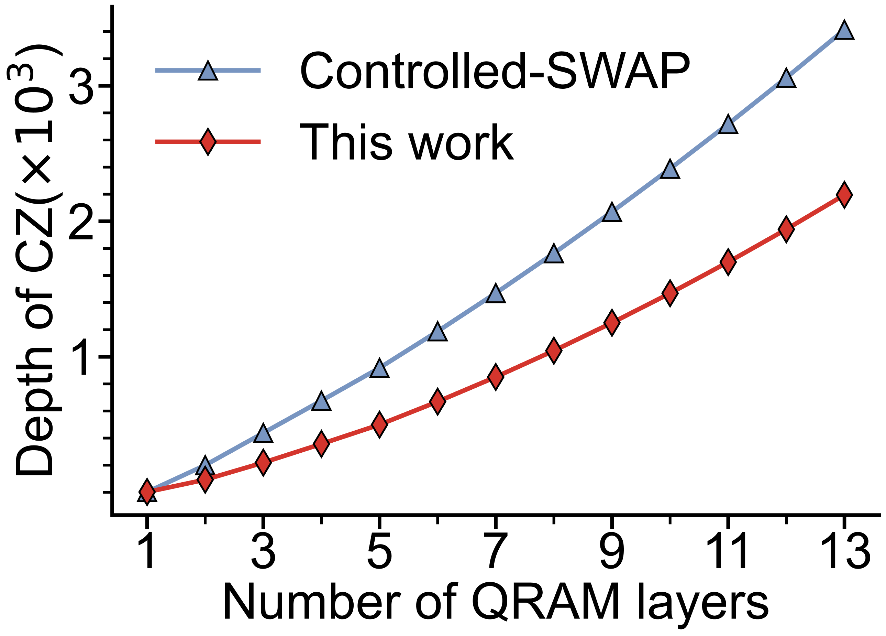
Routing Architecture Depth Optimization
Results
Depth reduced, fidelity improved
Topology | Routing | Depth | Fidelity
 | This work | 10 | 0.8935
 | CSWAP | 16 | 0.8529
 | This work | 12 | 0.8848
 | CSWAP | 20 | 0.8218
router
incident
L
R
incident
Depth reduced by more than 30%
L
router
R
Notes:
The real-device results show why this optimization matters. Compared with CSWAP, this work reduces routing depth and improves fidelity across the tested topologies. In the first topology, the depth decreases from 16 to 10 and the fidelity increases from 0.8529 to 0.8935. In the second topology, the depth decreases from 20 to 12 and the fidelity increases from 0.8218 to 0.8848. Overall, the depth is reduced by more than 30%.

Slide 23
Outline of Presentation
Background and challenges
Overview of QRAM
QRAM optimization
Experiment
API of QRAM
Notes:
With the routing optimizations in place, we can move to the experiment section. The next section covers the experimental platform, the error propagation mechanism study, the error mitigation method, and the final experimental analysis. The focus is on whether the optimized QRAM architecture remains meaningful under realistic noise on a superconducting processor.

Slide 24
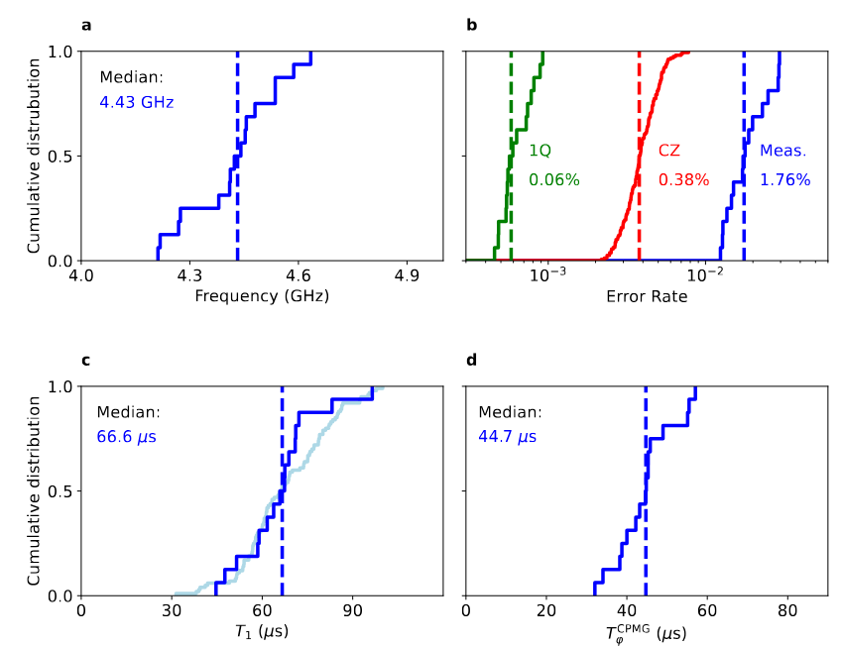
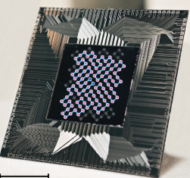
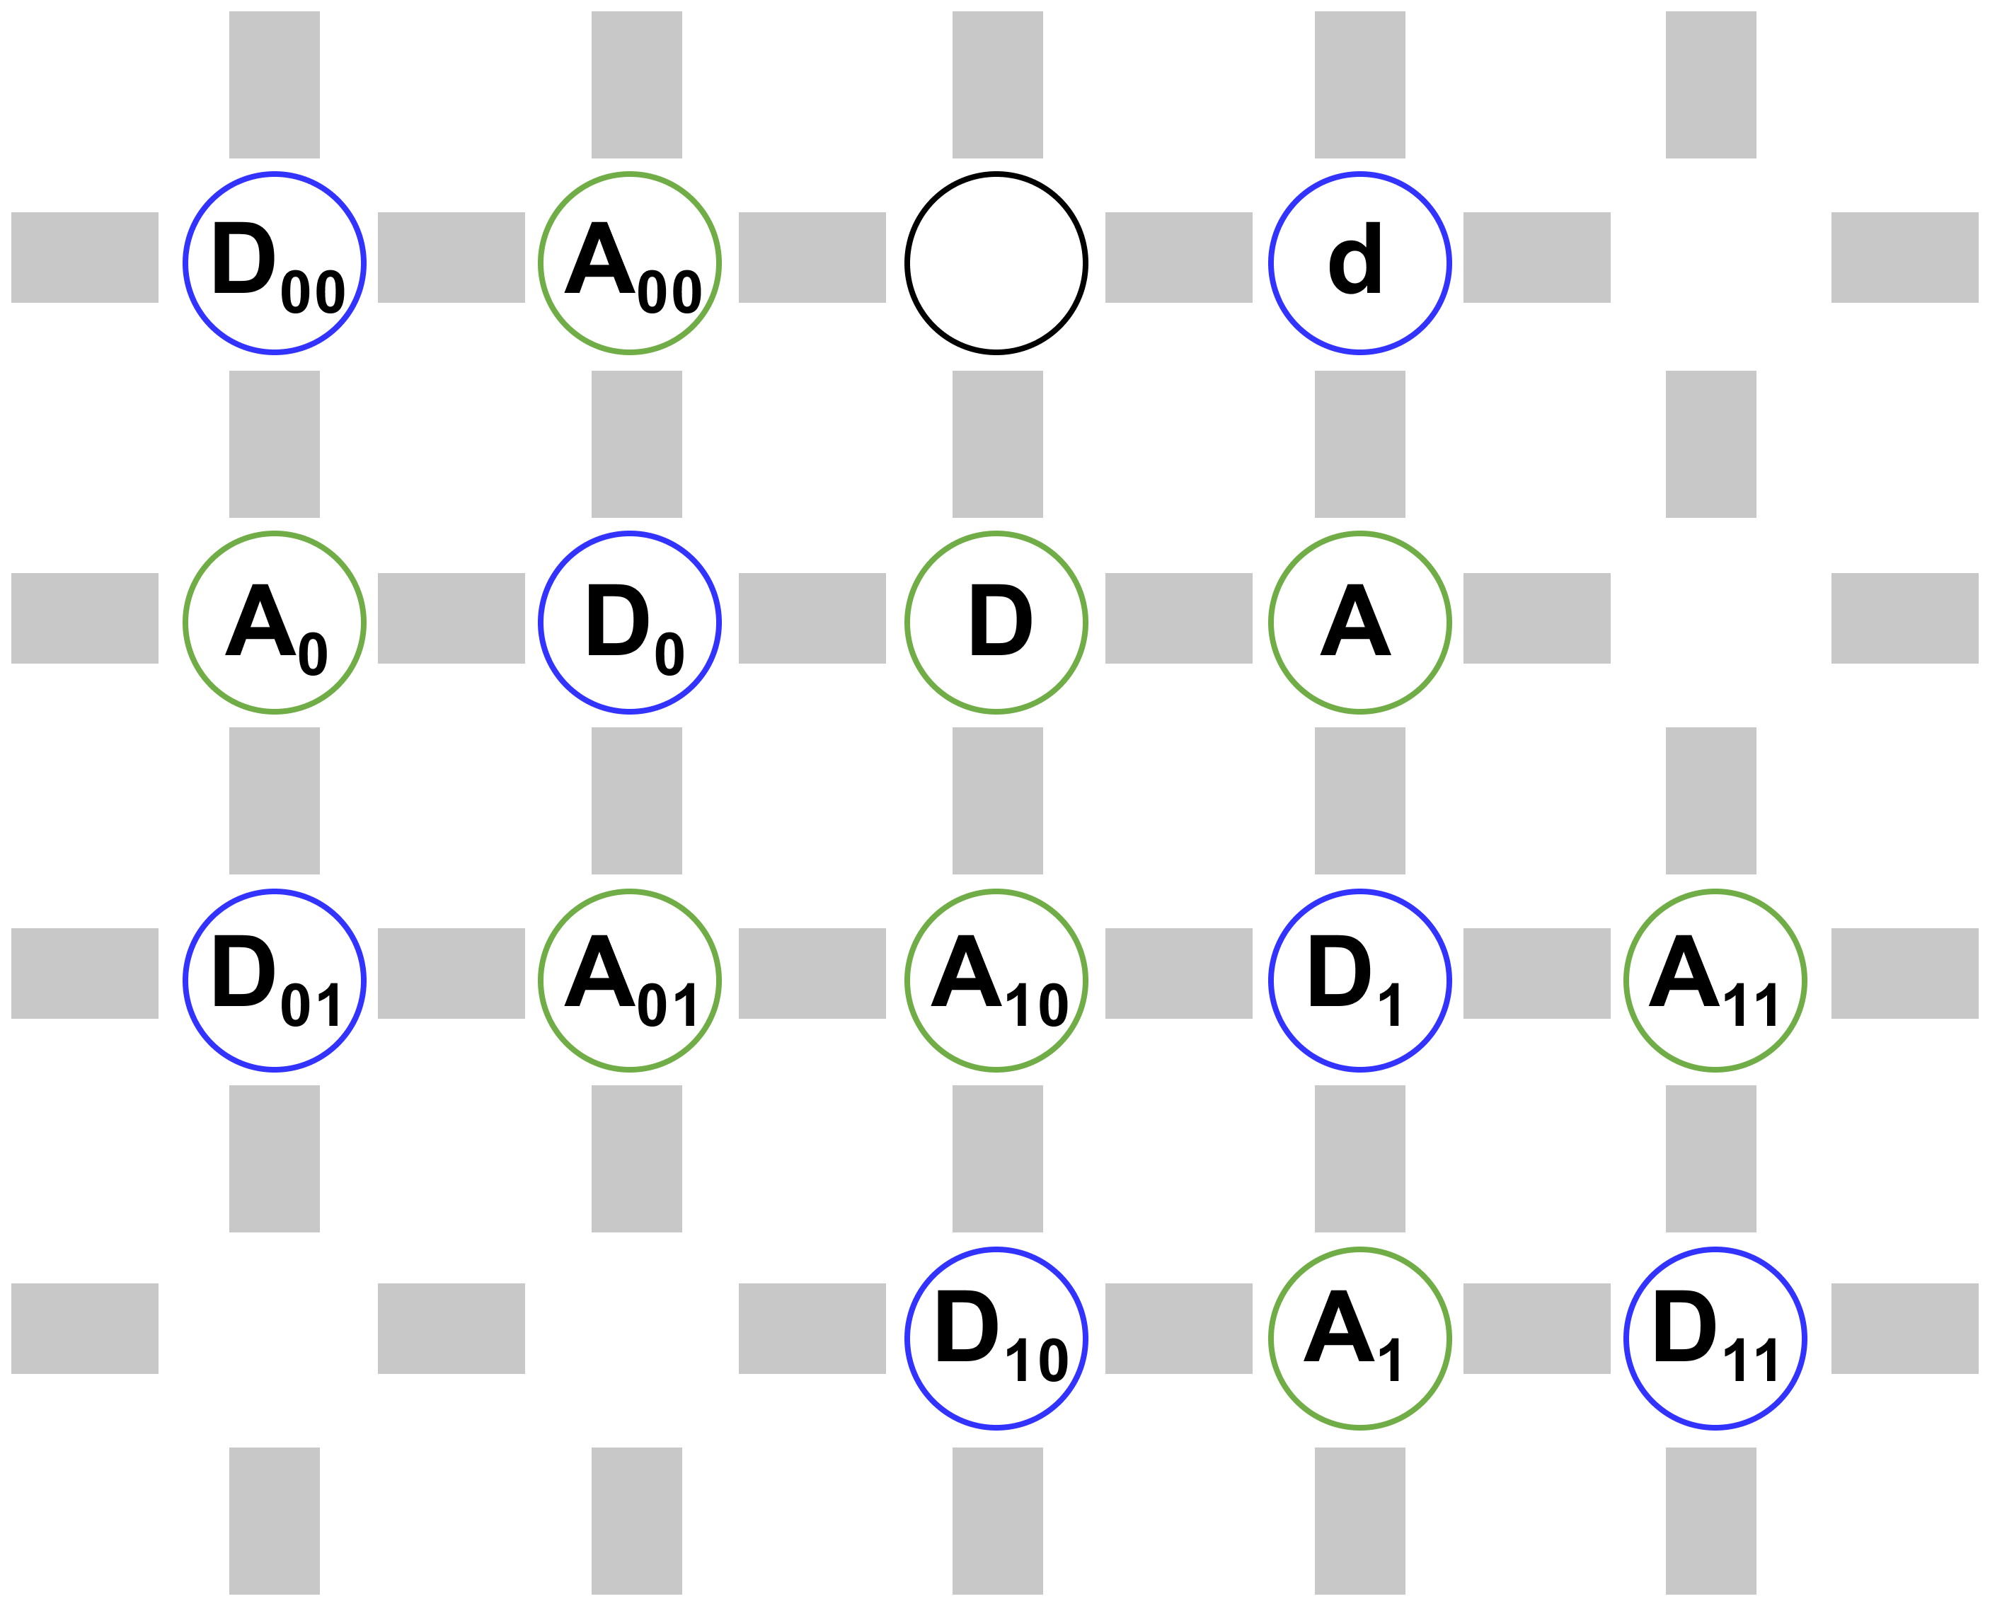
Experimental Platform
16 qubits selected for the experiment
127-qubit chip
High-fidelity Chip
Single-qubit gates: 99.94%; two-qubit gates: 99.6%, providing strong support for the experiment.
Notes:
The experimental platform is a high-precision chip. The device contains a 127-qubit chip, and 16 qubits are selected for the QRAM experiment. The gate performance is also central here: single-qubit gates reach 99.94%, while two-qubit gates reach 99.6%. These numbers provide the hardware basis for implementing the routing circuits, teleportation, tomography, and error mitigation protocol used in the experiment.

Slide 25
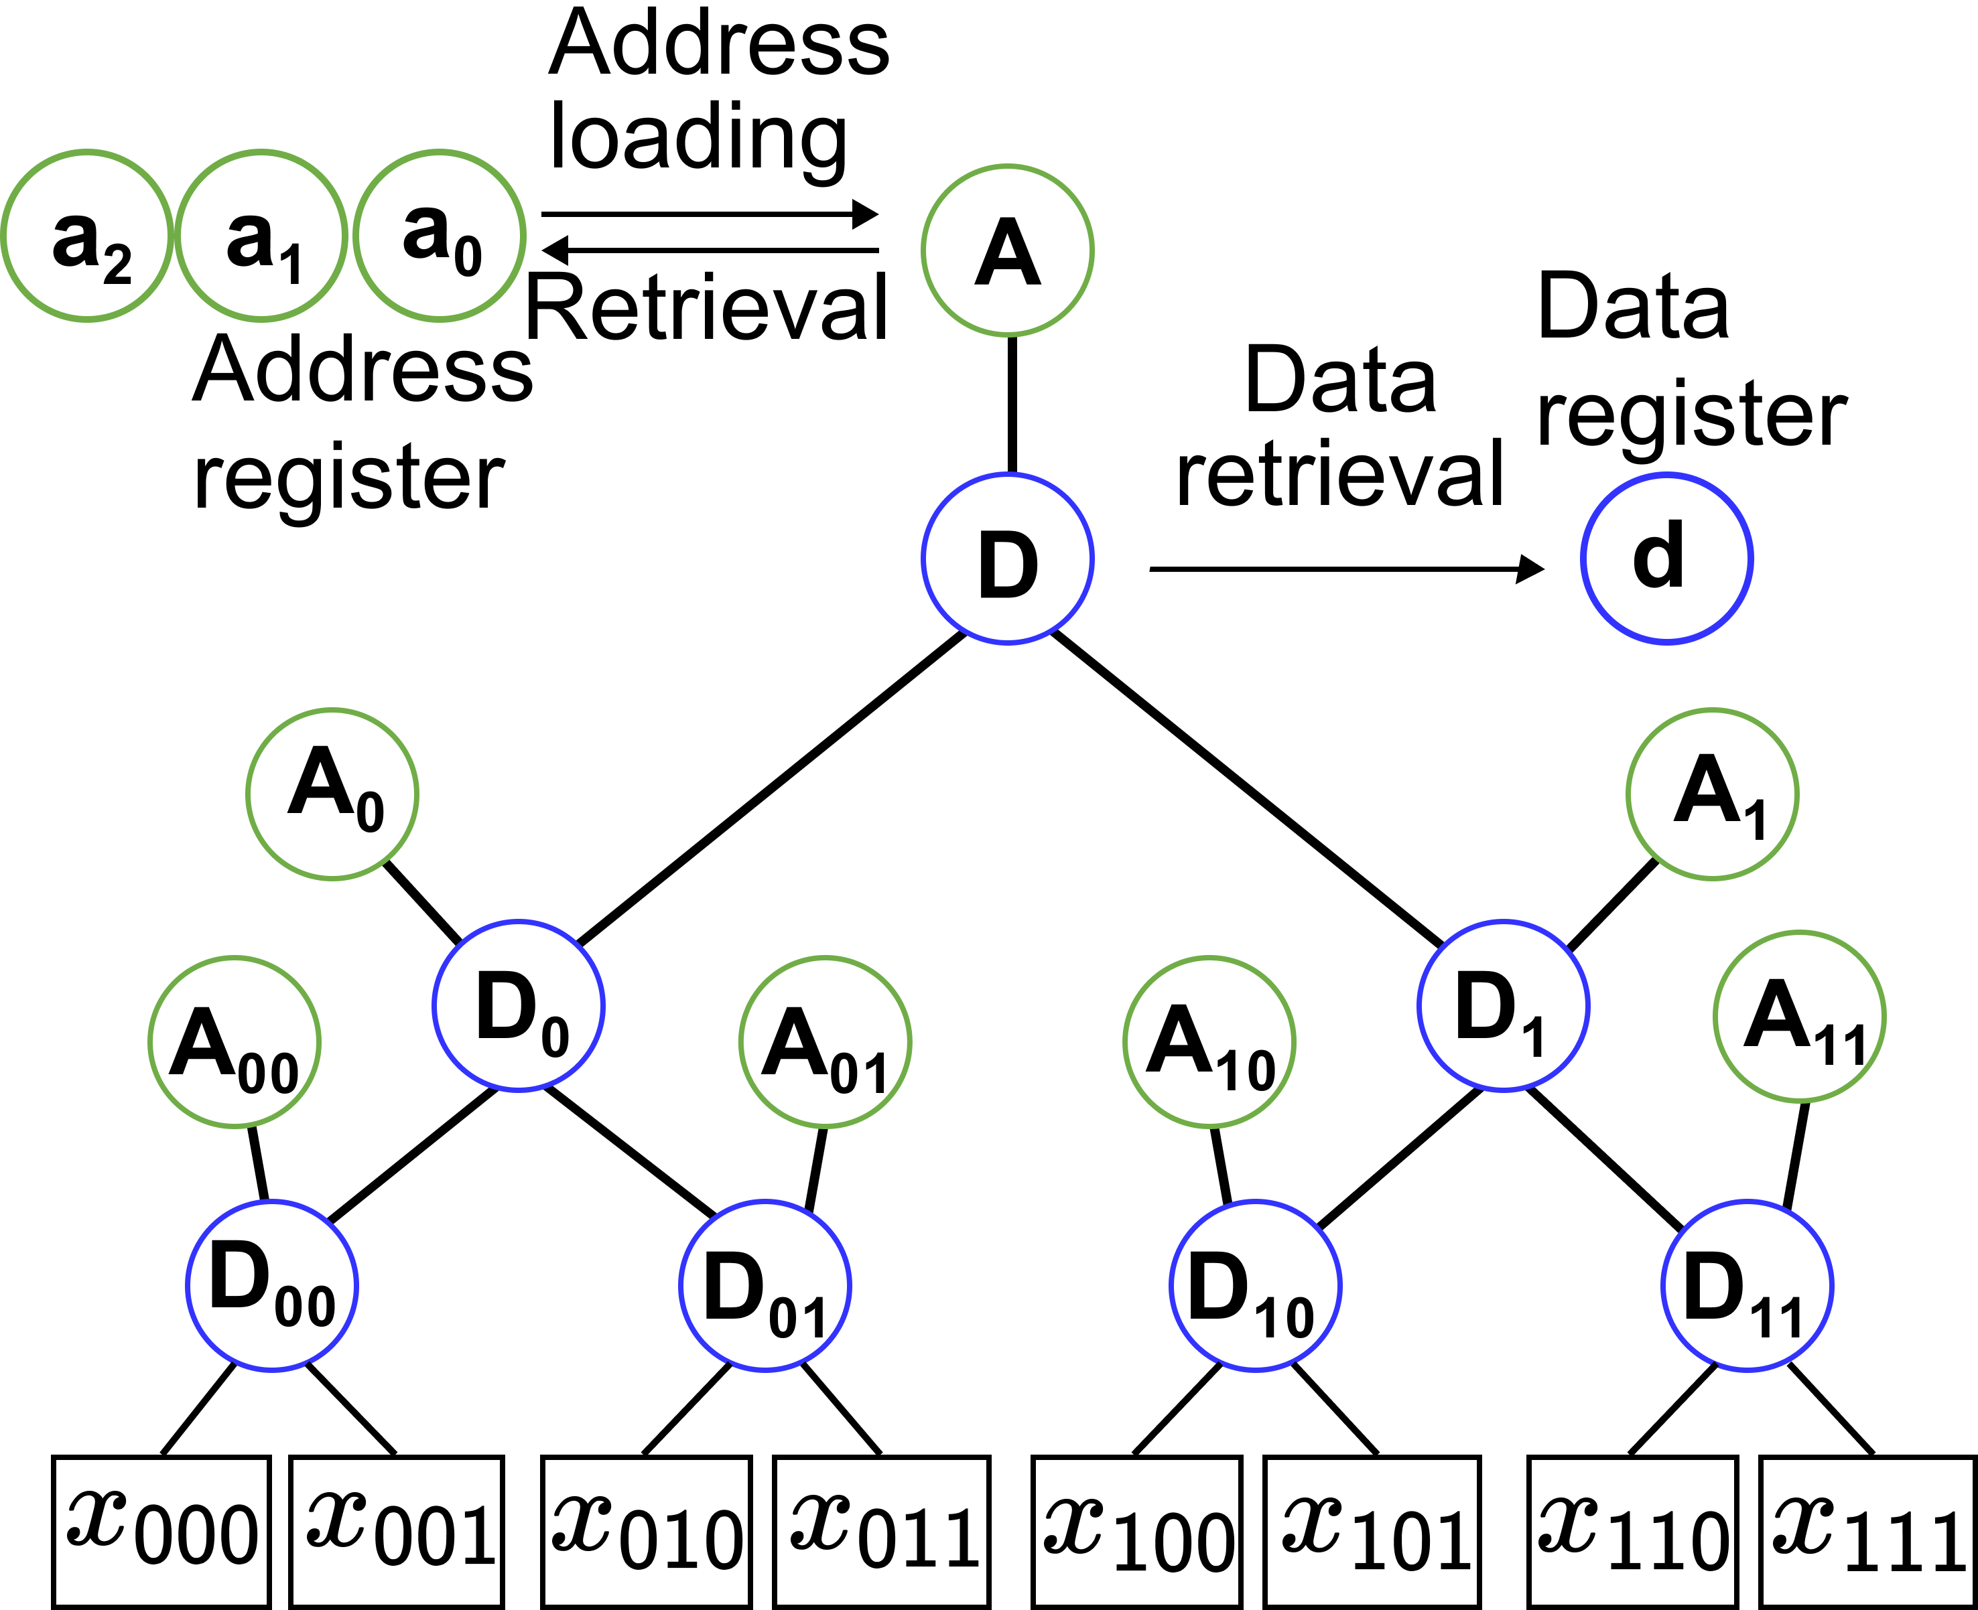
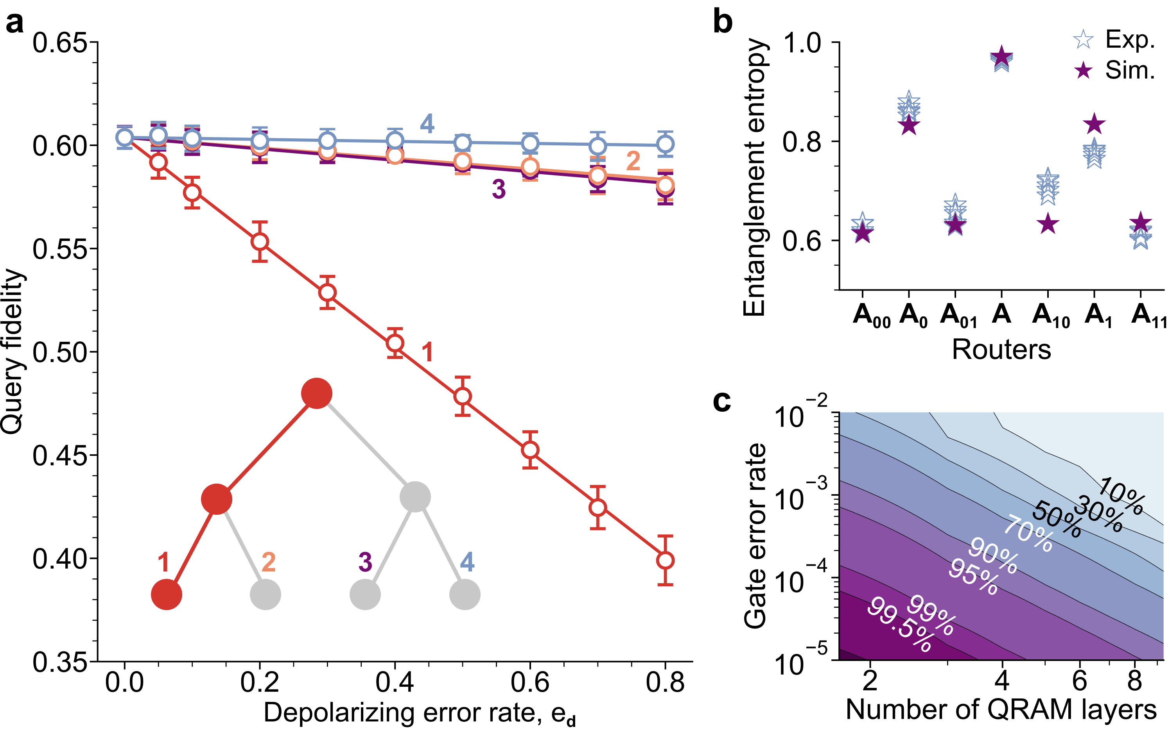









Error Propagation Mechanism Study
Core Idea
Inject errors at different positions and observe how final fidelity changes with error rate
$$\left|0\right\rangle$$
$$\left|0\right\rangle$$
$$\left|+\right\rangle$$
$$\left|0\right\rangle$$
$$\left|0\right\rangle$$
Noise on the queried branch has the largest impact on fidelity.
Inject noise into third-layer routing addresses
Notes:
To understand the error propagation mechanism, we inject errors at different positions and observe how final fidelity changes with error rate. The core idea is to inject noise into third-layer routing addresses and compare the response of the queried branch with other branches. The experimental conclusion shown here is that noise on the queried branch has the largest impact on fidelity, revealing the spatial structure of error propagation in QRAM.

Slide 26

Error Mitigation Method
Core Idea
Discard wrong routing results on the queried branch
Post-select readout results; discard outcomes equal to 1.
The effective post-selection ratio drops linearly with QRAM layers; only the first N layers need post-selection.
Notes:
The error mitigation method uses the router qubits as indicators of wrong routing results. After the query, we post-select readout results and discard outcomes equal to 1 on the queried branch. The slide also shows the scaling rule: the effective post-selection ratio drops linearly with QRAM layers, and only the first N layers need post-selection. This keeps the mitigation protocol aligned with the QRAM routing structure.

Slide 27
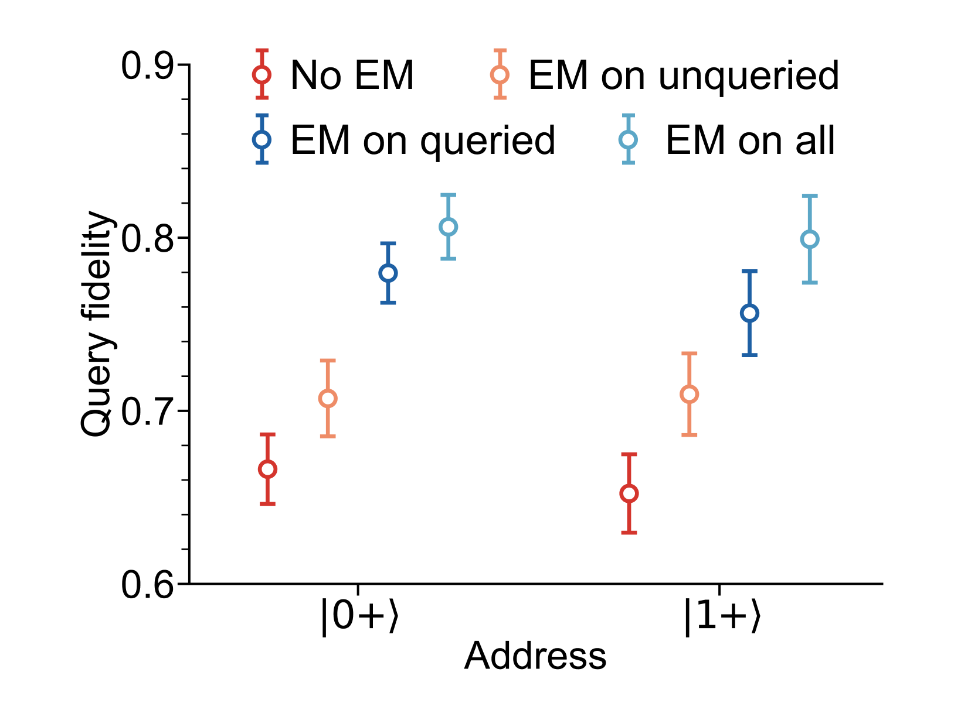
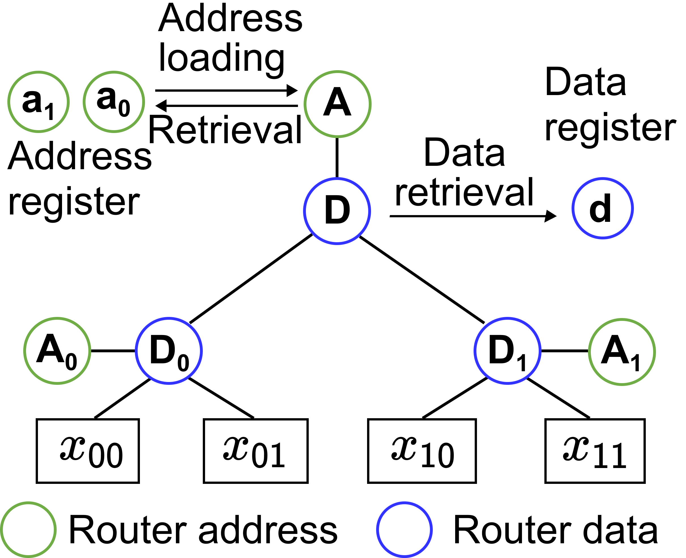


Error Mitigation Method
Results
Error mitigation improves query fidelity
$$\left|0\right\rangle$$
$$\left|+\right\rangle$$
queried
unqueried
Mitigating errors on the queried branch improves fidelity more significantly.
Notes:
The implementation effect is clear: fidelity greatly improved after mitigation. The comparison between queried and unqueried branches shows that mitigating errors on the queried branch improves fidelity more significantly. This agrees with the error propagation study, because errors on the active access path are more likely to reach the output state. The result gives both a practical error mitigation method and a diagnostic tool for identifying the most harmful branch errors.

Slide 28
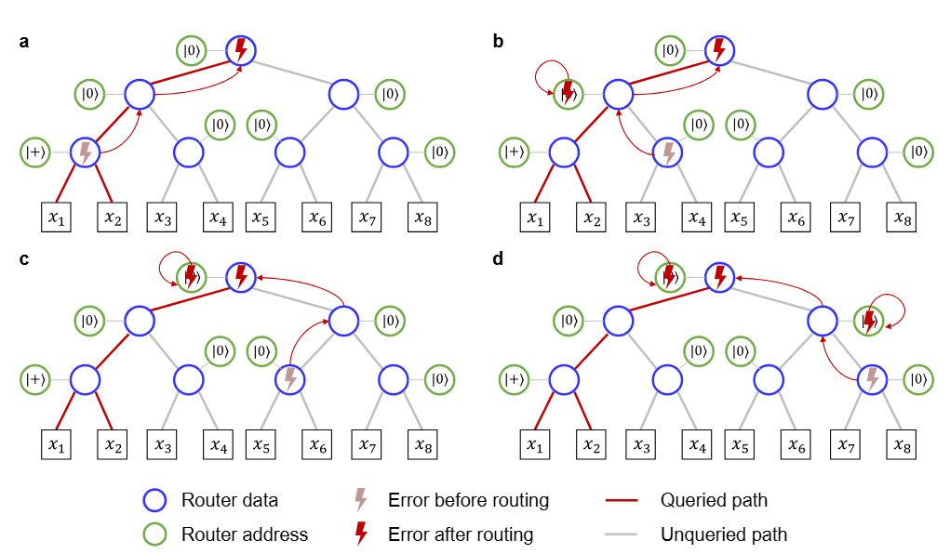
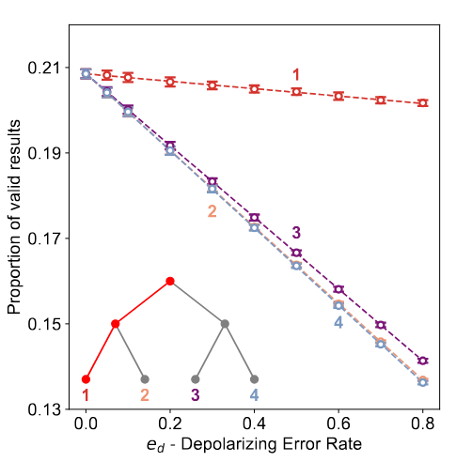
Error Mitigation Method
Analysis
Error propagation and effective-data-ratio analyses show scalability.
Notes:
The experimental analysis combines error propagation and effective-data-ratio measurements to evaluate scalability. Error propagation tells us where noise enters the final query result, while the effective-data-ratio analysis tells us how much data remain after post-selection. Together, these measurements show that the bucket-brigade QRAM architecture has a localized error structure, which supports scalability under realistic noise.

Slide 29
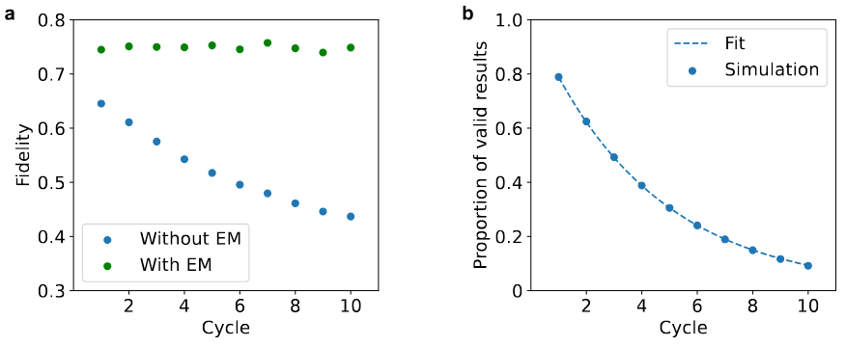
Error Mitigation Method
Results
Scalable, high-fidelity consecutive QRAM queries
Experimental Setup
Fidelity remains stable over multiple query rounds.
Effective data ratio decreases logarithmically.
QRAM
QRAM
QRAM
Accuracy
Effective ratio
…
Consecutive queries
Query rounds
Query rounds
Notes:
This slide extends the analysis to scalable, high-fidelity consecutive QRAM queries. The experimental setup repeats QRAM operations over multiple query rounds. The main observation is that fidelity remains stable over multiple query rounds, while the effective data ratio decreases logarithmically. That trend is important because practical algorithms may need repeated data access, so QRAM must support consecutive queries instead of a single isolated readout.

Slide 30
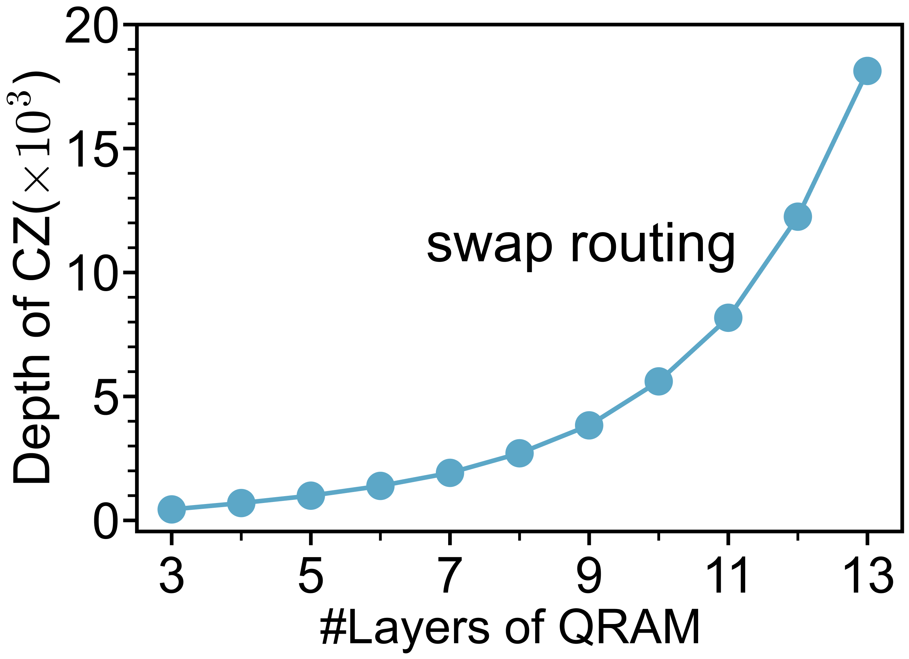
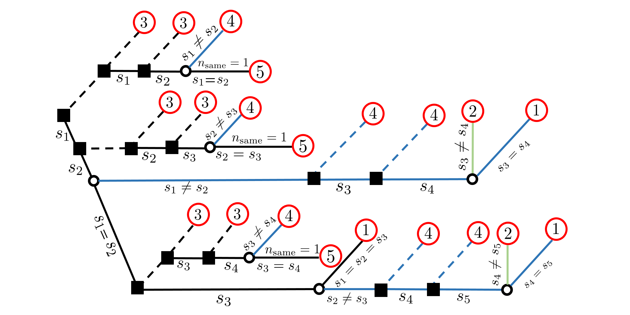
Summary
Main Contributions
First QRAM implementation on superconducting hardware, with noise-mechanism analysis.
Key Issue
Technical Solution
Traditional routing strategy
Subspace
routing
Teleportation routing
Exponential depth
Linear depth
Depth further reduced by over 30%
Circuit depth (1000)
Circuit depth grows exponentially
QRAM Layers
Noise propagation analysis
QRAM branch noise
Error mitigation
Fidelity improved by over 20%
Complex noise mechanism
Noise disrupts addressing results
Notes:
In summary, the main contributions are a first QRAM implementation on superconducting hardware, together with noise-mechanism analysis. The key issue of exponential depth is addressed by teleportation routing, which changes exponential depth into linear depth, and by subspace routing, which further reduces depth by over 30%. The key issue of noise disrupting addressing results is addressed by QRAM branch noise analysis and error mitigation, improving fidelity by over 20%.

Slide 31
Outline of Presentation
Background and challenges
Overview of QRAM
QRAM optimization
Experiment
API of QRAM
Notes:
After the scientific summary, I will close with the API of QRAM. The purpose of this final part is to connect the experimental and architectural ideas to a usable programming interface. We will look at how to configure a QRAM instance, construct a bucket-brigade QRAM circuit, inspect resources, query one classical address, and simulate the QRAM readout.

Slide 32
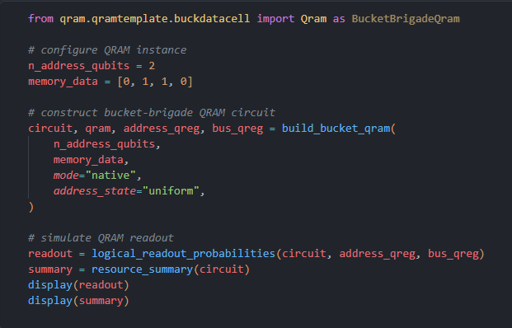
API of QRAM
configure QRAM instance
construct bucket-brigade QRAM circuit
inspect resources
Notes:
The API of QRAM starts from three basic operations. First, configure QRAM instance parameters, such as the address size, memory content, and routing strategy. Second, construct bucket-brigade QRAM circuit objects that implement the routing and data readout logic. Third, inspect resources, including circuit depth, gate counts, and qubit usage. These API functions make the architecture concrete for compilation and benchmarking.

Slide 33
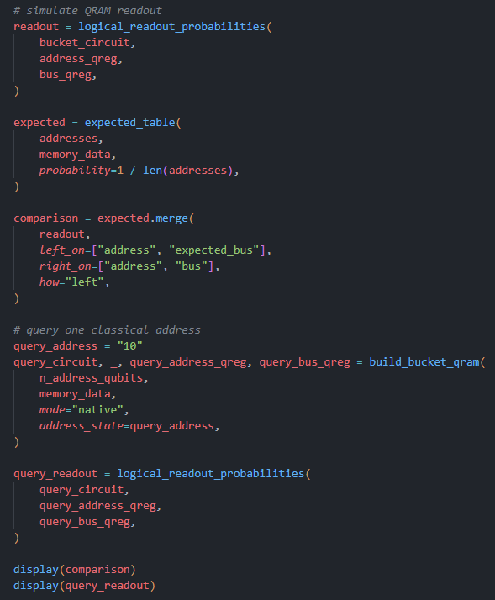


API of QRAM
expected data
simulate QRAM readout
query result
query one classical address
Notes:
The next API step is execution. We query one classical address and simulate QRAM readout. The expected data field records what should be returned from the memory, and the query result shows the simulated output. This is the practical loop needed for testing: build the QRAM circuit, run the query, compare expected data with query result, and use the mismatch to debug routing or noise assumptions.

Slide 34

Thanks for listening
Experimental realization of the bucket-brigade quantum random access memory
Notes:
Thanks for listening. The main message is that experimental realization of the bucket-brigade quantum random access memory is now possible on superconducting hardware when routing, circuit depth, and error mitigation are designed together. I would be happy to discuss the QRAM implementation, the Nature Physics results, and the API workflow in more detail.

